Slide 1

BOARD MANAGEMENT SYSTEM
BSAI-IV-A
200645-200673

Slide 2
INTRODUCTION
PROJECT: BOARD MANAGEMENT SYSTEM.
WORKING: HELPS MANAGE STUDENT DATA FOR BOARD.
DISPLAY: WHOLE STUDENT DATA AND ABILITY TO EDIT IT.

Slide 3
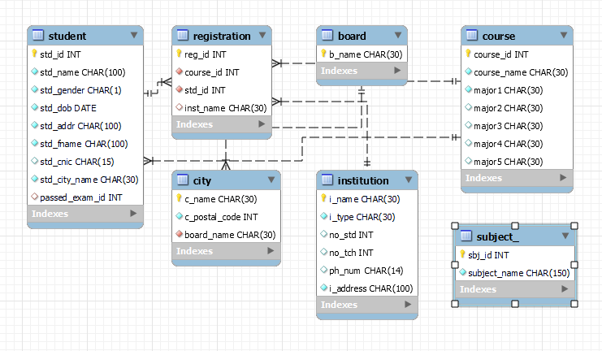
ER DIAGRAM

Slide 4
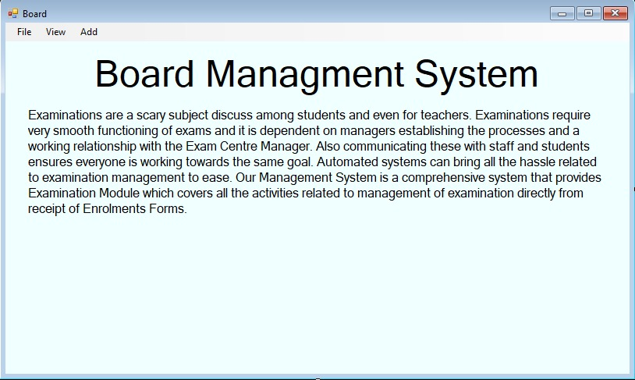
INTERFACE: hOME PAGE

Slide 5
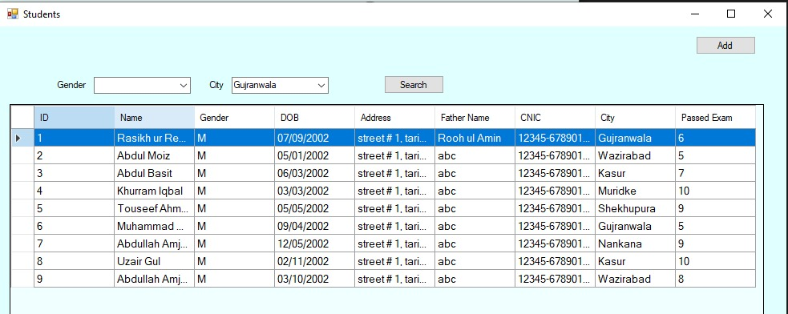
INTERFACE: view page

Slide 6
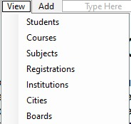
INTERFACE: insert PAGE

Slide 7
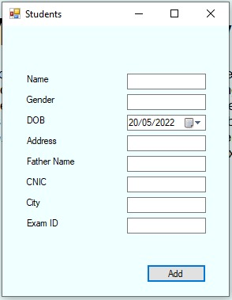
INTERFACE: data entering PAGE

Slide 8
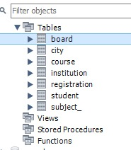
database

Slide 9
THANK YOU

