Slide 1

Network Intrusion Detection System using Deep Learning
Information Security

Slide 2

Introduction
Importance of ICT Interconnectivity
Security Concerns
Role of Intrusion Detection Systems
Integration of Machine Learning
Advancement to Deep Learning

Slide 3

UNSW-NB15 Dataset
IXIA PerfectStorm tool in the Cyber Range Lab of the Australian Centre for Cyber Security
9 Type of Attacks
Over 2.5 million records
40 features per network flow

Slide 4
Insights
id: An identifier for each record.
dur: Duration of the connection in seconds.
proto: The transport protocol (e.g., TCP, UDP).
service: The network service (e.g., http, ftp).
state: The state of the connection (e.g., FIN, INT).
spkts: Source-to-destination packet count.
dpkts: Destination-to-source packet count.
sbytes: Source-to-destination bytes count.
dbytes: Destination-to-source bytes count.
rate: Data transfer rate in bytes per second.
sttl: Source TTL (Time To Live).
dttl: Destination TTL (Time To Live).
sload: Source bits per second.
dload: Destination bits per second.
sloss: Source packet loss count.
dloss: Destination packet loss count.
sinpkt: Source inter-packet arrival time (in milliseconds).
dinpkt: Destination inter-packet arrival time (in milliseconds).
sjit: Source jitter (in milliseconds).
djit: Destination jitter (in milliseconds).
swin: Source TCP window size.
stcpb: Source TCP base sequence number.
dtcpb: Destination TCP base sequence number.
dwin: Destination TCP window size.

Slide 5
Insights
tcprtt: TCP round-trip time.
synack: SYN-ACK round-trip time.
ackdat: ACK data packet size.
smean: Source mean packet size.
dmean: Destination mean packet size.
trans_depth: Transaction depth (if applicable).
response_body_len: Length of the response body.
ct_srv_src: Count of source-to-destination service
connections.
ct_state_ttl: Count of states of the connection.
ct_dst_ltm: Count of destination-to-source state transitions.
ct_src_dport_ltm: Count of source-to-destination port connections.
ct_dst_sport_ltm: Count of destination-to-source port connections.
ct_dst_src_ltm: Count of destination-to-source IP address connections.
is_ftp_login: Indicates if the login attempt was via FTP.
ct_ftp_cmd: Count of FTP commands.
ct_flw_http_mthd: Count of HTTP methods in the flow.
ct_src_ltm: Count of source-to-destination state transitions.
ct_srv_dst: Count of service connections.
is_sm_ips_ports: Indicates if source and destination IP addresses are the same (1 if true, 0 if false).
attack_cat: The attack category (e.g., Normal, DoS, Probe, R2L, U2R).
label: Binary label indicating normal (0) or malicious (1) activity.

Slide 6
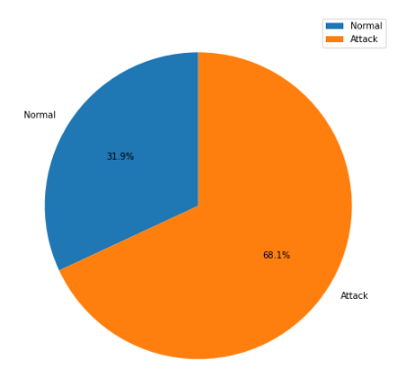
Insights

Slide 7
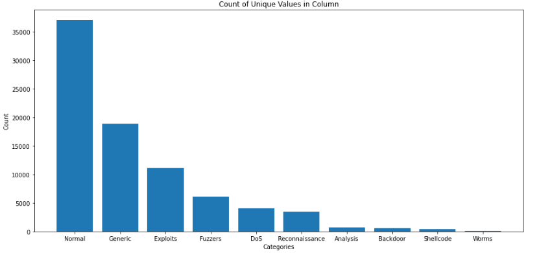
Insights

Slide 8
Objectives
Understanding the intrusions.
Analyze the characteristics and nuances of the UNSW-NB15 dataset
Develop and optimize a deep learning model tailored for intrusion detection
Perform a systematic evaluation of the deep learning models and machine learning algorithms
Compare the performance of these models to determine which approach, deep learning or machine learning, offers superior accuracy, precision, and recall in identifying network intrusions.

Slide 9
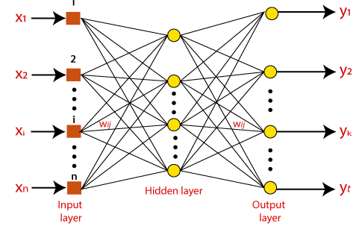
Model
ANN
Input and Output Layers
Hidden Layers
Transformations
Weighted Connections
Backpropagation
Learning

Slide 10

Thank You
Reference Paper:
https://doi.org/10.1016/j.procs.2021.05.025

