Slide 1


PRE-PLACEMENT PROJECT Data Analysis on festive sale BY RASIREDDY THEJA

Slide 2

CONTENTS
ABOUT FESTIVE SALE DATA
OBJECTIVE
OBJECTIVE QUESTION
TASKS , SOLUTIONS , INTERPRETATION
DATA PRE-PROCESSING
SUMMARY and CONCULSION

Slide 3
INTRODUCTION
"Unlocking Winter Wonderland: Insights from the Sales Data.
"Beyond Black Friday: Unveiling Customer Trends in the Festive Sales.
"Shopping Secrets Revealed: A Deep Dive into Festive Consumer Behavior."

Slide 4


Objective
Boost sales in top-performing segments: Target campaigns towards high-spending demographics (e.g., specific age groups, occupations, or states) identified in the analysis.
1
Optimize product portfolio: Invest in and expand offerings in profitable categories like Clothing & Apparel, Food, and Electronics & Gadgets, which contributed significantly to revenue.
2
Drive repeat purchases: Implement loyalty programs, personalized recommendations, and targeted discounts to encourage repeat customers for popular products.
3

Slide 5

Objective Questions
Customer Segmentation
Product Performance
Gender Analysis
Age Group Insights
Marital Status Impact
Geographic Analysis
Occupation Influence
Popular Product Categories
Repeat Orders Analysis
Revenue Trends Over Time
Market Basket Analysis
Average Transaction Value
Zone-wise Performance
Age Group Spending Patterns
Top Performing Products Category
Preferences by Age Group
Gender-based Purchasing Patterns Over Time
Marital Status Impact on Repeat Orders

Slide 6
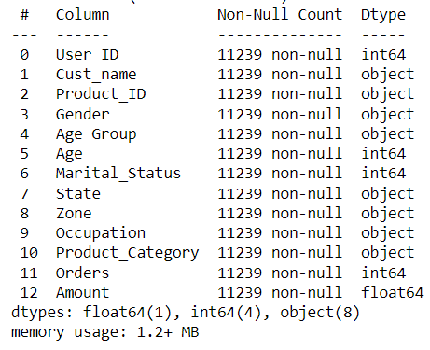
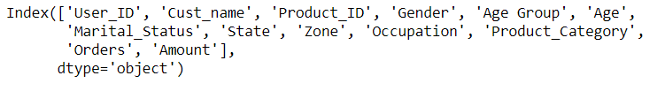
Data Pre-Processing
Loaded dataset from 'wintersaledata.csv' using Pandas.
Utilized df.shape() to get the dimensions of the dataset (11251 rows, 15 columns)
Initially dropped columns 'Status' and 'unnamed1' as they contained NaN values.
Removed rows with missing values using df.dropna.
Dataset – Kaggle.com

Slide 7
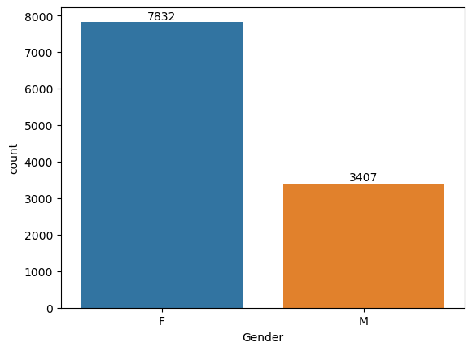
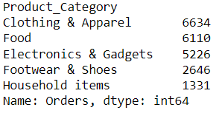
Customer Segmentation& Product Performance​ by sales
The gender distribution indicates that there are more purchases made by females than males.
The top product categories by orders are Clothing & Apparel, Food, Electronics & Gadgets, Footwear & Shoes, and Household items.

Slide 8
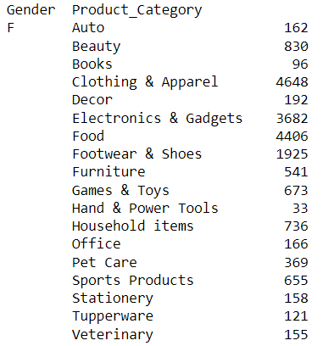
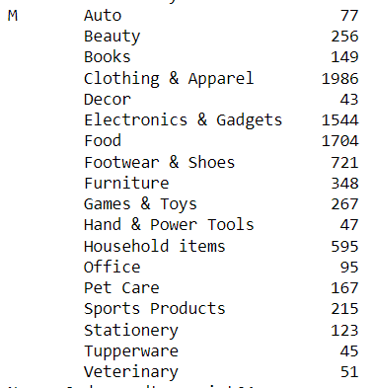
Gender Analysis & Age Group Insights
Females show higher orders in categories like Clothing & Apparel, Food, Electronics & Gadgets, and Footwear & Shoes, whereas males tend to have higher orders in the Auto category.
The age group-wise total amount spent reveals that customers in the 30-50 age group contribute the most to the revenue, followed by 18-30.

Slide 9


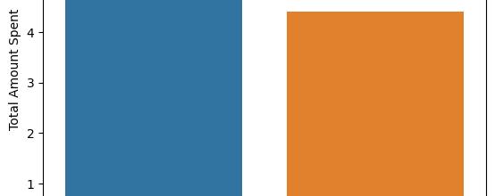
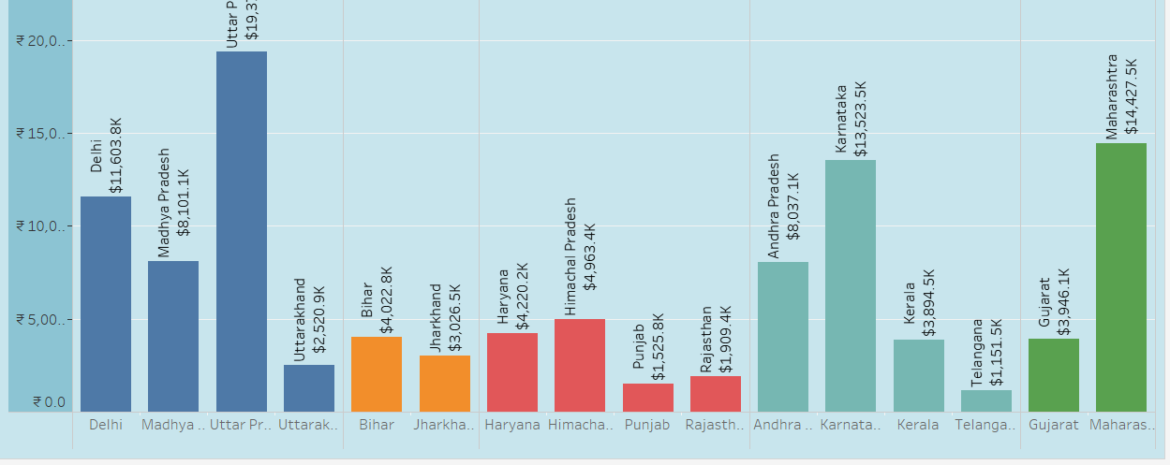
Marital Status Impact& Geographic Analysis
Customers with a marital status of 0 (presumably unmarried) contribute more to the total amount spent compared to those with a marital status of 1 (presumably married).
Maharashtra, Karnataka, and Uttar Pradesh are the top states contributing to the total amount spent.

Slide 10
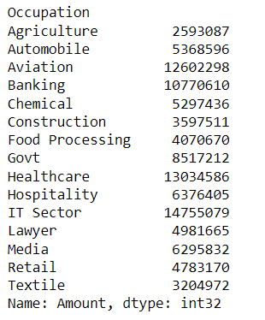
Occupation Influence
IT Sector, Healthcare, and Aviation are among the top occupations contributing to the total amount spent.

Slide 11
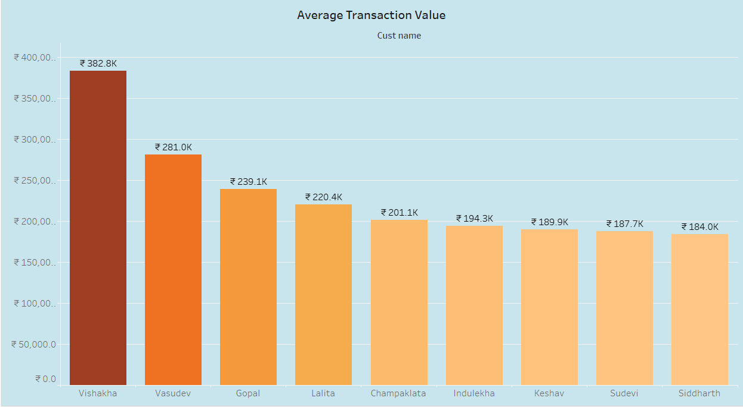
Average Transaction Value
Vishakha, Vasudev, Gopal, and Lalita are the four customers with the highest ATVs, all spending over ₹280,000 per transaction.

Slide 12
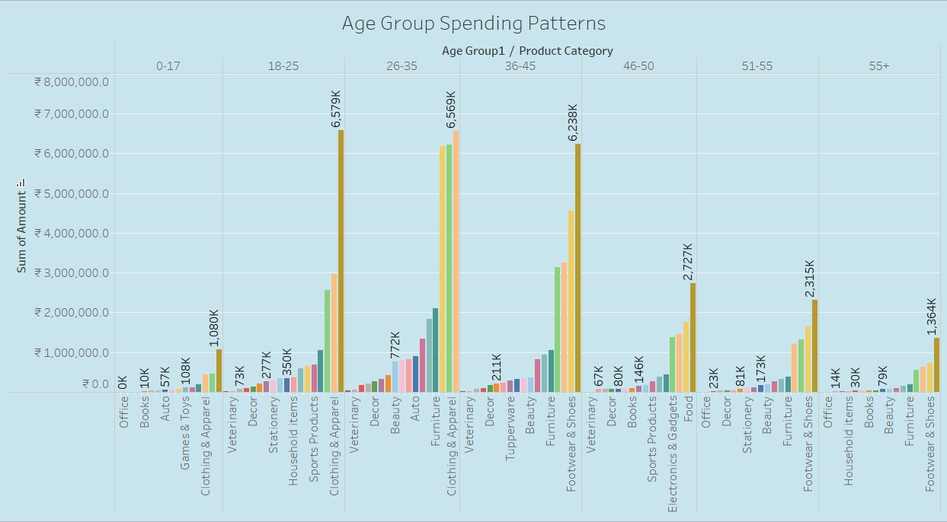

Age Group Spending Patterns & Top Performing Products
The age group 18-25 spending on Food more .

Slide 13
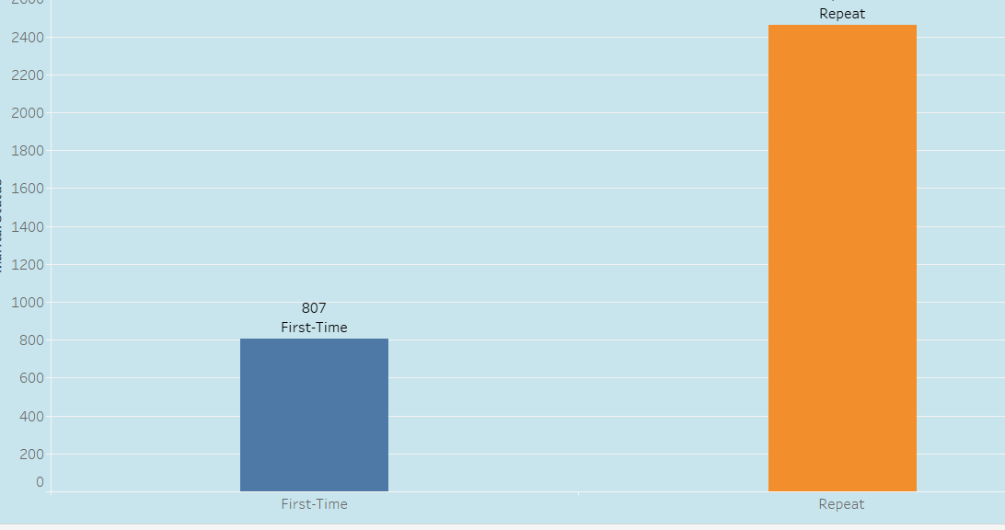
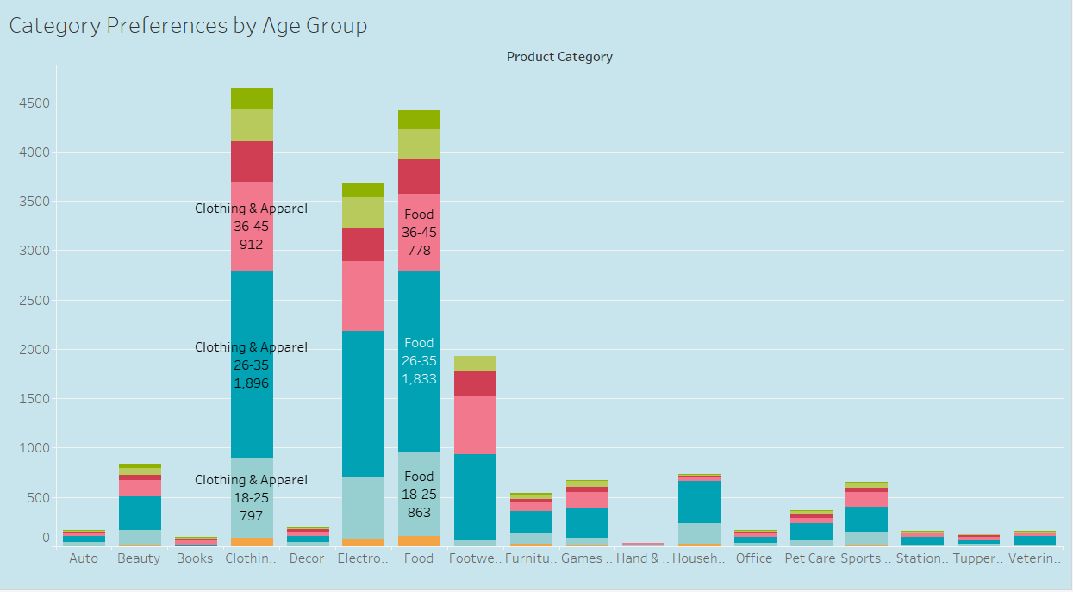
Category Preferences by Age Group & Marital Status Impact on Repeat Orders
Overall: Food tends to be a top spending category across most age groups, reflecting its essential nature.
Younger Age Groups (18-25): May prioritize Electronics & Gadgets, Clothing & Apparel, and Beauty products.
Middle Age Groups (26-50): Often allocate more towards Food, Household items, and Furniture.
Older Age Groups (50+): May exhibit higher spending on Healthcare, Travel, and Leisure activities.
Marital Status Impact on Repeat Orders:
Married couples: Generally tend to have higher repeat orders due to larger household needs and potentially more stable income.
Singles: May have lower repeat order rates due to smaller household needs and potentially more varied purchase decisions.

Slide 14
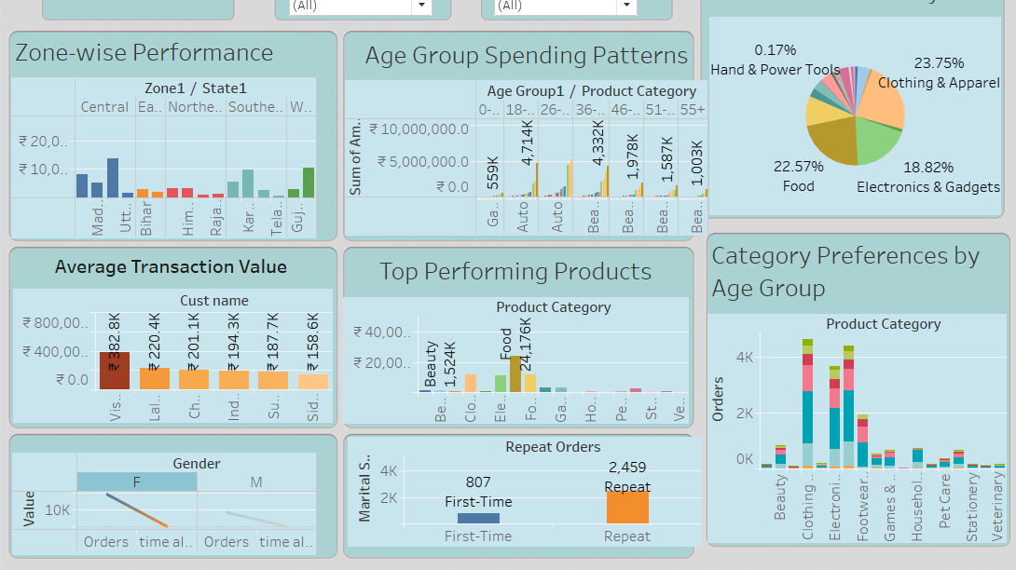
Dashboard

Slide 15
Summary
Product Performance Analysis:
Identified the top products based on the number of orders and total amount spent.
Revealed that "Clothing & Apparel," "Food," and "Electronics & Gadgets" were the top-performing product categories.
Customer Segmentation:
Explored gender distribution, revealing the number of orders for each gender and product category.
Analyzed the age group distribution, classifying customers into segments (<18, 18-30, 30-50, 50+).
Geographic Analysis:
Examined the total amount spent in different states and zones.
Unveiled insights into regional preferences, highlighting states and zones contributing significantly to sales.
Occupation Influence:
Explored the total amount spent by different occupations, identifying key contributors.
Marital Status Impact:
Investigated the influence of marital status on the total amount spent.
Discussed the variations in spending behavior between married and unmarried individuals.

Slide 16
Conclusion
Business Intelligence & Strategic Planning:
Establish a foundation for data-driven decision-making.
Gain insights into customer behavior, preferences, and market trends.
Next Steps for Increasing Profit:
Marketing Strategies:
Tailor campaigns to specific demographics and regions.
Craft personalized messaging for diverse customer segments.
Product Optimization:
Focus on top-performing categories for inventory alignment.
Explore new product development opportunities.
Customer Engagement:
Enhance the overall customer experience.
Implement targeted loyalty programs based on preferences.
Key Goal: Increasing Profit:
Maximize revenue through tailored marketing and product optimization.
Maintain agility in response to changing market dynamics.

Slide 17
Thank You

