Slide 1
PYTHON

Slide 2
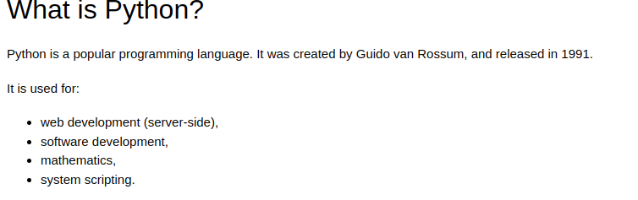

Slide 3
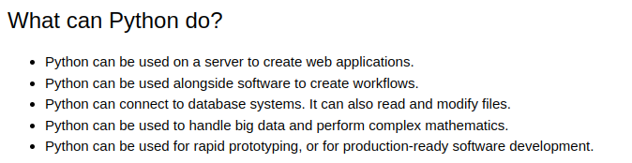

Slide 4
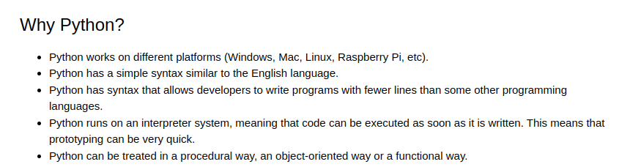

Slide 5
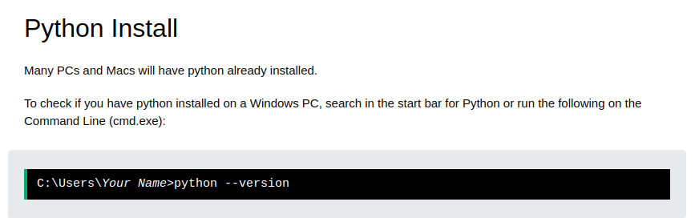

Slide 6
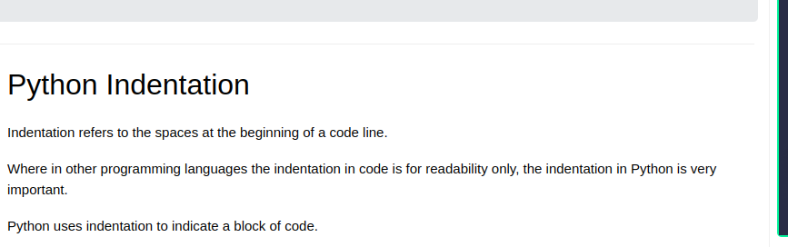
Python Syntax

Slide 7
Examples
Right Syntax
if 5 > 2:
print("Five is greater than two!")
Wrong Syntax
if 5 > 2:
print("Five is greater than two!")

Slide 8
Python Variables
x = 5
y = "John"
print(x)
print(y)

Slide 9
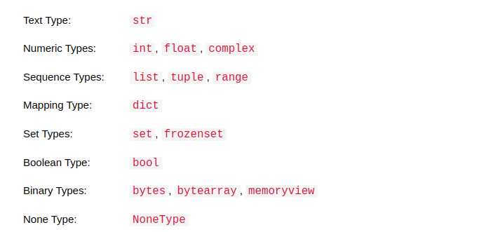
Python Data Types
❮ Previous
Next ❯

Slide 10
Python Casting
x = int(1) # x will be 1
x = float(1) # x will be 1.0
w = float("4.2") # w will be 4.2
x = str("s1") # x will be 's1'

Slide 11
Python Strings
❮ Previous
Next ❯
Strings in python are surrounded by either single quotation marks, or double quotation marks.
'hello' is the same as "hello".
You can display a string literal with the print() function:
print("Hello")
print('Hello')

Slide 12
Python - Slicing Strings
❮ Previous
Next ❯
b = "Hello, World!"
print(b[2:5])
Starting from start
b = "Hello, World!"
print(b[:5])

Slide 13
Python - Modify Strings
❮ Previous
Next ❯
The upper() method returns the string in upper case:
a = "Hello, World!"
print(a.upper())
The lower() method returns the string in lower case:
a = "Hello, World!"
print(a.lower())

Slide 14
Python - String Concatenation
❮ Previous
Next ❯
a = "Hello"
b = "World"
c = a + b
print(c)

Slide 15
age = 36
txt = "My name is John, I am " + age
print(txt)
F string in python
age = 36
txt = f"My name is John, I am {age}"
print(txt)

Slide 16
Python Booleans
print(10 > 9)
print(10 == 9)
print(10 < 9)
Return True or False

Slide 17
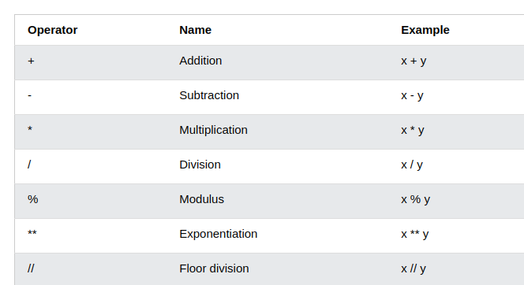
Python Operators

Slide 18
Python Lists
Lists are used to store multiple items in a single variable.
Lists are one of 4 built-in data types in Python used to store collections of data, the other 3 are Tuple, Set, and Dictionary, all with different qualities and usage.
Lists are created using square brackets:
Create a List:
thislist = ["apple", "banana", "cherry"]
print(thislist)

Slide 19
List Contd….
Allow Duplicates
Since lists are indexed, lists can have items with the same value:
Lists allow duplicate values:
thislist = ["apple", "banana", "cherry", "apple", "cherry"]
print(thislist)

Slide 20
Access Items -List
thislist = ["apple", "banana", "cherry"]
print(thislist[1])
Negative Indexing
thislist = ["apple", "banana", "cherry"]
print(thislist[-1])

Slide 21
Append Items -Lists
thislist = ["apple", "banana", "cherry"]
thislist.append("orange")
print(thislist)

Slide 22
Remove Specified Item -List
thislist = ["apple", "banana", "cherry"]
thislist.remove("banana")
print(thislist)

Slide 23
Python - Loop Lists
thislist = ["apple", "banana", "cherry"]
for x in thislist:
print(x)
By using For Loop
thislist = ["apple", "banana", "cherry"]
for i in range(len(thislist)):
print(thislist[i])

Slide 24
Python - Sort Lists
thislist = ["orange", "mango", "kiwi", "pineapple", "banana"]
thislist.sort()
print(thislist)
Descending Order.
thislist.sort(reverse = True)

Slide 25
Python - Copy Lists
You cannot copy a list simply by typing list2 = list1, because: list2 will only be a reference to list1, and changes made in list1 will automatically also be made in list2.
There are ways to make a copy, one way is to use the built-in List method copy().
thislist = ["apple", "banana", "cherry"]
mylist = thislist.copy()
print(mylist)

Slide 26
Python - Join Lists
list1 = ["a", "b", "c"]
list2 = [1, 2, 3]
list3 = list1 + list2
print(list3)
Another method
for x in list2:
list1.append(x)

Slide 27
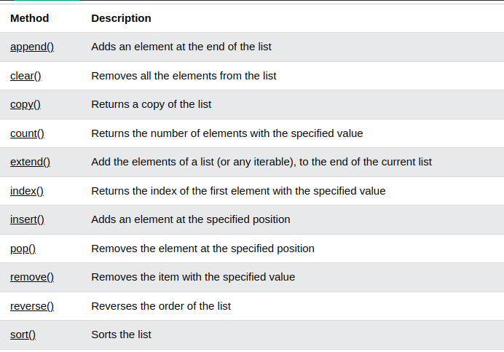
Python - List Methods

Slide 28
Python Tuples
A tuple is an immutable, ordered collection of items in Python.
Tuples are defined by enclosing the elements in parentheses ().
tupple = ("apple", "banana", "cherry")
print(tupple)

Slide 29
Python Sets
Definition:
A set is an unordered collection of unique elements in Python.
Sets are defined by enclosing elements in curly braces {} or using the set() function.
Key Characteristics:
Unordered: No indexing or slicing.
Unique: No duplicate elements allowed.

Slide 30
Contd…
# Creating a set with curly braces
my_set = {1, 2, 3, 4}
# Creating a set using the set() function
another_set = set([5, 6, 7, 8])
# Creating an empty set (must use set() function, not {})
empty_set = set()

Slide 31
Adding and Removing Elements
# Adding a single element
my_set.add(5)
print(my_set) # Output: {1, 2, 3, 4, 5}
# Adding multiple elements
my_set.update([6, 7])
print(my_set) # Output: {1, 2, 3, 4, 5, 6, 7}

Slide 32
# Removing a specific element (raises KeyError if not found)
my_set.remove(7)
print(my_set) # Output: {1, 2, 3, 4, 5, 6}
# Discarding a specific element (does not raise an error if not found)
my_set.discard(6)
print(my_set) # Output: {1, 2, 3, 4, 5}

Slide 33
# Union of two sets
set1 = {1, 2, 3}
set2 = {3, 4, 5}
union_set = set1 | set2
print(union_set) # Output: {1, 2, 3, 4, 5}

Slide 34
Python Dictionaries
Definition:
A dictionary is an unordered collection of key-value pairs in Python.
Dictionaries are defined by enclosing key-value pairs in curly braces {} with a colon : separating keys and values.
Key Characteristics:
Unordered: No indexing or slicing.
Mutable: Can change the content.
Unique keys: Each key must be unique.

Slide 35
Contd…
# Creating a dictionary with curly braces
my_dict = {'name': 'Alice', 'age': 25, 'city': 'New York'}
# Creating a dictionary using the dict() function
another_dict = dict(name='Bob', age=30, city='San Francisco')
# Creating an empty dictionary
empty_dict = {}

Slide 36
# Accessing a value by its key
print(my_dict['name']) # Output: Alice
# Using the get() method
print(my_dict.get('age')) # Output: 25
# Accessing a value by its key
print(my_dict['name']) # Output: Alice
# Using the get() method
print(my_dict.get('age')) # Output: 25

Slide 37
# Using the pop() method
removed_value = my_dict.pop('city')
print(removed_value) # Output: New York
print(my_dict) # Output: {'name': 'Alice', 'age': 26, 'email': 'alice@example.com'}
# Using the del statement
del my_dict['email']
print(my_dict) # Output: {'name': 'Alice', 'age': 26}
# Using the popitem() method (removes the last inserted key-value pair)
my_dict.popitem()
print(my_dict) # Output: {'name': 'Alice'}

Slide 38
# Getting all keys
keys = my_dict.keys()
print(keys) # Output: dict_keys(['name'])
# Getting all values
values = my_dict.values()
print(values) # Output: dict_values(['Alice'])
# Getting all key-value pairs
items = my_dict.items()
print(items) # Output: dict_items([('name', 'Alice')])

Slide 39
# Iterating over keys
for key in my_dict:
print(key, my_dict[key]) # Output: name Alice
# Iterating over key-value pairs
for key, value in my_dict.items():
print(key, value) # Output: name Alice

Slide 40
Python If ... Else
a = 200
b = 33
if b > a:
print("b is greater than a")
elif a == b:
print("a and b are equal")
else:
print("a is greater than b")

Slide 41
Python While Loops
i = 1
while i < 6:
print(i)
i += 1
Using Break
Break loop for some condition

Slide 42
Python For Loops
fruits = ["apple", "banana", "cherry"]
for x in fruits:
print(x)
for x in "banana":
print(x)

Slide 43
Python Functions
Definition:
A function is a block of organized, reusable code that performs a specific task.
Functions help break programs into smaller, manageable, and modular chunks.
Key Characteristics:
Improve code reusability and readability.

Slide 44
Examples
# FUnction Defination
def my_function():
print("Hello from a function")
#Function Calling
my_function()

Slide 45
Function Parameter and Return Value
def add(a, b):
return a + b
result = add(2, 3)
print(result) # Output: 5

Slide 46
Return Multiple Results
def min_max(numbers):
return min(numbers), max(numbers)
min_val, max_val = min_max([1, 2, 3, 4, 5])
print(min_val, max_val) # Output: 1 5

Slide 47
Variable Scope In Function-Python
# Global variable
x = 10
def modify():
# Local variable
x = 5
print(x)
modify() # Output: 5
print(x) # Output: 10

Slide 48
Default And Flexible Arguments
def power(base, exponent=2):
return base ** exponent
print(power(3)) # Output: 9
print(power(3, 3)) # Output: 27

Slide 49
def add(*args):
return sum(args)
print(add(1, 2, 3)) # Output: 6
print(add(4, 5)) # Output: 9

Slide 50
def print_info(**kwargs):
for key, value in kwargs.items():
print(f"{key}: {value}")
print_info(name="Alice", age=25, city="New York")
# Output:
# name: Alice
# age: 25
# city: New York

Slide 51
Lambda Function
A lambda function is a small anonymous function defined using the lambda keyword.
x = lambda a : a + 10
print(x(5))

Slide 52
Hands On Projects …..

