Slide 1
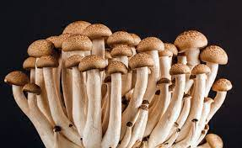
*
MUSHROOM EDIBILITY PREDICTION
BY: RASHMITA MAHAPATRA

Slide 2
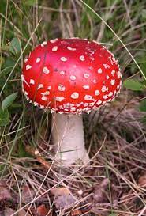

INTRODUCTION
Mushroom foraging is a delightful and rewarding activity, but the challenge lies in distinguishing between edible and poisonous varieties, making it crucial to have a reliable identification tool.
Traditional methods of identification are often complex and carry inherent risks.
Our project leverages the power of machine learning to enhance safety for mushroom foragers.

Slide 3
OBJECTIVE
Our primary objective is to develop a robust and accurate machine learning model dedicated to predicting the edibility status of mushrooms, with a specific focus on distinguishing between poisonous and edible varieties.
our goal is to introduce a reliable and efficient tool that enhances the safety of individuals engaged in this timeless activity.
By employing advanced machine learning techniques, we aim to unravel intricate patterns within these features that serve as key indicators of a mushroom's edibility.

Slide 4
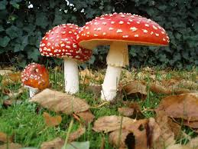
Dataset Overview
DATASET OVERVIEW
the dataset encapsulates essential features that play a pivotal role in determining the edibility status of mushrooms.
Key attributes include cap diameter, cap shape, cap surface, gill characteristics, stem dimensions, veil properties, spore print color, habitat, and season.
Each data point is accompanied by a classification label indicating whether the mushroom is edible ('e') or poisonous ('p'), serving as the target variable for predictive modeling.

Slide 5
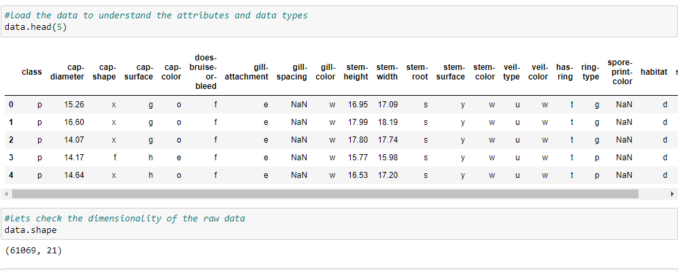
Exploratory Data Analysis
EXPLORATORY DATA ANALYSIS
Let’s have a look at the data:
This dataset has 61069, data points and 21 features along with their target label. The first 5 rows appeared as shown above.

Slide 6
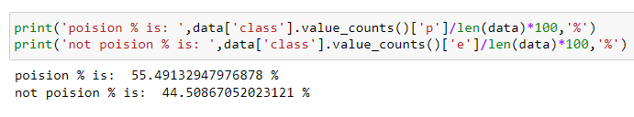
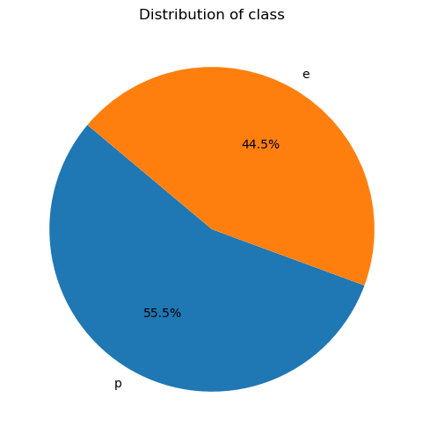
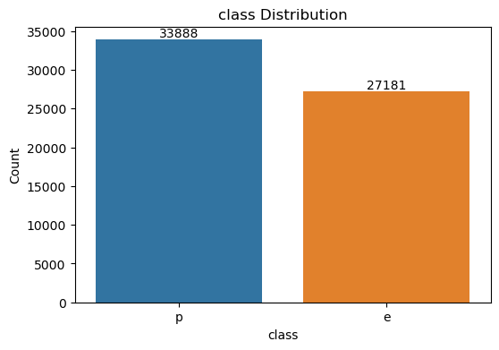
Exploratory Data Analysis
EXPLORATORY DATA ANALYSIS
Distribution of classes
There are more poisonous mushrooms than edible mashroom.the percentage of edible mashroom is 44.5%. the percentage of poisonous mushroom is 55.5%.

Slide 7
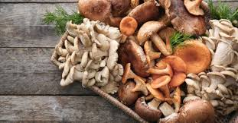
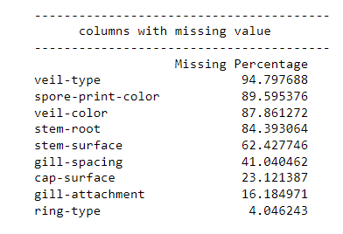
Exploratory Data Analysis
EXPLORATORY DATA ANALYSIS
Missing values
some column have missing values.let's drop columns with more than 50% of missing values.

Slide 8
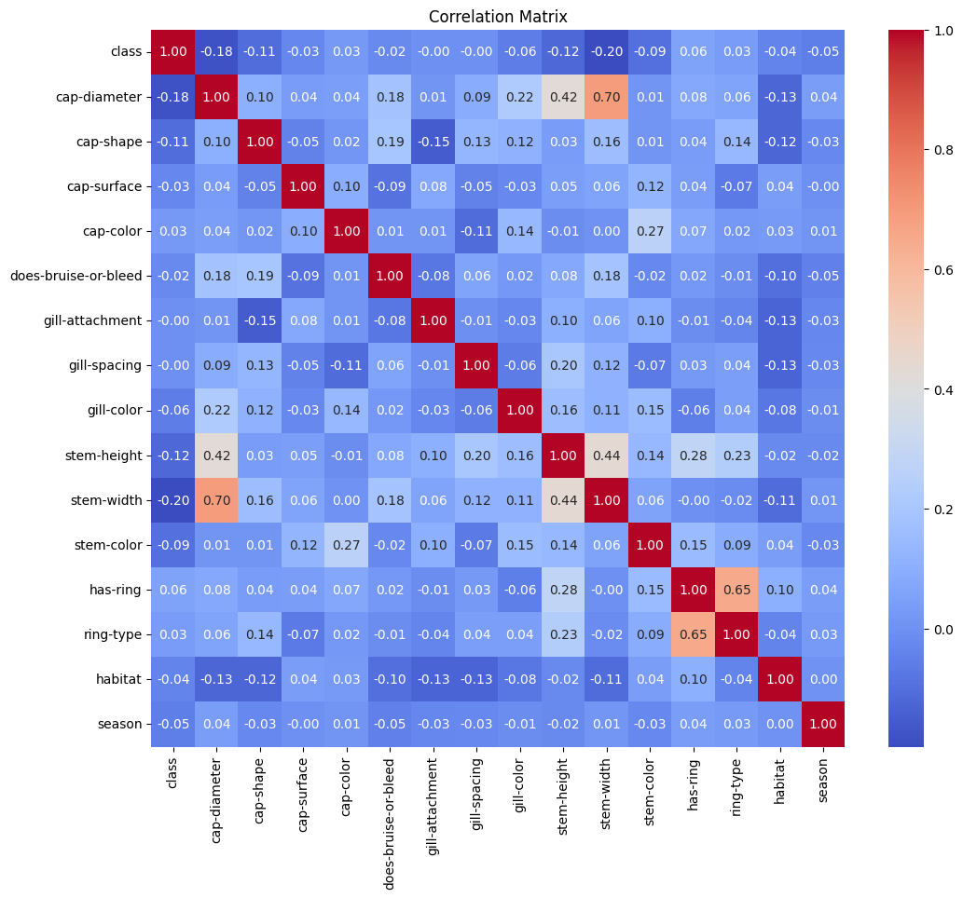
Exploratory Data Analysis
EXPLORATORY DATA ANALYSIS
Correlation of numeric features

Slide 9
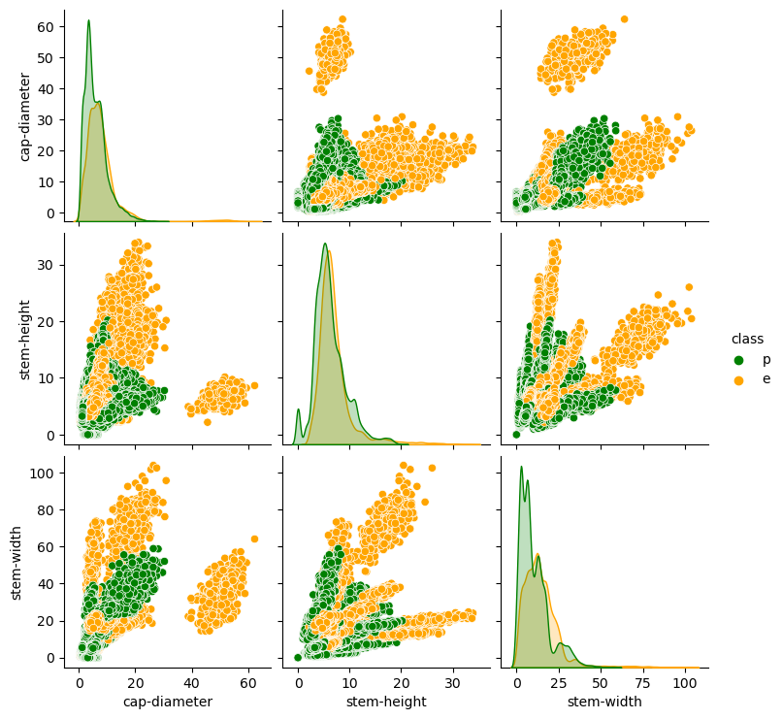
Exploratory Data Analysis
EXPLORATORY DATA ANALYSIS
Based on these plots,it looks like a large cap-diameter coupled with a large stem-height or stem-width is a good indication that a mashroom is edible.

Slide 10
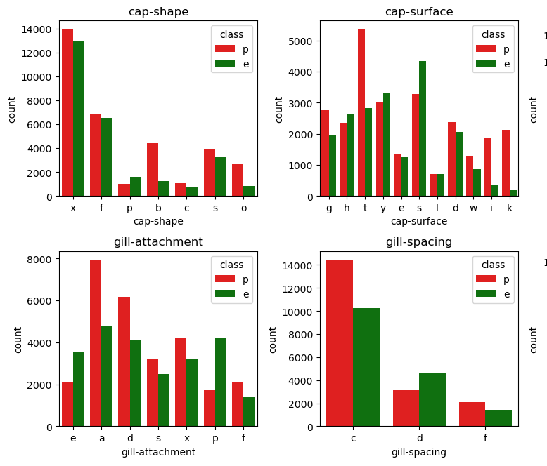
Exploratory Data Analysis
EXPLORATORY DATA ANALYSIS
Cap shape -As per capshape, there are more convex shaped caps than all other cap shapes.
cap surface-fibrous(i),silky(k),wrinkled(w),sticky(t) cap surfaced mashrooms have more poisonous mushroom than edible mushroom.
gill attachment-The pores(p) gill attachment type mushroom, have more edible mushrooms than poisonous mushrooms.
gill spacing-most of the mashrroms have close gill spacing,while very less mushrroms have no gill spacing.

Slide 11
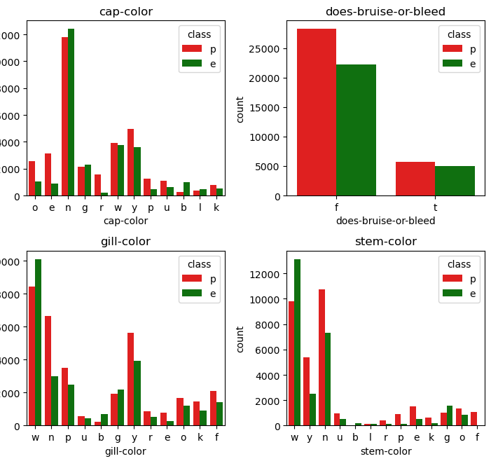
Exploratory Data Analysis
EXPLORATORY DATA ANALYSIS
cap color-red(e),green(r),purple(u),pink(p) coloured mushrooms have more poisonous mushroom while buff(b) coloured mushroom have more edible mushrooms.
Bruise/bleed-
The percentage of edible mushrooms among those that bruise or bleed is slightly higher compared to those that do not.
gill color-
Most of mushrooms have white colored gills and very least have purple colored gills.
stem color-
all buff(b) stem colored mushrooms are edible.

Slide 12
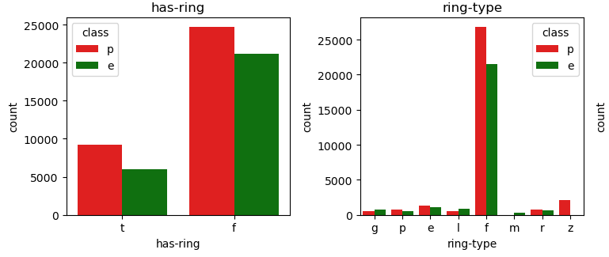
Exploratory Data Analysis
EXPLORATORY DATA ANALYSIS
has ring-most of the mushrooms have no rings while less have rings.
ring type- most of the mushrooms have no rings and very little mushroom have movable ring type.

Slide 13
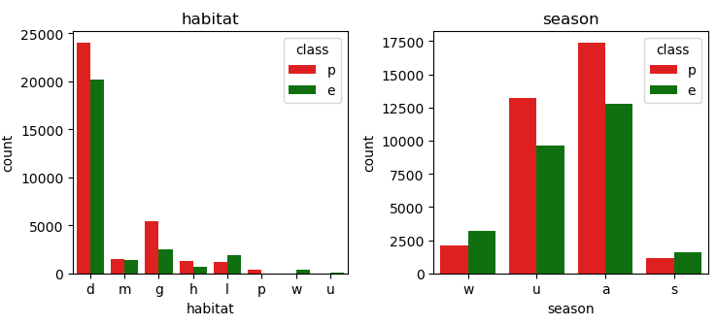
Exploratory Data Analysis
EXPLORATORY DATA ANALYSIS
Habitate-As per habitat, most of mushrooms in given data are grown on woods.
Season- as per the data nost of the mushrooms are from autum and spring season has less mashrooms.

Slide 14
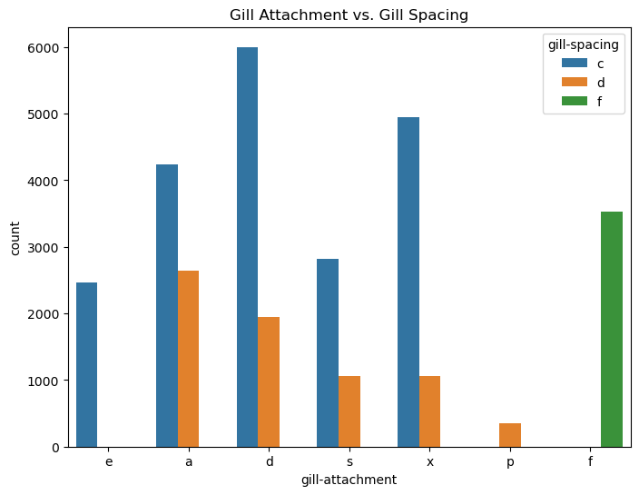
Exploratory Data Analysis
EXPLORATORY DATA ANALYSIS
Mushrooms with no(f) gill spacing have no (f)gill attachment. Mushrooms with pores(p) gill attachment have only distant (d)gill spacing. Mushrooms with free(e) gill attachment have only close(c) gill spacing.

Slide 15
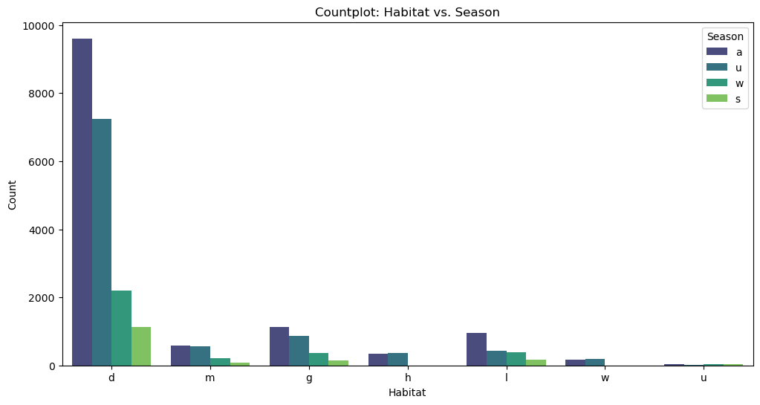
Exploratory Data Analysis
EXPLORATORY DATA ANALYSIS
waste and heaths habitate edible mushrooms are found in only autumn and summer seasons. most edible mushrooms are found in woods in autumn season.
Edible mushrooms have cap dia exceeding 40,stem heights surpassing 20, and stem widths greater than 60.additionally mushrooms with buff colored stems are edible. Edible mushrooms found in waste and heath habitates in autumn and summer seasons. The majority of edible mushrooms are typically discovered in woodland areas during autumn season.

Slide 16

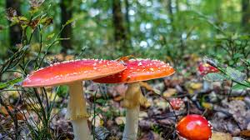

DATA PREPROCESSING
Data Splitting:
Data splitting is a crucial step in machine learning to evaluate and validate models effectively.
Splitting data into train and test sets.
Data Scaling
After splitting the dataset into train and test performed Data normalization or scaling to Standardize numeric features.
Data normalization or scaling is a crucial preprocessing step in machine learning to ensure that the features in your dataset have similar scales or ranges.

Slide 17
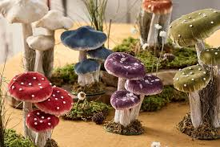
Model Selection
MODEL SELECTION
There are many machine learning algorithms to experiment with when you are working on a classification problem.
Here we are using the following models on our dataset.
Logistic Regression
Random Forest Classifier
KNN
Xgboost
SVC

Slide 18
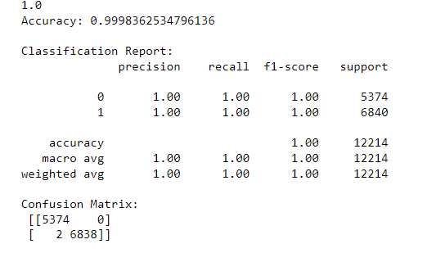
MODEL TRAINING
Now we will plot the table comparing accuracy of each model. .
Plotting accuracy ,F1 score,AUC Table for models.
XGBClassifier model is giving the highest accuracy,f1 score and AUC.
after applying hyperparameter tuning xgb classifier model accuracy increses to 99.98% . so we for our final model we are going to use xgb classifier with fine tuning.
MODEL | ACCURACY | F1-SCORE | AUC
RANDOM FOREST | 0.996 | 0.9969 | 0.9998
LOGISTIC REGRESSION | 0.621 | 0.693 | 0.66
XG BOOST | 0.9998 | 0.9997 | 1
KNN | 0.9995 | 0.9996 | 1
SVC | 0.9993 | 0.99994 | 0.9999

Slide 19
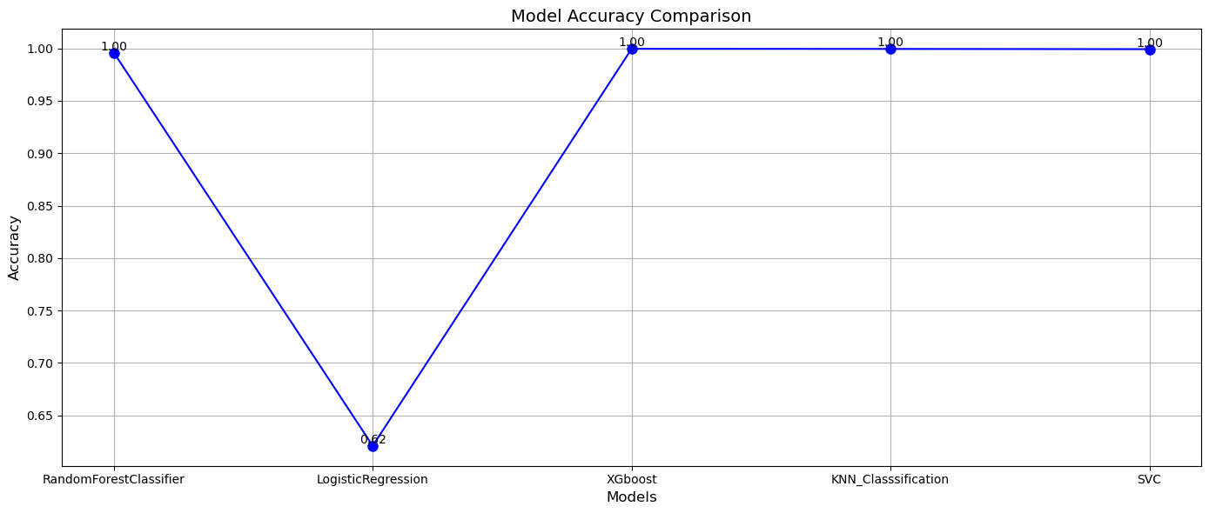
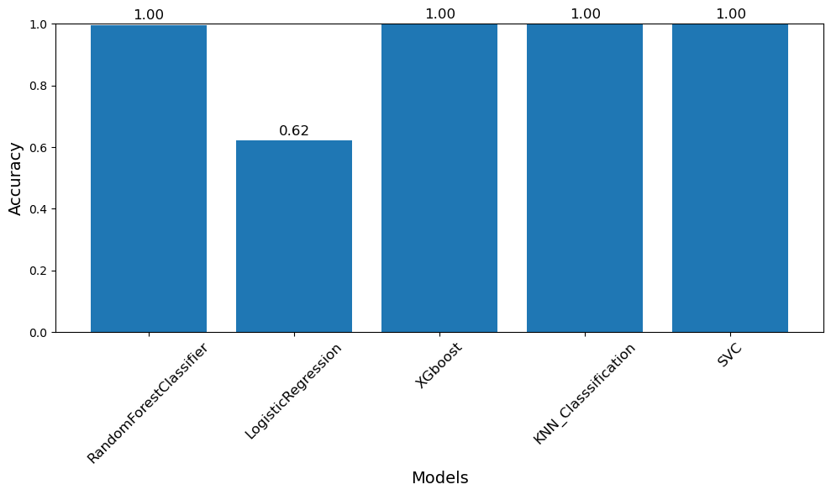
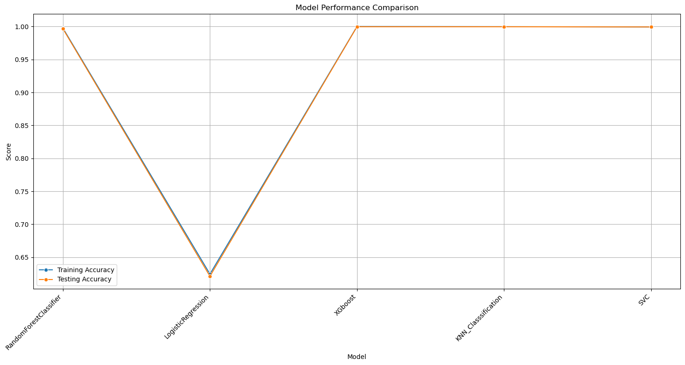
MODEL COMPARISION

Slide 20
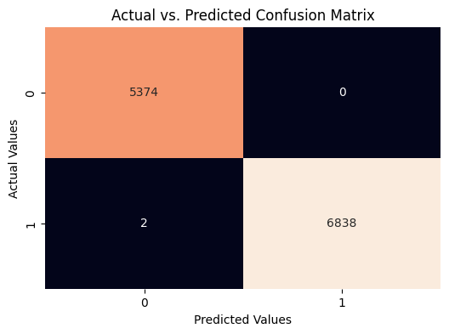
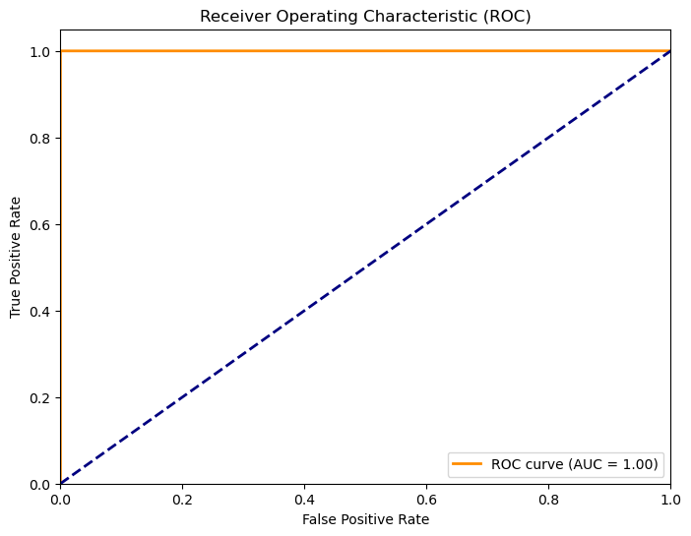
MODEL EVALUATION
The Receiver Operating Characteristic (ROC) curve illustrates the trade-off between the true positive rate (sensitivity) and false positive rate (1-specificity) across different thresholds. With an Area Under the Curve (AUC) of 0.996, our model demonstrates reasonably good discriminative power.
The confusion matrix provides an insight into our model's ability to correctly classify positive and negative instances.

Slide 21
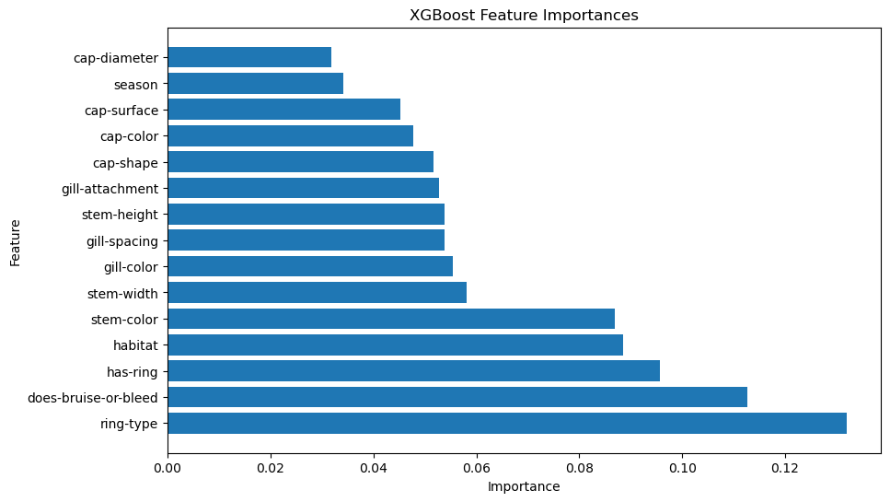
FEATURE IMPORTANCE
Based on the summary plot, it shows that ring-type , has-ring and does-bruise-or-bleed give the most impact on the model decision.

Slide 22
CONCLUSION
CONCLUSION
This Mushroom edibility prediction project dedicated to predicting the edibility status of mushrooms with a specific focus on distinguishing between poisonous and edible varieties.
Model PerformanceOur exploration into machine learning algorithms for mushroom edibility prediction has culminated in the identification of a standout performer—XGBoost, showcasing an outstanding accuracy of approximately 99.98%.
Model Evaluation: We employed evaluation metrics such as Confusion Matrix and the ROC Curve, precision, recall, F1 score. The ROC Curve, with an AUC of 0.99, demonstrated our model's discrimination capability.
Feature Importance: Based on the summary plot, it shows that ring-type , has-ring and does-bruise-or-bleed give the most impact on the model decision.
Conclusion : Edible mushrooms have cap dia exceeding 40,stem heights surpassing 20, and stem widths greater than 60.additionally mushrooms with buff colored stems are edible. Edible mushrooms found in waste and heath habitates in autumn and summer seasons. The majority of edible mushrooms are typically discovered in woodland areas during autumn season.

Slide 23
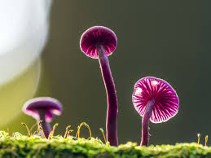
THANK YOU

