Slide 1


Real-Time Sign Language Interpretation
Bridging Communication Gaps with Innovative Technology
INSTRUCTOR : Guangjing Wang
Presenters: Srinija Reddy Maddula
Rasmitha Chinthalapally
Vishal Varma Vuddaraju

Slide 2

Introduction
Sign language interpretation is crucial for effective communication with the deaf and hard-of-hearing community. Despite its importance, there is a significant shortage of qualified interpreters, leading to communication barriers. Sign Language Interpretor, aims to address this issue by leveraging advanced technology to provide accessible and efficient interpretation services.
1

Slide 3
Motivation
5%
72%
75%
Use sign language globally
Families don’t sign with Deaf children
Deaf individuals face job challenges
Need for real-time, AI-based sign language interpretation
2

Slide 4
Goal
Develop an AI-powered real-time sign language interpreter.
Enable seamless communication without human translators.
Improve accessibility for Deaf individuals.
3

Slide 5
Related work
Rule- based systems
Glove based systems
Computer vision based approaches
Existing Apps
4

Slide 6
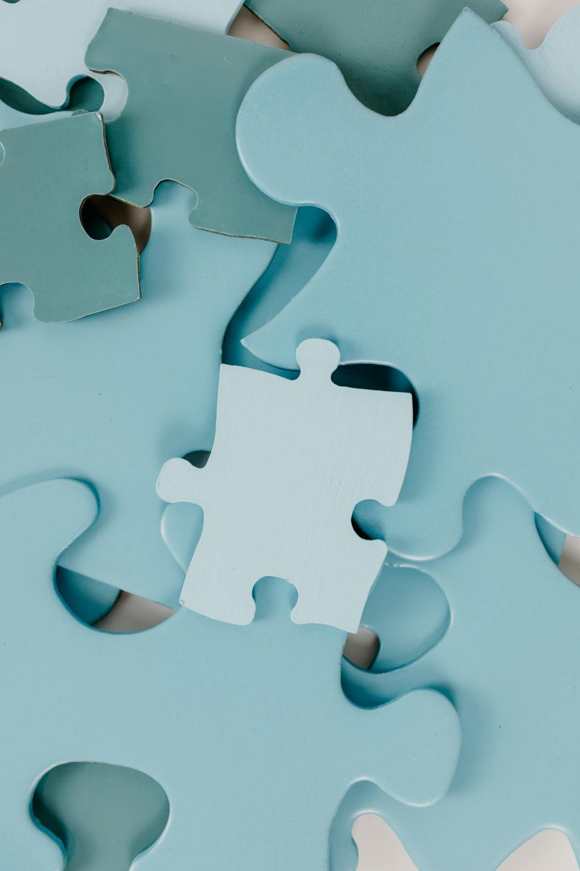
Proposed solution
Real-time Hand Gesture Recognition using CNN & OpenCV.
Converts hand gestures into text & voice output.
Offline Mode
Scalable & Extendable
Real-time processing for seamless communication.
5

Slide 7
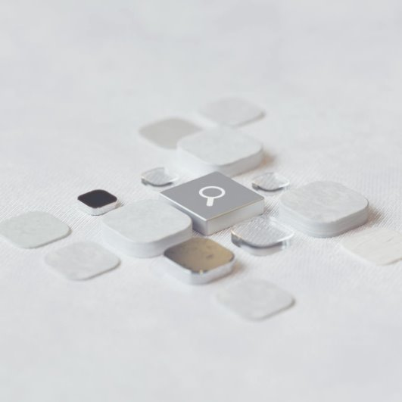
Dataset
ASL gesture dataset.
Open-source repositories
Custom recordings.
LSA64
6

Slide 8
Data Preparation
Data Collection
Preprocessing
Augmentation
Splitting
Feature Extraction
7

Slide 9
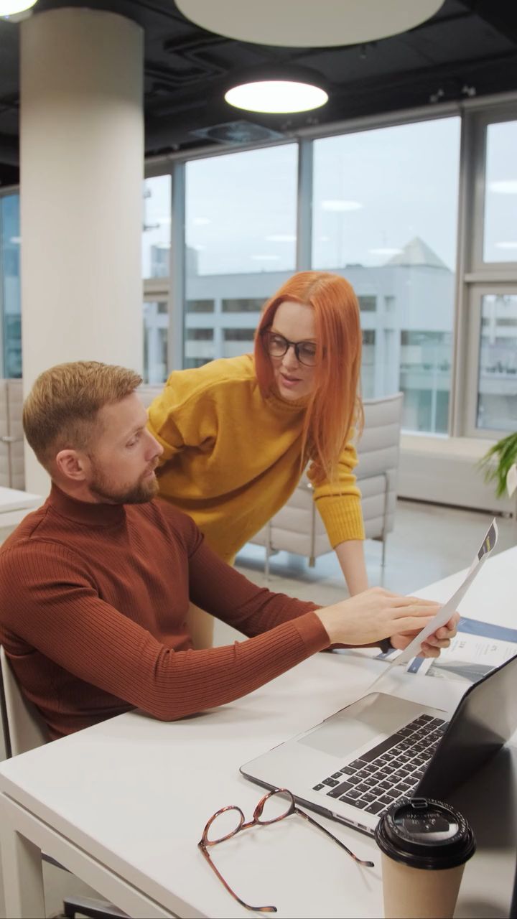
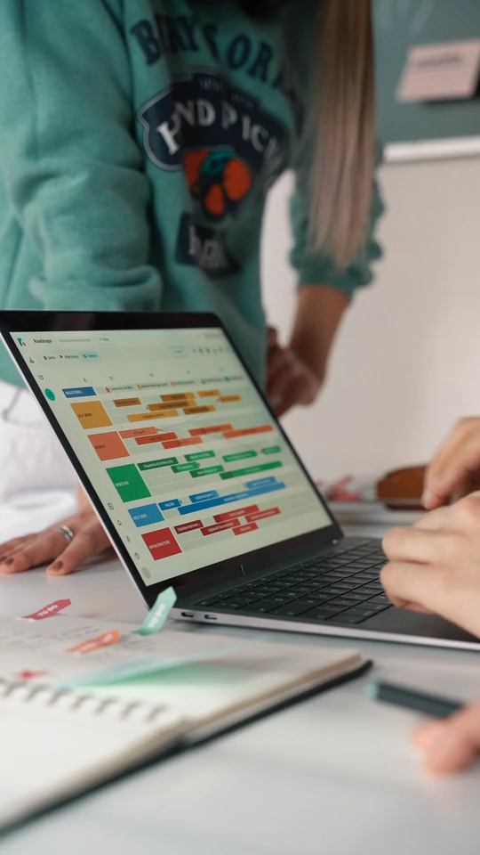
Model Selection
CNN
Captures Spatial Relationships
Automatic Feature Learning
Scalability
8

Slide 10
Technologies and tools
Python
TensorFlow/Keras
OpenCV
SQLite
pyttsx3
9

Slide 11
Implementation
Setting Up Hand Histogram
Captures the skin tone histogram to segment hand gestures from the background.
Creating and labeling Gestures
Captures images of different hand signs and stores them in directory after labeling.
10

Slide 12
Creating and labeling Gestures
Captures images of different hand signs and stores them in directory after labeling.
Data Augmentation
Enhances dataset by flipping images horizontally
Preprocessing and dataset preparation
Reads images, converts them to grayscale, and normalizes pixel values. Finally, splits the dataset.
11

Slide 13
Preprocessing and dataset preparation
Reads images, converts them to grayscale, and normalizes pixel values. Finally, splits the dataset.
Training cnn model
Trains a CNN for sign language recognition and saves the best model in .h5 file.
Real-Time Gesture Recognition
Converts recognized gestures into text and speech output
12

Slide 14
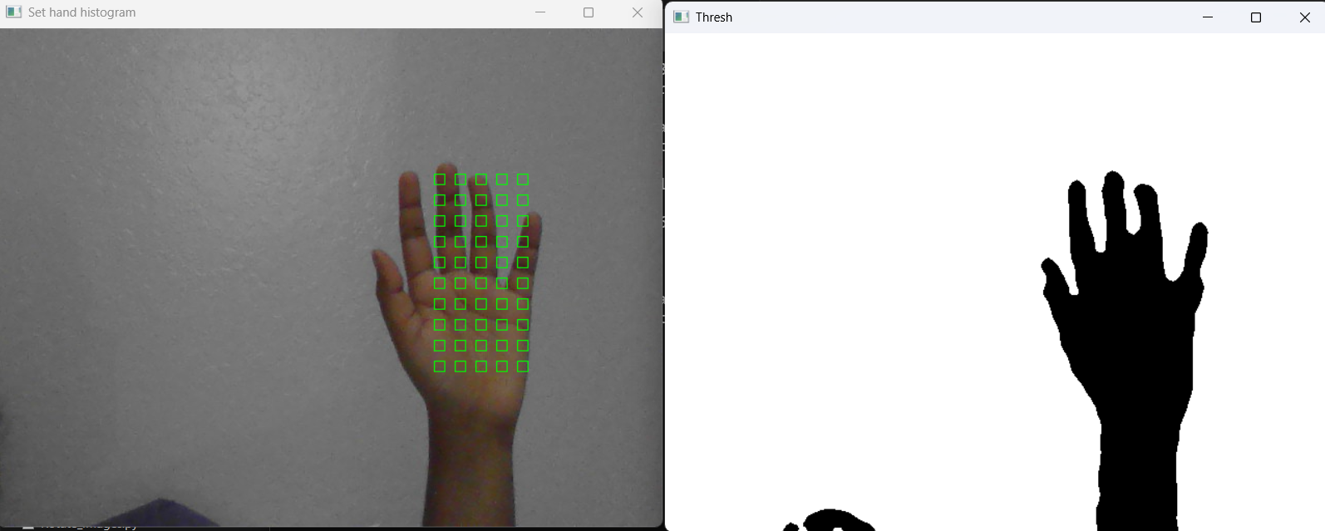

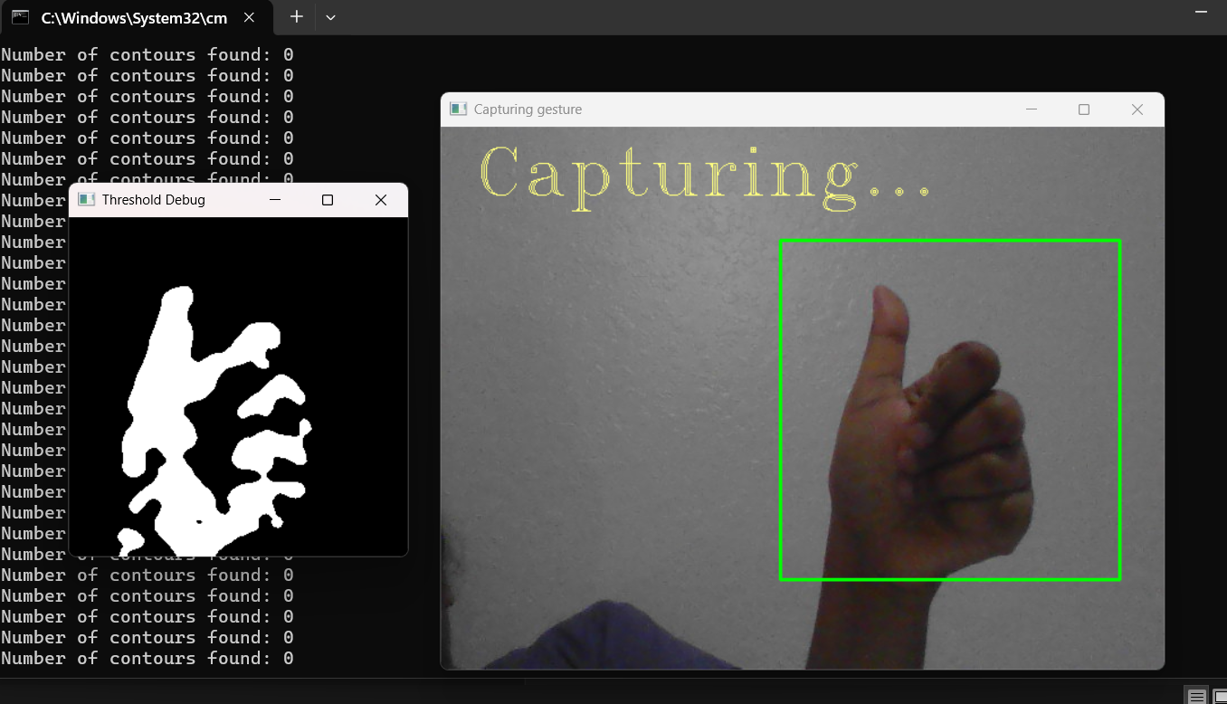
13

Slide 15
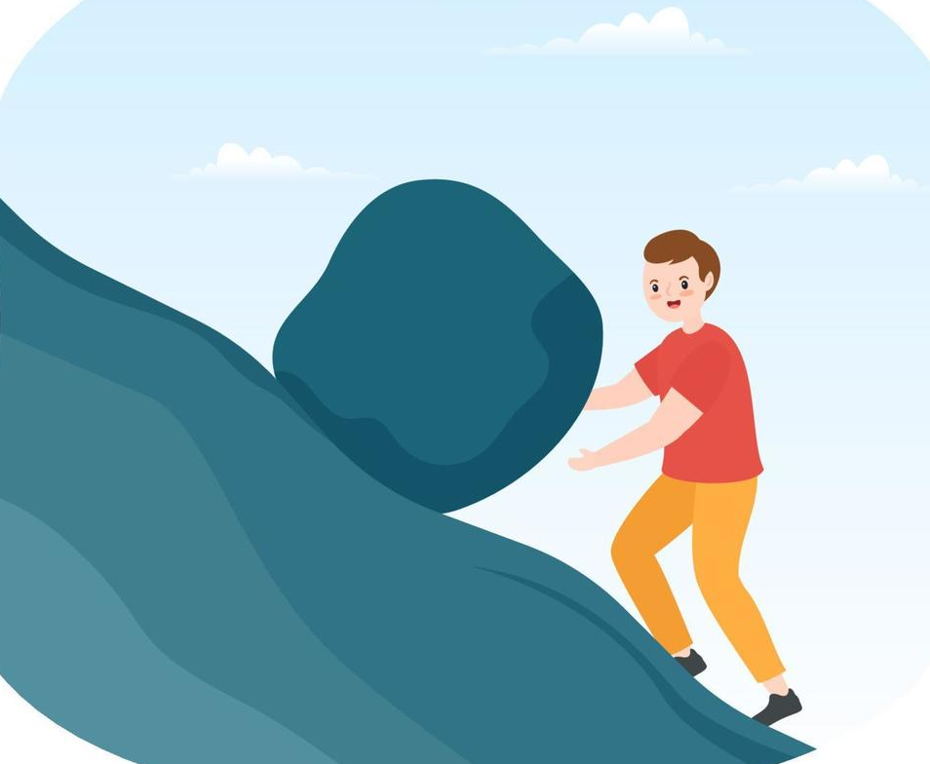
Challenges
Low accuracy on complex gestures
Background Noise in Camera Feed
Sign Variation Across Users
14

Slide 16

Solutions
Increased dataset size & used data augmentation.
Applied image thresholding & hand segmentation.
Added multiple variations for each gesture.
15

Slide 17
Future Scope
Mobile App Deployment for accessibility.
Integration with Virtual Assistants (Alexa, Google Assistant).
16

Slide 18



Applications
Healthcare
Assisting patients with disabilities.
Education
Helping students with hearing impairments.
Customer Service
Improving accessibility in businesses.
17

Slide 19

Conclusion
Achieves real-time gesture recognition with high accuracy using CNNs. It overcomes challenges through optimized training and data augmentation, making it scalable and accessible. Future enhancements will expand its global impact for inclusivity.
18

Slide 20
Thank You

