Slide 1
Machine Learning Operations
02476 Machine Learning Operations
Nicki Skafte Detlefsen,
Postdoc
DTU Compute
Loosely based on https://www.youtube.com/watch?v=VU5Em1qkWDU

Slide 2
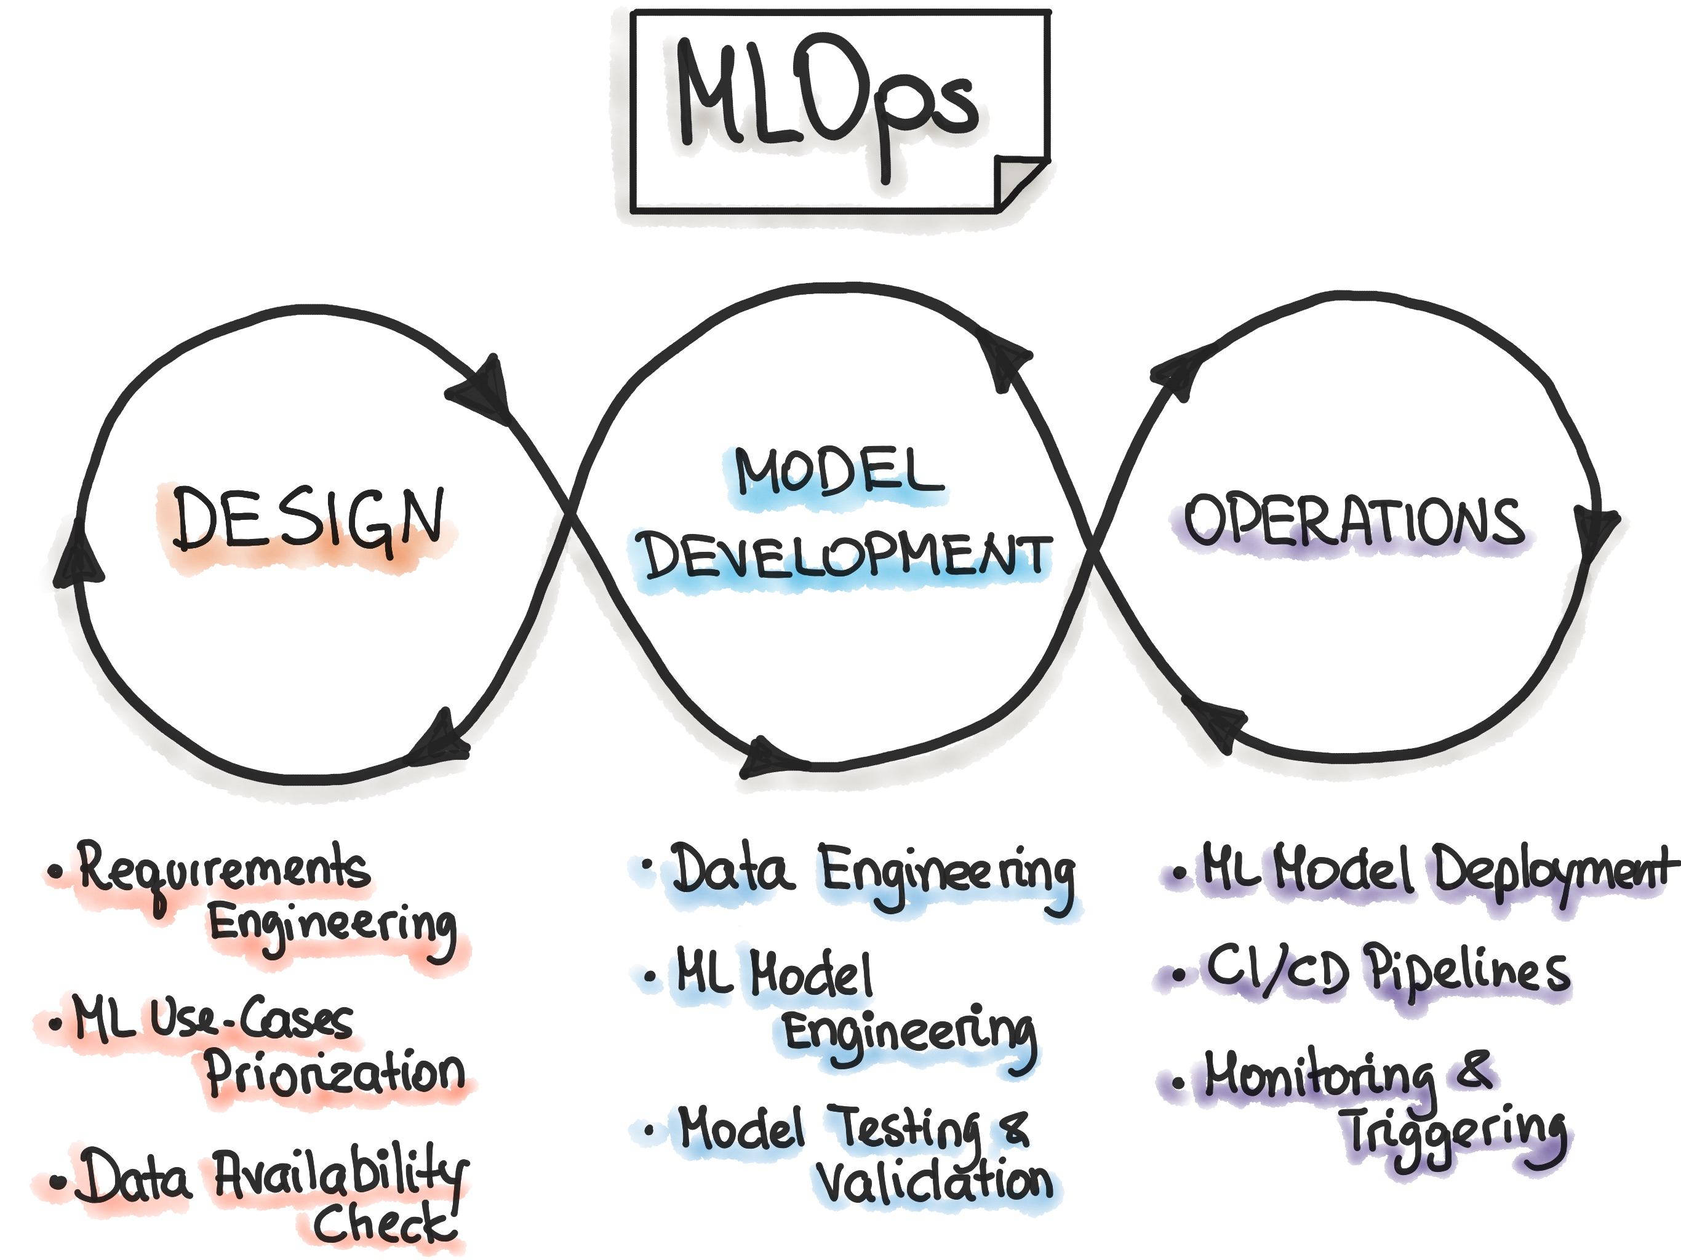
What is machine learning operations
Is a set of tools, processes, and mindset that aim to make ML Lifecycle reproducible, trackable, testable and maintainable
Notice: ITS A CYCLE!

Slide 3
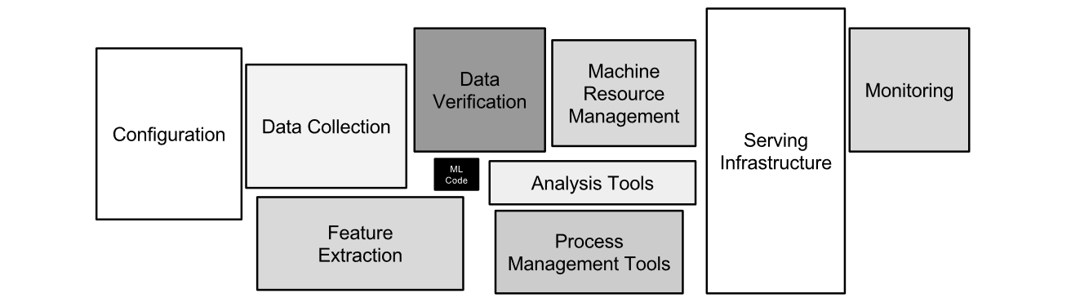
Why should you care?
Teeny tiny part is actual ML code, the rest is operations
D. Sculley, Gary Holt, Daniel Golovin, Eugene Davydov, Todd Phillips, Dietmar Ebner, Vinay Chaudhary, Michael Young, Jean-Francois Crespo, and Dan Dennison. 2015. Hidden technical debt in Machine learning systems. In Proceedings of the 28th International Conference on Neural Information Processing Systems - Volume 2 (NIPS'15). MIT Press, Cambridge, MA, USA, 2503–2511.

Slide 4
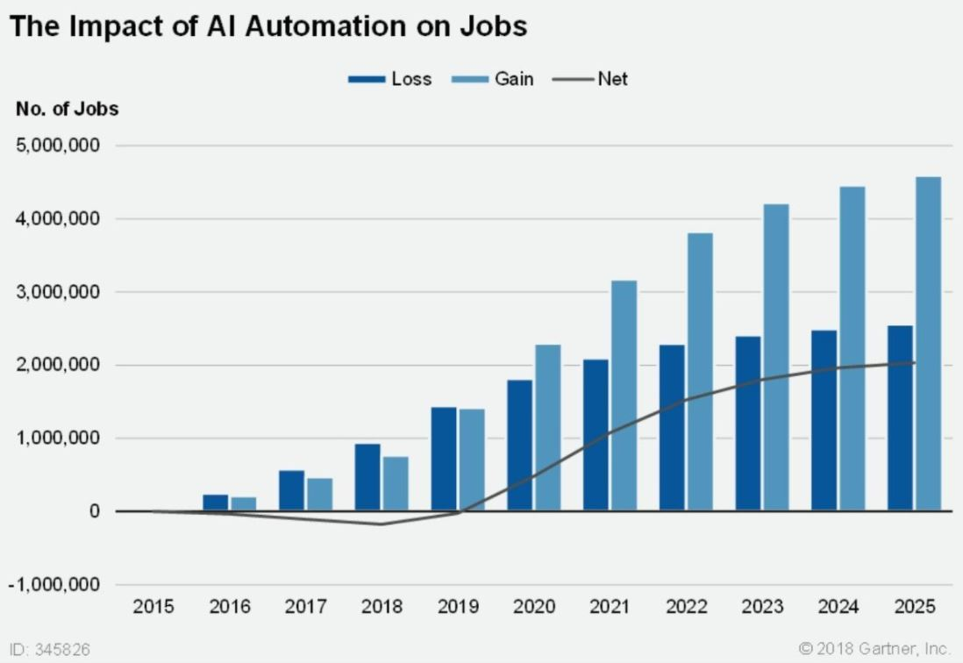
Why does companies care
ML automatization is going to increase over the years
Examples:
Which stocks to buy or sell?
Where is the tumor in the picture
What should be the price of a banana today?

Slide 5
Why does companies care
Having automated model deployed with errors can cost ALOT of money:
”A famous example of the dangers here was Knight Capital´s system losing $465 millons in 45 minutes, apparently because of unexpected behavior from obsolete experimental codepaths” – Hidden Technical depth in Machine Learning Systems

Slide 6
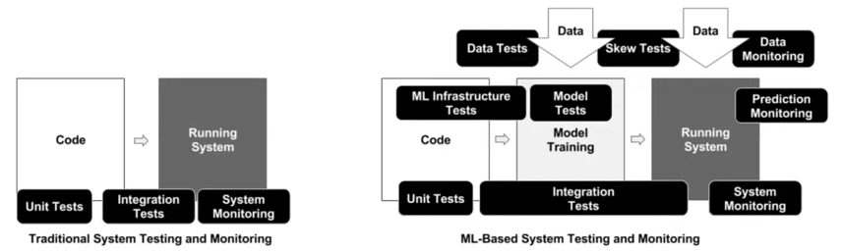
Why is MLOps harder than DevOps
It involves a freaking lot of testing

Slide 7
Design
The is the main part we train you at DTU
Analyze a problem
Look in litterature for references
Check if you have access to data for investigating this

Slide 8
Development
This is somewhat covered in other courses
Going from ideas to practical implementation
How should data be formatted to guide the development
How should model be validated and tested
This course will introduce tools to be more organised in this phase

Slide 9
Operations (The new kid)
To my knowledge, is not teached at DTU
Operations = How to make sure models do not break
My hope is that you will get at feeling of this topic
Specifically we will touch apon deployment and CI

Slide 10
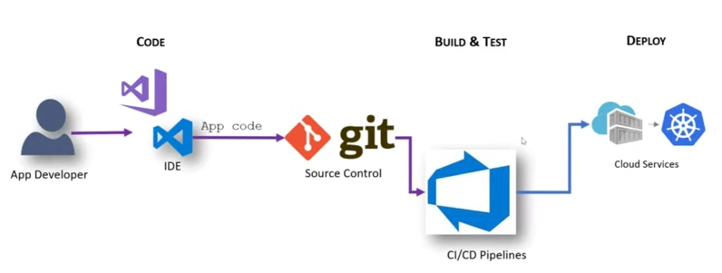
The workflow of standard DevOps

Slide 11
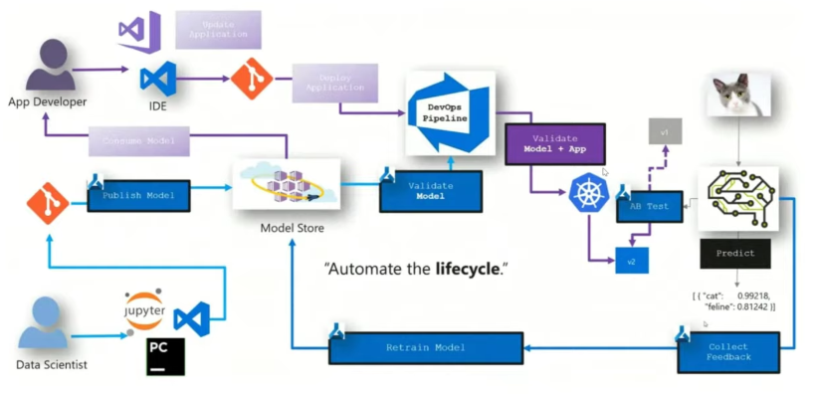
The workflow of MLOps
DevOps on steriods
The big difference is MLOps requires domain knowledge
This is what I expect you can do

Slide 12
MLOps at a high level
Optimizing workflows
Getting organized cost time initially but will save you time down the line
Versioning
Keep track of code changes, trained models etc. so everything can be backtracked
Automatization and Continuous X
Make sure that new changes automatically gets tested, deployed etc.
Reusability
Why rewrite the same code for a new project if you can reuse
Reproducibility
Make sure that your results can be redon by others

Slide 13
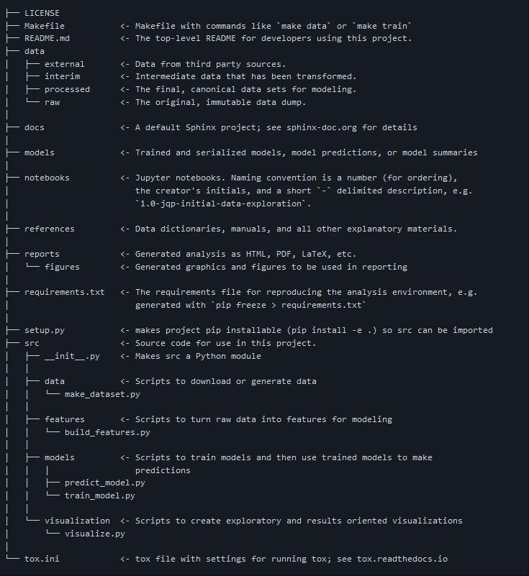
The first step of MLOps: Organization, code style and version control
Today exercises is all about organizing your workflow.
While organization is maybe not that big of a deal on personal projects, it is an essential factor when working on large scale projects

Slide 14
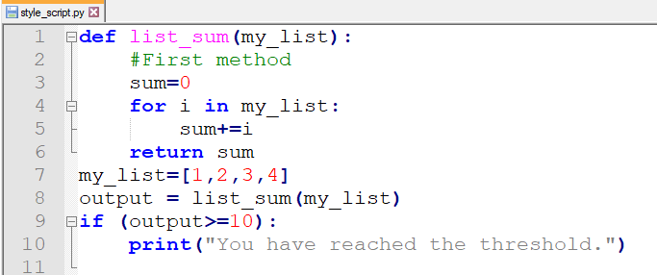
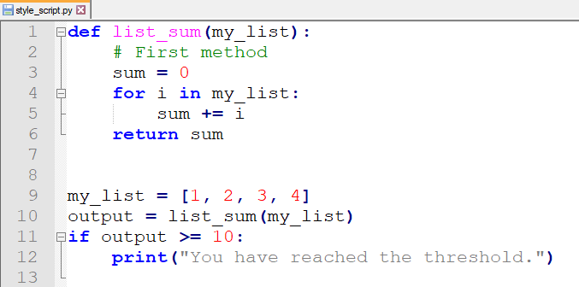
The first step of MLOps: Organization, code style and version control
There is no right and wrong way
It comes down to being consistent
However, complying to standard

Slide 15
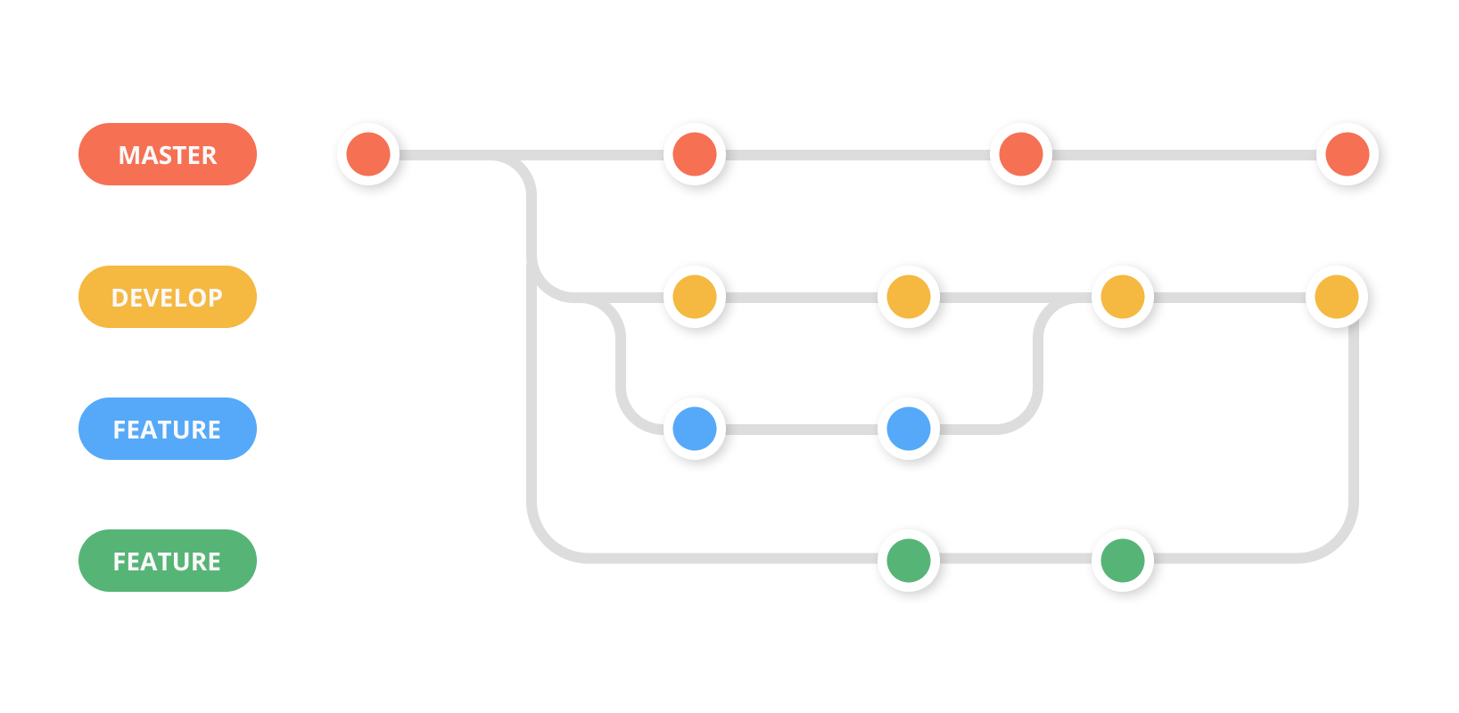
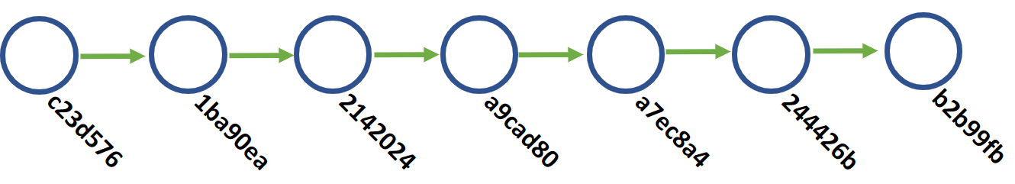
The first step of MLOps: Organization, code style and version control
Version control helps keep track of code changes, enabling to always roll back if something goes wrong
I able to scale to 1000+ developers working on the same codebase

Slide 16
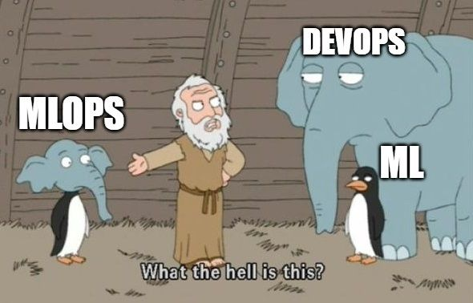
Meme of the day
https://skaftenicki.github.io/dtu_mlops/s2_organisation_and_version_control/S2.html

