Slide 1
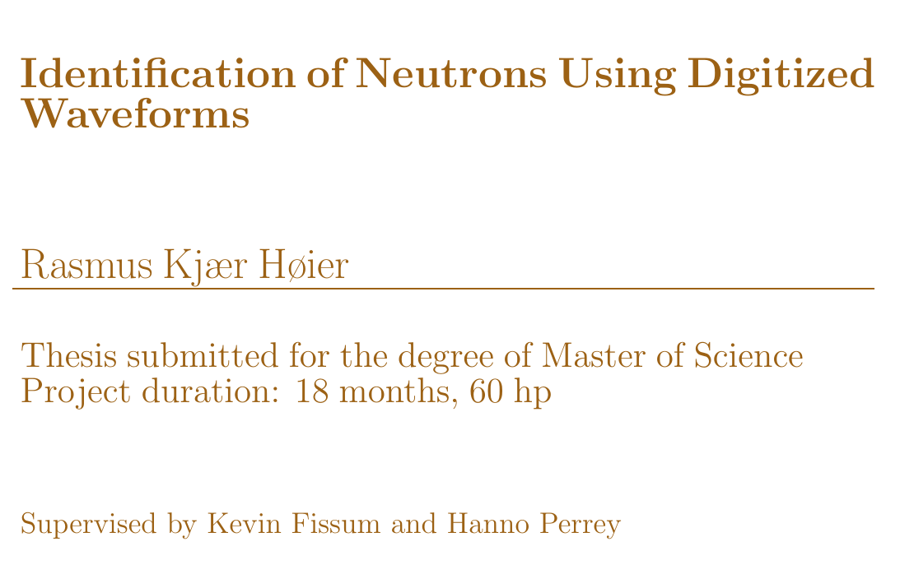

Slide 2
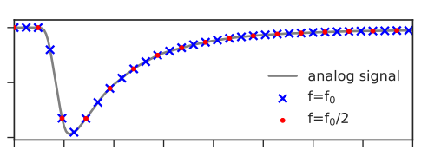
Identification of Neutrons Using Digitized Waveforms
Waveform digitizer
  Emulate existing setup
    Neutron time of flight
    Q-based PID
  Explore new possibilities
    Neural network based PID
Is the analog or digital approach better?
Amplitude
Time

Slide 3

The Neutron
When neutrons are thermalized
they become cooler!
Uncharged
  Penetrating
Unstable
  Halflife 10 minutes
  Decays into proton by beta decay

Slide 4
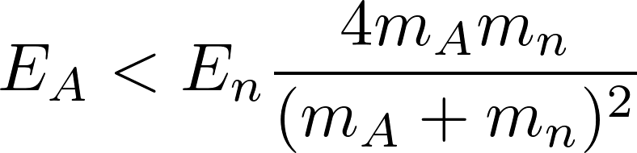
Scattering basics
A
n
“Billiard-ball” collision:
Scatters against nuclei:
Lighter target ⇒ more energy potentially transferred

Slide 5
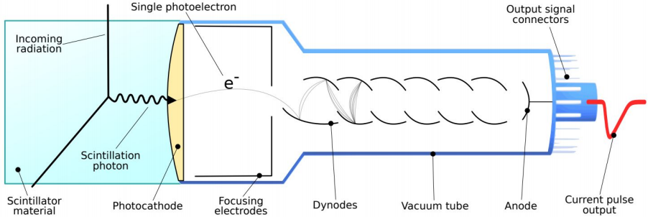
Scintillation Detectors
Fast neutron detection:
  Hydrogen rich medium
  Elastic scattering
  Recoil proton
Gamma-ray detection
  Compton scattering
  Recoil electron
Metastable states
  Slow component depends on dE/dx
  Different decay times ⇒ PSD
Figure from [1]

Slide 6
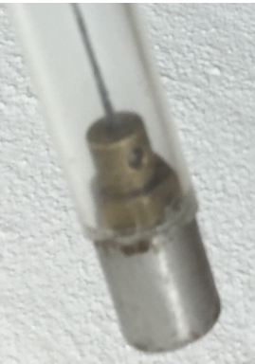
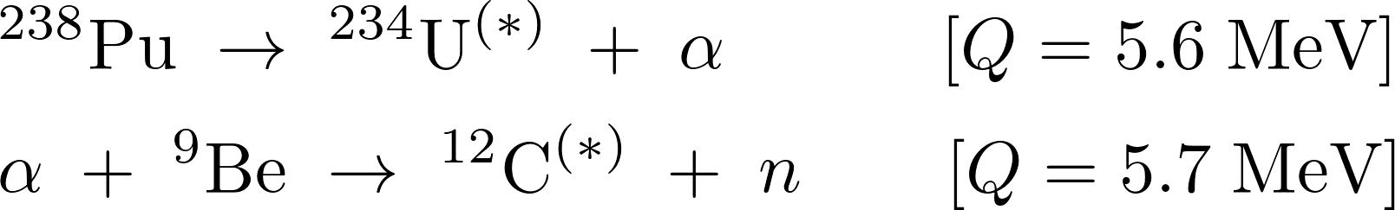
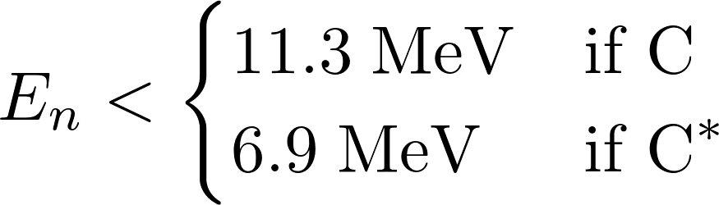
Neutron and Gamma-ray Source
De-excite: cascade of photons
De-excite: 4.4 MeV gamma-ray
≈5 cm
Figure from [2]

Slide 7
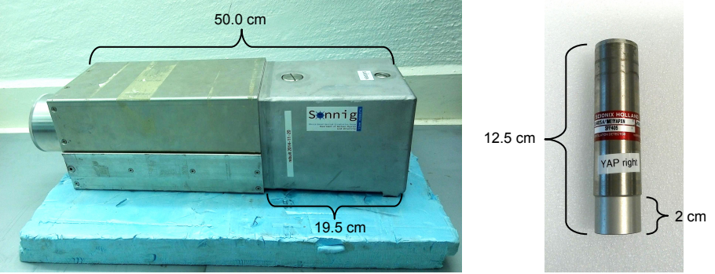
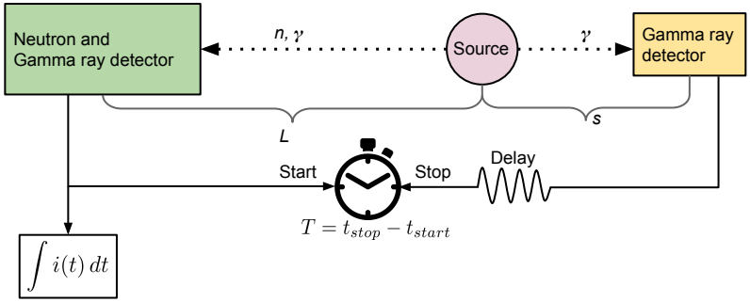
Experimental Setup

Slide 8
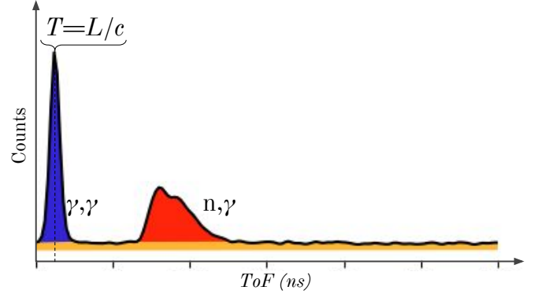

Neutron Tagging
γ γ
n γ

Slide 9
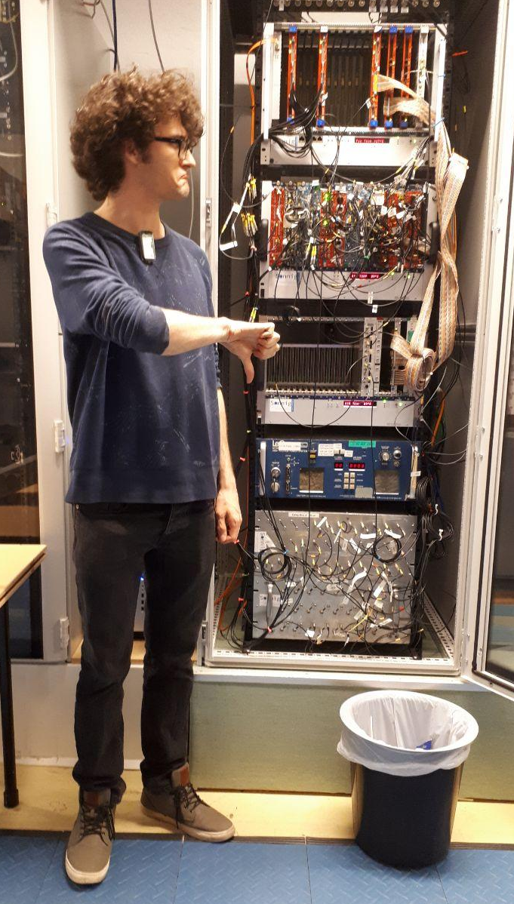
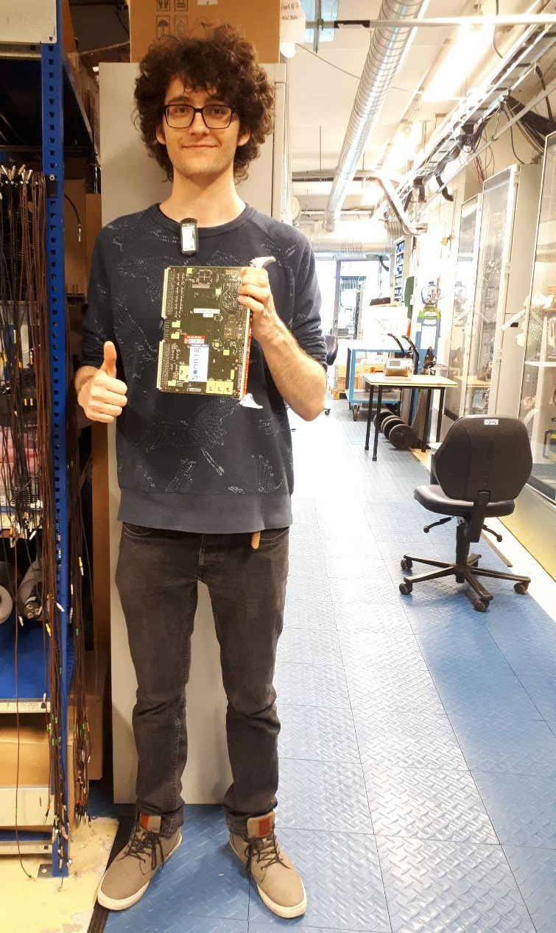
Experimental Setup
Analog setup
  NIM modules for pulse selection
  VME modules for charge and time digitization
Digitizer based setup
  Digitizer module digitizes pulses
  Selection and analysis done in software

Slide 10
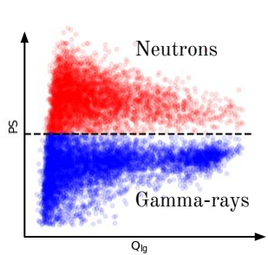
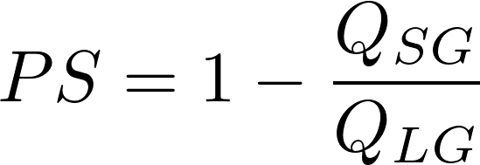
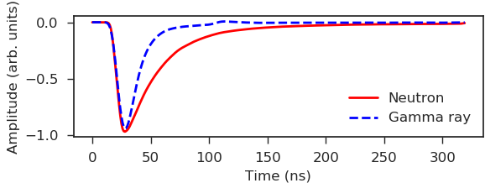
Charge Comparison
SG
LG
Overlapping distributions!

Slide 11
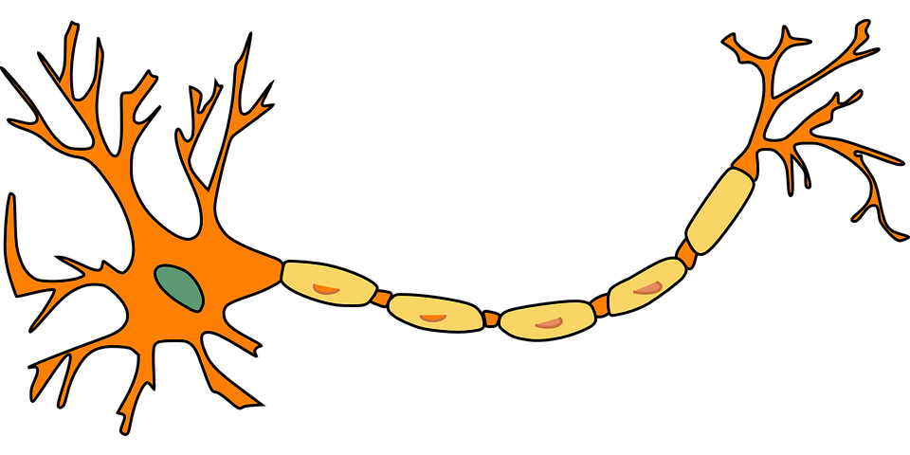
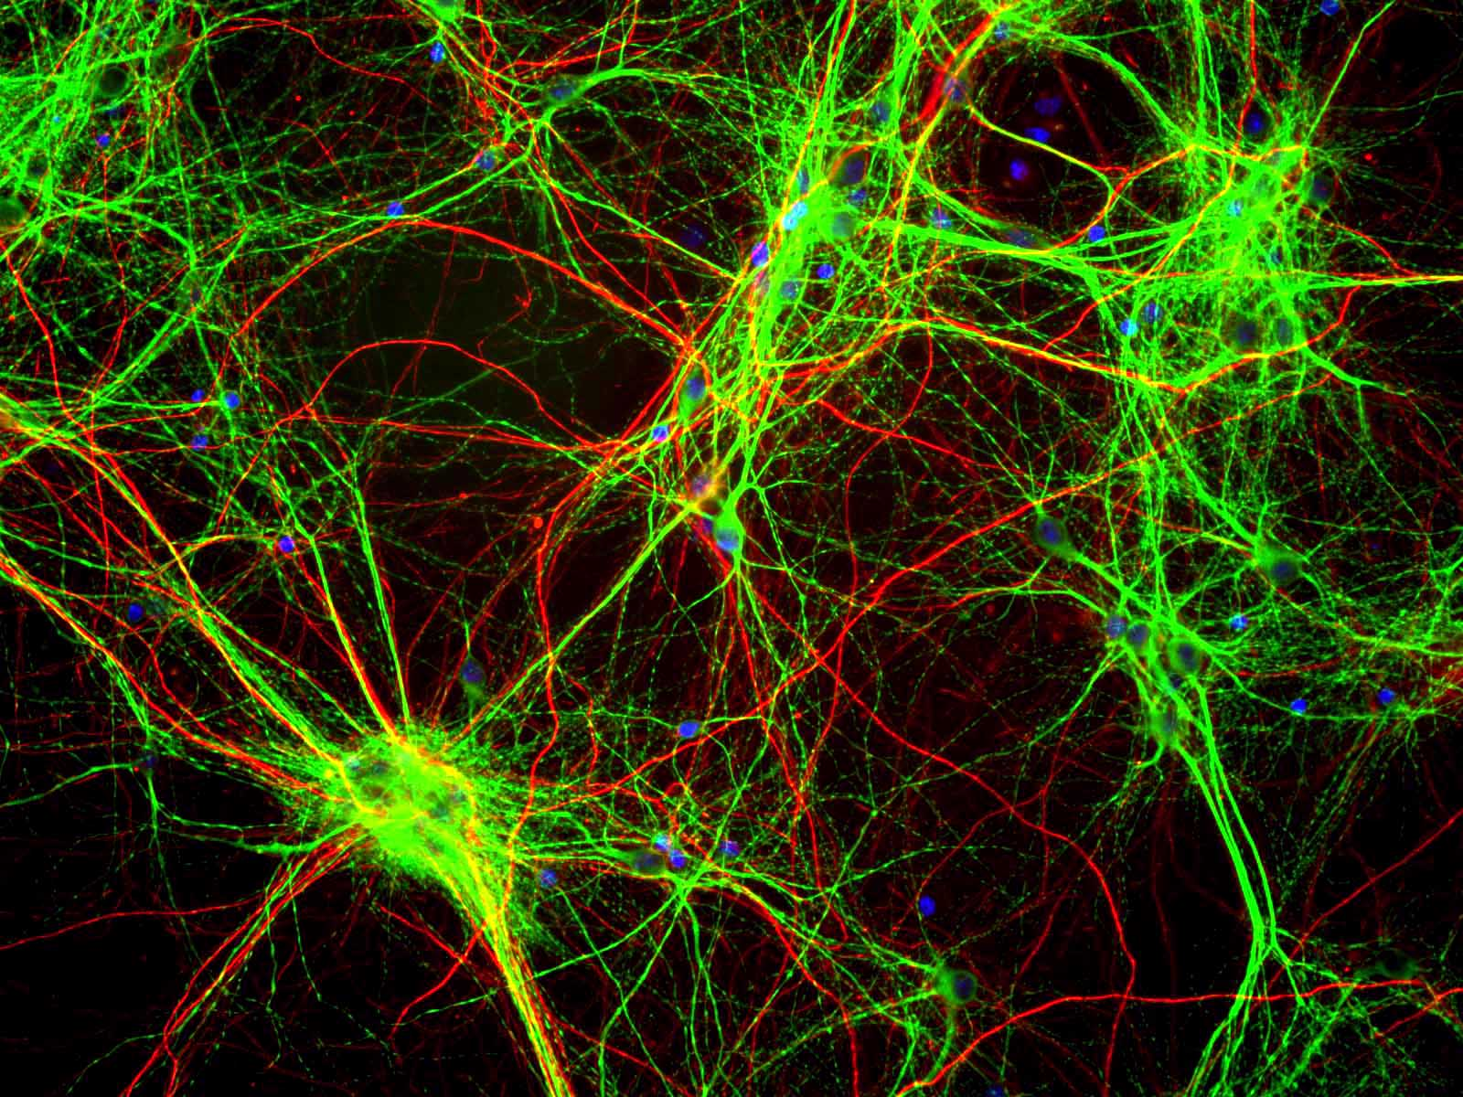
Neural Network Basics
Receivers
(dendrites)
Biological neural network
A network of neurons
Nucleus
Transmitters
(synaptic terminals)
Figure from [5]
Figure from [2]

Slide 12
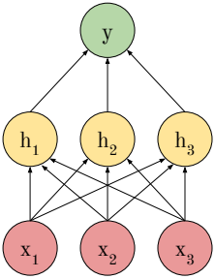
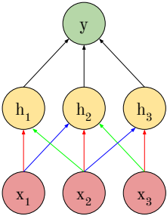
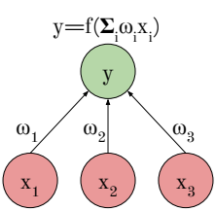
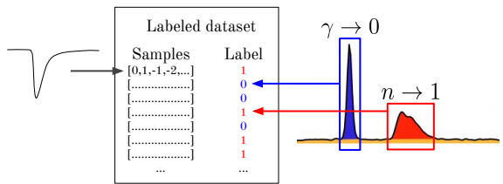
Neural Network Basics
Artificial neuron
  A neuron is a function
Artificial neural network
  A function of functions
Weights
  Found through “training”
CNN ⇒ neurons share weights

Slide 13
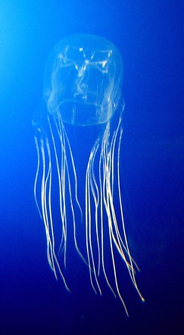
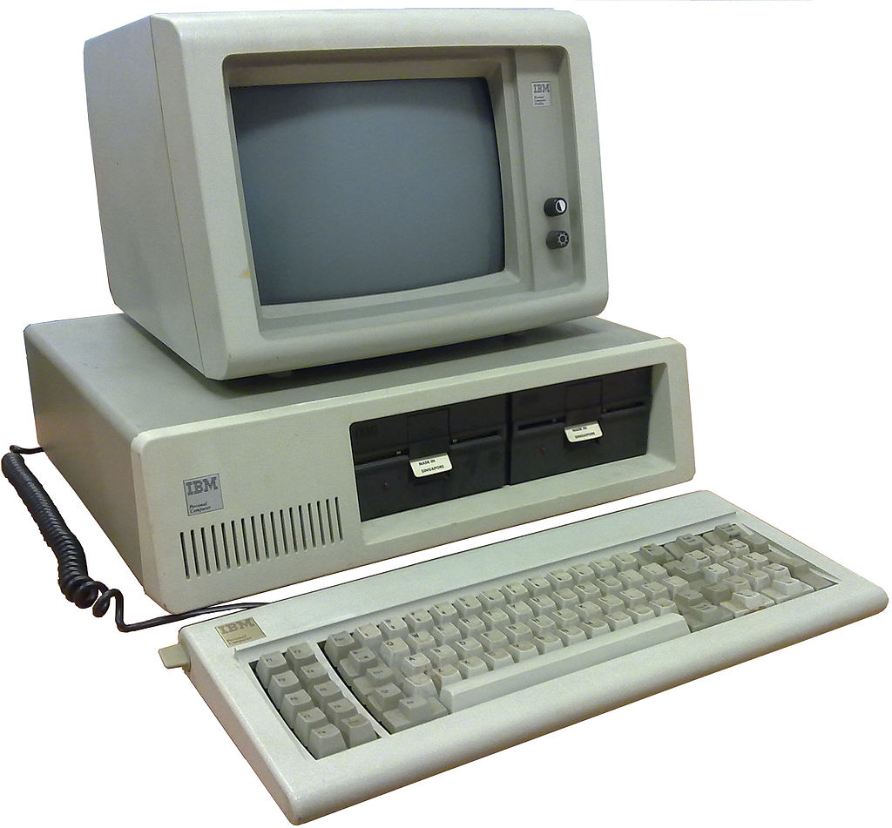
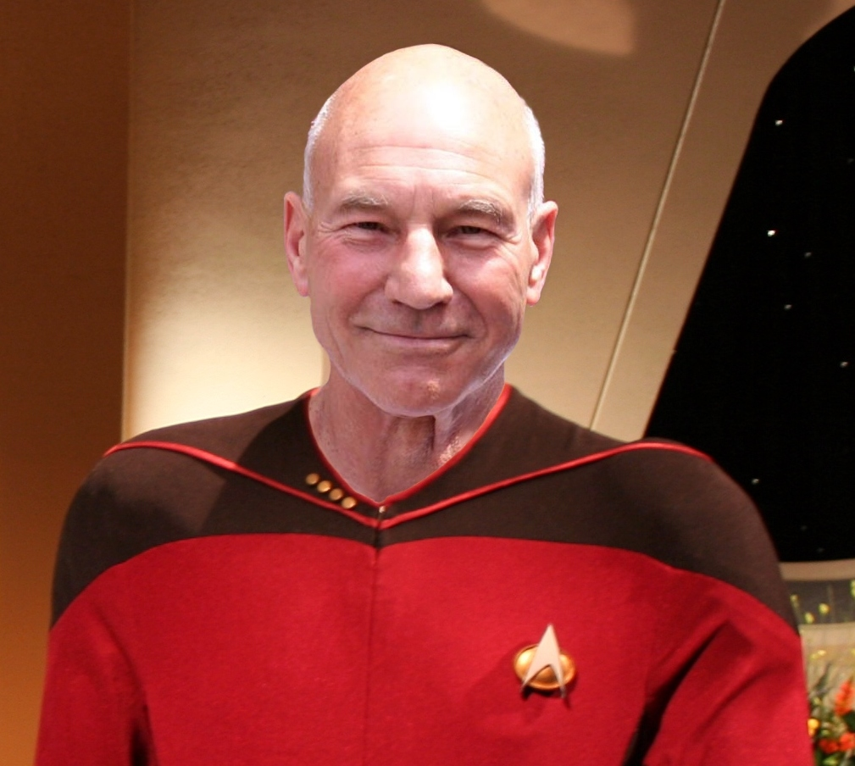
Neural Network Basics
Box Jellyfish
[4]
Employed network
  Implemented with the library Keras
  ≈1200 artificial neurons
  ≈1100 weights
Box Jelly fish
  ≈13,000 neurons
Human
  ≈ 10¹¹ neurons
[6]
[7]

Slide 14
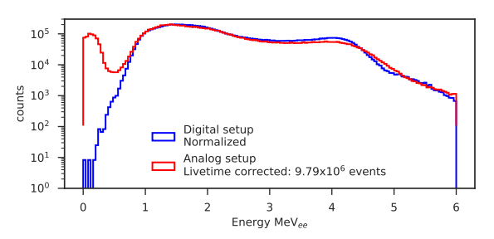
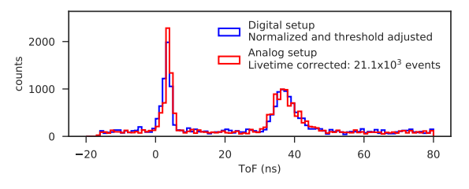
Datasets
1 hour
Analog setup:
4.3 million Ne213 events
Digital setup:
2.2 million Ne213 events

Slide 15
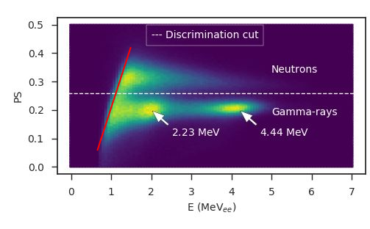
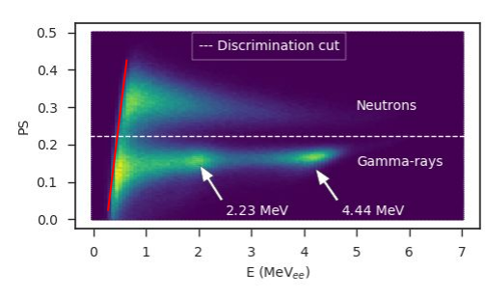
Charge Comparison
Analog
Digital

Slide 16
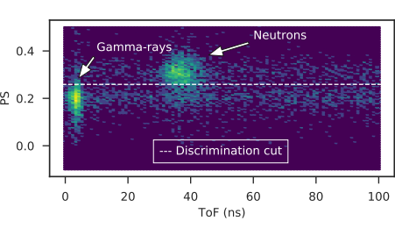
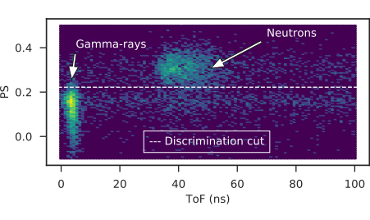
Charge Comparison
Analog
Digital

Slide 17
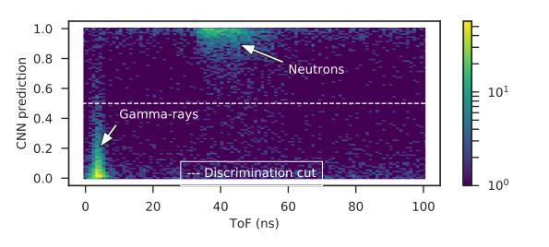
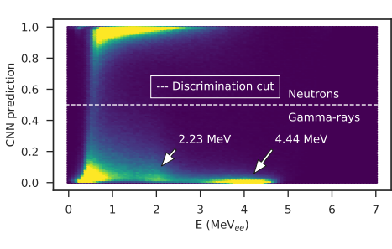
Convolutional Neural Network

Slide 18
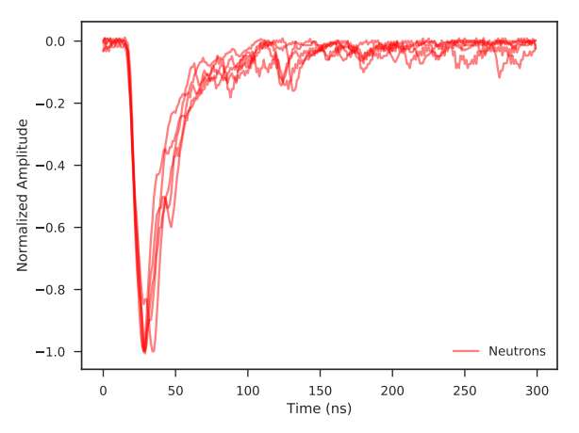
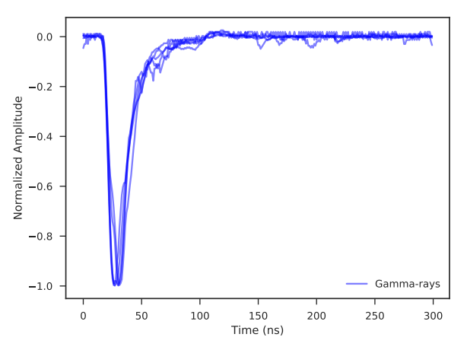
Convolutional Neural Network
Pulses classified with confidence > 95%
Neutrons: Slow decline, tail jitter
Gamma-rays: Fast decline, less tail jitter

Slide 19
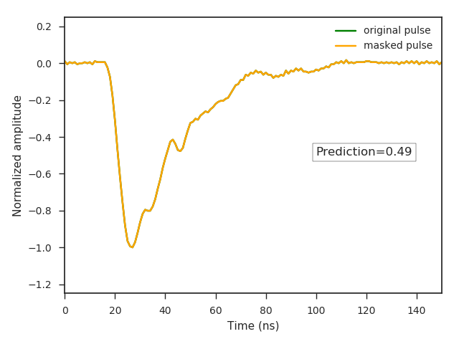

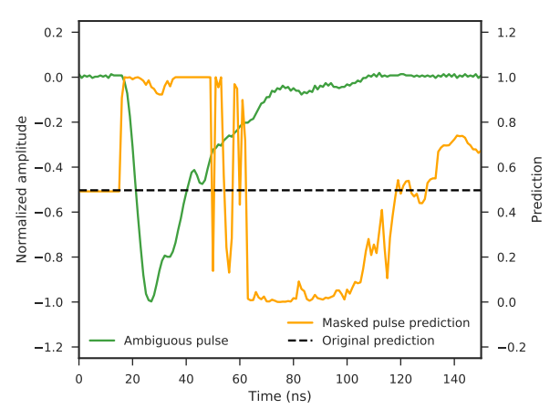
Convolutional Neural Network
Ambiguous pulse: prediction ≈ 0.5
Neutrons: prediction ⇒ 1
Gamma-rays: prediction ⇒ 0
Alter prediction with 31 pixel masking window

Slide 20
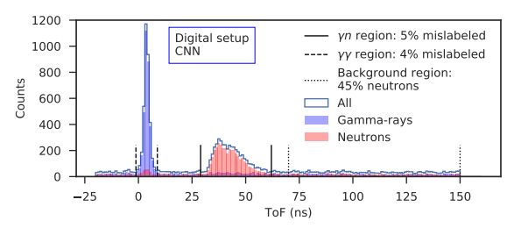
PSD benchmarks

Slide 21
PSD benchmarks
PSD method | Gamma-ray mislabeled | Neutron mislabeled
Analog: CC | 12% | 16%
Digital: CC | 3% | 12%
Digital: CNN | 4% | 5%

Slide 22
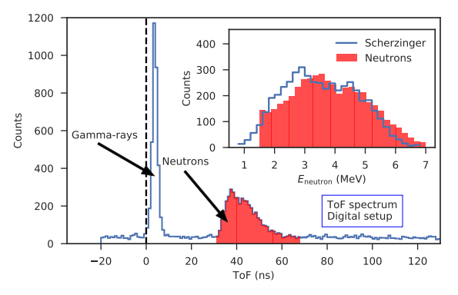
Neutron Tagging

Slide 23
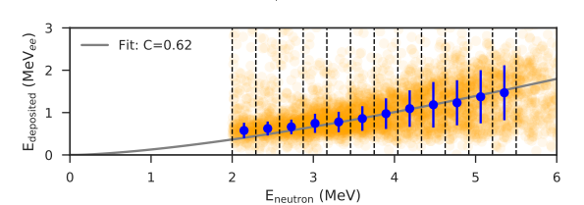
Neutron Kinetic and Deposited Energy
Equation from [8]

Slide 24
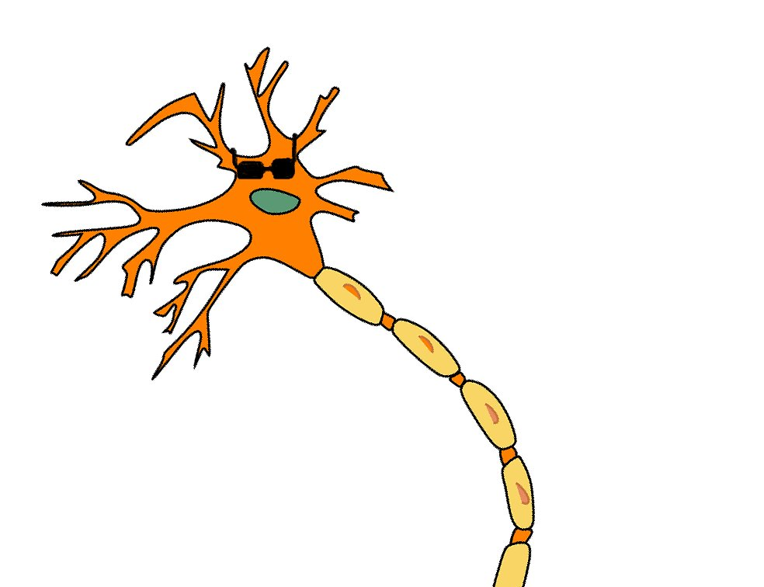

Summary
Neutron tagging and Q-based PID implemented with digitizer.
Generally the digitizer performs better
The CNN based PID outperforms Charge comparison method
Is the analog or digital approach better?
  Analog setup for teaching
  Digital setup for research

Slide 25
References
[1] Mauritzsson, Nicholai, Design, Construction and Characterization of a Portable Fast-Neutron Detector
[2] Koufigar, Sharareh, The Radiological Footprint of a Be-based Neutron Source
[3] Pixabay, Neuron
[4] Gautch, Guido, Box Jellyfish
[5] Gerry Shaw, Culture of rat brain cells stained with antibody to MAP2 (green), Neurofilament (red) and DNA (blue)
[6] Ruben de Rijcke, IBM 5150 Personal Computer
[7] Derek Springer, Jean-Luc Picard
[8] R. A. Cecil, B.D. Anderson, R. Madney, Improved Predictions of Neutron Detection Efficiency for Hydrocarbon Scintillators from 1 Mev to About 300 Mev*

Slide 26
Extra Slides

Slide 27
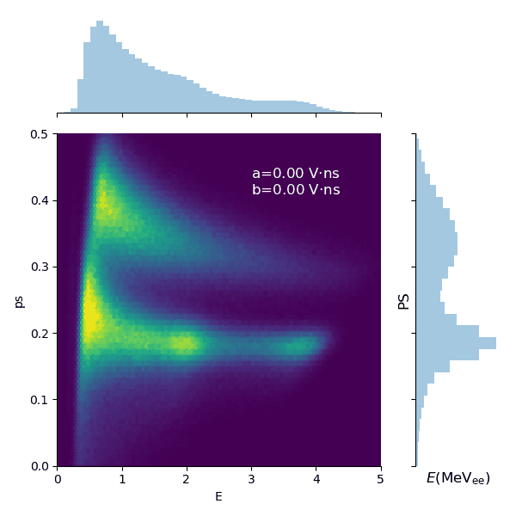

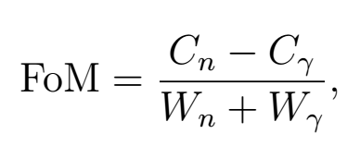
Charge Comparison

Slide 28
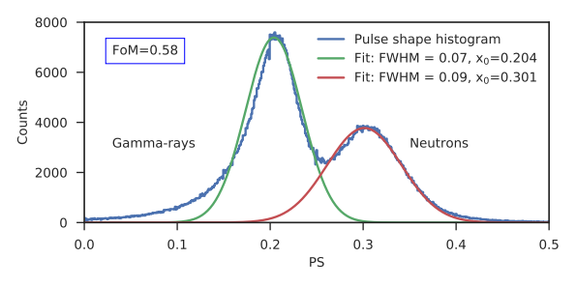
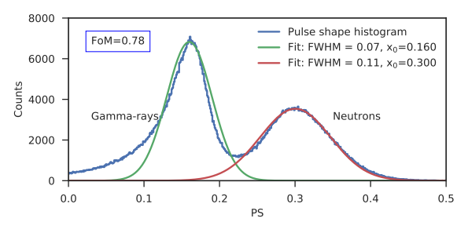
Results: PSD
Analog setup
Digital setup
Analog setup: CC
Digital setup: CC

Slide 29
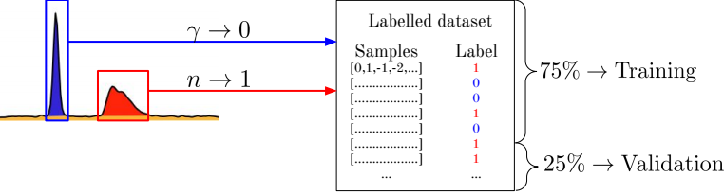
Convolutional Neural Network

Slide 30
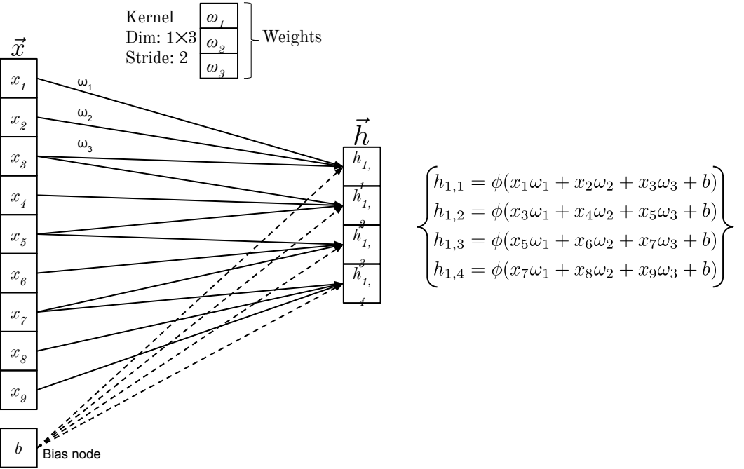
Convolutional Neural Network

Slide 31
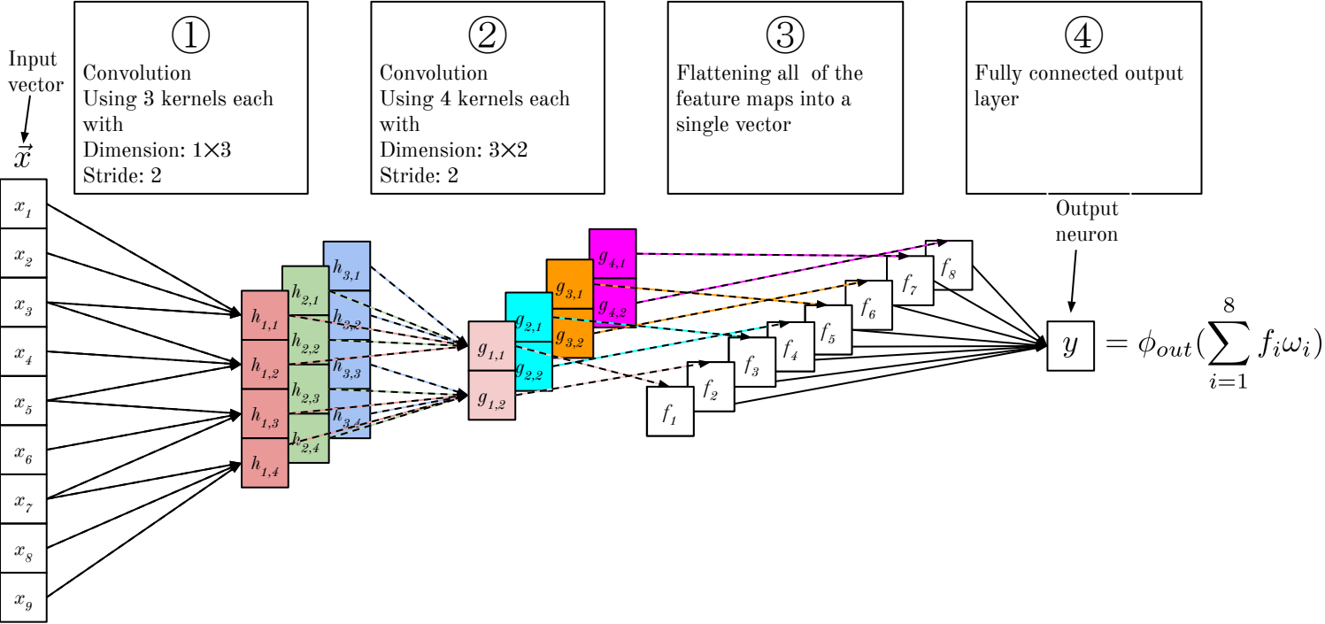
Convolutional Neural Network

Slide 32
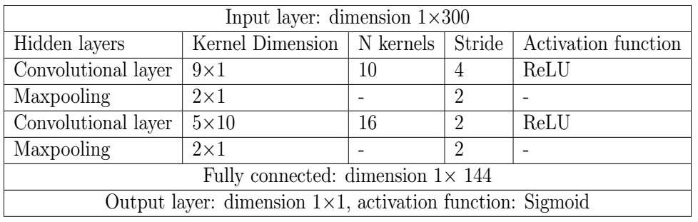
Convolutional Neural Network

Slide 33
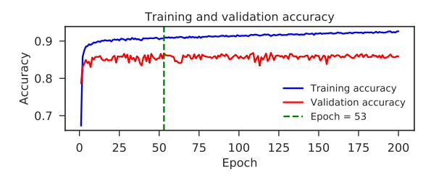
Convolutional Neural Network

Slide 34
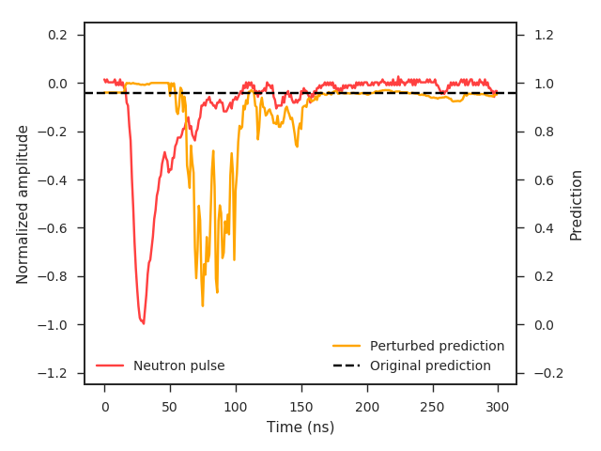
Convolutional Neural Network
Neutron-like pulse: prediction≈1
Perturbing CNN prediction with 31 pixel occlusion region

Slide 35

Convolutional Neural Network
Gamma-ray-like pulse: prediction≈1
Perturbing CNN prediction with 31 pixel occlusion region

Slide 36

Convolutional Neural Network
Ambiguous pulse: prediction ≈ 0.5
Neutrons: prediction ⇒ 1
Gamma-rays: prediction ⇒ 0

Slide 37

Experimental Setup

Slide 38



Experimental Setup

