Slide 1
Windows Process Injection
Demonstrated on LockDownBrowser

Slide 2
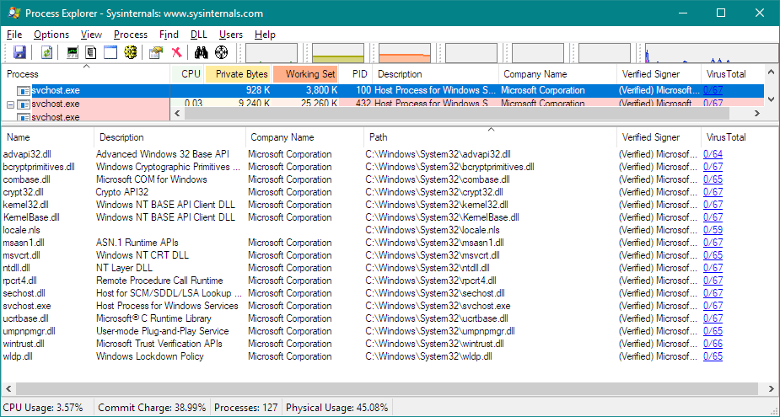
Preface – “Windows Process”

Slide 3
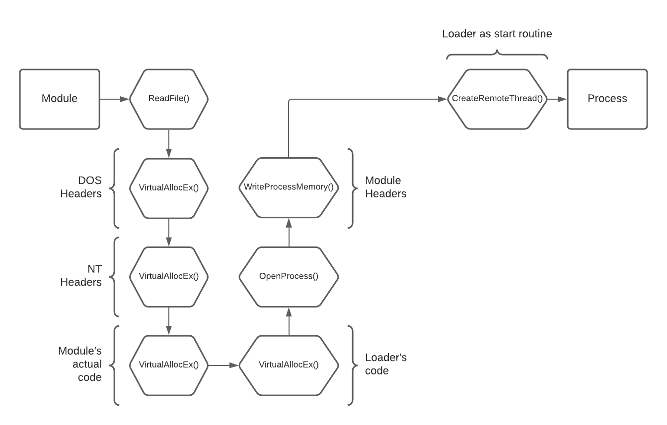
Preface – module INjection
Usually, two methods

Slide 4
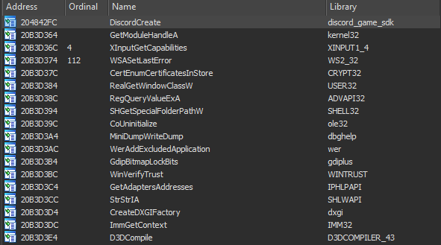
One more method
Only works in executables that ship with a library

Slide 5
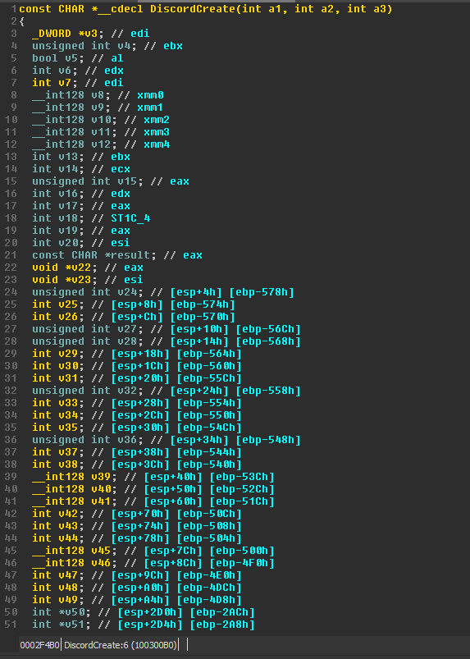
Looking further
DiscordCreate() function under the hood

Slide 6
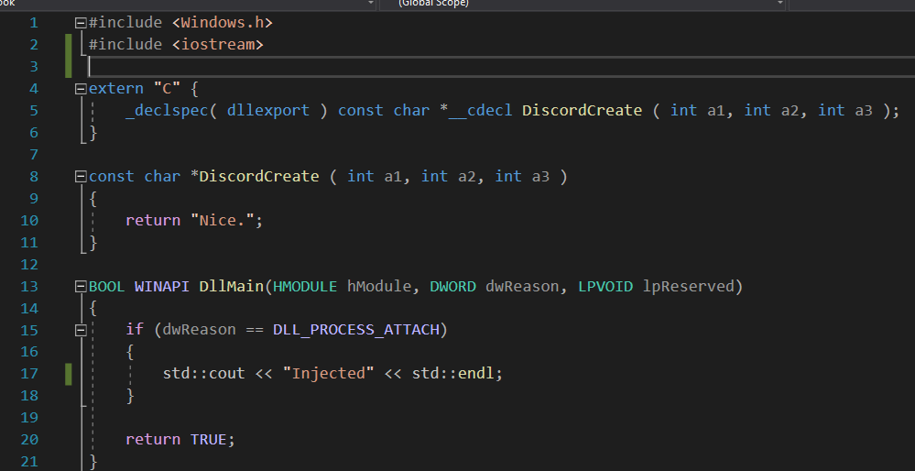

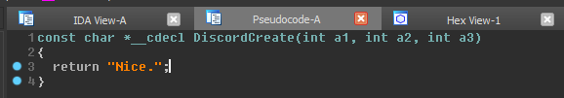
Fake export
We exported our own function called DiscordCreate() and return any const char*

Slide 7
Does this work?
Yes! A few drawbacks however:
Hash checking
Proper error handling
Replacing a required function*
The best quality if viable? Completely undetectable

Slide 8
Lockdown browser specific
What is LockDown Browser comprised of?
Heavily modified Chromium
Tons of WINAPI function calls to disable potential bypasses
Few of low-level hardware & software hooking (what we are interested in)

Slide 9
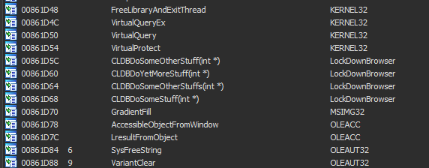
Lockdown browser imports
OwO whats this?

