Slide 1
Windows Process Injection
Demonstrated on LockDownBrowser

Slide 2
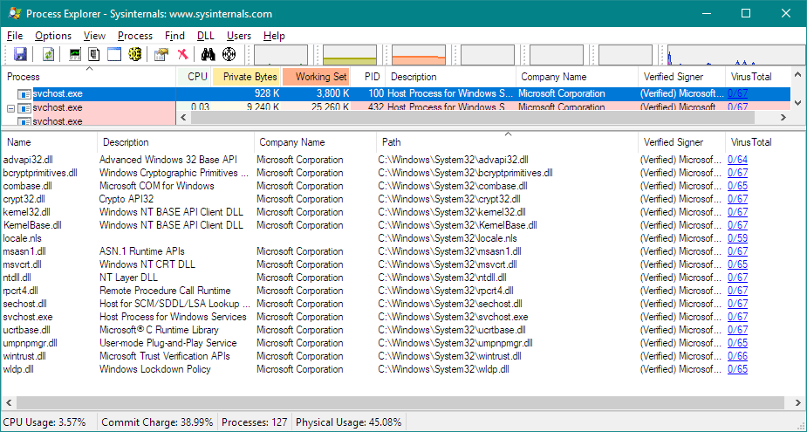
Preface – “Windows Process”

Slide 3
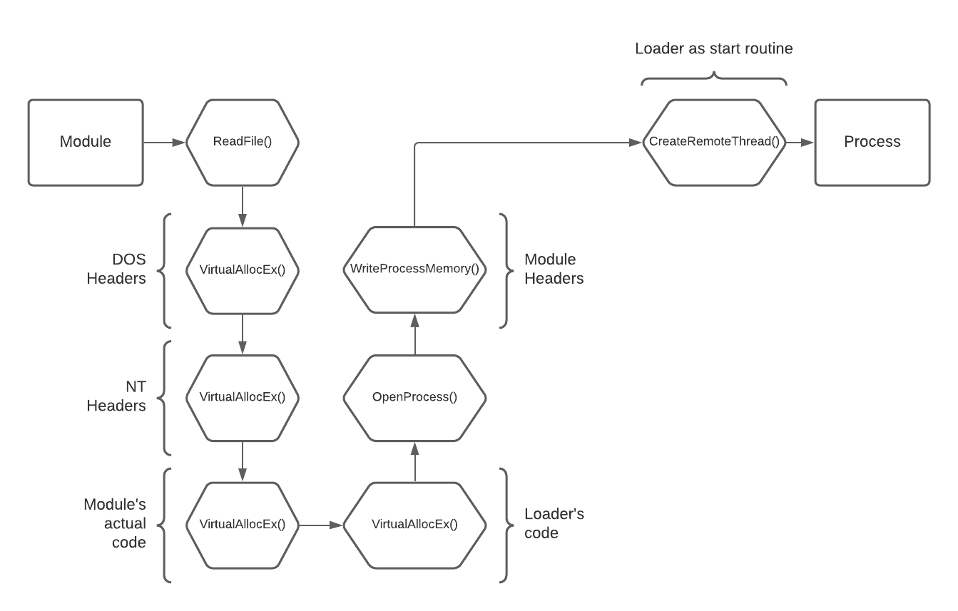
Preface – module INjection
Usually, two methods

Slide 4
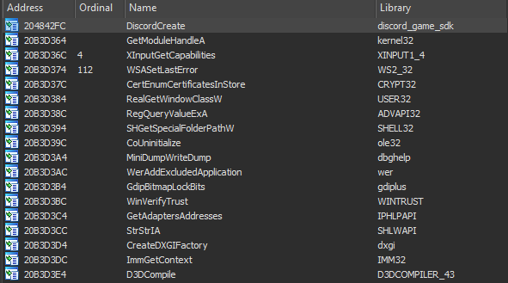
One more method
Only works in executables that ship with a library

