Slide 1
Object-Oriented Programming
EE316 (CSOL 06)

Slide 2
Programming approaches
Procedural Programming
Object-Oriented programming

Slide 3
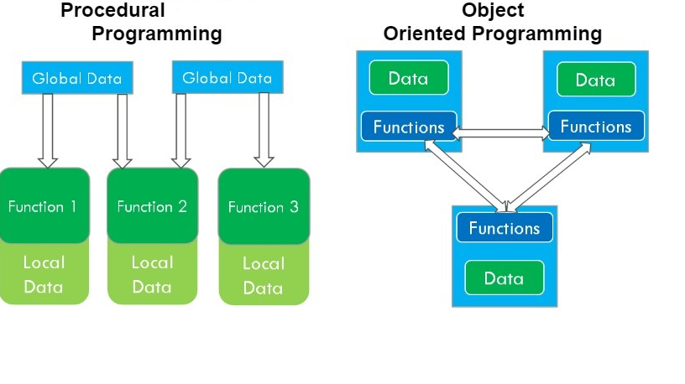

Slide 4
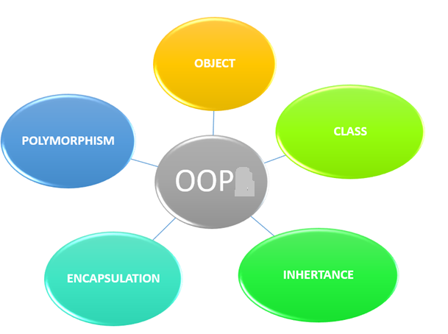
OOP

Slide 5
Object
Object is the fundamental component of Object-Oriented programming.
Each object represents an entity in the real world. Ex: student, employee, car, table, circle, loan, apple, dog etc. Each entity has certain properties and behaviour.
Ex: Bank account has properties no, name, balance and behavior withdraw ,deposit & display
Properties of an entity are represented as attributes and behaviour as methods in an object.
Class is a template for creating objects.
Objects are created from classes. An object is an instance of a class.
Creating an object from a class is known as instantiation.
An object has unique identity, state and behaviour.
Python automatically assigns each object a unique id.
An object’s state is represented by attributes.
Object’s behaviour is defined by methods. Methods are functions that are related to the objects.

Slide 6
Class
Class specifies the set of attributes and methods that are bundled together for defining a type of object.
“class” keyword is used to define the classes.
Define a method in a class by including function definition within the scope of the class block.
A class provides a special method __init__.
This method, known as initializer, is invoked to initialize a new object’s state when it is created.
All methods, including the initializer have the first parameter self. This parameter refers to the object that invokes the method.
Once a class is defined, objects are created from the class using the Classname followed by parenthesis .
Ex: p1 = Person() , Person is the class and p1 is the object instantiated.
Each member of an object either attribute or method is called by using a period after the object. Ex: acct.name (attribute), acct.deposit() (method).
The period is referred to as the dot operator, used to select a member of a given object.
Objects of same kind are defined using the same class. Any number of objects can be created from a class.
All objects instantiated from the same class contain the same set of attributes and methods. Attributes and methods of an object are known as members of an object.

Slide 7
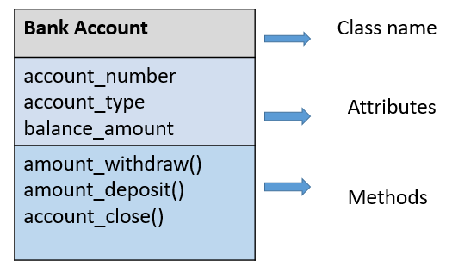
Class and object
class
object
account1
account_number = 10100434 account_type=“savings” balance_amount= 25580
amount_withdraw() amount_deposit() account_close()

Slide 8
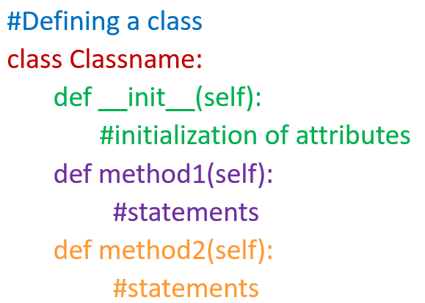
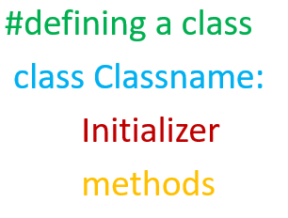
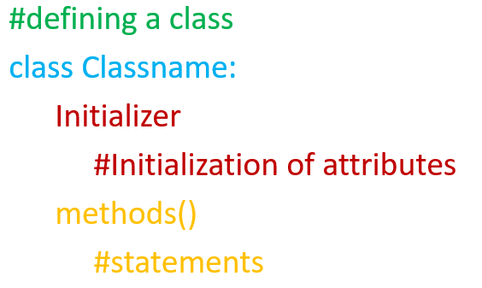
Defining a class

Slide 9
Self parameter
The first parameter of each method in a class is self.
“self” is not used when the method is called.
“self” is a parameter that references the object itself.
Using self, you can access object’s members in a class definition.
Syntax self.x can be used to access the instance variable x and syntax self.m1() can be used to invoke() the instance method m1 for the object self in a class.
The scope of an instance variable is the entire class once it is created.
The scope of a local variable is within the method.

Slide 10
Concepts of OOP
Encapsulation - refers to wrapping data and methods that operate on that data together into a single unit
Polymorphism- the ability of a method or an operator to take on multiple forms.
Inheritance - a mechanism which allows to create a new class from an existing class.

Slide 11
Encapsulation
Encapsulation – Bundling of data and methods restricts the direct access to some components of an object, such that users cannot access state values for all of the variables of a particular object.
It can be used to hide both data members and methods associated with an instantiated class or object.
It prevents unauthorized access to the data. Publicly accessible methods are generally provided as interface of the object.
It hides the implementation complexity and provides abstraction.

Slide 12
Polymorphism
Polymorphism is implemented by
Method overloading
Operator overloading
Method overriding

Slide 13
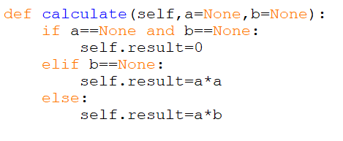
Method overloading
Method overloading: is a mechanism that permits to define multiple methods in a class with the same name but with different parameters.
With multiple definitions, the function behaves differently based on the arguments passed to the function.
Python do not support method overloading directly. But with default arguments, it is possible to implement method overloading.

Slide 14
Operator Overloading
Operator overloading is the ability of a single operator to perform more than one operation based on the type of operands.
Operator overloading needs methods to be defined for operators..
It provides the ability to define a data type with it’s own definition of operators. A programmer can overload the operators such as arithmetic, comparison and inbuilt functions like length and type conversion.
Overloading operators and inbuilt functions makes user defined types to behave exactly like built-in types.

Slide 15
Special methods
To support operator overloading, Python associates a special method with each operator and inbuilt function.
Corresponding to the special method, Python internally converts an expression in to a call to perform certain operation.
For ex, if a programmer gives an expression x + y to find sum of two objects, Python internally converts the expression x + y to call a special method __add__. To overload the + operator, programmer needs to include implementation for the special method __add__

Slide 16
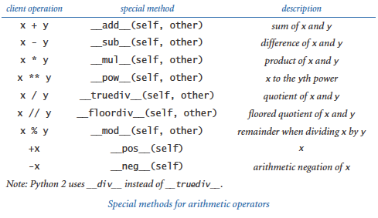
Special methods

Slide 17
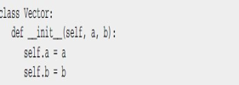
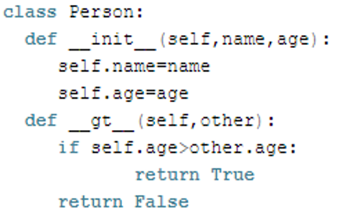
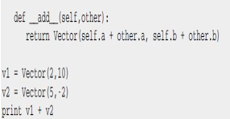
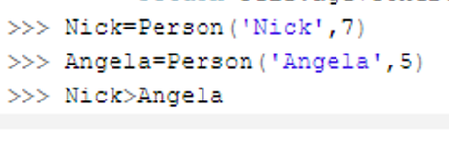


Operator overloading

Slide 18
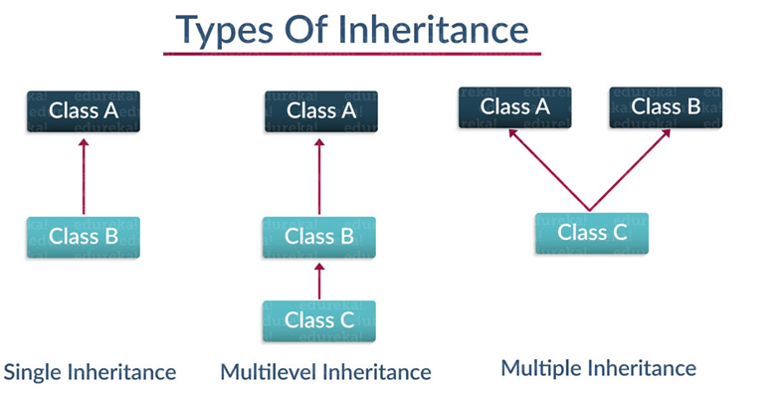
Base class / super class
Parent
Derived class / sub class
Child

Slide 19
Inheritance
Inheritance allows us to define a class that inherits all the methods and properties from another class. The Parent class is the class being inherited from, also called base class. The Child class is the class that inherits from another class, also called derived class.
Single inheritance - allows a derived class to inherit the properties and behavior from a single base class.
Multilevel inheritance – A class can inherit from a derived class, thereby making this derived class the base class for the new class.
Multiple inheritance - is a feature of object oriented concept, where a class can inherit properties of more than one base class. The derived class has multiple base classes.

Slide 20
Method overriding
Defining a method in sub class(derived class) which is already present in parent class(base class) is known as method overriding.
Overriding permits a child class to give its own implementation to a method which is already provided by the parent class.
In this case the method in parent class is called overridden method and the method in child class is called overriding method.
The super() function gives access to methods and properties of a parent class. The super() function in Python makes class inheritance more manageable and extensible.

Slide 21
Advantages of Inheritance
Provides reusability of code. No need to write the same code again and again.
Time taken for application development will be less.
Redundancy reduced.
Easy to represent real-world relationships.
Allows to add more features to a class without modifying it.
It is transitive in nature, which means that if class B inherits from another class A, then all the subclasses of B would automatically inherit from class A.

Slide 22
Private variables
Instance variables of an object can be directly accessed.
Direct access of instance variable is not a good practice.
Data may be tampered with
The class becomes difficult to maintain and vulnerable to bugs
To prevent direct modifications of data, define private instance variables with two leading underscores.
A private method can be defined with two leading underscores.
Private data variables and methods can be accessed within a class, but they can not be used outside the class.
Making data fields private protects data and makes the class easy to maintain.

Slide 23
Queries ??
Thank you

