Slide 1
Embedded Robotics
Object Tracking and Image processing

Slide 2
Project objectives
Identify a robot (object) in 8*18’ by 8*18’
Calculating the distance from each Raspberry Pi
Calculating the angle from each Raspberry Pi
Directing the Robot to move to a specific location
Estimating the percentage error

Slide 3
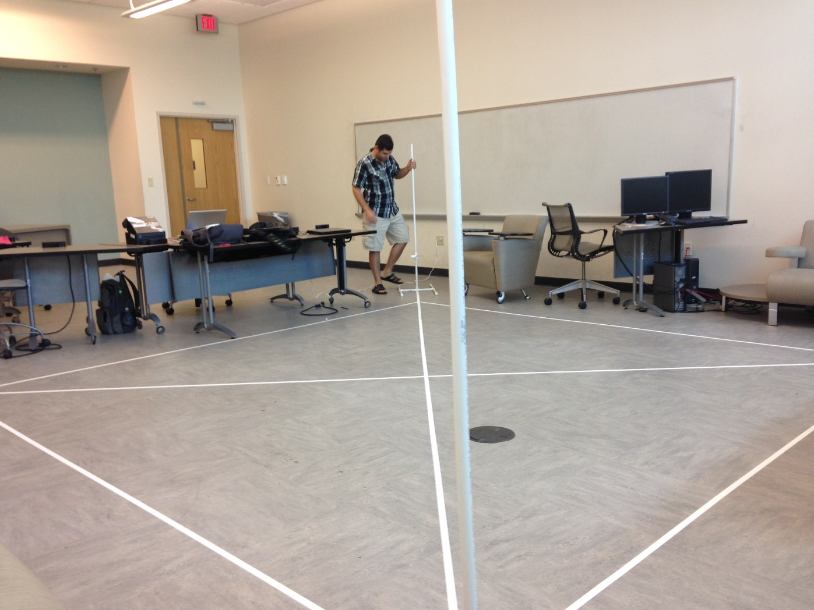
Each Raspberry Pi is located in every corner

Slide 4
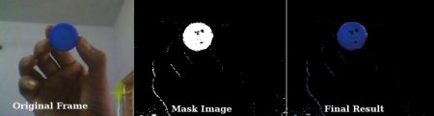
Object Tracking
Color isolation is used
Open CV is utilized
USB PS camera is used to capture real time streaming
Blue color is identified and isolated
Distance is calculated
Angle is measured

Slide 5
Overview of the process
The first thing we need to do is to get a single frame of the video feed and convert its color model from RGB which OpenCV uses to represent images by default to HSV since we can then look at just a single value to determine the Hue.
Now that we have our image in the correct format we can apply a threshold to eliminate(set their value to 0) all pixels that don’t meet our criteria. This will leave only the object we aim to track so then to determine its location we can get OpenCV to calculate its moments and compute its co-ordinal position.

Slide 6
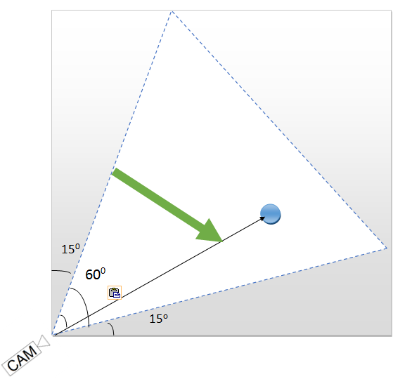
PS eye camera depth of field

Slide 7
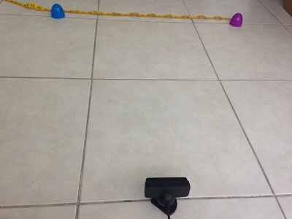
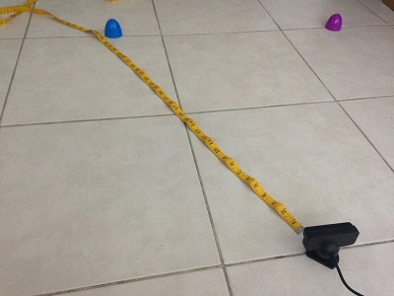
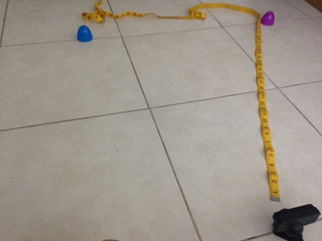
Angle calibration and mesurement

Slide 8
The average angle is about 60
Distance | Angle
15’ | 60.1
30’ | 59.2
60’ | 58.5
90’ | 58.8

Slide 9
Distance measurement
Polynomial equation is used
Curve fitting is applied
Equation is utilized to calculate the distance

Slide 10
Y = 1804.1 * x ^{-1.145}

Slide 11
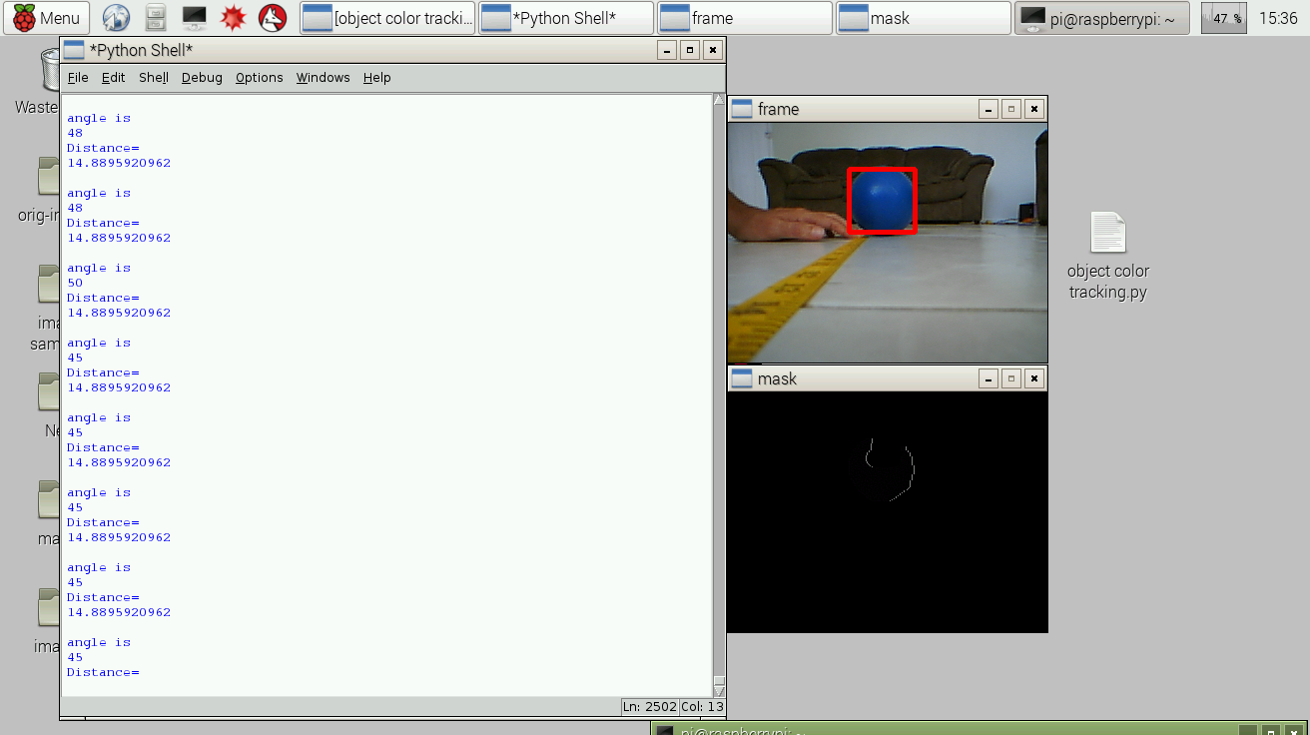

Slide 12
Thank you

