Slide 1


Website: www.edublocks.org
Twitter: @edu_blocks
Website: www.raspikidd.com
Twitter: @RaspiKidd

Slide 2
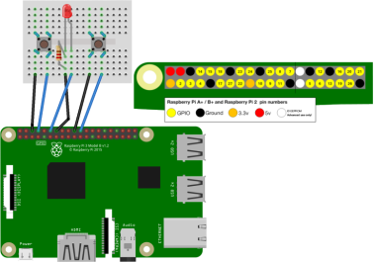
Quick Reaction Game
* 1 x Electronic Breadboard
* 1 x LED
* 1 x Resistor
* 2 x Buttons
* 6 x Male to Female Jumper Wires
* 1 x Raspberry Pi Set up

Slide 3
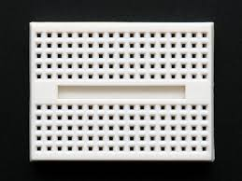
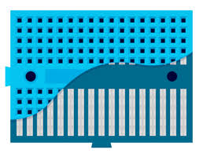
What is a Breadboard?
* Solderless device for prototyping

Slide 4
What is an LED?

