Slide 1
Workshop Construye tu Librería de componentes con Lerna
Because reDo components is not fun!
Notes:
Explicacion por encima de quienes somos y en que se va a centrar esta presentacion:1.- Diapos rapidas (menos de 5min)2.- Demo

Slide 2
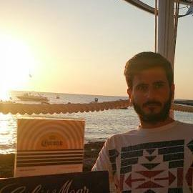

Hello
🔭 I’m currently working on SCRM Lidl
I’m currently learning Blockchain, svelte, GCP & kubernetes!
👯 I’m looking to collaborate on open source projects
📫 How to reach me: https://twitter.com/aresgonza
⚡ Fun fact: Trying to learn how to paint warhammer!

Slide 3
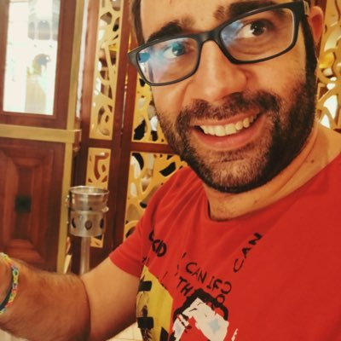

Hello
I am Adrián Díaz Cervera
Squad Technical Lead at SCRM- Lidl International Hub
Office Development MVP
@AdrianDiaz81
http://theavenger.dev

Slide 4
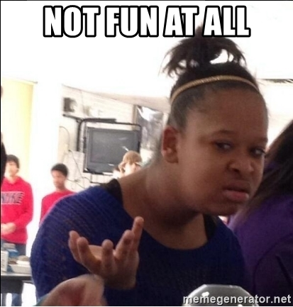


Motivation
Do not redo over and over same styles - components
Shared components-style between tribu
Fast development

Slide 5






What we used to make it?

Slide 6
Agenda
Link to repo https://github.com/Rassell/canariasjs-lerna-workshop
16:00-17:00 Intro a Lerna Puntos 1-5
17:00- 18:00 Boostrap, Hoist, Testing StoryBook, Versionado Lerna
18:00- 18:30 Standar Version

Slide 7

Q & A

