Slide 1



GRAPHQL & APOLLO
LETS KILL REST APIS

Slide 2
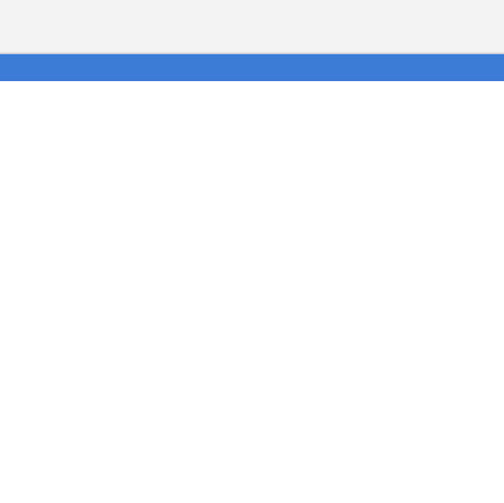

$whoami.
Gonzalo Soriano
Fullstack developer at Tokiota
@aresgonza

Slide 3

agenda.
what is graphql
what is apollo
START
01
02
03
Why use it

Slide 4

agenda.
Apollo client
END
04
05
06
Apollo server
Hands on

Slide 5

01. what is graphql
GraphQL is a specification for building APIs (schema definition).
Query Lenguague.
Describe the data, ask what you want, get not more no less.

Slide 6
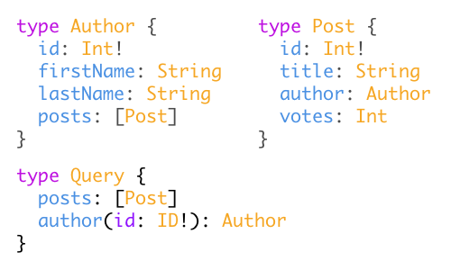
02. Why use it
Uses strong typing in order to prevent errors and make easier to communicate with the user that is going to consume the API (Auto docs)
Update structure on the fly, add or deprecate easy, not all the api, just some fields
Clear and simple structure on the backend (1 end point)

Slide 7
03. What is Apollo
Server tools to build an implementation of a GraphQL, also on an existing server!
Client tools to consume GraphQL server implementations

Slide 8
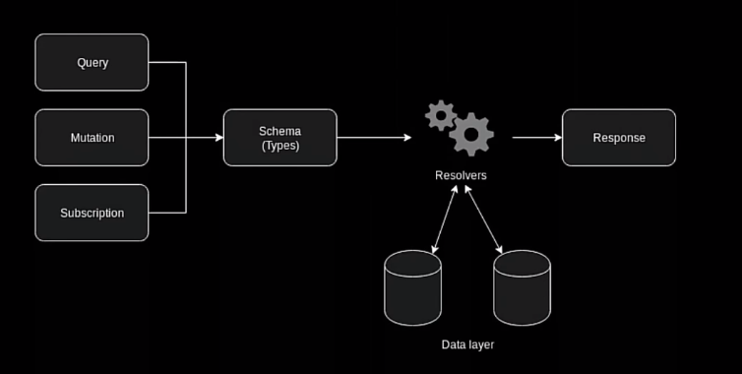
04. Apollo server

Slide 9
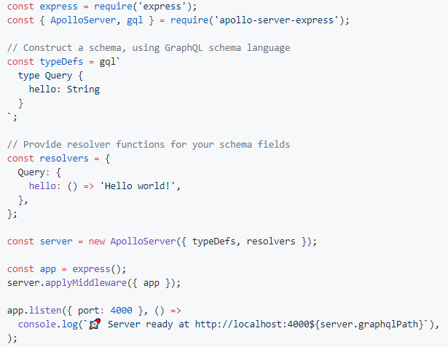
04. Apollo server

Slide 10
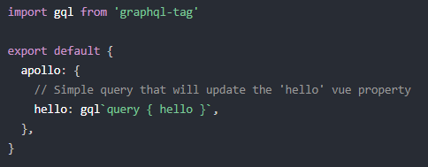
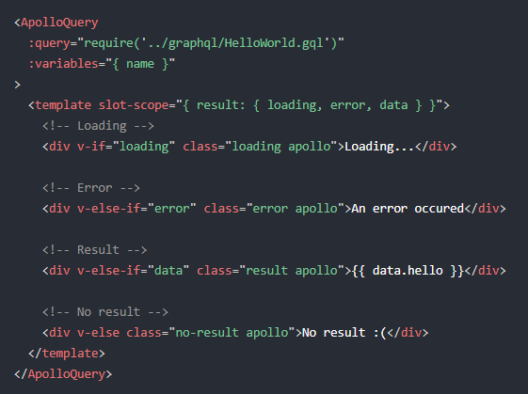
05. Apollo client.

Slide 11
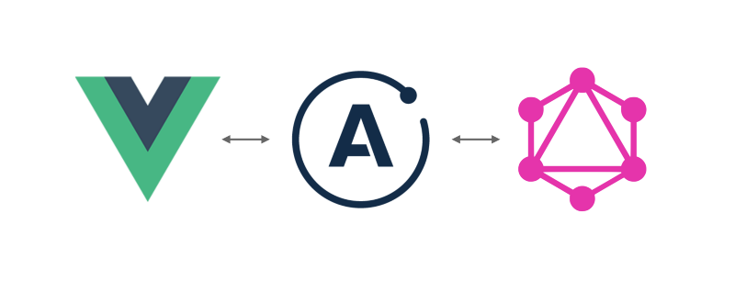
06. Hands on

Slide 12


thanks for your attention.
This presentation uses info from:
https://www.youtube.com/watch?v=nq5q_gOOimA
https://akryum.github.io/vue-apollo/

