Slide 1
Git Boot Camp
Kevin O’Neill

Slide 2
What is Git
Git is a Distributed Version Control System (DVCS).
When using a DVCS every user has their own local repository (repo) in which they make changes.
When a user wants to share his/her changes with everyone, the user ‘pushes’ their local repo to the remote repo.

Slide 3
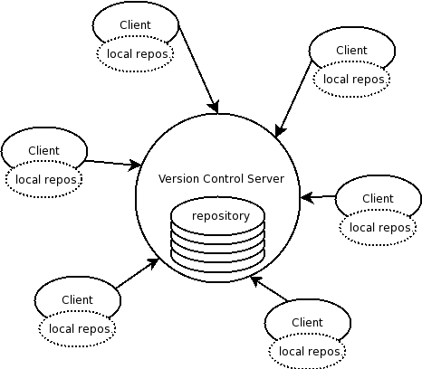
What is Git? Visual Description

Slide 4
Pros Cons
Fast / Low Impact / Small
Connection to server only needed when pushing/pulling
Can code from home!
More than one person can work on one file at a time
Not centralized
Need to update projects ‘regularly’
No good GUI available
Silly name

Slide 5
EtiGit (Etiquette)
Before you start working on a project pull from the server to ensure latest code.
Reduces conflicts later on.
If you are working on altering code in CoreFunctions, copy the code to a new folder and work on it there. Move it back and delete the folder when you are finished.
Do not push broken code on top of working code of common projects (Core Functions), unless you use a temporary work folder. (See above)

Slide 6
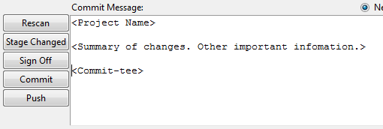
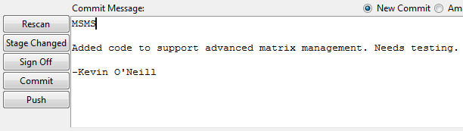
EtiGit (Etiquette)
When commenting your ‘commits’ use the following template to convey what changes were made (and where).

Slide 7
How to use Git: A Simple Procedure
Log onto computer / navigate to current project’s repository folder
Run PushRepo.ps1
Updates the current project to latest code
Start coding!
When finished, or milestone is achieved, commit code.
Run PushRepo.ps1 again to push changed code to the code server

Slide 8
Properties of PushRepo.ps1
Located in each repository’s main directory
Pulls down any new code from code server
Merges your changes with new code (if any) from code server
Applies changes to local repo
Pushes applied changes to code server
Switches project back to a ‘work branch’

