Slide 1
STORMPILOT / PROJECT BRIEF
Resilient Dispatch
& Agile Delivery
01
02
03
A local reliability-engineering lab with a working Scrum and Kanban workflow
API + UI
OBSERVE
RECOVER
Project presentation | 12 October 2026

Slide 2
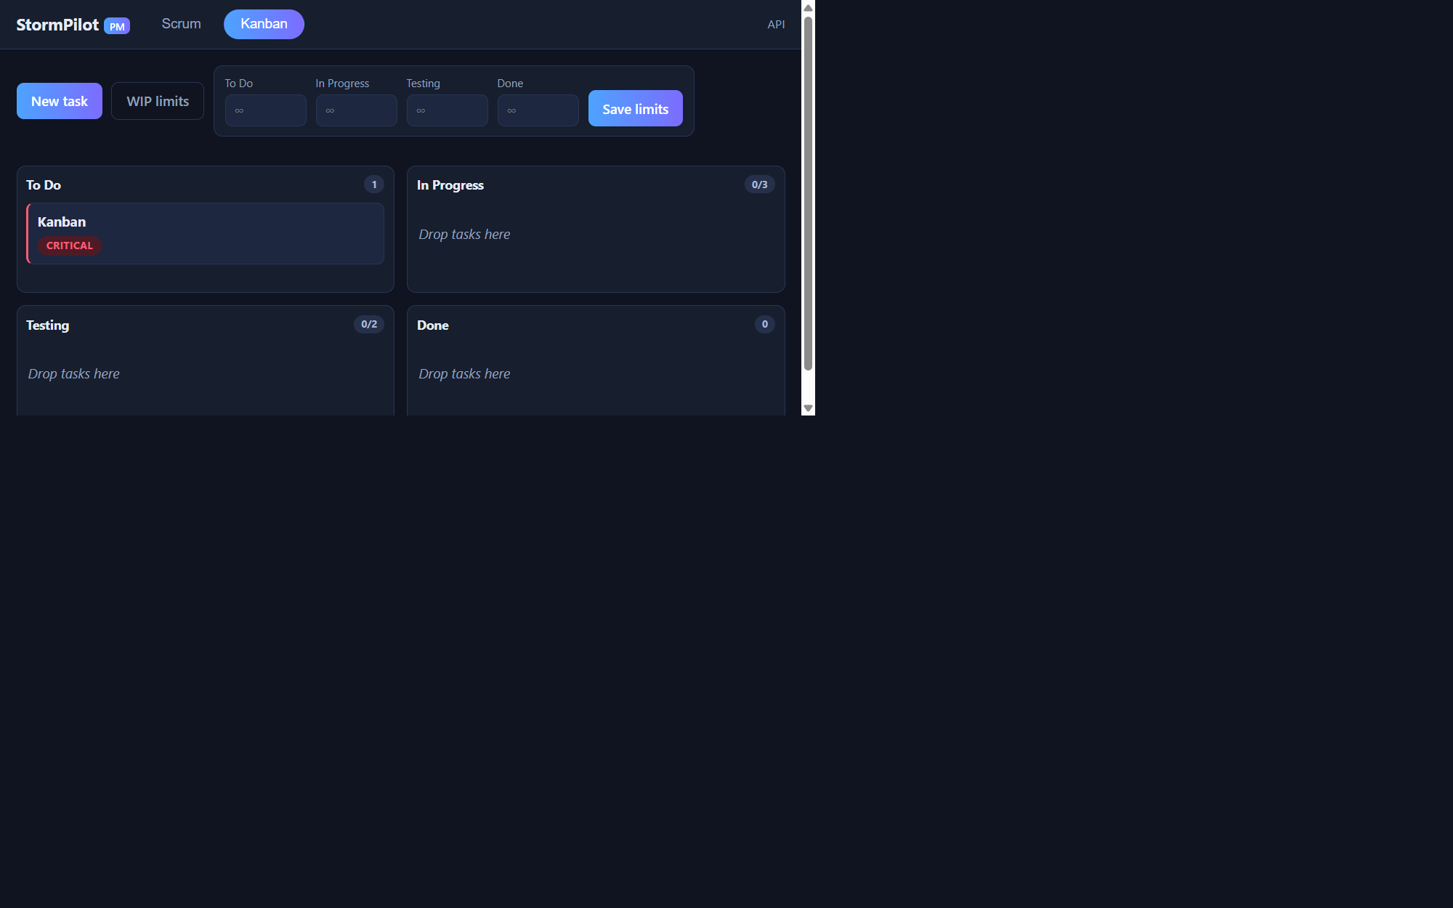
01 / USER EXPERIENCE
Product workflow in the browser
LIVE LOCAL CAPTURE
Kanban board
Four workflow stages with WIP limits
Existing task: Kanban / To Do / Critical
Scrum backlog and sprint views also available
SQLite-backed tasks, stories, and sprints
Captured from localhost; no demo records added for this deck.

Slide 3
02 / ARCHITECTURE
One application, several reliability layers
Browser UI
->
Python HTTP API
->
SQLite
->
Prometheus / Grafana
Scrum + Kanban
JSON + health + metrics
Persistent work data
Configured observability
Docker Compose
Kubernetes
Local API + Prometheus + Grafana demo
Replicas, probes, reconciliation, optional HPA
Compose and Kubernetes layers are configured; end-to-end execution is pending in this environment.

Slide 4
03 / ENGINEERING CONTROLS
Reliability controls are designed into the lab
01
Container boundary
Non-root image; read-only API filesystem and dropped capabilities in Compose.
02
Health and signals
Health/readiness endpoints, request counters, uptime metric, Prometheus rules.
03
Recovery patterns
Kubernetes replicas, probes, disruption budget, and guarded one-pod experiment.
04
Scaling path
CPU HPA manifest is optional and depends on a working metrics-server.
Configured controls are not the same as a completed failure-recovery test.

Slide 5
04 / TEST EVIDENCE
What has been verified locally
6 / 6
130
0
HTTP integration tests passed
successful requests in a bounded 2-second smoke run
failures in that smoke run
Live checks covered identity, readiness, health, dispatch, and metrics.
Bash syntax and YAML/JSON configuration parsing passed.
Browser confirms the task board and modal/tab navigation locally.
Short smoke test only: not a capacity, uptime, or SLO measurement.

Slide 6
05 / LIMITS AND DEMO PLAN
Next steps before claiming full-stack resilience
Not yet run
Presentation flow
Docker/Compose build and monitoring runtime
Show Scrum/Kanban board and the saved task
Grafana visual QA and Prometheus rule validation
Run the six tests and local API smoke checks
kind pod replacement, HPA, and image scan
Explain Compose observability and Kubernetes recovery design
SBOM and registry publication
Separate executed evidence from configured experiments
GitHub repository creation was blocked by HTTP 403; no remote publication occurred.
StormPilot is an educational lab, not a production deployment.

