Slide 1
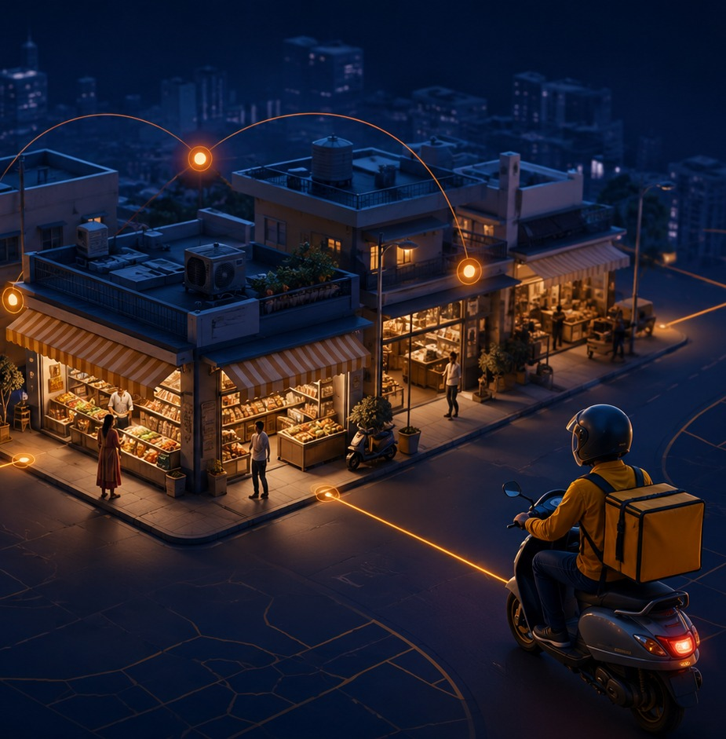
QK
BuyQK
Investor Pitch Deck • 2026
Every Local Need.
One Intelligent Marketplace.
BuyQK connects customers, local businesses and delivery partners through a unified commerce layer built for Indian neighborhoods.
MVP in development • Pilot planning • Pre-seed conversation
Confidential investor preview
01

Slide 2
QK
BuyQK
THE THESIS
Local commerce needs an operating system, not another single-category app.
Customers want convenience. Merchants need demand. Riders need efficient routes. Today, these three layers are disconnected.
Demand
Supply
Fulfillment
Customers search local needs across categories.
Neighborhood businesses publish inventory and offers.
Riders move orders through optimized local routes.
Confidential investor preview
02

Slide 3
QK
BuyQK
MARKET PROBLEM
Local commerce is fragmented.
Customers, merchants and delivery partners operate in separate silos—creating friction, lost demand and slower fulfilment.
Customers
Merchants
Delivery
Nearby options are hard to discover, compare and order from one place.
Local shops have low digital visibility and fragmented tools.
Rider allocation, ETA and dispatch often remain manual or inefficient.
Result: people still depend on calls, WhatsApp, scattered apps and manual coordination for everyday local needs.
Confidential investor preview
03

Slide 4
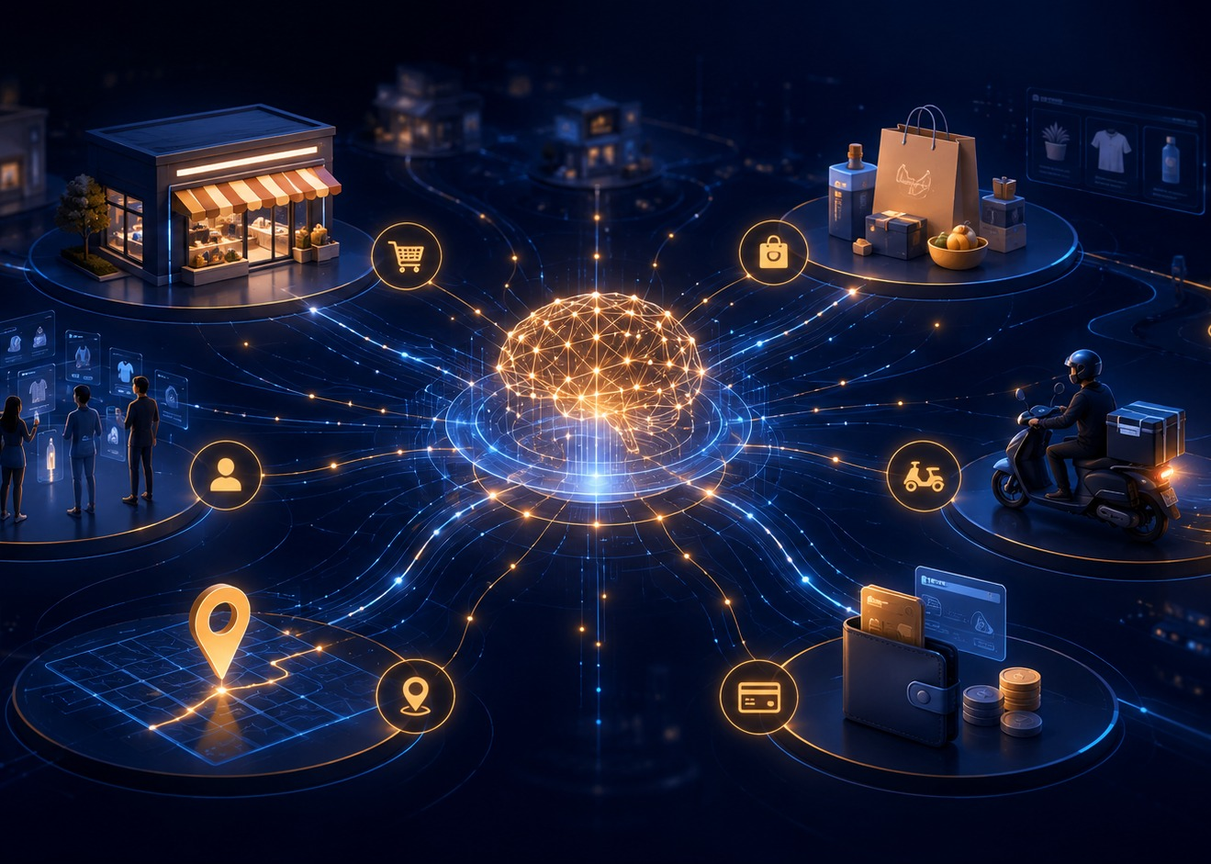
QK
BuyQK
WHY NOW
The timing is shifting toward local digital commerce.
Retail is expanding, quick commerce is educating users, and AI makes discovery more personalized and efficient.
>$2T
$6–7B
India retail potential by 2030
Quick-commerce market estimate in 2024
~40%
Expected quick-commerce annual growth to 2030
Sources: IBEF retail overview; Reuters reporting on Bain/Flipkart e-retail estimates.
Confidential investor preview
04

Slide 5
QK
BuyQK
THE SOLUTION
BuyQK turns local demand into one seamless buying experience.
Search, compare, order, checkout and delivery—across neighborhood products and services.
Search
Compare
Order
Checkout
Delivery
One app for customers. One growth channel for merchants. One fulfilment network for riders.
Confidential investor preview
05

Slide 6
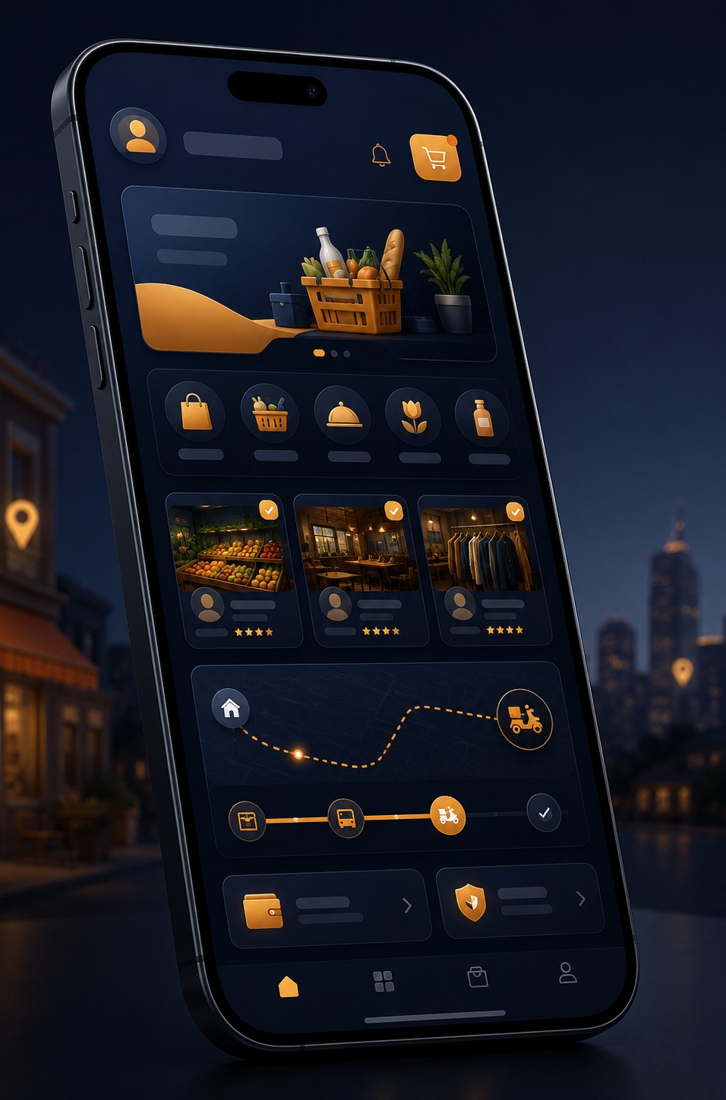
QK
BuyQK
PRODUCT ECOSYSTEM
Four connected products, one local-commerce network.
The MVP is designed as a connected workflow, not isolated screens.
Customer App
Rider App
Local discovery, cart, payment, order tracking and AI recommendations.
Login, live availability, order assignment, navigation and delivery status.
Merchant Panel
Admin Console
Catalogue, pricing, availability, orders and performance insights.
Store onboarding, order control, operations monitoring and support.
Confidential investor preview
06

Slide 7
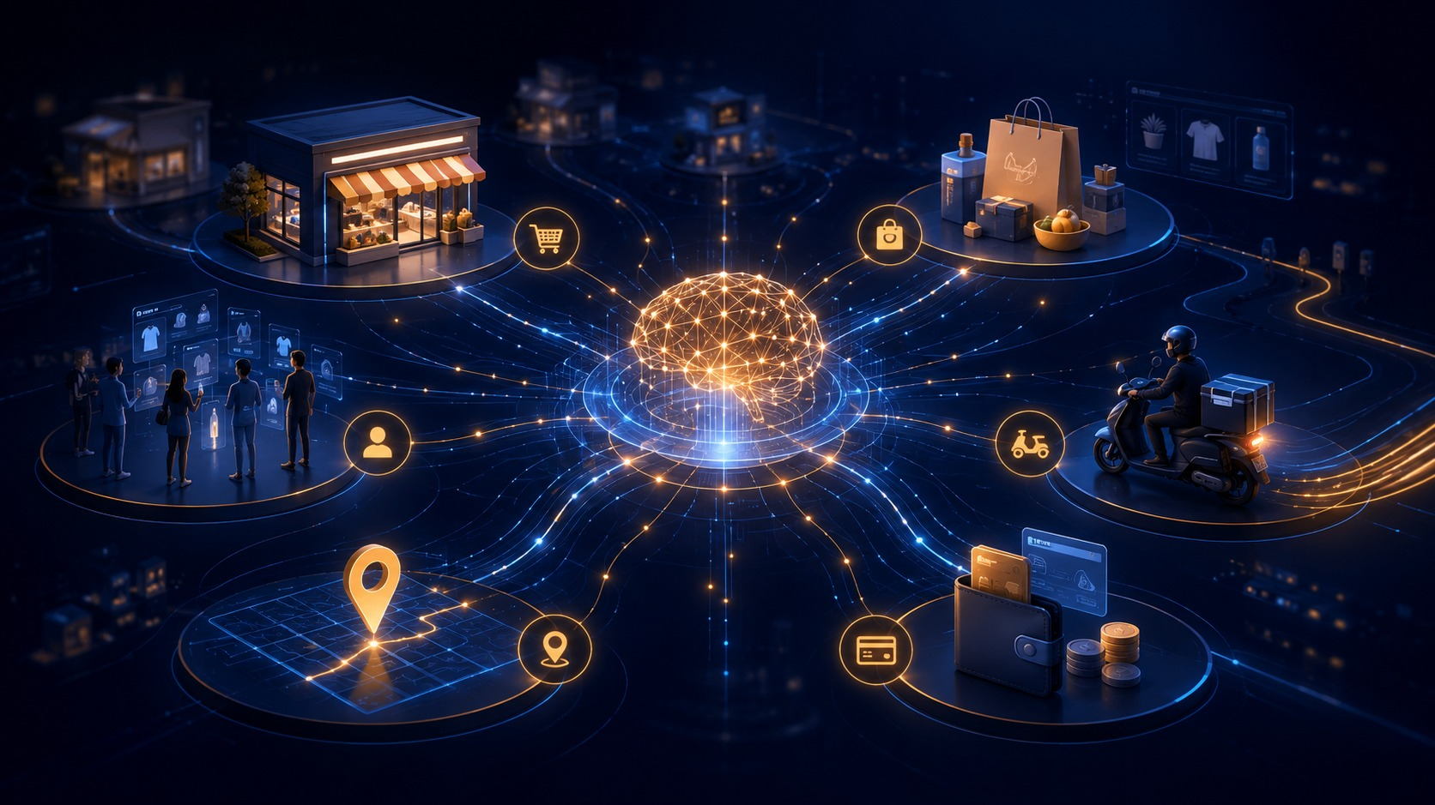
QK
BuyQK
AI LAYER
AI powers discovery, decisions and fulfilment.
BuyQK can become the intelligence layer across search, merchant data and delivery operations.
Natural-language search
Recommendation engine
Find relevant local products and services from plain language.
Personalize products, merchants and reorder prompts.
Price comparison
Delivery prediction
Track local prices and surface faster, smarter choices.
Estimate routing, ETA and availability more reliably.
Merchant intelligence
Show demand trends, inventory gaps and promotions.
Confidential investor preview
07

Slide 8
QK
BuyQK
COMPETITIVE LANDSCAPE
Existing solutions solve slices. BuyQK targets the local stack.
The opportunity is not to copy a quick-commerce app; it is to unify local supply, discovery and delivery.
Company
Primary scope
Core limitation
Amazon
Everything marketplace
Not built for real-time neighborhood commerce
Zepto / Blinkit
Quick commerce
Grocery-led, dark-store heavy model
Swiggy / Zomato
Food + adjacent quick commerce
Restaurant/owned category origins
Urban Company
Services marketplace
Services only, not daily products
BuyQK
All local commerce
Multi-category, merchant-first, AI-powered
Positioning: BuyQK is designed as an aggregator for local merchants before scaling into deeper logistics infrastructure.
Confidential investor preview
08

Slide 9
QK
BuyQK
BUSINESS MODEL
Multiple revenue streams from the same local transaction graph.
The model starts simple for pilot validation, then expands with merchant tools and promotions.
Commission / Take-rate
Delivery fee
Small percentage on orders from participating merchants.
Customer-paid or merchant-shared fee based on distance and order value.
Merchant subscription
Promoted listings
Optional pro tools: analytics, catalogue support, priority listing.
Sponsored placement for local stores and offers after demand is validated.
Pilot focus: validate repeat orders and merchant economics before increasing monetization complexity.
Confidential investor preview
09

Slide 10
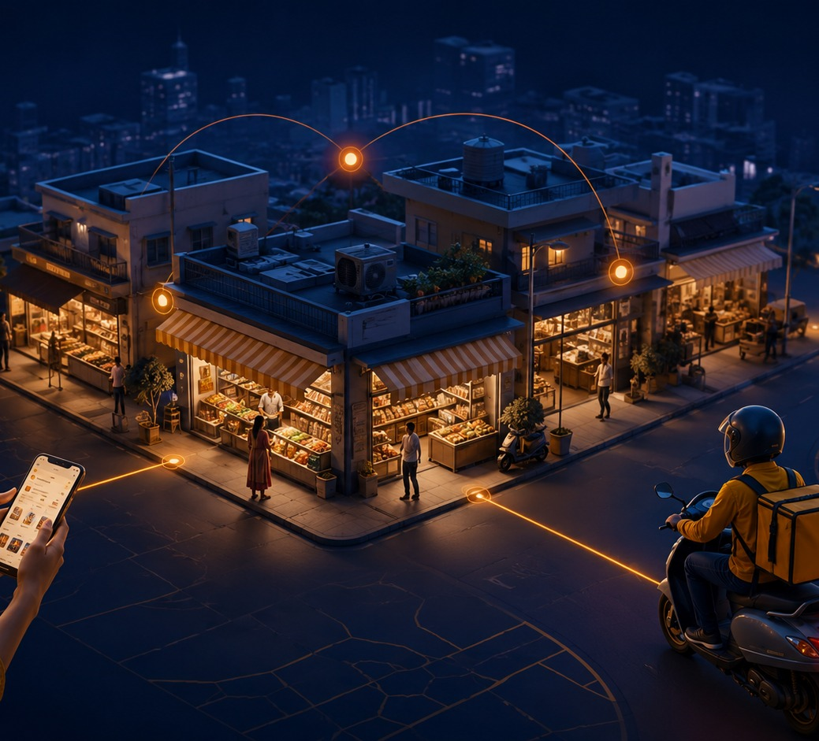
QK
BuyQK
GO-TO-MARKET
Win one dense locality before expanding the city.
BuyQK should prove repeat demand, store reliability and rider efficiency in a controlled pilot zone.
01
Select one high-density zone
Start with a narrow delivery radius to protect SLA.
02
Onboard anchor merchants
Grocery, pharmacy, snacks, dairy, bakery, stationery.
03
Launch manual-first pilot
Use MVP + ops control to learn before automating everything.
04
Scale by category density
Add merchants where demand and repeat orders are proven.
Confidential investor preview
10

Slide 11
QK
BuyQK
OPERATING MODEL
Asset-light first, infrastructure later.
BuyQK can begin with neighborhood merchants and unified delivery, then decide where deeper supply control is needed.
Local Merchants
BuyQK Layer
Rider Network
Customer
Catalogue + live orders
Search + checkout + dispatch
Pickup + delivery status
Track + reorder
Strategic choice: avoid dark-store capital burn in the earliest stage; use merchant inventory first, then invest where order density proves it.
Confidential investor preview
11

Slide 12
QK
BuyQK
ROADMAP
Milestones are built around proof, not vanity growth.
Each phase should unlock the next fundraising and expansion step.
0–30 days
31–90 days
3–6 months
6–12 months
MVP polish + pilot setup
Controlled pilot
City playbook
Expansion
Merchant interviews • user waitlist • category selection
Orders • delivery SLA • repeat rate • refunds/cancellations
Merchant density • rider utilization • unit economics
More zones • category breadth • merchant tools
Core KPIs: orders/day, repeat rate, GMV, fulfilment SLA, merchant retention, contribution margin per order.
Confidential investor preview
12

Slide 13
QK
BuyQK
CURRENT STAGE & ASK
MVP is in development. The next milestone is a measurable pilot.
The immediate goal is to convert product progress into merchant, user and order-level proof.
Now
Customer, merchant and rider flows under development
Proposed pre-seed ask
₹15–25L
Next
Pilot in one Patna locality with onboarded merchants
Pilot capital + strategic mentorship
Proof
Repeat orders, delivery SLA and early unit economics
Use of funds: product completion, pilot operations, merchant onboarding, marketing tests and core cloud/legal setup.
Note: ask amount can be adjusted after final MVP cost, team plan and pilot budget are locked.
Confidential investor preview
13

Slide 14
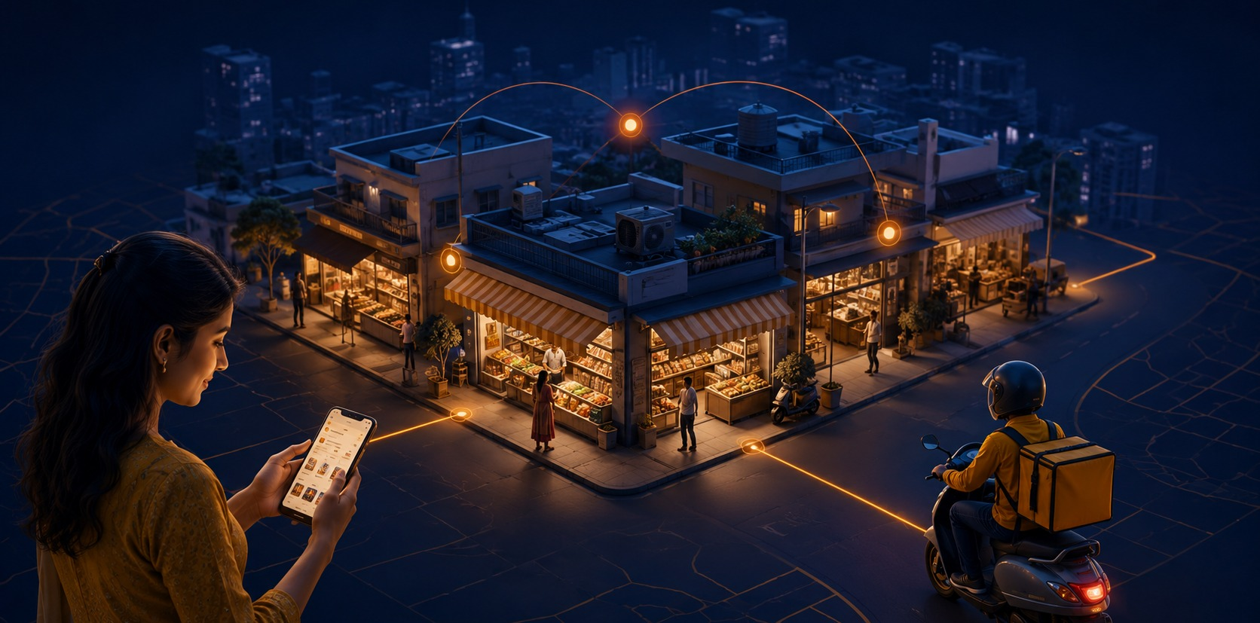
QK
BuyQK
CLOSING
BuyQK is building the commerce layer for every local business.
The next step is simple: finish the MVP, run a controlled pilot, prove repeat demand and scale with discipline.
Next conversation
MVP demo + pilot execution plan
Abhijeet Shrivastav • Founder, BuyQK
Contact details can be added before sending.
Confidential investor preview
14

Slide 15
QK
BuyQK
SOURCES & ASSUMPTIONS
Market numbers are directional and should be updated before investor sending.
Use this slide as an internal appendix or remove it for a shorter live presentation.
01
IBEF Retail Industry Overview: India retail sector outlook toward 2030.
02
Reuters, Mar 2025: Bain & Flipkart report on India e-grocery and quick-commerce market estimates.
03
Economic Times / Times of India, Jul 2026: Bernstein-reported dark store expansion trends.
04
Assumptions: MVP stage, pilot city/locality, proposed pre-seed ask and KPI targets are editable placeholders.
Before fundraising, replace directional targets with actual merchant interviews, waitlist numbers, pilot order data and final product screenshots.
Confidential investor preview
15

