Slide 1
STUDENT PERFORMANCE MONITORING SYSTEM
Name | ID
Rasula Makbul | 1730019
Md. Shadman Sakib Talukder | 1810762
Tamanna Shabnam | 1821801
Md. Mushfiqur Rahman | 1721684
Ahmed Jubair Nijum | 1730265

Slide 2
INTRODUCTION
Student Performance Monitoring System focuses on the performance of students by taking assessments and exam marks.
For monitoring the performance of students, the idea of this project is to evaluate the Course Outcome (CO) achieved in assessments with mapped PLO achieved by each student in each of the enrolled courses.
In this system, we will get an idea about how learning might improve in a given course that is the course quality improve then the program quality will also improve.

Slide 3
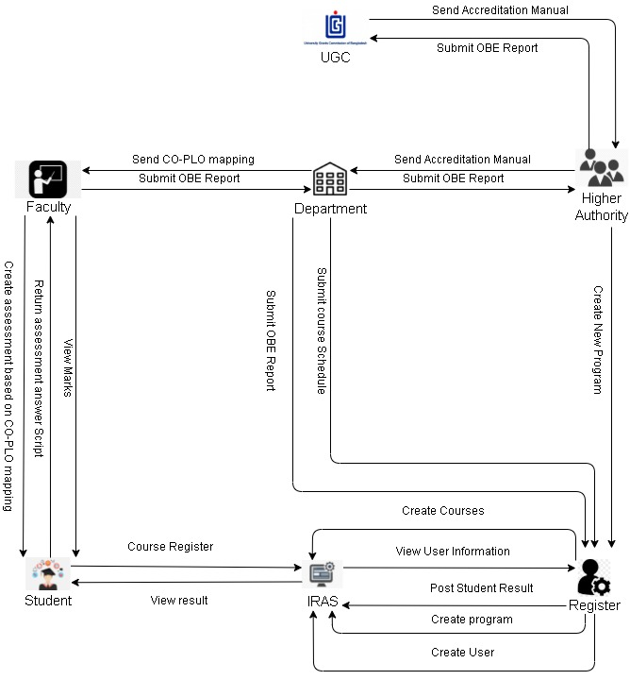
RICH PICTURE(AS-IS)

Slide 4
SIX ELEMENTS (AS-IS)
PROCESS
Mapping Course outcomes(COs) to Program Learning Outcomes (PLOs)
Student Assessment
Creating & Submitting OBE Report
Preview Grades and Transcripts
Student and Faculty account details

Slide 5
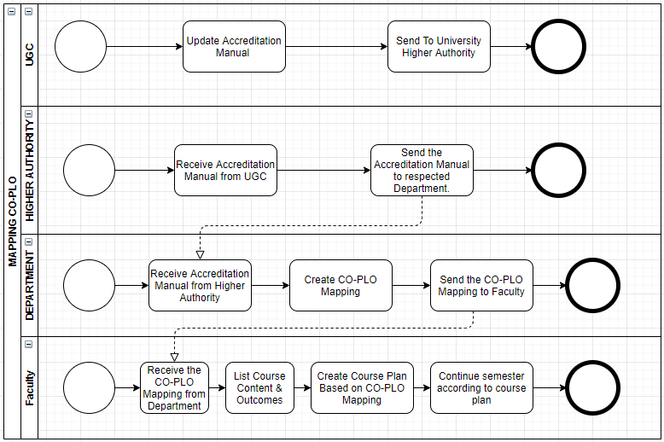
PROCESS DIAGRAM (AS-IS)

Slide 6
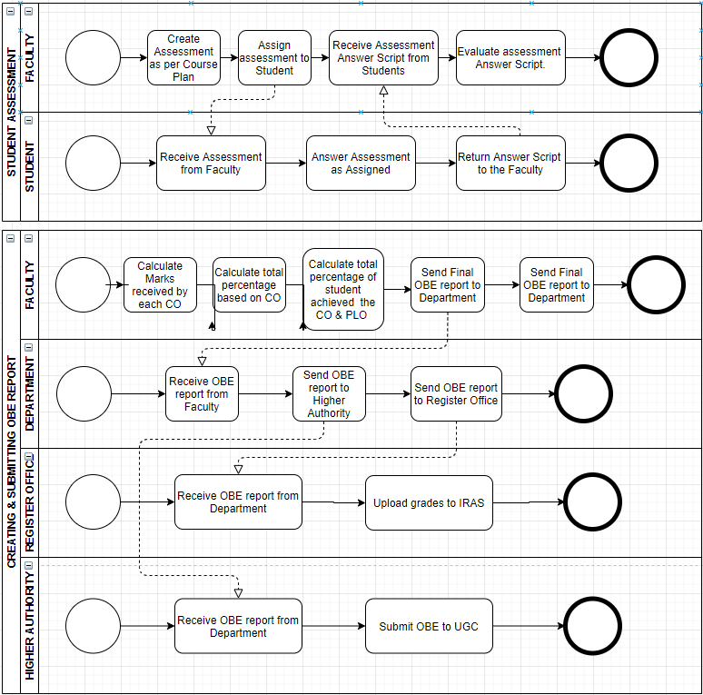
PROCESS DIAGRAM (AS-IS) CONTINUED

Slide 7
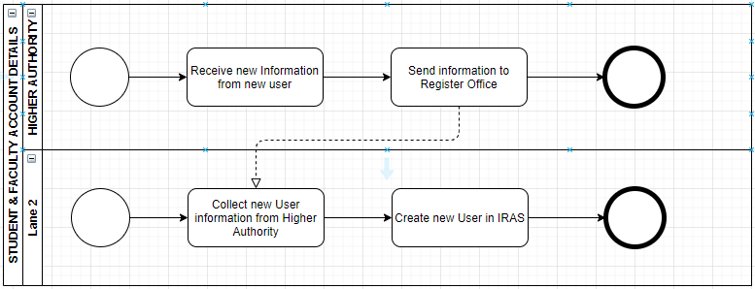
PROCESS DIAGRAM (AS-IS) CONTINUED

Slide 8
PROBLEM ANALYSIS :
PROCESS NAME
Mapping Course outcomes(COs) to Program Learning Outcomes (PLOs)
Student Assessment
Creating & Submitting OBE Report
Preview Grades and Transcripts
Student and Faculty account details

Slide 9
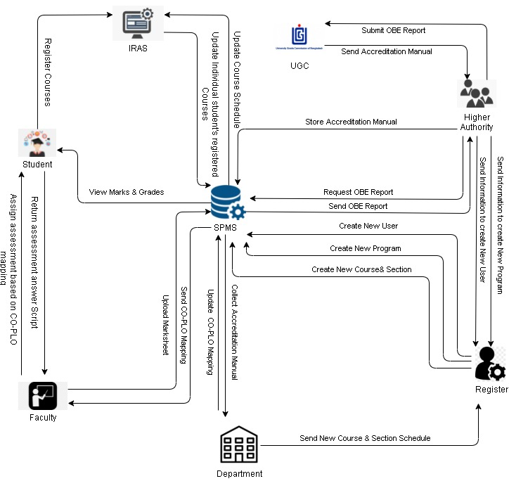
RICH PICTURE (TO-BE)

Slide 10
SIX ELEMENTS (TO-BE)
PROCESS NAME
Mapping Course outcomes(COs) to Program Learning Outcomes (PLOs)
Student Assessment Data
Creating & Submitting OBE Report
Preview Grades and Transcripts
Student and Faculty account details
View OBE report and Mark Sheet

Slide 11
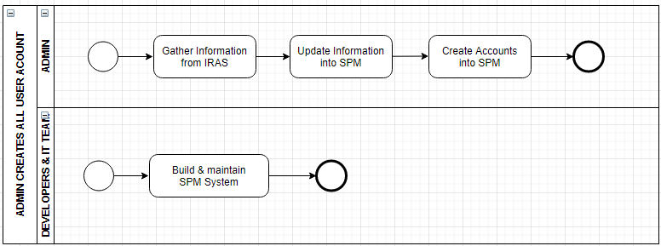
PROCESS DIAGRAM (TO-BE)

Slide 12
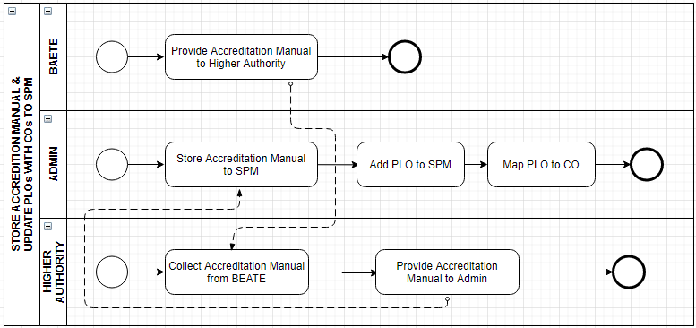
PROCESS DIAGRAM (TO-BE) CONTINUED

Slide 13
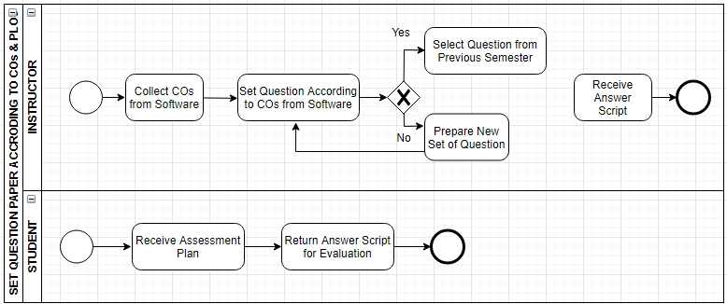
PROCESS DIAGRAM (TO-BE)

Slide 14
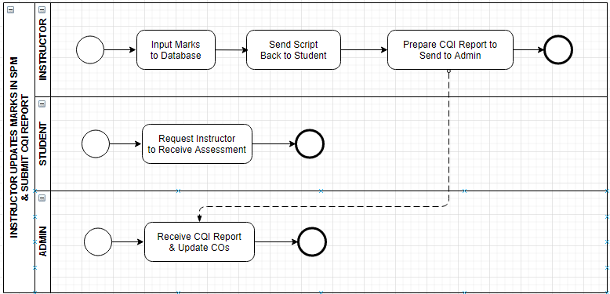
PROCESS DIAGRAM (TO-BE)

Slide 15
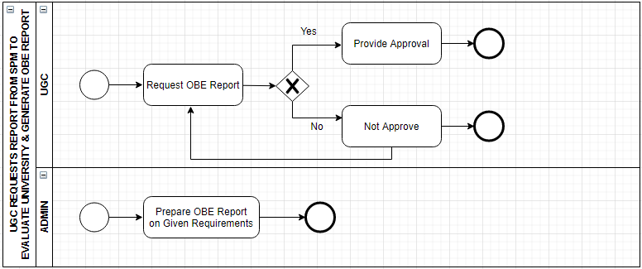
PROCESS DIAGRAM (TO-BE)

Slide 16
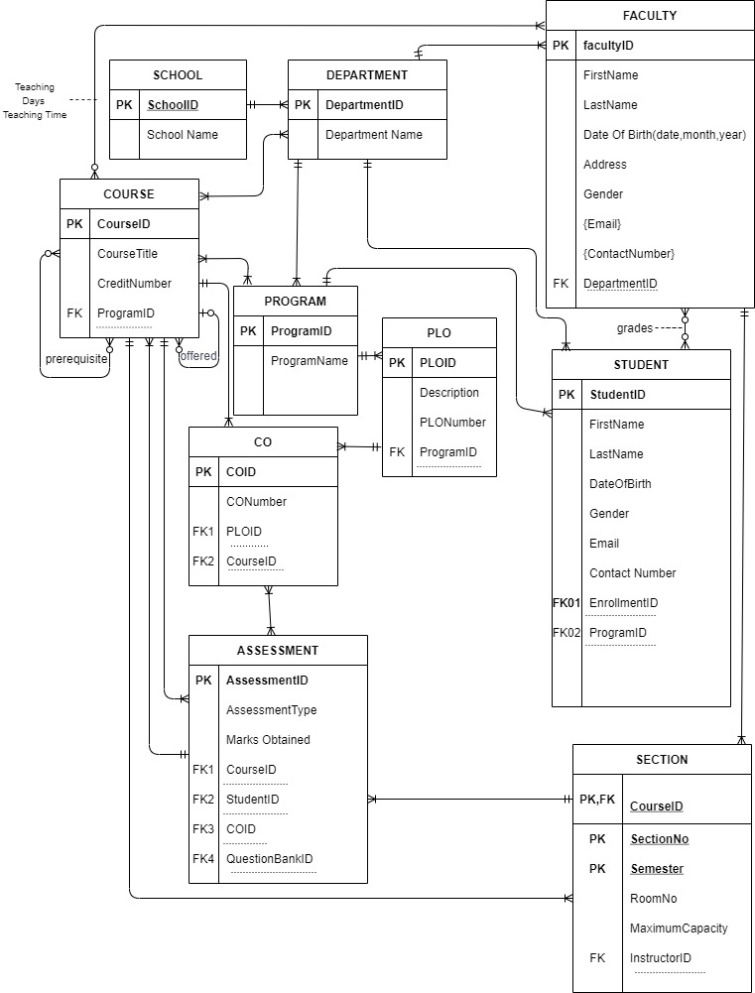
ERD

Slide 17
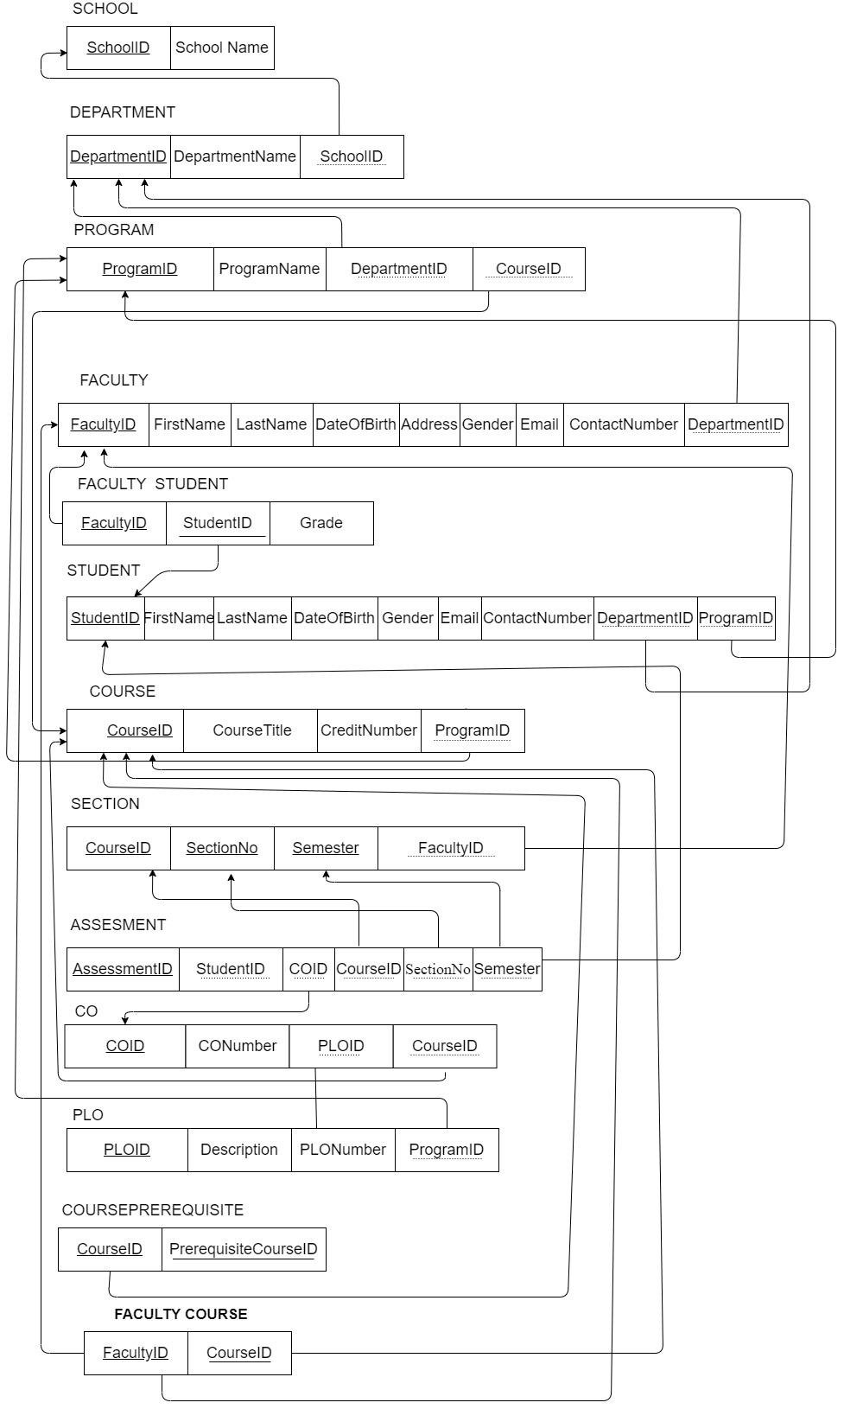
RELATIONSHIP SCHEMA

Slide 18
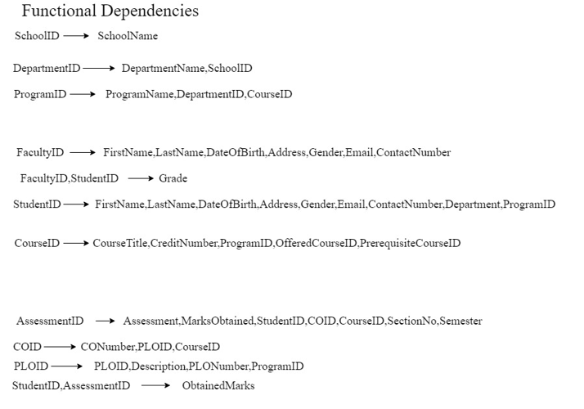
NORMALIZATION

Slide 19
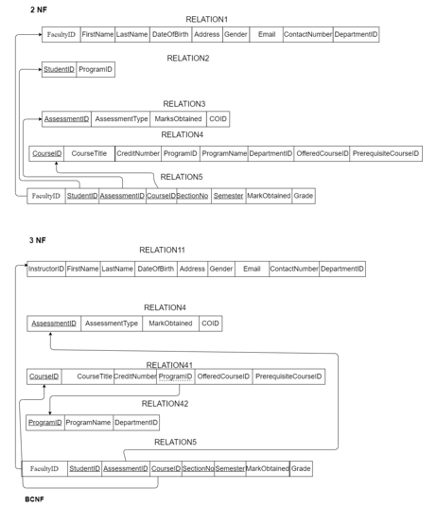
NORMALIZATION(Continued)

Slide 20
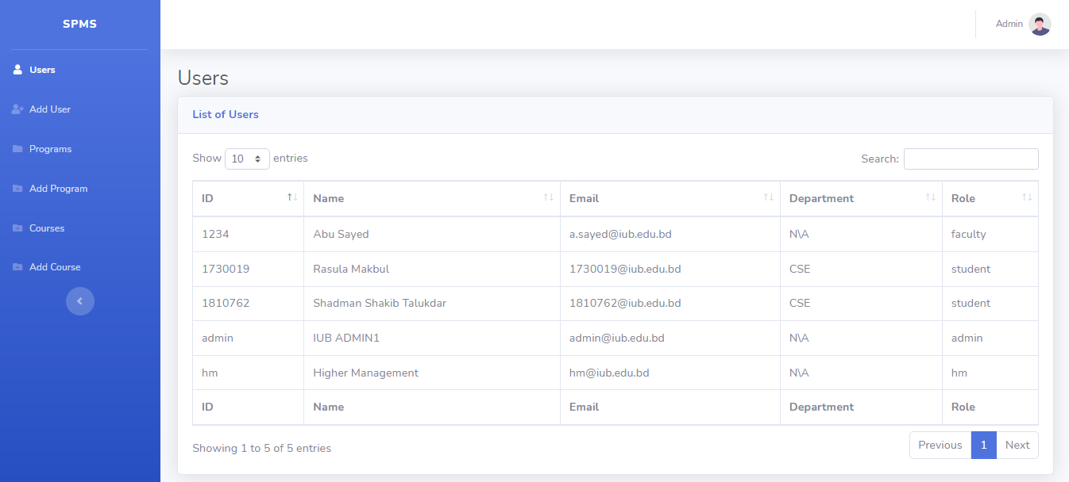
System design Figure 1: Users

Slide 21
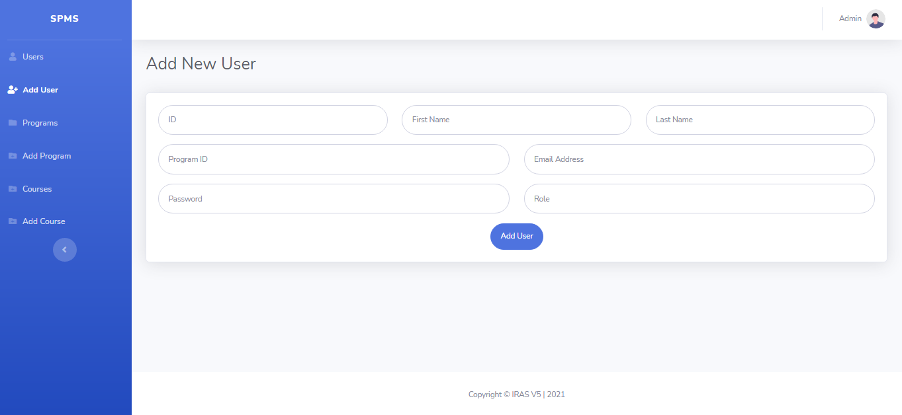
Figure 2: Add new User

Slide 22
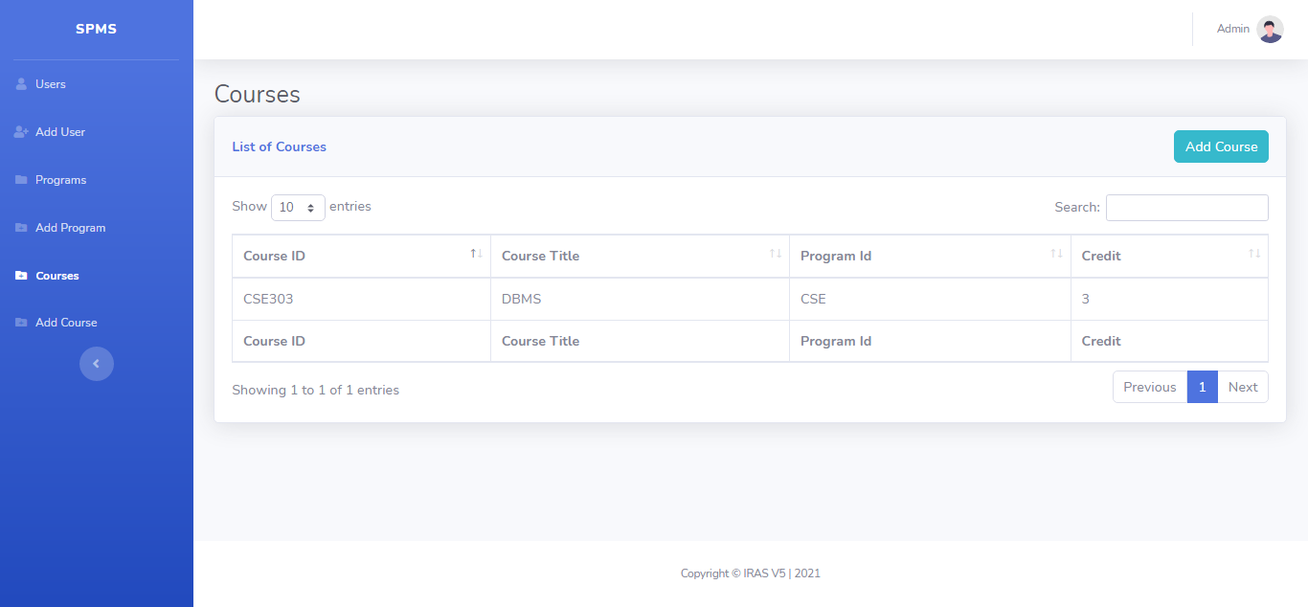
Figure 3 : Courses

Slide 23
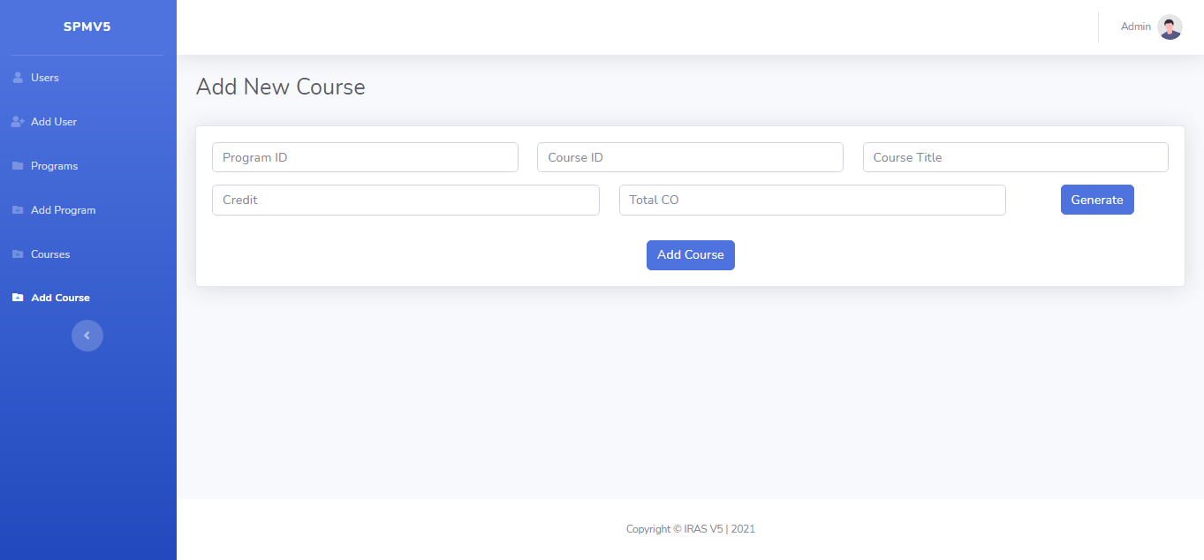
Figure 4: Add New Course

Slide 24
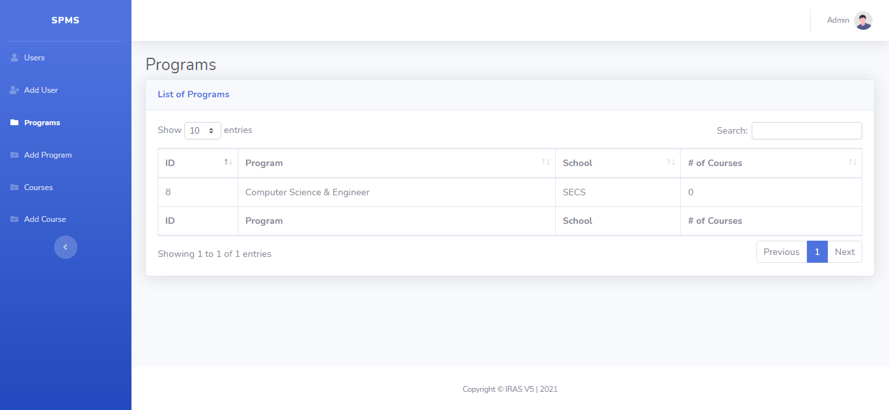
Figure 5 : Program

Slide 25
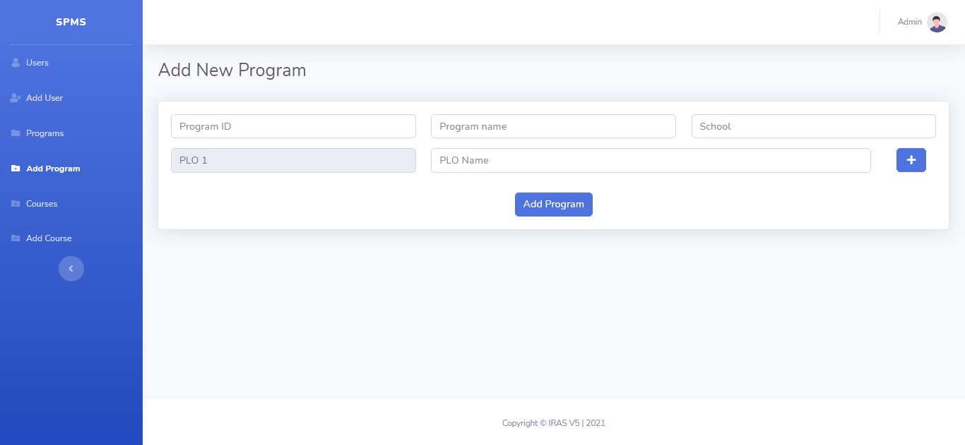
Figure 6: Add new Program

Slide 26
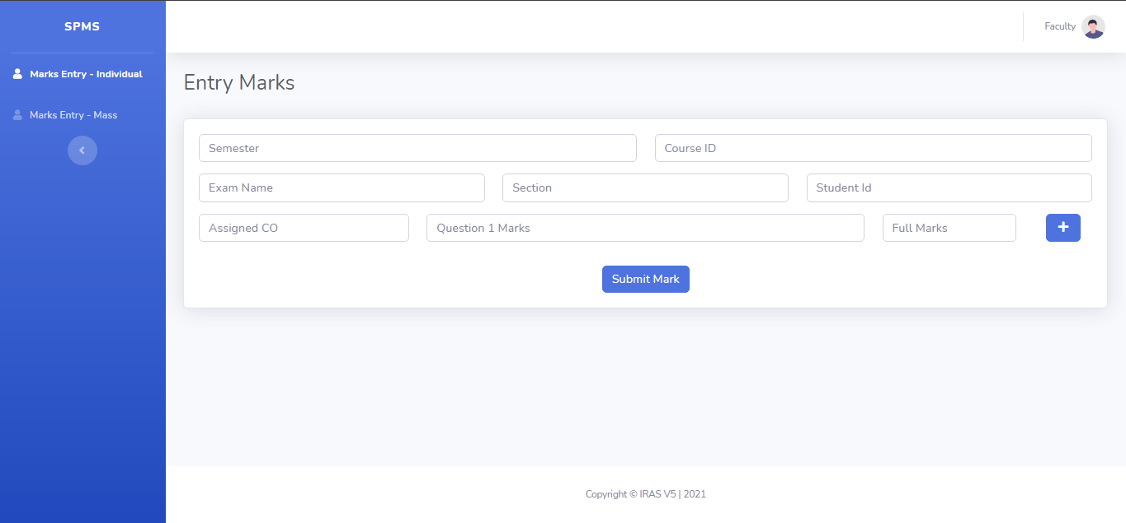
Figure 7: Entry Marks

Slide 27
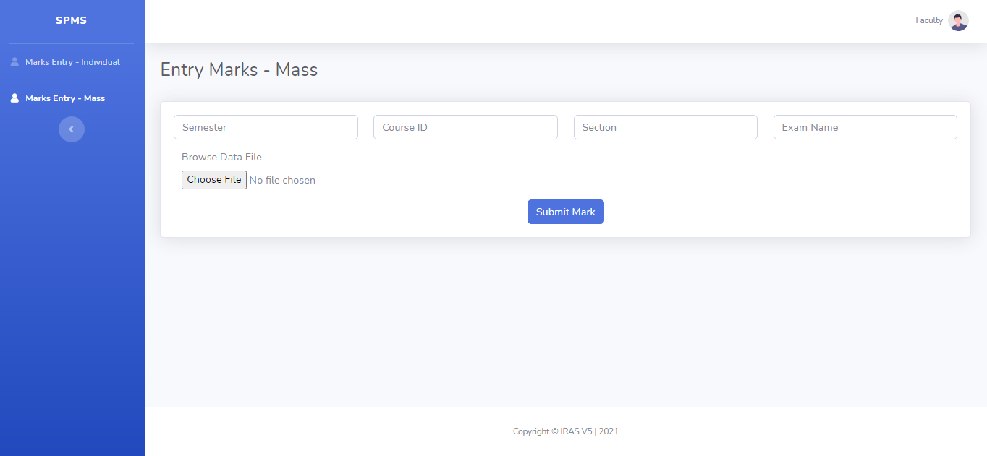
Figure 8: Entry Marks Mass

Slide 28
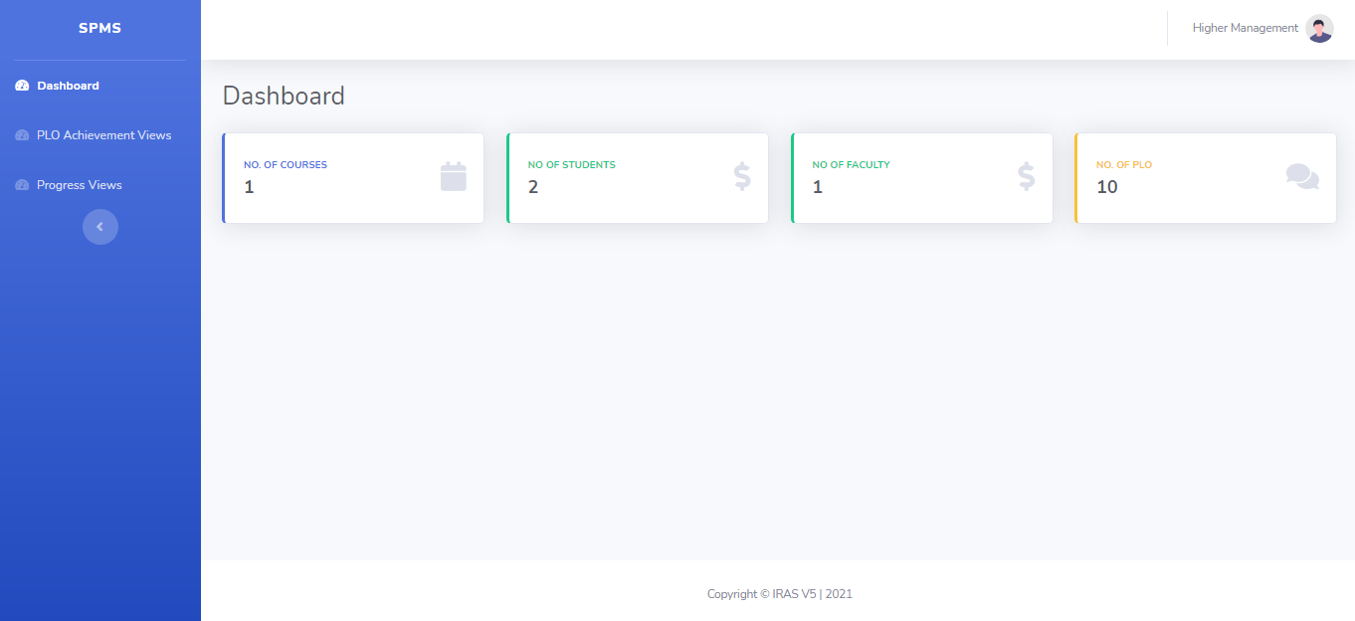
Figure 9: Higher Management Dashboard

Slide 29
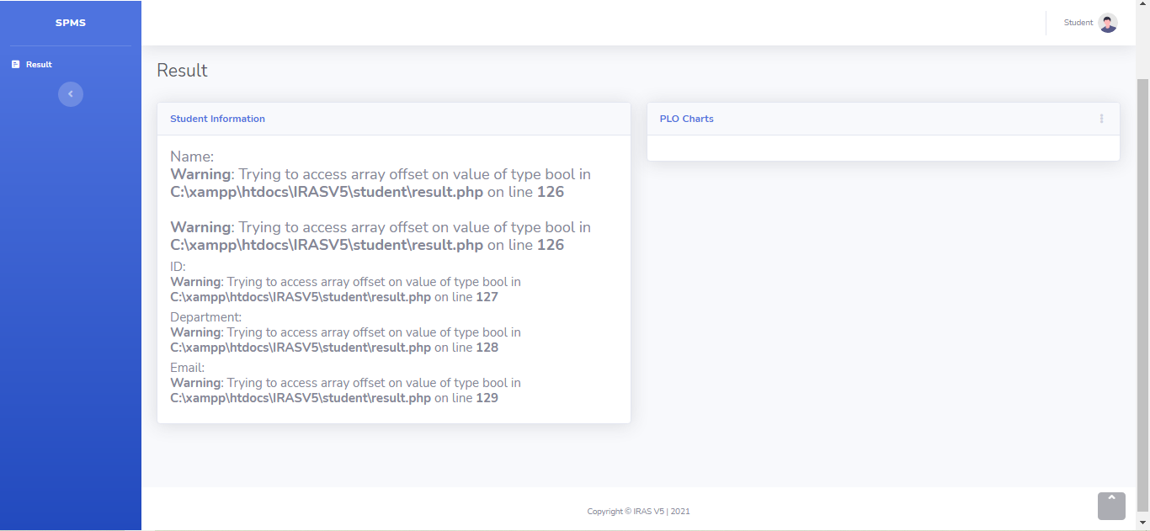
Figure 10: Student Result

Slide 30
CONCLUSION Analysis Phase
While creating the rich picture and six elements' analyses, assumptions were made about the organization’s operations. This required requalification from the instructor and thus slowed the pace. Following this, queries are made more explicitly when collecting information from a stakeholder.
Design Phase
A large percentage of the initially created entities (and their respective relations) were irrelevant to the needs of the project. Entities such as Grading Policy and Grade Change request had to be removed, and the final iteration of the ERD and Logical Schema were made while keeping only the bare minimum requirements in mind.
Feature & Future Development
Future plans for this project are to finish implementing the functionalities that are missing in the implementation stage.

Slide 31
Thank you

