Slide 1
List

Slide 2
Data structures: List
List is a linear data structure:
Order is not given by their physical placement in memory.
Each element points to the next.
Example:
Train.

Slide 3
Data structures: List Example
Here is the structure of list:
data – is a section for custom data, that list must hold.
pointer (grey part) – is a section that points to the next node. Last node points to the null.
data
data
data
data
null

Slide 4
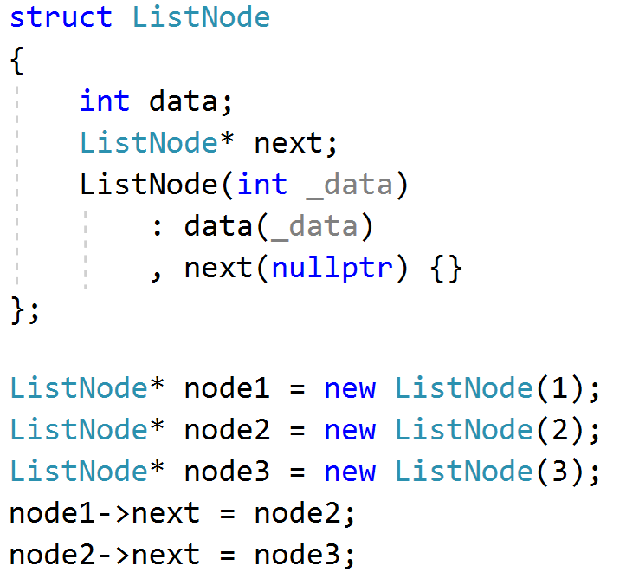
Data structures: List Structure
The following struct could be used to create a list from the last example:

Slide 5
Data structures: List Operations
insert: Inserts item to the specified position in list. Time complexity is O(1).
remove: Removes item from the specified position in list. Time complexity is O(1).
access: Element accessing is performs by iteration to that element. Time complexity is O(n).

Slide 6
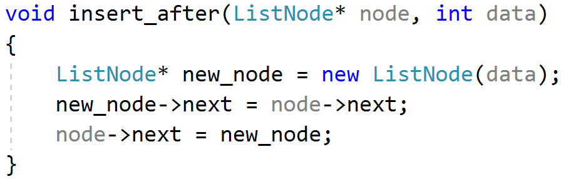
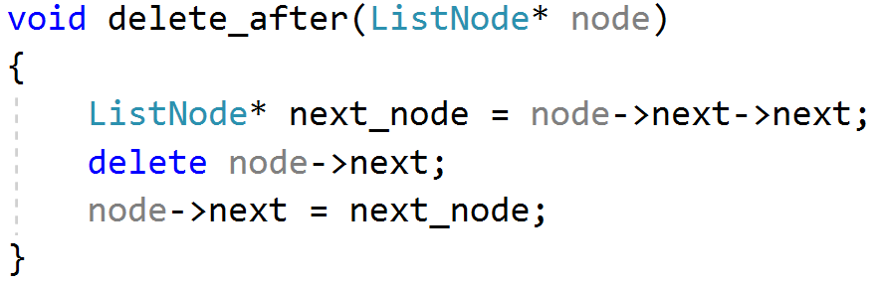
Data structures: List Problems
For good understanding why insert and delete is O(1), let’s solve the following problems
Given a node, you need to insert given you value after this node.
Given a node, you need to delete the node located next to it.

Slide 7
Data structures: List Problem: Cycle
You are given a list by its first node, need to answer if there is a cycle in that list:
No cycle:
Has cycle:
data
data
data
data
nullptr
data
data
data
data
 | data
 | data
 | data

Slide 8
Data structures: List Problem: Cycle
Here is visualization of mentioned algorithm:
First pointer is visualized as blue node and second as green.
At the start both pointers points to the node 1
 |  | 1
 | 2
 | 3
 | 4
7
6
5

Slide 9
Data structures: List Problem: Cycle
Here is visualization of mentioned algorithm:
First pointer is visualized as blue node and second as green.
On the step 1, first pointer start point to the node 2 and second to the node 3
 | 1
 | 2
 | 3
 | 4
7
6
5

Slide 10
Data structures: List Problem: Cycle
Here is visualization of mentioned algorithm:
First pointer is visualized as blue node and second as green.
On the step 2, first pointer start point to the node 3 and second to the node 5
 | 1
 | 2
 | 3
 | 4
7
6
5

Slide 11
Data structures: List Problem: Cycle
Here is visualization of mentioned algorithm:
First pointer is visualized as blue node and second as green.
On the step 3, first pointer start point to the node 4 and second to the node 7
 | 1
 | 2
 | 3
 | 4
7
6
5

Slide 12
Data structures: List Problem: Cycle
Here is visualization of mentioned algorithm:
First pointer is visualized as blue node and second as green.
On the step 4, first pointer start point to the node 5 and second to the node 3
 | 1
 | 2
 | 3
 | 4
7
6
5

Slide 13
Data structures: List Problem: Cycle
Here is visualization of mentioned algorithm:
First pointer is visualized as blue node and second as green.
On the step 5, first pointer start point to the node 6 and second to the node 5
 | 1
 | 2
 | 3
 | 4
7
6
5

Slide 14
Data structures: List Problem: Cycle
Here is visualization of mentioned algorithm:
First pointer is visualized as blue node and second as green.
And on the step 6, both pointers will point on the same node 7, and algorithm will return true.
 | 1
 | 2
 | 3
 | 4
7
6
5

Slide 15
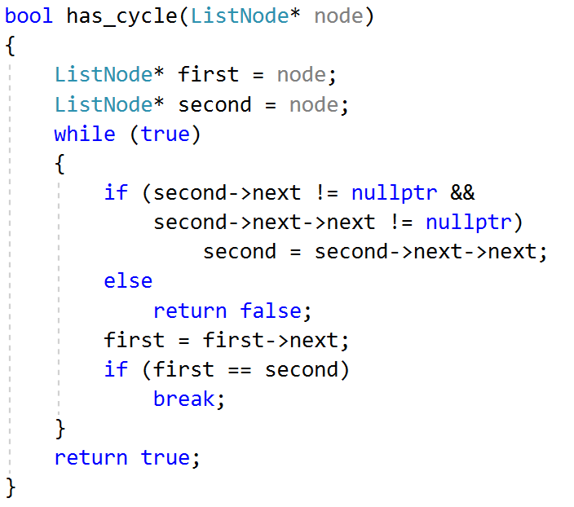
Data structures: List Problem: Cycle
Solution:
Let’s take 2 pointers on the first node. On each step move one pointer to the next node, and second pointer to the next next node. If there was a cycle in some moment these 2 pointers will point on the same node. If not, then the second pointer will reach null.

