Slide 1
Selection sort

Slide 2
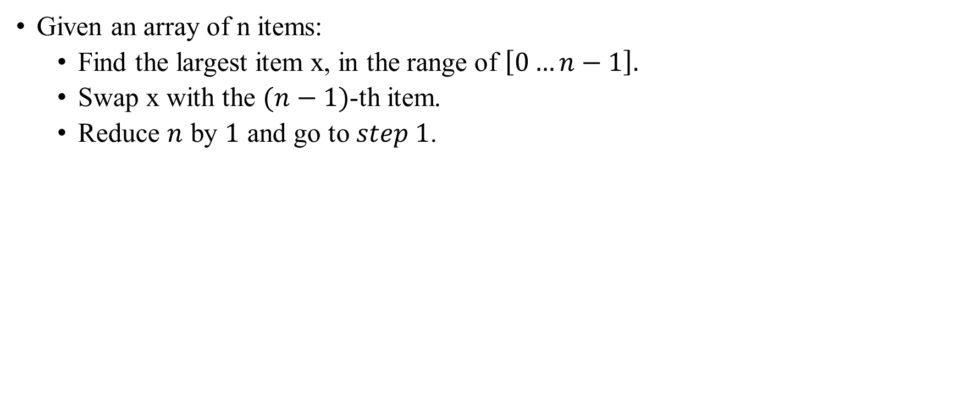
Selection Sort Idea

Slide 3
Selection Sort Example
29 | 10 | 14 | 37 | 13

Slide 4
Selection Sort Example
29 | 10 | 14 | 37 | 13
37 is the largest, swap it with the last element, i.e. 13.

Slide 5
Selection Sort Example
29 | 10 | 14 | 13 | 37
37 is the largest, swap it with the last element, i.e. 13.

Slide 6
Selection Sort Example
29 | 10 | 14 | 13 | 37

Slide 7
Selection Sort Example
29 | 10 | 14 | 13 | 37
29 is the next largest, swap it with the appropriate element, i.e. again 13.

Slide 8
Selection Sort Example
13 | 10 | 14 | 29 | 37
29 is the next largest, swap it with the appropriate element, i.e. again 13.

Slide 9
Selection Sort Example
13 | 10 | 14 | 29 | 37

Slide 10
Selection Sort Example
13 | 10 | 14 | 29 | 37
14 is the next largest, swap it with the appropriate element, i.e. with himself.

Slide 11
Selection Sort Example
13 | 10 | 14 | 29 | 37

Slide 12
Selection Sort Example
13 | 10 | 14 | 29 | 37
13 is the next largest, swap it with the appropriate element, i.e. with 10.

Slide 13
Selection Sort Example
10 | 13 | 14 | 29 | 37
13 is the next largest, swap it with the appropriate element, i.e. with 10.

Slide 14
Selection Sort Example
10 | 13 | 14 | 29 | 37

Slide 15
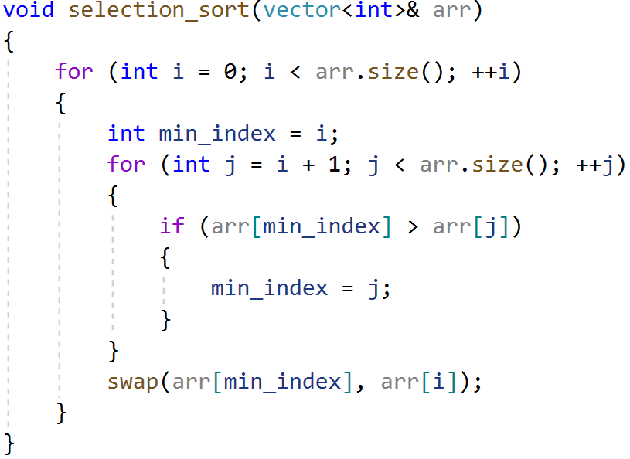
Selection Sort Implementation

Slide 16
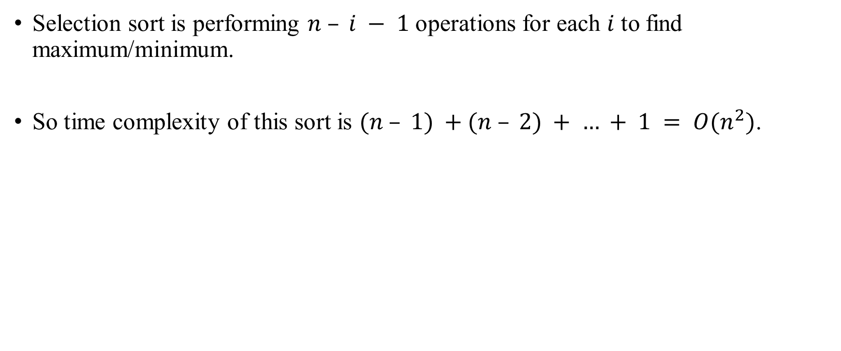
Selection Sort Analysis

