Slide 1
A Robust Solution for Warranty Management
Warranty hub
Presented by -
Rasuri Vignesh
Jobh kumar Abhishek
Leehan Thulluri

Slide 2

🧩Problem
In today’s digital world, individuals purchase multiple electronic and household devices from various brands. However, managing their warranties, maintenance records, and receipts remains a scattered and manual process.
No centralized solution exists to manage warranties across different brands.
Warranty documents and receipts are often lost or misplaced.
Users forget warranty expiration dates and miss free service opportunities.
Documents are spread across emails, paper copies, or brand-specific portals.

Slide 3
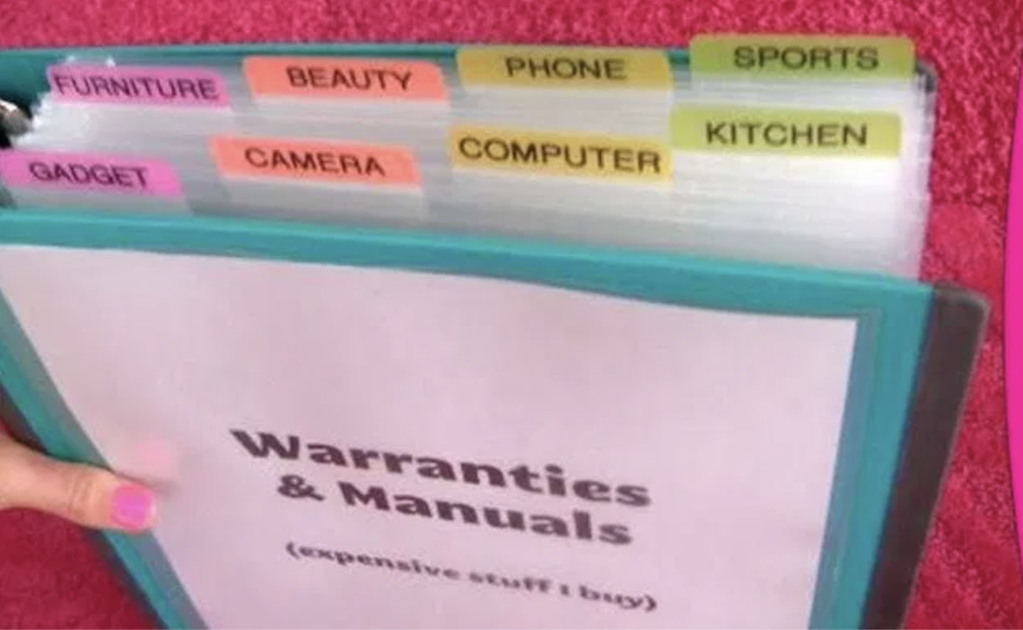
💡Objective
Cloud Storage for Warranty Documents
Store warranty documents securely in the cloud, eliminating the need to search through physical documents when repairs are needed.
Comprehensive Device Management
Display and manage all household devices in one centralised location for better organisation and tracking.
Repair History Tracking
Record and track repair history for each device to maintain a comprehensive maintenance record.
Expense Monitoring
Track annual expenses related to device maintenance and repairs for better financial planning.

Slide 4
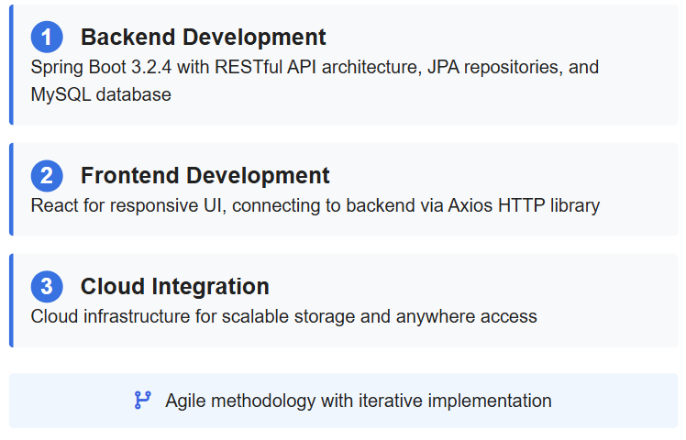
methodology

Slide 5
literature Review
Reliance Digital
Offers brand-specific warranty tracking limited to products purchased from Reliance. Stores buyer and device data in a closed ecosystem.
Croma
Provides warranty management for Croma products only. Users must maintain separate accounts for different retailers.
Key Limitations
Brand/retailer-specific solutions only
No cross-brand warranty management
Limited home device organization features
No comprehensive expense tracking

Slide 6
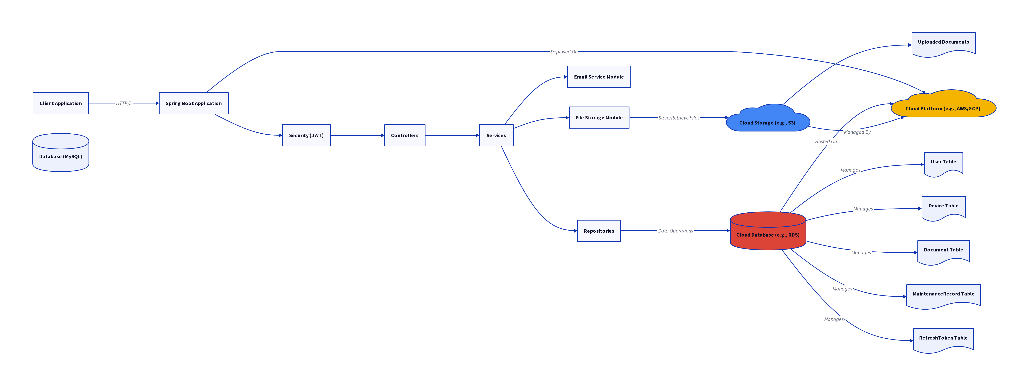
Architectural Flow: API Interactions

Slide 7
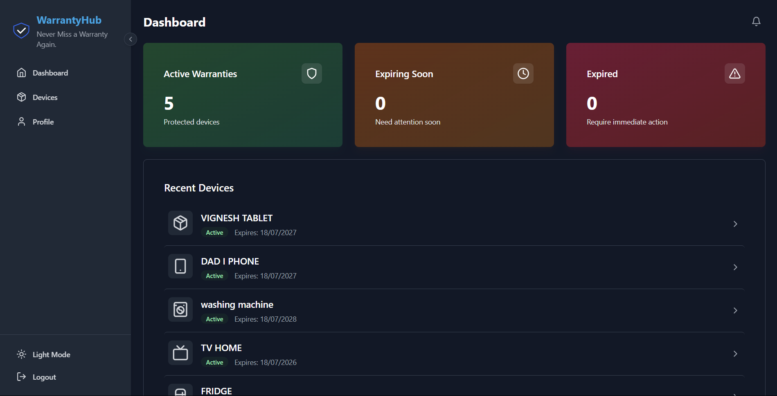
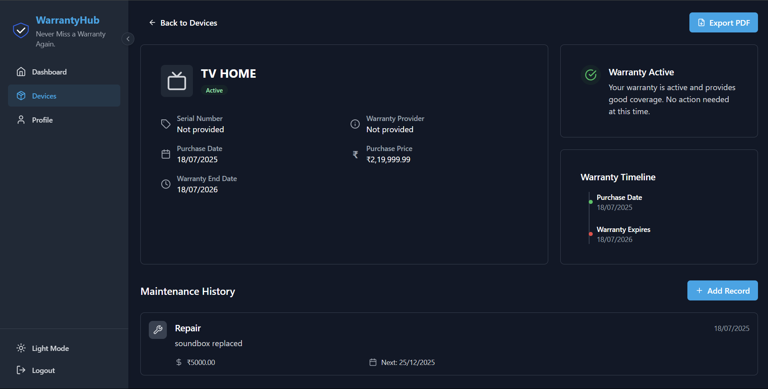

Slide 8
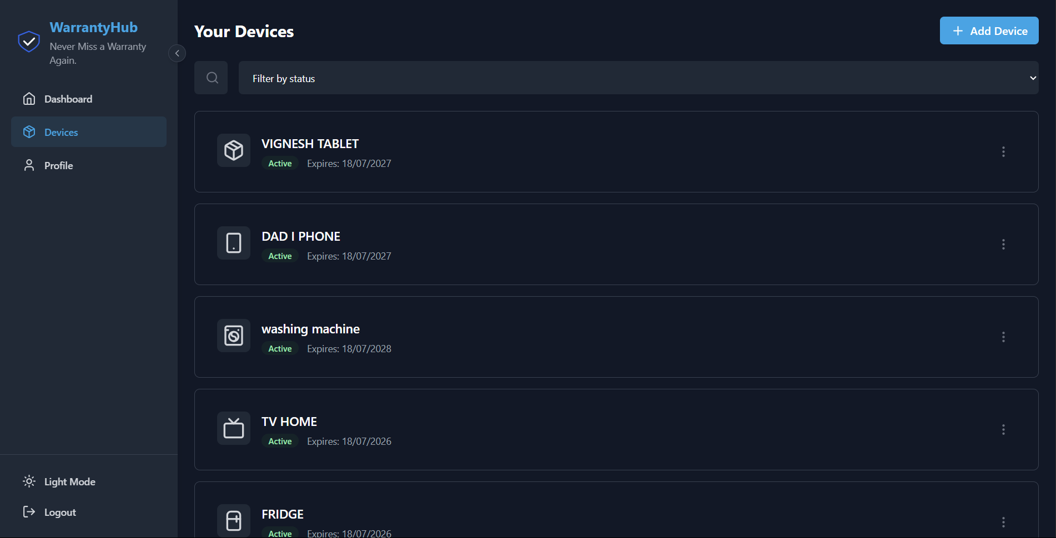
novelty
Home-Centric Approach
Designed for Households
Unlike company-specific solutions, WarrantyHub is designed specifically for home users to manage all their devices regardless of brand.
Cross-Brand Integration
Consolidates warranty information from multiple manufacturers in one centralized platform.

Slide 9

THANK YOU

