Slide 1
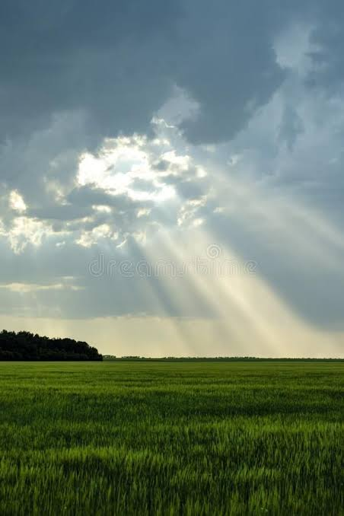


Multi-Modal Satellite Cloud Removal & Reconstruction
Optical satellites suffer up to 70% cloud blockage during critical Kharif cycles. Single-modality methods fail under dense cover. While SAR penetrates clouds, it lacks optical spectral properties. Furthermore, global benchmark models struggle with severe domain shifts on complex Indian smallholder fields.

Slide 2








Project Objectives
Data Engineering
Automated Masking
Build an end-to-end multi-modal data pipeline pairing 2-band Sentinel-1 SAR (VV, VH) with 13-band Sentinel-2 optical images.
Implement Stage 1 segmentation to generate precise binary masks ( ) identifying clouds and shadows.
SAR-Guided Reconstruction
Cross-Domain Evaluation
Construct a Stage 2 deep fusion model conditioned on SAR features to reconstruct missing optical bands (R, G, B, NIR, SWIR).
Validate benchmark performance on SEN12MS-CR and execute zero-shot dynamic testing over Indian monsoon agricultural zones via GEE.

Slide 3
Literature Survey
Classical Optical Interpolation Spatiotemporal filtering and cloud-filling algorithms (e.g., DINEOF, localized linear regression) fail during extended multi-week cloud cover.
Single-Modal Deep Learning Autoencoders and GANs (e.g., STGAN) synthesize plausible textures but suffer from hallucination without structural ground truth.
Early Multi-Modal Fusion Early SAR-optical combination models (e.g., DNSMS, Pix2Pix adaptations) struggle with non-aligned spatial features and color distortion.
State-of-the-Art Benchmark Frameworks SEN12MS-CR baseline models demonstrate SAR-to-Optical translation efficacy but lack targeted downstream evaluation on dynamic agricultural vegetation indices like NDVI.

Slide 4






Research Gap
Spectral Radiometric Distortion
Spatial Alignment Artifacts
Lack of Monsoon Generalization
Current architectures often introduce high-frequency boundary artifacts when merging radar texture with optical background regions.
Existing models focus primarily on RGB visual plausibility rather than preserving radiometric fidelity in the NIR and SWIR bands.
Most literature evaluates models exclusively on static global datasets without testing performance against severe real-time monsoon cloud cover.

Slide 5

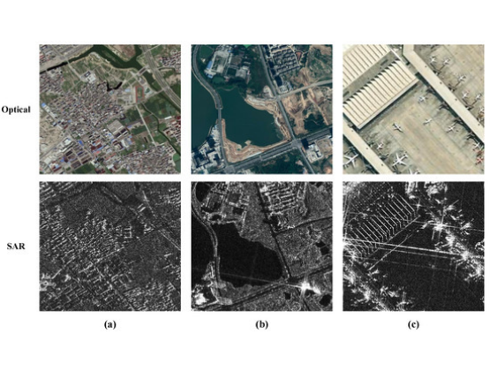
Proposed Novelty
Two-Stage Modular Architecture Decouples explicit cloud/shadow mask generation (Stage 1) from SAR-conditioned multi-spectral reconstruction (Stage 2) to eliminate feature confusion.
Physics-Informed Spectral Loss Integrates an explicit NDVI-preserving loss function alongside spatial losses to ensure reconstructed pixel values remain biologically meaningful for crops.
Hybrid Cloud-Local Pipeline Utilizes persistent local cloud NVMe caching for SEN12MS-CR benchmark training alongside dynamic Google Earth Engine API integration.

Slide 6


Dataset Configuration
Benchmark Dataset (SEN12MS-CR)
India-Specific Test Dataset
•
Sentinel-1 SAR: Dual-polarization (VV, VH) at 10m spatial resolution.
•
Dynamic Stream: Real-time spatial subsets covering major Indian agricultural belts (e.g., Indo-Gangetic Plains / Punjab Paddy fields).
•
Sentinel-2 Optical: 13 multi-spectral bands (Cloudy input + Clear Ground Truth target).
•
Temporal Window: Tailored specifically to the Kharif monsoon season (July–October).
•
Volume & Split: Multi-gigabyte regional splits (e.g., Spring ROI subsets) mounted and extracted via Google Drive / Colab NVMe.
•
Application: Direct GEE connection for downstream zero-shot testing.

Slide 7
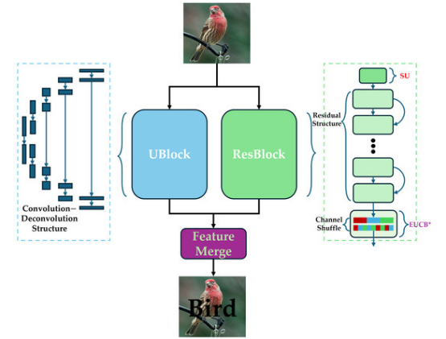
Proposed Architecture
Stage 1 (Segmentation Masker) Input: Cloudy 13-band Sentinel-2 Optical tensor. Output: Binary cloud/shadow mask .
Stage 2 (Reconstruction Network) Inputs: Sentinel-1 SAR (VV, VH), Masked S2 Optical, and Binary Mask .
Encoder-Decoder Backbone Dual-stream U-Net / ResNet generator with cross-attention modules fusing radar structural feature maps into optical channels.
Final Generation Output: Fully reconstructed 13-band cloud-free optical output .

Slide 8
Current Implementation
Environment & Infrastructure Configured VS Code remote connection to Google Colab T4 Cloud GPU environments with Google Drive persistence.
Data Ingestion & Verification Built and verified automated multi-stream downloaders (wget / tar) for massive SEN12MS-CR benchmark splits.
Multi-Modal Data Loading Implemented custom PyTorch data loading pipelines and geospatial visualization scripts using rasterio and matplotlib to extract paired SAR (VV), Cloudy RGB, and Clear RGB ground-truth triplets.

Slide 9


Evaluation Metrics & Results
Reconstruction Metrics
Downstream Agricultural Metrics
•
PSNR (Peak Signal-to-Noise Ratio): Measures absolute pixel-level reconstruction fidelity (Target: > 28dB).
•
NDVI Mean Squared Error ( ):
Measures agreement between reconstructed NIR/Red vegetation index curves and clear temporal baselines over Indian agricultural zones.
•
SSIM (Structural Similarity Index): Evaluates spatial texture and geometric structure retention (Target: > 0.88).
Ensures pixel fidelity translates directly to agricultural analysis reliability.
•
SAM (Spectral Angle Mapper): Quantifies radiometric spectral angle distortion across all 13 bands.

Slide 10
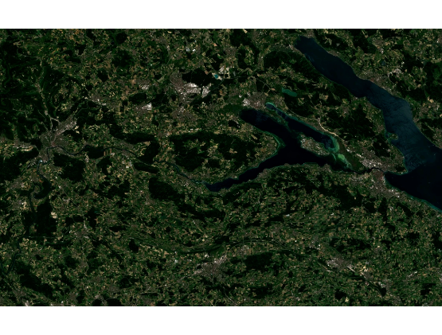
Interactive Demo
Initialization Automated mounting and validation of benchmark dataset streams.
Input Analysis Side-by-side multi-spectral visualization of raw input pairs (SAR Radar vs. Cloudy Optical).
Real-Time Inference Preview showing predicted cloud masks and restored optical patches.
Dynamic GEE Rendering Dynamic GEE bounding box query rendering reconstructed cloud-free optical maps over Indian test fields.

Slide 11
References
Ebel, P., Meraner, A., Schmitt, M., & Zhu, X. X. (2020). SEN12MS-CR: A dataset for cloud removal from multi-spectral Sentinel-2 imagery using Sentinel-1 SAR data. IEEE Geoscience and Remote Sensing Letters.
Meraner, A., Ebel, P., Zhu, X. X., & Schmitt, M. (2020). Cloud removal in Sentinel-2 imagery using a deep residual neural network and SAR-optical data fusion. ISPRS Journal of Photogrammetry and Remote Sensing.
Gorelick, N., et al. (2017). Google Earth Engine: Planetary-scale geospatial analysis for everyone. Remote Sensing of Environment.
Isola, P., Zhu, J. Y., Zhou, T., & Efros, A. A. (2017). Image-to-image translation with conditional adversarial networks (Pix2Pix). IEEE CVPR.

