Slide 1


DATA DEFENDER:
CYBER CRIME DATA ANALYSIS COMPETITION
BY
RASWANT.P
raswantraswant@gmail.com

Slide 2

CONTENTS
QUESTIONS ABOUT DATASET.
ANALYSIS QUESTIONS

Slide 3

QUESTIONS ABOUT THE DATASET
IT CONSISTS OF 15 QUESTIONS!!!

Slide 4
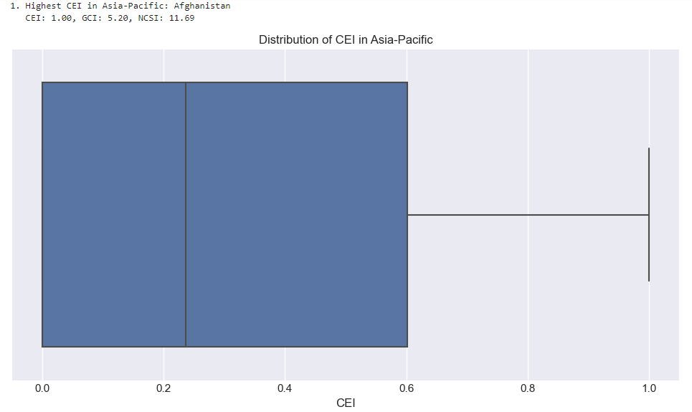

1) Which country in the Asia-Pacific region has the highest CEI score, and how does its GCI and NCSI compare to other countries in the same region?
*Afghanistan stands out as having the highest Cybersecurity Exposure Index (CEI) score of 1.00 in the Asia-Pacific region, significantly above the regional median of around 0.3.
* However, its low Global Cybersecurity Index (GCI) of 5.20 and National Cyber Security Index (NCSI) of 11.69 suggest that despite facing the highest cybersecurity risks, Afghanistan may have limited measures in place to address these challenges compared to its regional counterparts

Slide 5
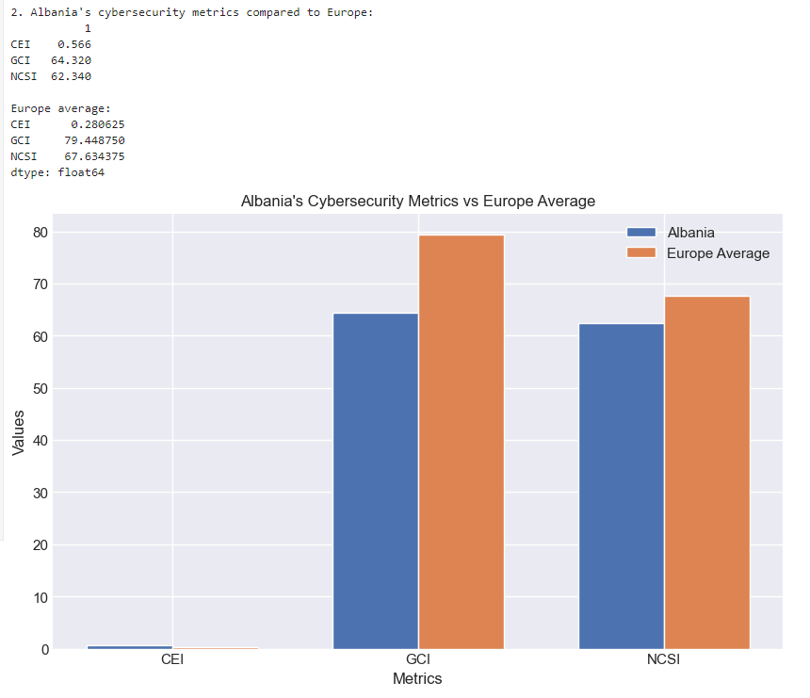
2) How does Albania's cybersecurity metrics (CEI, GCI, NCSI) compared to other European countries?
*Albania's cybersecurity metrics show a mixed picture compared to the European average.
While Albania has a significantly higher Cybersecurity Exposure Index (CEI) of 0.566 versus Europe's 0.280625, indicating greater cybersecurity risk, its Global Cybersecurity Index (GCI) and National Cyber Security Index (NCSI) scores are lower than the European averages.
*This suggests that although Albania faces higher cybersecurity threats, its preparedness and implementation of cybersecurity measures lag behind the regional standard.

Slide 6
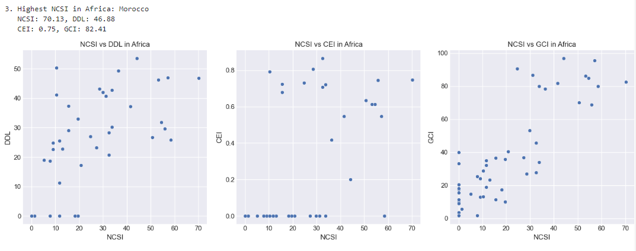
3) Which country in Africa has the highest NCSI and how does its DDL relate to its other cybersecurity indicators?
Morocco leads Africa with the highest National Cyber Security Index (NCSI) of 70.13, coupled with a Digital Development Level (DDL) of 46.88. Despite its high NCSI, Morocco faces significant cybersecurity exposure with a CEI of 0.75. The scatter plots reveal a general trend where countries with higher NCSI scores tend to have higher DDL and GCI scores, but the relationship with CEI is less clear, suggesting that even countries with strong cybersecurity measures can face high exposure to cyber risks.

Slide 7
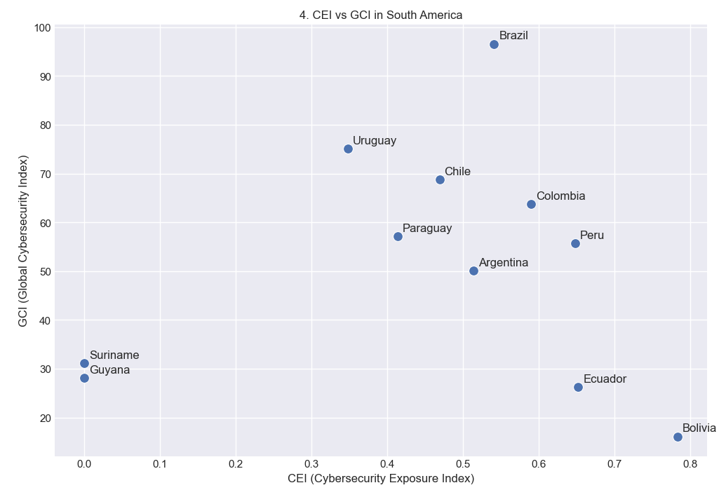
4) What is the relationship between CEI and GCI for countries in South America?
In South America, the relationship between the Cybersecurity Exposure Index (CEI) and the Global Cybersecurity Index (GCI) shows that countries with lower CEI values tend to have higher GCI scores, indicating stronger cybersecurity measures relative to their exposure. Brazil, with a low CEI, ranks highest on the GCI, suggesting its cybersecurity readiness is strong despite exposure risks. In contrast, Bolivia and Ecuador, with higher CEI values, have comparatively lower GCI scores, reflecting limited cybersecurity defenses. This negative relationship implies that as cybersecurity risks increase (higher CEI), some countries struggle to keep up in terms of cybersecurity capabilities (lower GCI).

Slide 8
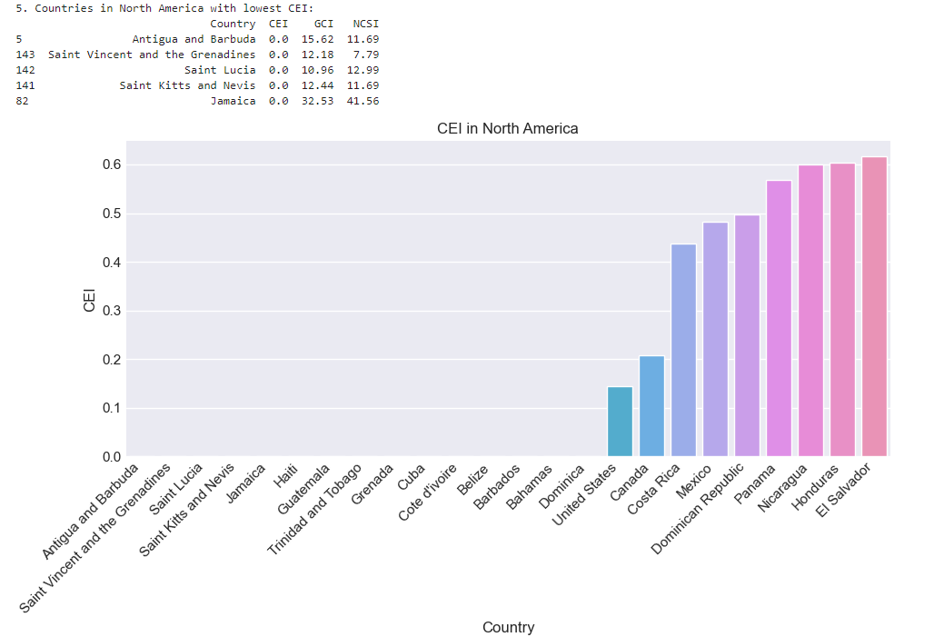
5) Which countries in North America have the lowest Cybersecurity Exposure Index (CEI), and how does it relate to their GCI and NCSI?
The provided data reveals that several Caribbean nations in North America, including Antigua and Barbuda, Saint Vincent and the Grenadines, Saint Lucia, Saint Kitts and Nevis, and Jamaica, exhibit low Cybersecurity Exposure Index (CEI) scores. Despite moderate levels of overall cybersecurity maturity, these countries display varying levels of network security preparedness. This suggests that while they have made efforts to enhance their cybersecurity, challenges persist in securing their digital infrastructure and mitigating cyber risks.

Slide 9
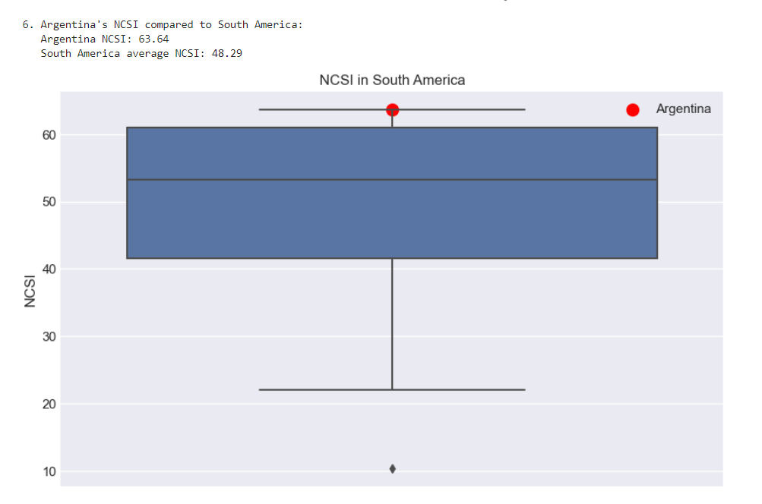
6) How does Argentina's NCSI score compare with other South American countries, and what trends can be observed?
The box plot illustrates that Argentina's NCSI score of 63.64 significantly exceeds the average NCSI score of 48.29 for South America. This suggests that Argentina's network cybersecurity maturity is notably higher than that of its regional peers. The box plot also reveals that Argentina's NCSI score is an outlier, indicating that it is significantly different from the distribution of NCSI scores in the rest of South America.

Slide 10
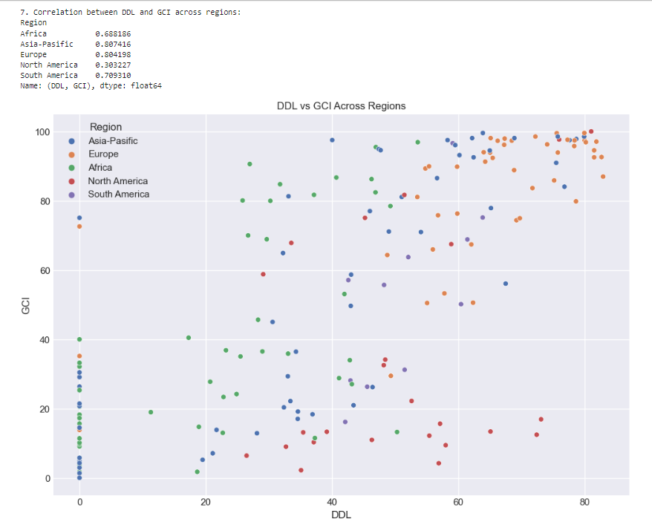
7)What is the correlation between Digital Development Level (DDL) and Global Cybersecurity Index (GCI) across various regions?
The scatter plot illustrates the relationship between DDL and GCI across different regions. The correlation coefficients provided in the table indicate a strong positive correlation between DDL and GCI in all regions except North America. This suggests that in most regions, countries with higher levels of DDL tend to also have higher levels of GCI. However, in North America, the correlation between DDL and GCI is relatively weak, indicating that the relationship between these two variables is less pronounced in this region.

Slide 11
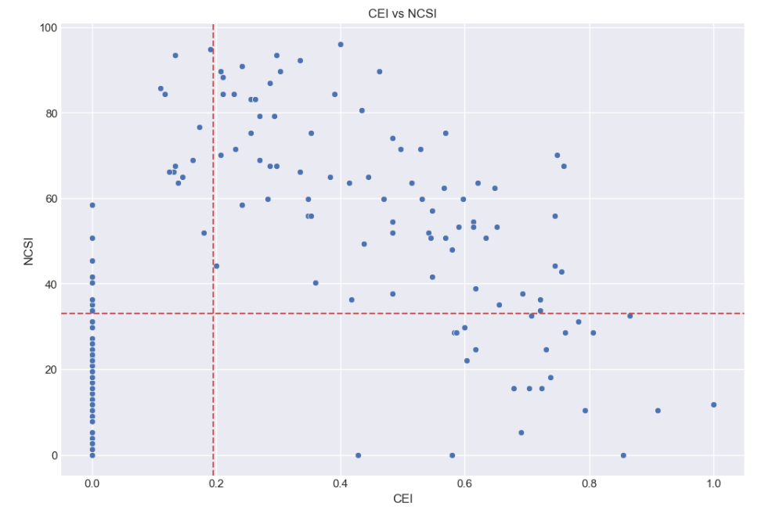
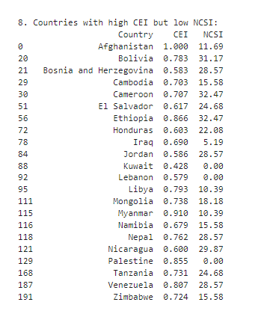
8) Which countries exhibit a high CEI but low NCSI, and what does that imply about their cybersecurity status?
The provided table lists countries with high CEI scores but low NCSI scores. This indicates that these countries have a relatively high level of cybersecurity exposure, suggesting that they may be vulnerable to cyber threats, but they have a low level of network cybersecurity maturity, indicating that they may have limited capabilities to protect their digital infrastructure. Some notable examples include Afghanistan, Bolivia, Bosnia and Herzegovina, Cambodia, Cameroon, and El Salvador. It is important for these countries to invest in improving their network cybersecurity capabilities to mitigate their vulnerability to cyber attacks.

Slide 12
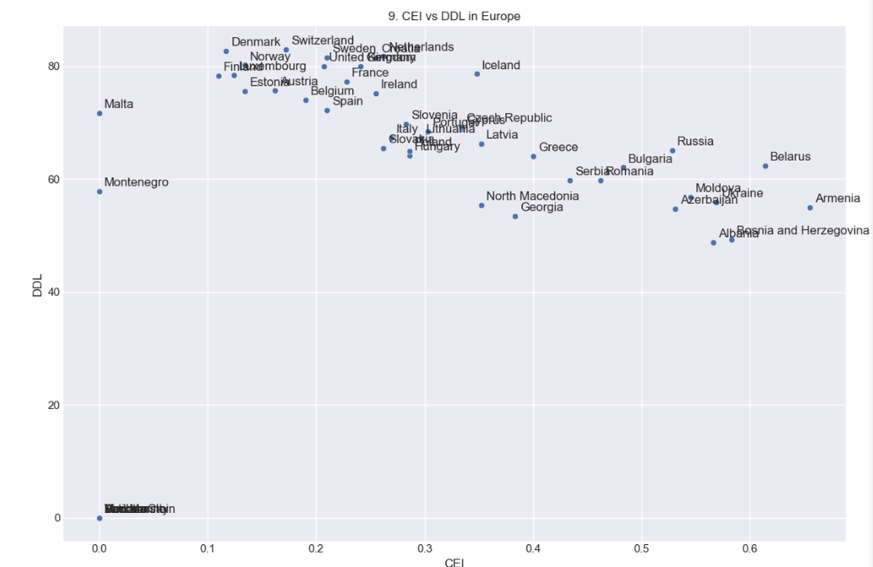
9) How do countries in Europe compare in terms of CEI vs. DDL levels? Are there any clear patterns or anomalies?
For example, some countries in Eastern Europe, such as Russia and Belarus, have relatively high CEI scores but low DDL scores, suggesting that they may have made progress in improving their cybersecurity posture but still face challenges in promoting digital literacy and inclusion. some Western European countries, such as Denmark, Switzerland, and the Netherlands, have both high CEI and DDL scores, indicating that they have made significant strides in both cybersecurity and digital development. Overall, the plot suggests that there is a diverse range of experiences across Europe in terms of CEI and DDL levels, and that the relationship between these two variables is complex and multifaceted.

Slide 13
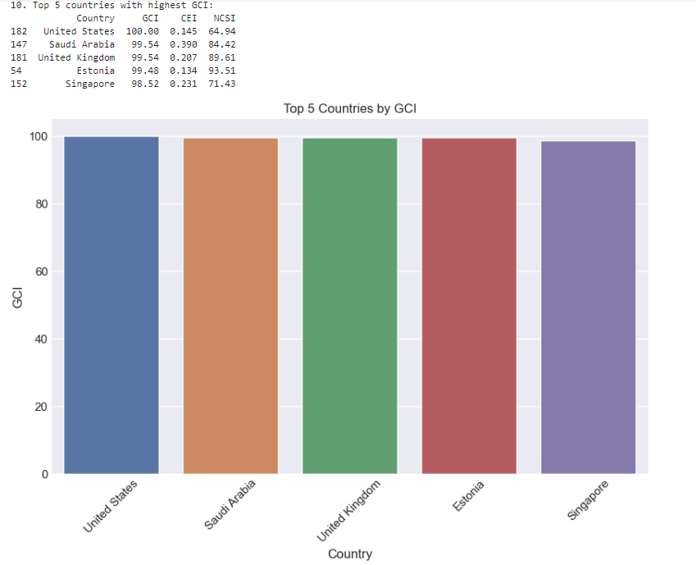
10) What are the top 5 countries with the highest GCI scores globally, and what are their CEI and NCSI values?
The bar chart ranks the United States, Saudi Arabia, the United Kingdom, Estonia, and Singapore as the top 5 countries globally in terms of GCI. These countries demonstrate strong cybersecurity practices, with low CEI scores and high NCSI scores, indicating a robust digital infrastructure and effective protection against cyber threats.

Slide 14
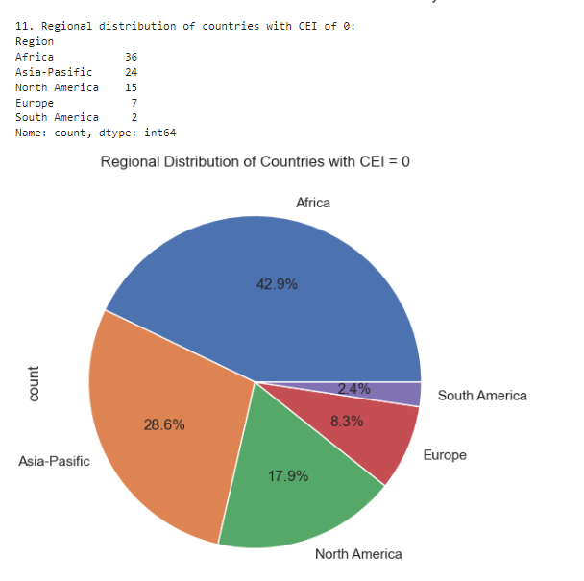
11) What is the regional distribution of countries with a CEI of 0, and what could explain the cybersecurity status in those regions?

Slide 15
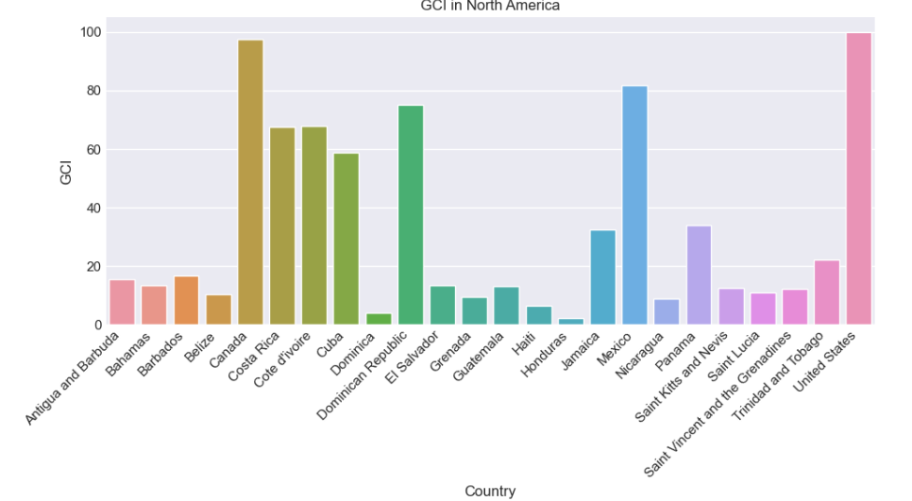
12) How does Canada's GCI compare with other North American countries, and what factors contribute to its ranking?

Slide 16
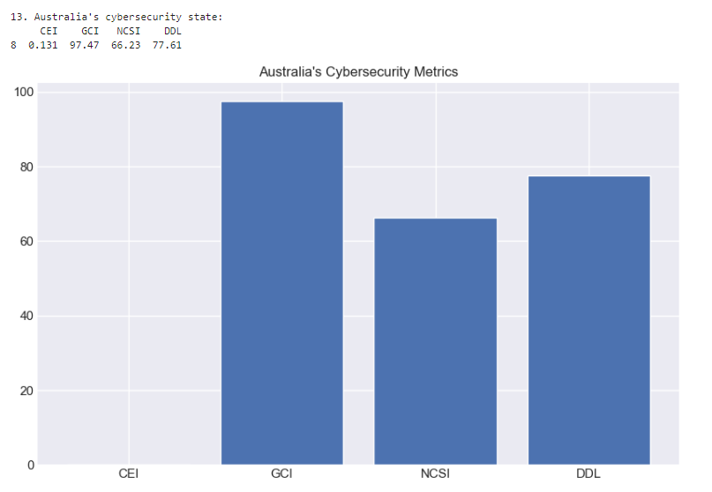
13) What can be inferred about the cybersecurity state of Australia based on its CEI, GCI, NCSI, and DDL?

Slide 17
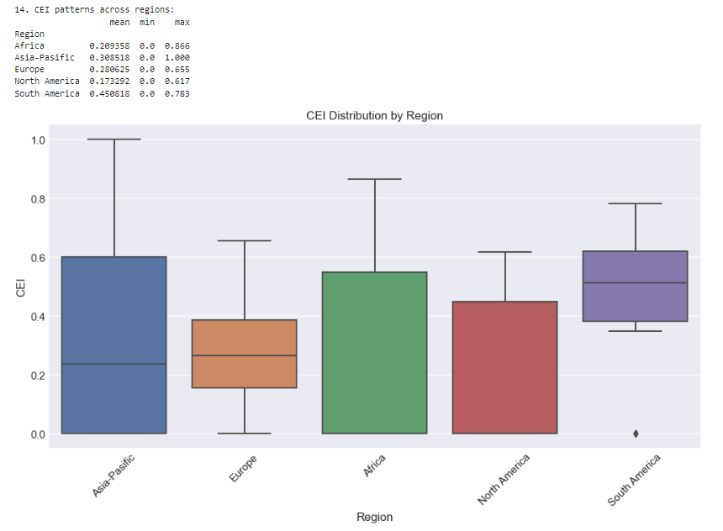
14) What patterns emerge when comparing CEI scores across different regions (Africa, Europe, Asia-Pacific, etc.)?

Slide 18
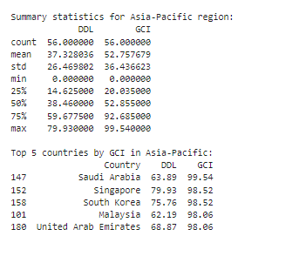
15) How does the Digital Development Level (DDL) impact the GCI scores within the Asia-Pacific region?

Slide 19

ANALYSIS QUESTIONS

Slide 20
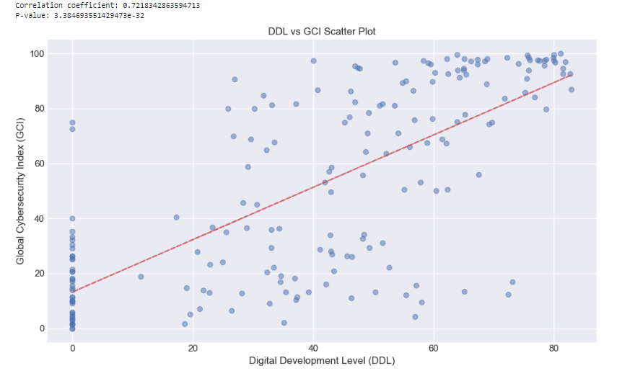
Correlation Analysis
The scatter plot illustrates a strong positive correlation between DDL and GCI, with a correlation coefficient of 0.7218 and a p-value of 3.3847e-32. This suggests that countries with higher levels of digital development tend to also have higher levels of cybersecurity maturity. The red regression line further emphasizes this relationship, showing a clear upward trend. This finding implies that investments in digital development can contribute to improved cybersecurity capabilities, potentially leading to better protection against cyber threats and enhanced digital resilience.

Slide 21
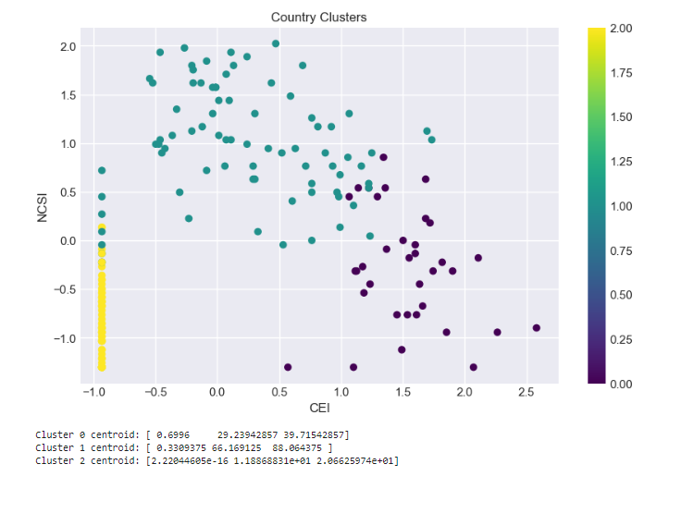
Cluster Analysis
The scatter plot illustrates the distribution of countries based on their CEI and NCSI scores, with three distinct clusters identified.
Cluster 1 is characterized by countries with relatively low CEI scores and high NCSI scores. This suggests that these countries have a strong cybersecurity posture and are well-prepared to mitigate cyber threats, despite having a lower level of cybersecurity exposure.
Cluster 2 is comprised of countries with very low CEI scores and moderate NCSI scores. This indicates that these countries have a low level of cybersecurity exposure but may still face some challenges in ensuring the security of their networks.
Cluster 3 includes countries with high CEI scores and low NCSI scores. This suggests that these countries are vulnerable to cyber threats and may have limited capabilities to protect their digital infrastructure.
Overall, the plot reveals that there are distinct groupings of countries based on their cybersecurity profiles, highlighting the diverse range of experiences and challenges faced by different nations in this area.

Slide 22
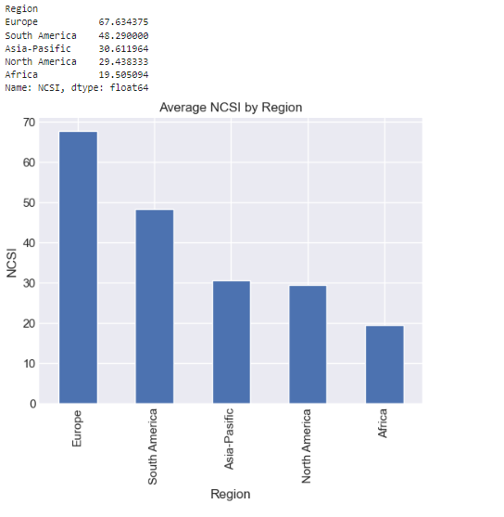
Regional Comparisons

Slide 23
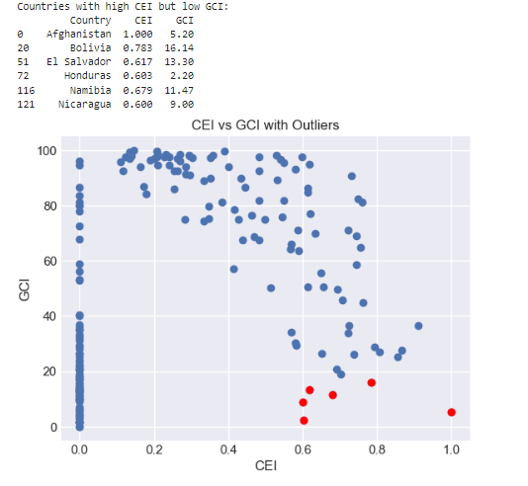
Outlier Analysis

Slide 24
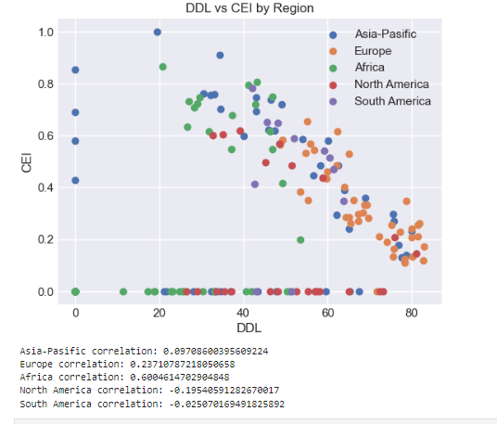
Trend Analysis

Slide 25

THANK YOU

