Slide 1
employee monitoring software
KEY-LOGGER PROJECT
Presented By:
M.R.Raswanth- Jeppiaar institute of technology –
Artificial intelligence and data science

Slide 2
OUTLINE
Problem Statement
Proposed System/Solution
System Development Approach
Algorithm & Deployment
Result (Output Image)
Conclusion
Future Scope
References

Slide 3
Problem Statement
As an employer, it is important to ensure that employees are using their work computers in a productive and responsible manner. One way to monitor employee activity is through keylogging software. Develop a keylogger program that can record and store all keystrokes made on a work computer to help employers identify unproductive or unauthorized activities.

Slide 4
Proposed Solution
employee monitoring keylogger program would be to create a software that can log all keystrokes made on work computers, and save them to a secure server or cloud storage. The software would be installed on all work computers, and would run silently in the background, capturing all keystrokes, including those made in applications, web browsers, and other programs.
The software would have an administrative dashboard, where employers can view the logs and search for specific keywords or phrases. The logs would be encrypted and password-protected, ensuring that only authorized personnel can access them. The software would also have the ability to filter out personal or irrelevant information, such as keystrokes made while the employee is on break or using personal applications.
To ensure compliance with privacy laws and regulations, the software would have a built-in notification system, informing employees that their keystrokes are being monitored. Employers would be required to obtain consent from employees before installing the software, and to use the software only for legitimate business purposes.

Slide 5
System Approach
The system approach for this keylogger software would involve using the Tkinter library to create the GUI, and the pynput library to capture keystrokes. When the start button is clicked, the keylogger would begin capturing keystrokes, and saving them to a text and JSON file. The user would be able to stop the keylogger at any time by clicking the stop button. The output directory for the log files would be specified in the code, but could be changed by modifying the OUTPUT_DIRECTORY variable.

Slide 6
Algorithm & Deployment
Algorithm: The algorithm for this keylogger software would be as follows:
Initialize the keys_used list, the flag variable, and the keys and last_sequence variables.
Specify the output directory and file paths for the text and JSON log files.
Create a listener to capture keystrokes, including the key pressed and the key released.
When a key is pressed, add its character to the keys string.
When the enter key is pressed, save the keys string to the keys_used list and the log files, and clear the keys string.
Create a start button to begin the keylogger and a stop button to stop the keylogger.
When the start button is clicked, start the keylogger and disable the start button.
When the stop button is clicked, stop the keylogger and enable the start button.
Deployment: To deploy this keylogger software, the following steps can be taken:
Install the required libraries (Tkinter and pynput) on the target computer.
Modify the OUTPUT_DIRECTORY variable to specify the desired output directory for the log files.
Save the code as a Python file (e.g. "keylogger.py").
Run the Python file to launch the keylogger software.
Use the GUI to start and stop the keylogger as needed.

Slide 7
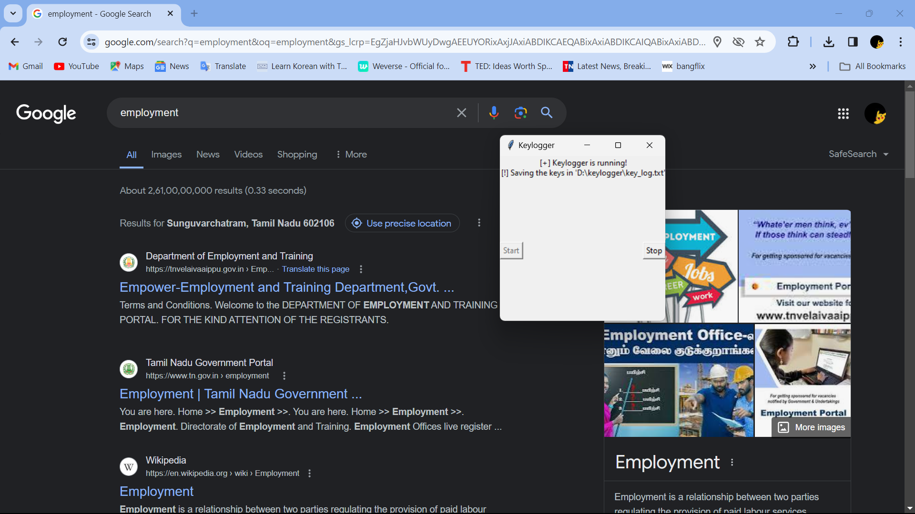

Result

Slide 8
Conclusion
In conclusion, employee monitoring software, including keyloggers, can be a valuable tool for employers to ensure productivity and responsible use of work computers. However, it is important to use such tools ethically and legally, with proper notification and consent from employees. The proposed solution in this case is a keylogger program that can record and store all keystrokes made on a work computer, with the ability to save logs to a secure server or cloud storage, and an administrative dashboard for viewing and searching logs.
While the proposed solution can be a useful tool for employers, it is important to note that it is not a substitute for trust and communication in the employer-employee relationship. Employers should also ensure that they are complying with all relevant laws and regulations regarding employee monitoring and privacy.

Slide 9
Future scope
There are several ways in which the proposed employee monitoring keylogger program could be further developed and improved. Here are some possible ideas:
Integration with other monitoring tools: The software could be integrated with other monitoring tools, such as time-tracking software or website blockers, to provide a more comprehensive view of employee activity.
Real-time alerts: The software could be configured to send real-time alerts to managers or supervisors if certain keywords or phrases are detected. This could help employers to identify and address issues as they arise.
Machine learning algorithms: Machine learning algorithms could be used to analyze the logs and identify patterns or anomalies in employee behavior. This could help employers to identify employees who may be struggling with productivity or who may be engaging in unauthorized activities.
Mobile device support: The software could be extended to support mobile devices, such as smartphones or tablets. This would allow employers to monitor employee activity on these devices as well.

Slide 10
References
"Employee Monitoring Laws: What Employers Need to Know" by the National Law Review: https://www.natlawreview.com/article/employee-monitoring-laws-what-employers-need-to-know
"Keyloggers: What Are They and How Do They Work?" by Norton: https://us.norton.com/internetsecurity-how-to-keyloggers-what-are-they-and-how-do-they-work.html
"The Ethics of Employee Monitoring" by the Harvard Business Review: https://hbr.org/2018/06/the-ethics-of-employee-monitoring
"Employee Monitoring Software: What It Is and How It Works" by Veriato: https://www.veriato.com/resources/what-is-employee-monitoring-software/
"Keylogger Detection and Removal: A Comprehensive Guide" by Avast: https://www.avast.com/c-keylogger-detection-removal

Slide 11
THANK YOU

