Slide 1
Cryptool337
Encryption Techniques

Slide 2
Approach
C# - WUP
Visual studio 2017
Graphical interface from which we can open and save new text file
Caesar cipher , (AES)

Slide 3
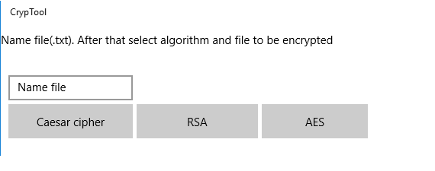
Graphical interface
First interface

Slide 4
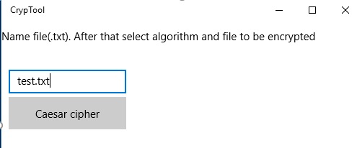

Slide 5
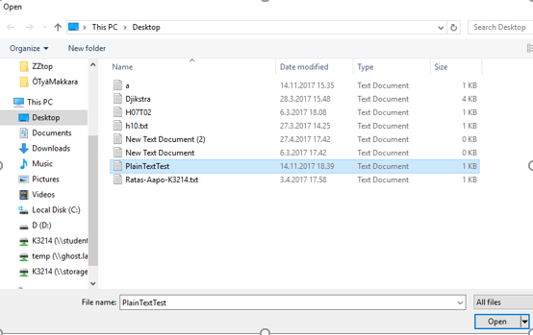
Graphical Interface
Second interface
In the folder is ’abcdefg’

Slide 6
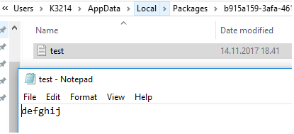
Interface
Crypted file saved.

Slide 7
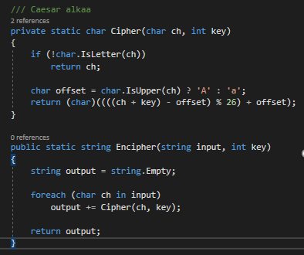
Code - Caesar

Slide 8
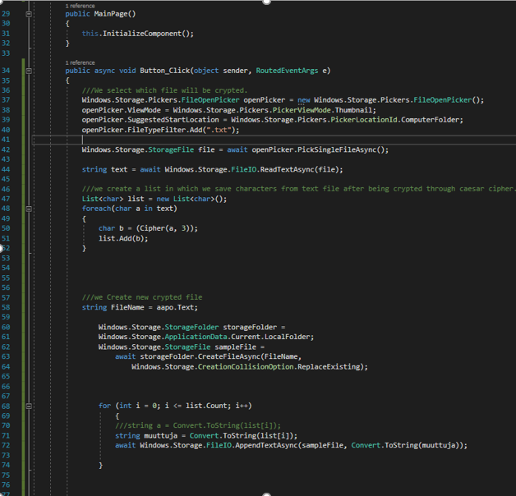
Code

Slide 9
Code
Idea was to save characters from file to a list and crypt them one by one.
Print encrypted text character at a time to a new file.

Slide 10
Conclusion
Basic code and interface works fine
Openin – and saving to file was the hardest part.
Very dissapointed that we only got 1 algorithm to work
Though, the program itself works and only lacks those algorithm

Slide 11
Thank You

