Slide 1
E-COMMERCE SALES & CUSTOMER ANALYTICS
E-commerce sales
and customer analytics
Data analysis · sales, products, customers, markets and time trends
Python · Pandas · NumPy · Matplotlib · Seaborn · SQL/MySQL
01

Slide 2
SCOPE AND METHOD
524,878 cleaned transactions provide a broad view of sales performance
524,878
12
19,962
4,338
cleaned transaction rows
analysis columns
unique orders
identified customers
01
Prepare the base
02
Engineer the data
03
Answer business questions
Remove duplicates, handle missing descriptions and customer IDs, and exclude non-positive quantity or price transactions.
Create Revenue, Year, Month_Name and Day to support KPI, product, geography and time analysis.
Use Python analysis, visualization and the project's SQL/MySQL scope to turn transactions into business insights.
SOURCE · E-Commerce Sales & Customer Analytics
02

Slide 3
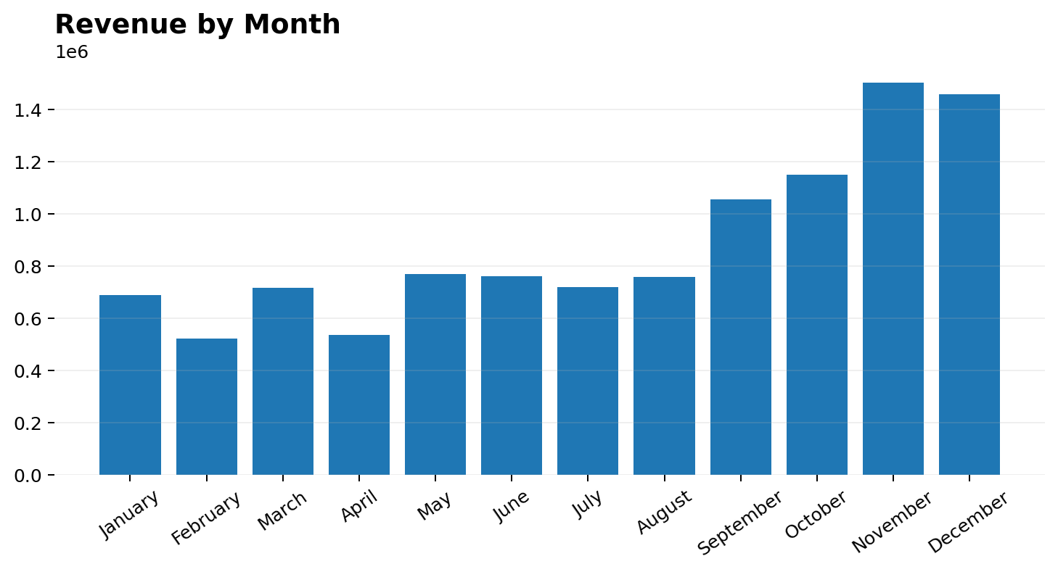
REVENUE PERFORMANCE
Revenue is highly concentrated in the strongest sales periods
PEAK MONTH
November
≈ 15.4 lakh
Highest recorded monthly revenue in the project analysis. December follows at approximately 14.59 lakh.
SO WHAT
Peak periods require inventory and operational capacity; weaker months create an opportunity for targeted promotions.
SOURCE · Project analysis · Revenue by Month
03

Slide 4
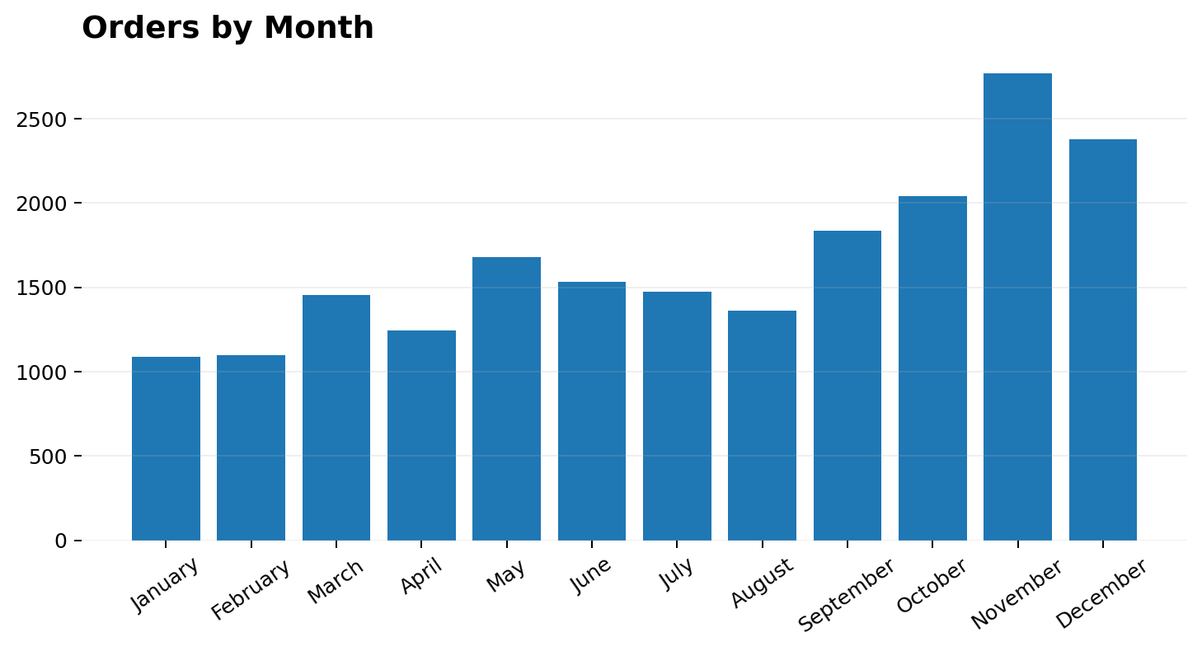
ORDER VOLUME
Order activity follows the same seasonal peak as revenue
NOVEMBER
2,769 orders
Highest monthly order count in the analyzed data. December follows with 2,378 orders.
DECISION FRAME
Plan stock, fulfillment capacity and customer support ahead of the peak season.
SOURCE · Project analysis · Orders by Month
04

Slide 5
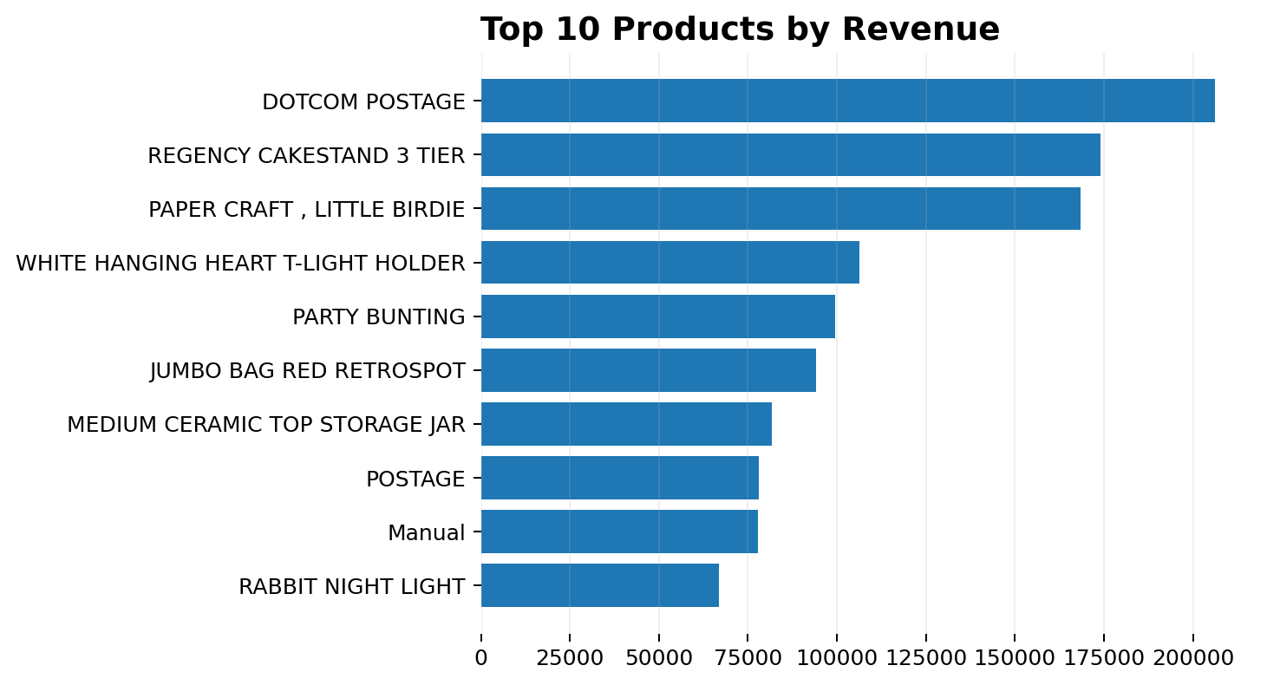
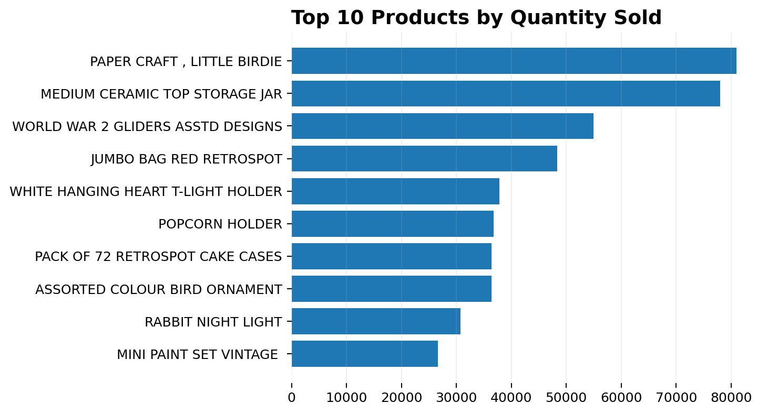
PRODUCT PERFORMANCE
A small group of products drives meaningful revenue and volume
Revenue leader: DOTCOM POSTAGE · ≈ 2.06 lakh
Quantity leader: PAPER CRAFT, LITTLE BIRDIE · 80,995 units
SOURCE · Project analysis · Product revenue and quantity
05

Slide 6
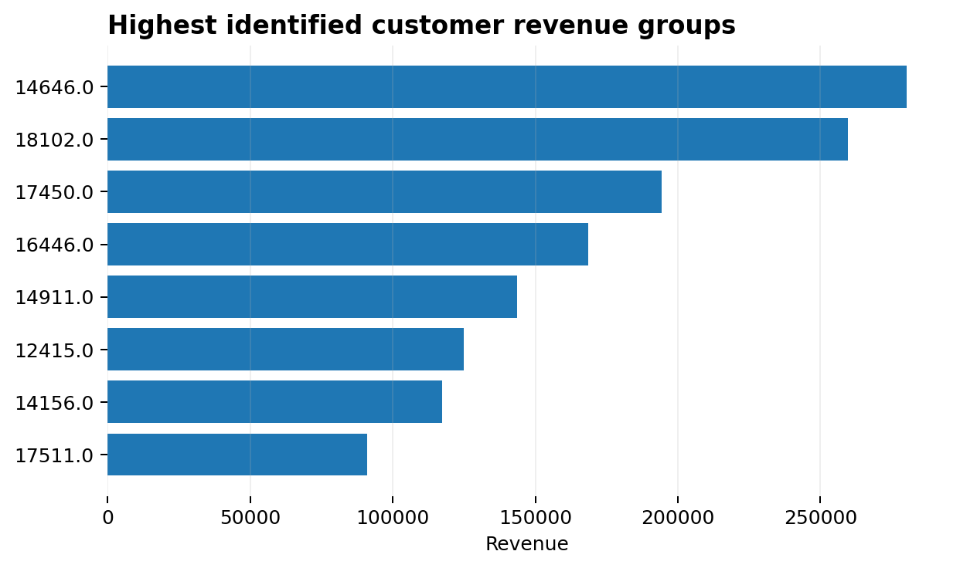
CUSTOMER VALUE
Customer-level analysis can identify high-value revenue groups
TOP CUSTOMER GROUPS BY REVENUE
DATA QUALITY NOTE
Customer ID 0 represents transactions whose original Customer ID was missing. It should not be interpreted as one real customer.
BUSINESS USE
Use identified high-value customers as a starting point for retention, loyalty and personalized offers.
SOURCE · Project analysis · Customer revenue
06

Slide 7
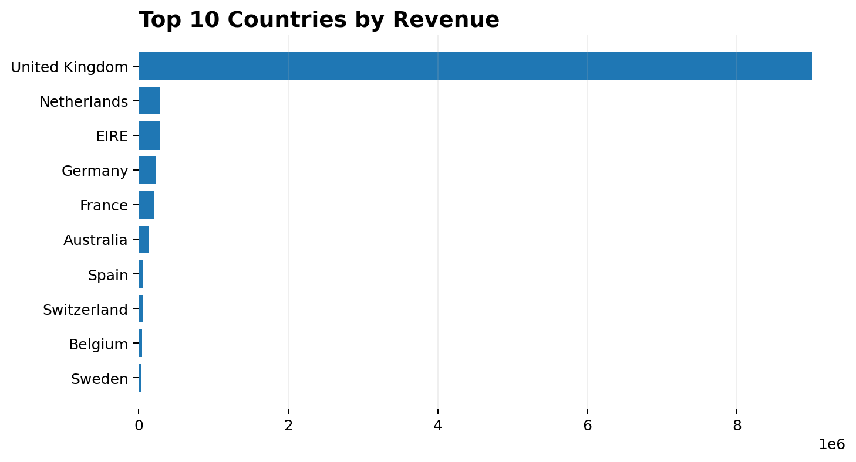
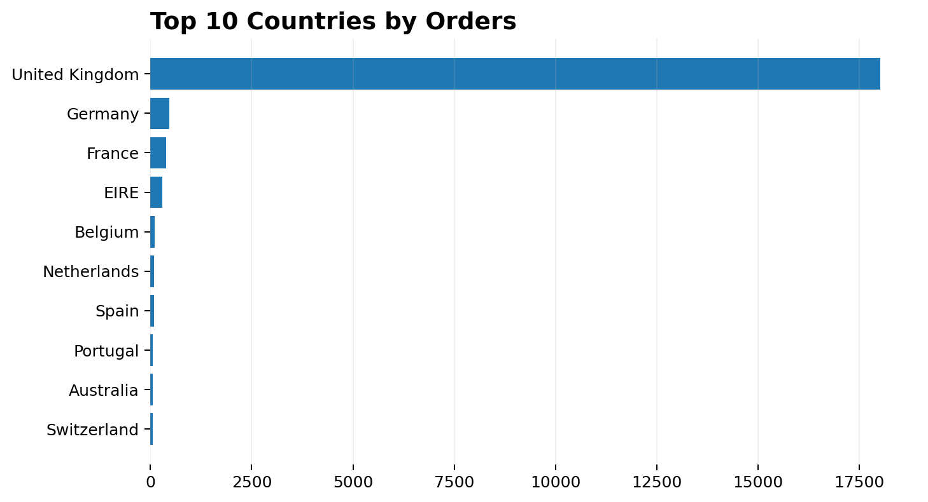
GEOGRAPHIC PERFORMANCE
The United Kingdom is the dominant market in the analysis
≈ 90.02 lakh revenue
18,019 orders
SOURCE · Project analysis · Country revenue and orders
07

Slide 8
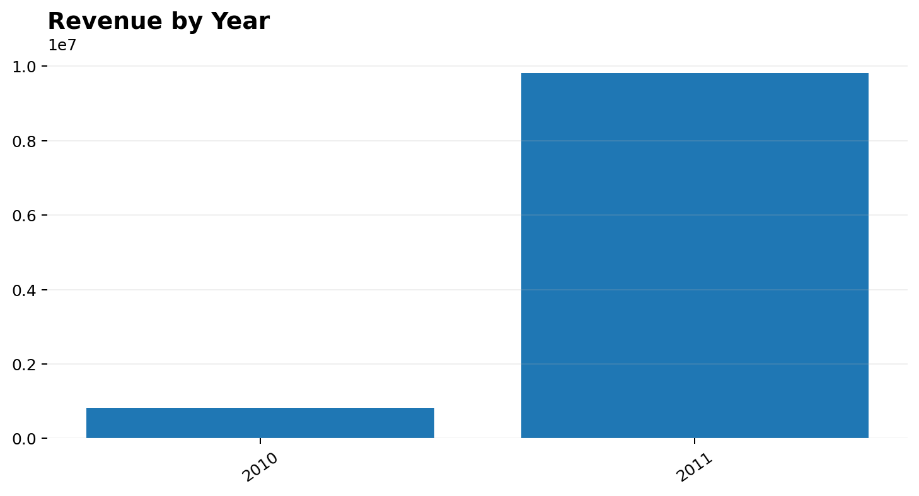
YEARLY PERFORMANCE
Revenue increased substantially from 2010 to 2011
2010
≈ 8.21 lakh
2011
≈ 98.21 lakh
NEXT ANALYSIS
Investigate which products, markets and customer behaviors contributed to the year-over-year increase.
SOURCE · Project analysis · Revenue by Year
08

Slide 9
RECOMMENDATIONS
Observed patterns can be converted into focused business actions
01
Prepare for peak demand
Align inventory and operational capacity with November and December demand.
02
Protect product availability
Prioritize stock planning for high-revenue and high-volume products.
03
Retain high-value customers
Use loyalty initiatives and personalized offers for identified high-value customers.
04
Strengthen the core market
Maintain strong service and operational capacity in the United Kingdom.
05
Activate weaker periods
Test targeted promotions and engagement strategies in lower-performing months.
DECISION LOGIC
Observed behavior → focused action → measured commercial outcome
SOURCE · E-Commerce Sales & Customer Analytics
09

Slide 10
CONCLUSION
The analysis turns transactional data into a practical business readout
01
Sales
Revenue and order activity peak around November and December.
02
Products
A focused set of products leads revenue or sales volume.
03
Markets
The United Kingdom dominates the analyzed revenue and order base.
04
Customers
Customer revenue analysis provides a basis for retention and loyalty strategies.
05
Growth
The 2010–2011 increase should be investigated to understand its drivers.
E-COMMERCE SALES & CUSTOMER ANALYTICS · DATA ANALYSIS PROJECT
10

