Slide 1
PYTHON BASICS
Lesson 6
Tracing

Slide 2
Tracing
Tracing a program means running the program, by hand, on paper.
Tracing a program is an excellent way to:
1. Understand what someone else's program is doing.
2. Find errors in your own program.

Slide 3
How to Trace
Find all variables in the program
Write these variables as headings in a nice neat table
Add a heading for output.
Follow the program one line at a time and record any changes to the variables.
Keep in mind that variables only hold one value at a time so any reference to a variable refers to its current value (the bottom value in that column)

Slide 4
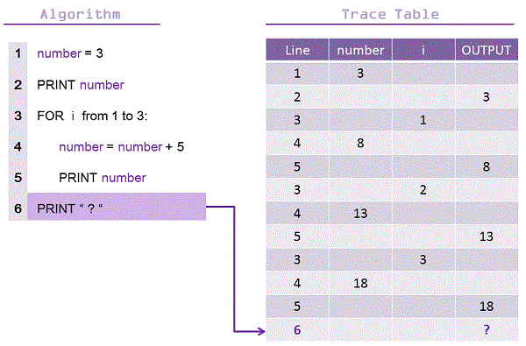
Trace Table Example

Slide 5
Review Questions
#Using Microsoft Word, create a table to trace the following program and save it as trace1.doc. Save a copy for yourself and submit a copy into your hand-in folder.
# trace1.py
t1 = 1
t2 = 1
t3 = 0
while t3 < 50:
t3 = t1 + t2
print t3
t1 = t2
t2 = t3

Slide 6
Review Question
#Using Microsoft Word, create a table to trace the following program and save it as trace2.doc. Save a copy for yourself and submit a copy into your hand-in folder.
# trace2.py
name = "Google"
ans = ""
pos = 0
while pos < len(name):
ans = name[pos] + ans
pos += 1
print ans

