Slide 1

Breast Cancer Prediction using Machine Learning
Early and accurate diagnosis can save lives.
Objective: Build a classifier to distinguish between benign (non-cancerous) and malignant (cancerous) tumors.

Slide 2
Chapter 1
Dataset Overview & Preparation
Our project utilized the publicly available Breast Cancer Wisconsin (Diagnostic) dataset from Kaggle. This robust dataset provides a foundation for developing and testing predictive models.
30
Numeric features covering cell characteristics (e.g., radius, texture, symmetry).
Source: Kaggle - Breast Cancer Wisconsin (Diagnostic)
Rigorous preprocessing was essential to ensure data quality, including:
Handling missing values,
Removing irrelevant columns, and
Standardizing features for optimal model performance.
Total Samples: 569 patient records
Target Variable: Diagnosis (M = Malignant, B = Benign)

Slide 3
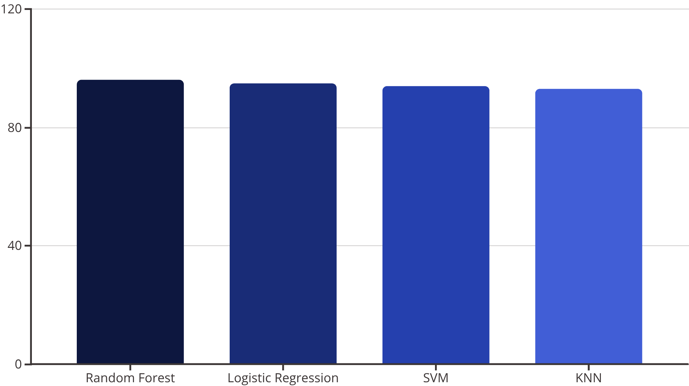

Model Development & Performance
We explored several robust machine learning models, training them on 80% of the data and testing on the remaining 20% using a stratified split to maintain class distribution.
Models Evaluated:
Logistic Regression
Random Forest
Support Vector Machine (SVM)
K-Nearest Neighbors (KNN)
Best Performer:
Random Forest at ~96% accuracy. Its ensemble approach proved most effective in capturing complex patterns within the dataset.

Slide 4



Conclusion & Future Directions
High Accuracy
Robustness
Future Work
Exceptional precision in distinguishing between malignant and benign cases.
Consistent performance, even with varying data subsets, crucial for real-world application.
Hyperparameter tuning,
Testing on diverse datasets, and
Exploring Deep Learning for advanced feature extraction.
This project lays the groundwork for developing accessible and effective diagnostic aids, potentially transforming early detection strategies.

