Slide 1
Automated Spice Mixer
Group S9
Michael Kuchnik, Philippe Laban, Sunny Patel, RatchapongTangkijvorakul

Slide 2
Intro
Four technical aspects of the Automated Spice Mixer project are introduced:
General computing and controllers
Mechanical layout of storage
Weighing and vibration configuration
User Interface guidelines

Slide 3
Computing
Distributed system of computers.
Raspberry Pi as central computer with Linux, interacting with user and network.
Multiple microcontrollers to offload control and sensor logic and maintain real time constraints.
Controllers will decouple carousel from containers, allowing separate development and test.

Slide 4
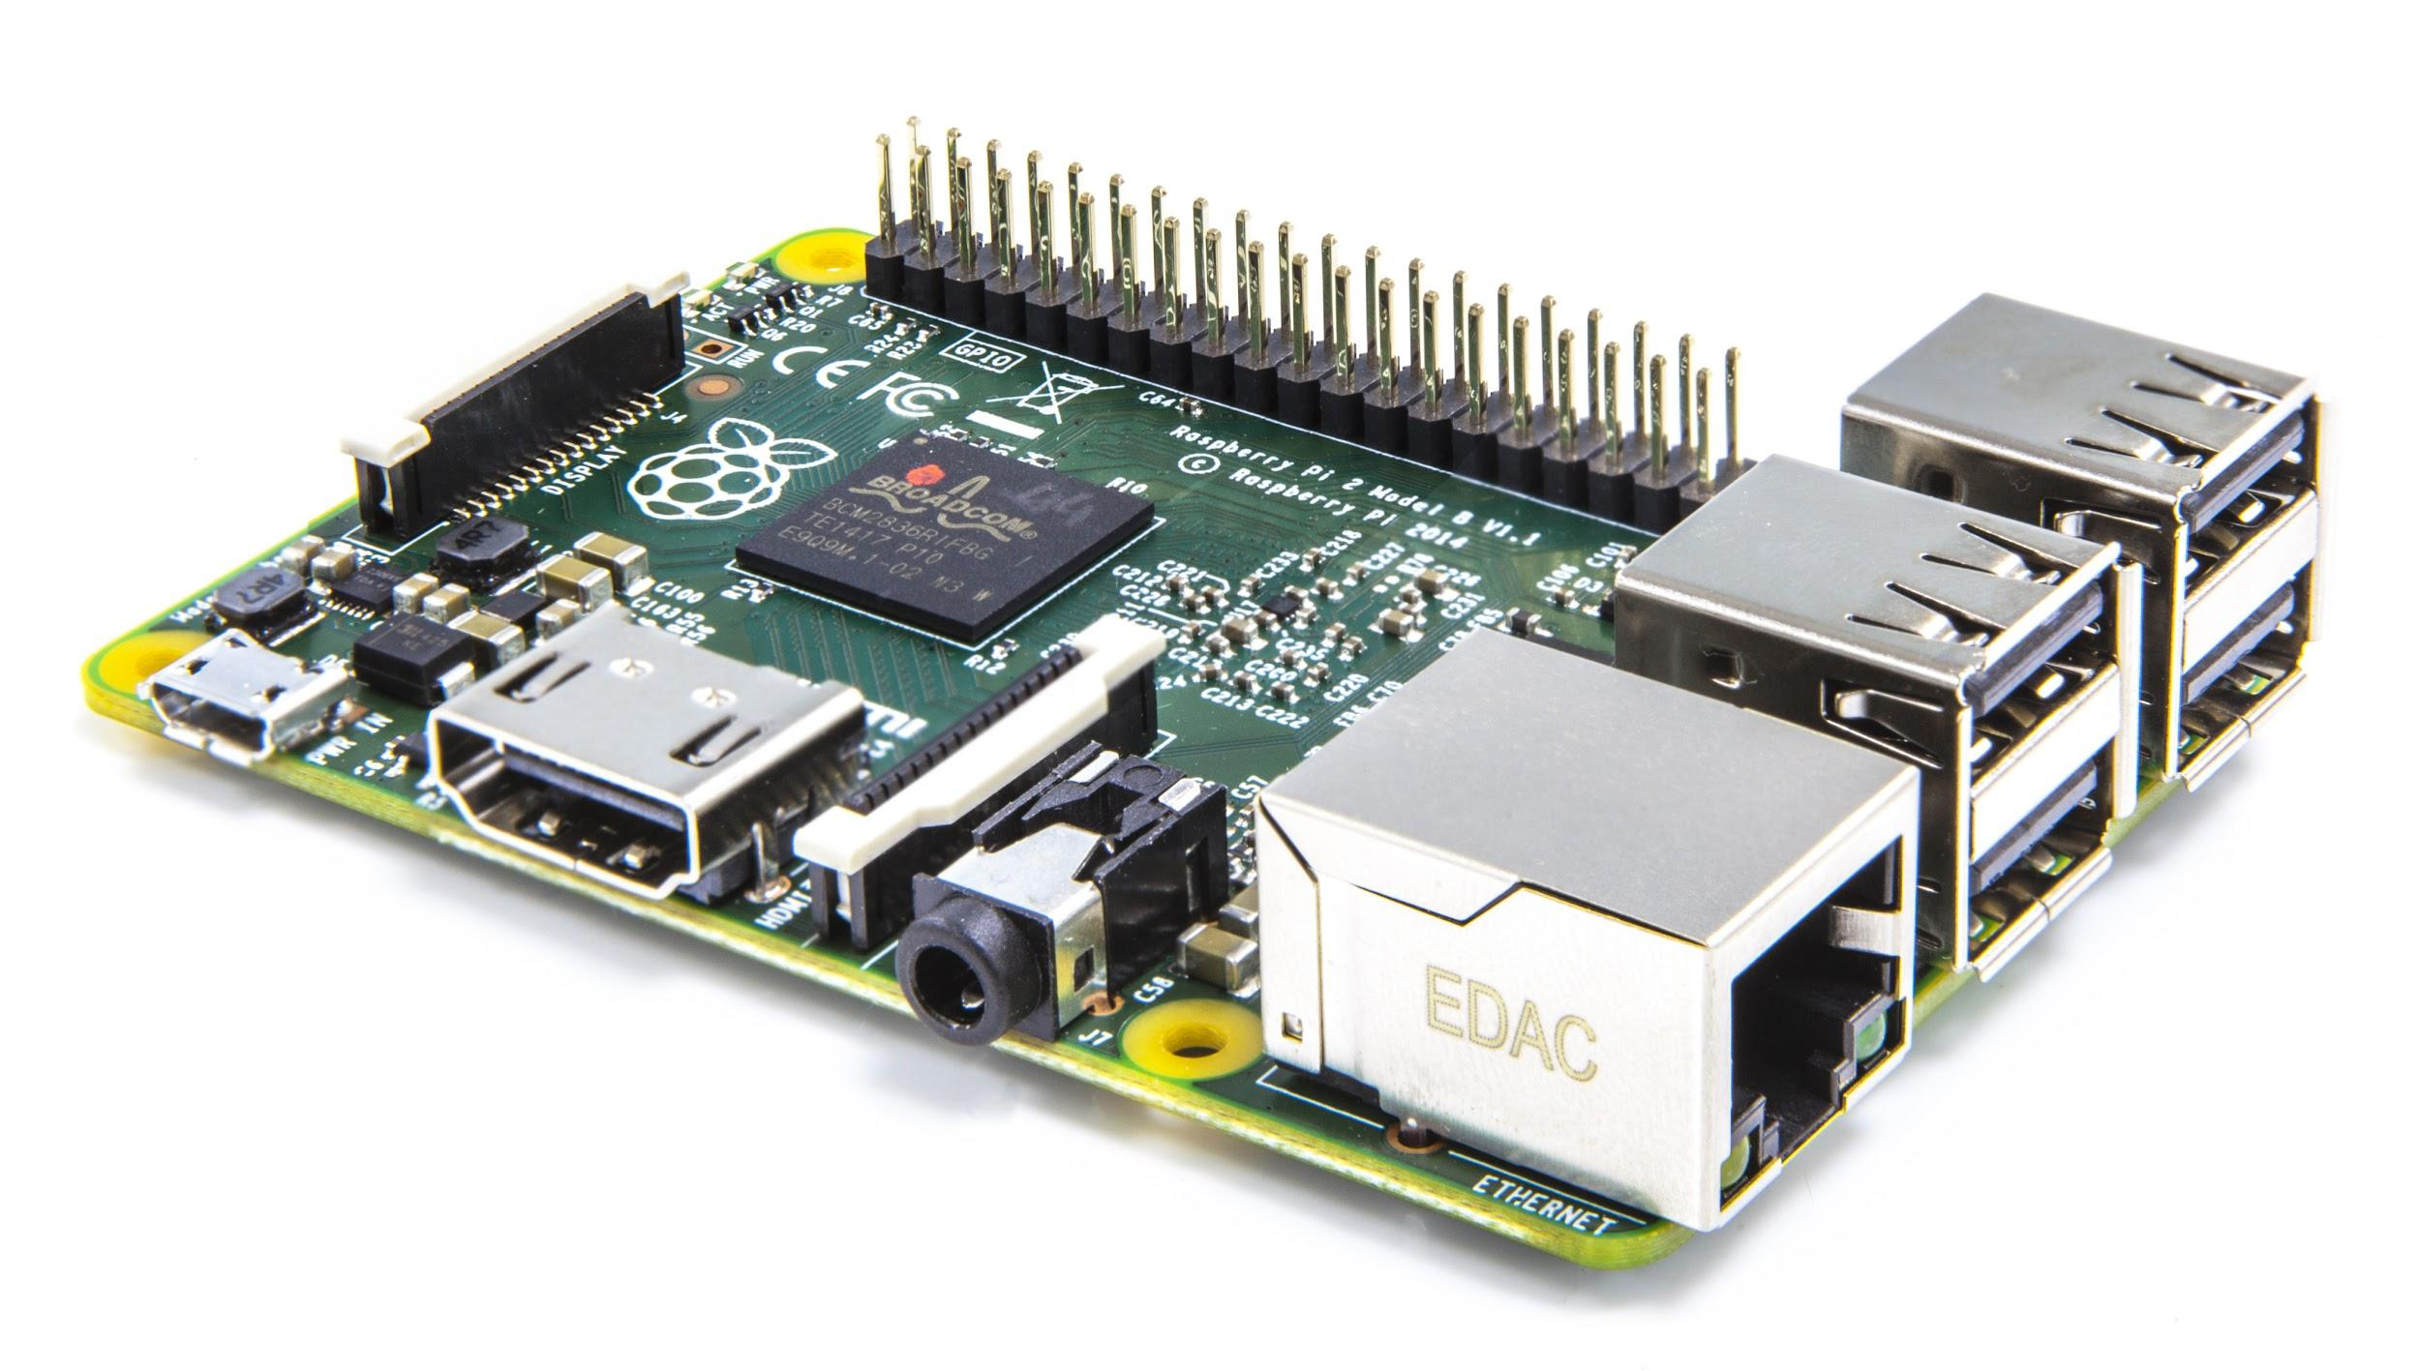
Raspberry Pi
Strong Processor and Operating System Services (networking, GUI, display, GPU).
Low pin count, limited device protocol support (SPI, I2C, CAN), low compute reliability.
Good for central brain to command specialized controllers.

Slide 5
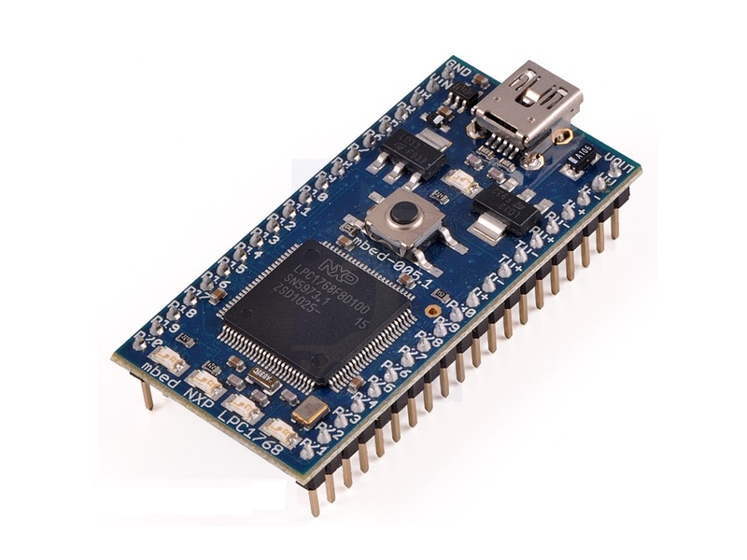
Specialized Controllers
Specialized microcontrollers are cheaper, more efficient, and have more hardware support for pins.
Will be running simple control/sensor loop with state controlled by Pi.
May be embedded into the device packaging.

Slide 6
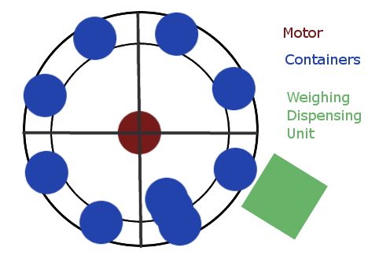
Mechanical Layout
Horizontal Carousel
Rails to stabilize containers
Containers lifted off rails for weighing and dispensing
Shaking/Vibrating Unit implemented with Dispensing unit

Slide 7
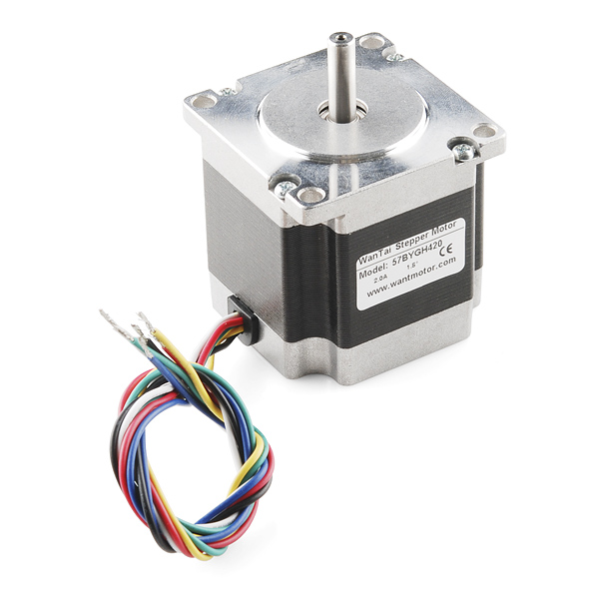
Motor Choice
Current Choice: Stepper Motor, 125 oz.in
Unipolar or Bipolar
Step Angle: 1.8 degrees (precise enough)
Available with more torque if needed
Motor Datasheet

Slide 8
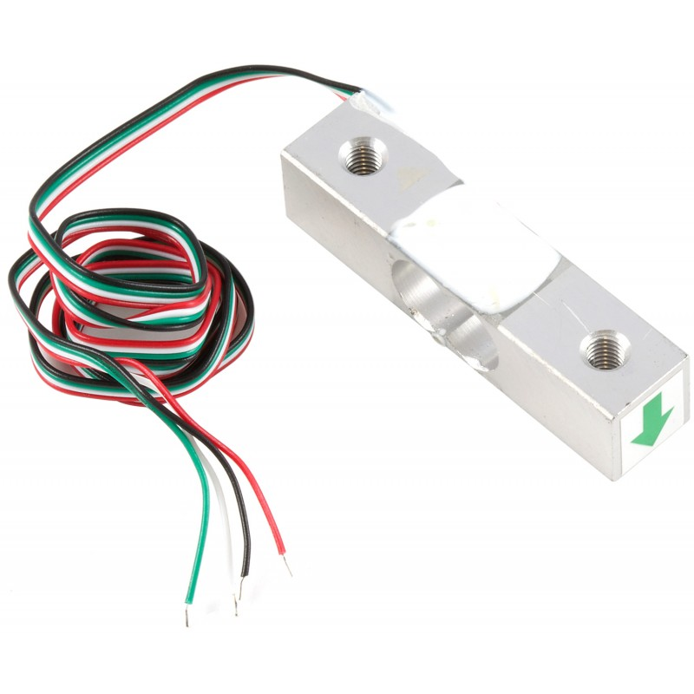
Weighing Mechanism
Micro load cell as the main component for weighing each container.
Micro load cell has 5 kg load limit
Resolution of 0.05%.
+/- 2.5 grams
The weight will be displayed on the LCD touchscreen

Slide 9
Mechanism Diagram
Attached to the micro load cell is a ring smaller than the diameter of the container
The ring will be able to hold the cone shaped container steady and take an accurate measurement
The load cell has a hole to mount the ring extension
The ring will vibrate to help dispense the spices
Container
5 kg Micro Load Cell

Slide 10
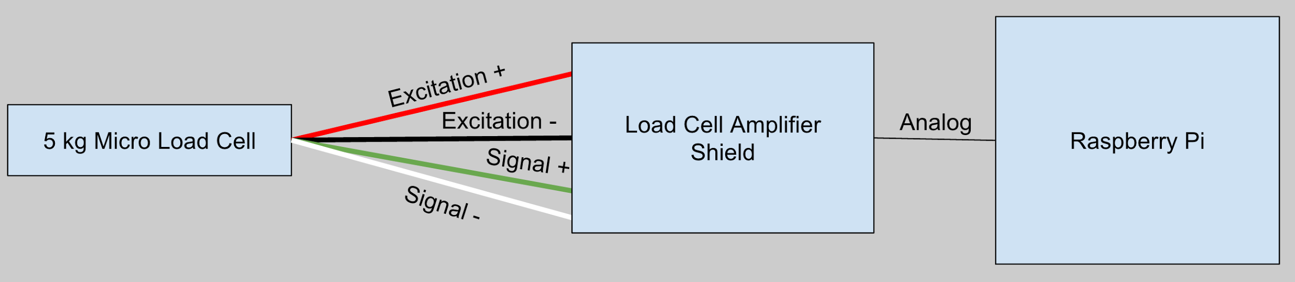
Connection Diagram
Micro load cell is connected to a load cell amplifier via four wires
The load cell amplifier is then connected via Analog to the Raspberry Pi

Slide 11
User Interface Design Principles
Touchscreen LCD 7” will be used to display GUI.
Employ User Interface Design Principles
The Gestalt Principles
Ensure that the design is intuitive
Don Norman’s Design Principles
Ensure that the design is user-friendly

Slide 12
User Interface Design (Gestalt)
Proximity
Buttons are placed to provide visual context
Similarity
Consistent fonts and styling for different context (Menu capitalized etc.)
Common Fate
Neat alignment of object in grid format
Closure
Each visual context is clearly divided (Closed rectangle etc.)

Slide 13
User Interface Design (Norman)
Two important will be focused on.
Feedback
Show user relevant information after he/she executes the task.
Affordance
User should intuitively know “how to use” the interface.
Other concepts such as Visibility, Constraints, Mapping, Consistency will also be adhered to but not as strictly.

Slide 14

Questions?

