Slide 1
Bioinformatics Lecture 02
Course Code: CSE 469
Credit: 3.0
Total Course Hour: 36

Slide 2
Cell Cycle
Living cells go through a series of stages known as the cell cycle. The cells grow, copy their chromosomes, and then divide to form new cells.
G1 phase. The cell grows.
S phase. The cell makes copies of its chromosomes. Each chromosome now consists of two sister chromatids.
G2 phase. The cell checks the duplicated chromosomes and gets ready to divide.
M phase. The cell separates the copied chromosomes to form two full sets (mitosis) and the cell divides into two new cells (cytokinesis).
The period between cell divisions is known as 'interphase'.
Cells that are not dividing leave the cell cycle and stay in G0.

Slide 3
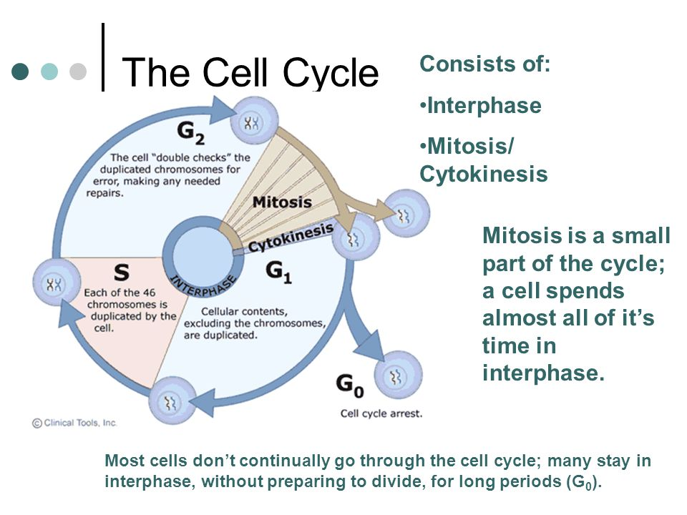

Slide 4
Cell Division
All cells are derived from pre-existing cells
New cells are produced for growth and to replace damaged or old cells
Differs in prokaryotes (bacteria) and eukaryotes (plants & animals)
DNA must be copied or replicated before cell division
Each new cell will then have an identical copy of the DNA
Two types Mitosis & Meiosis

Slide 5
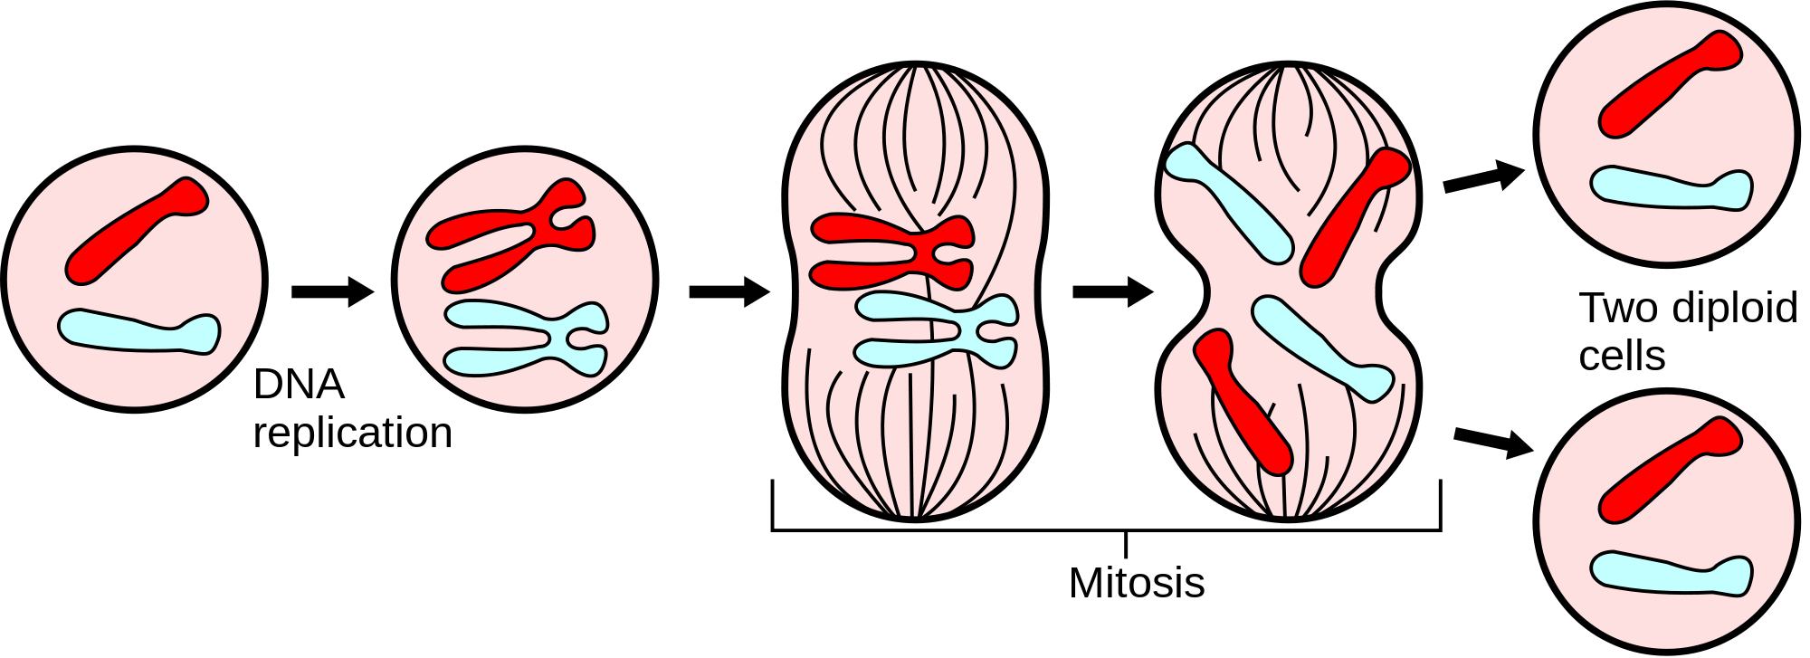
Mitosis

Slide 6
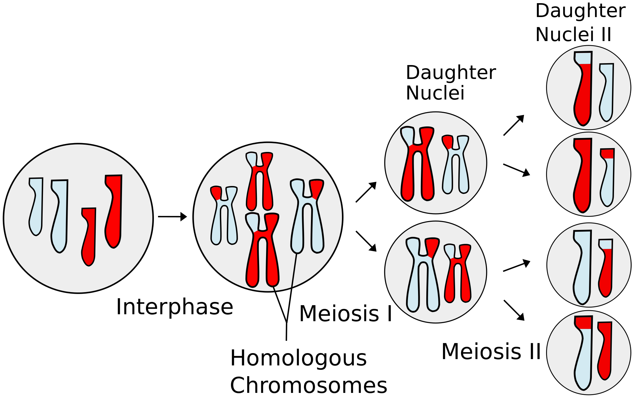
Meiosis
Crossover

Slide 7
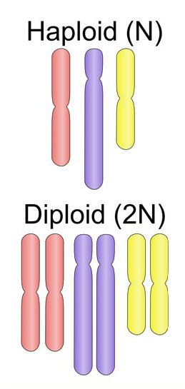
Haploid vs Diploid Cells
A diploid cell has two of each chromosome, one from each parent. Diploid cells comprise the majority of your body, example- somatic cells.
A haploid cell, which only has one copy of every chromosome. Examples of haploid cells are eggs and sperm (also called gametes).
If a haploid cell has n chromosomes, a diploid cell has 2n (n represents a number, which is different for every species – in humans, for example, n = 23 and 2n = 46).

Slide 8
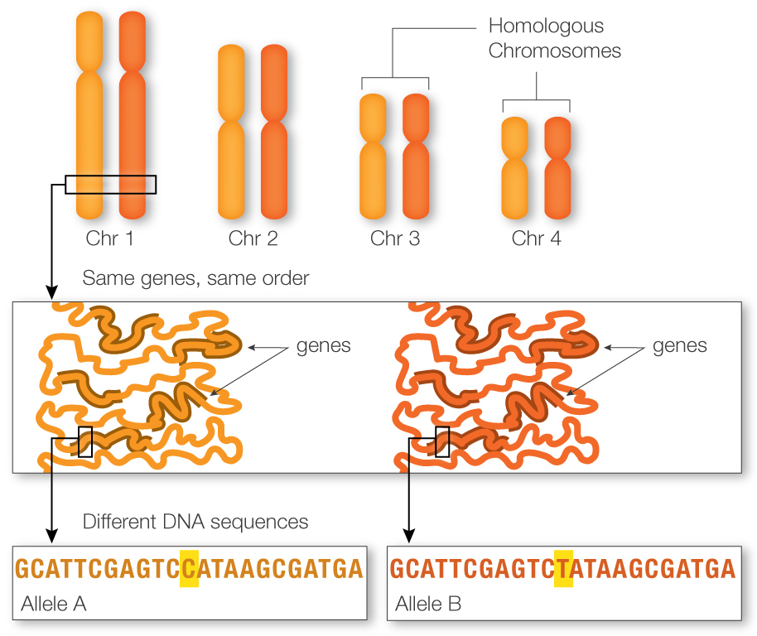
Homologous Chromosomes

Slide 9
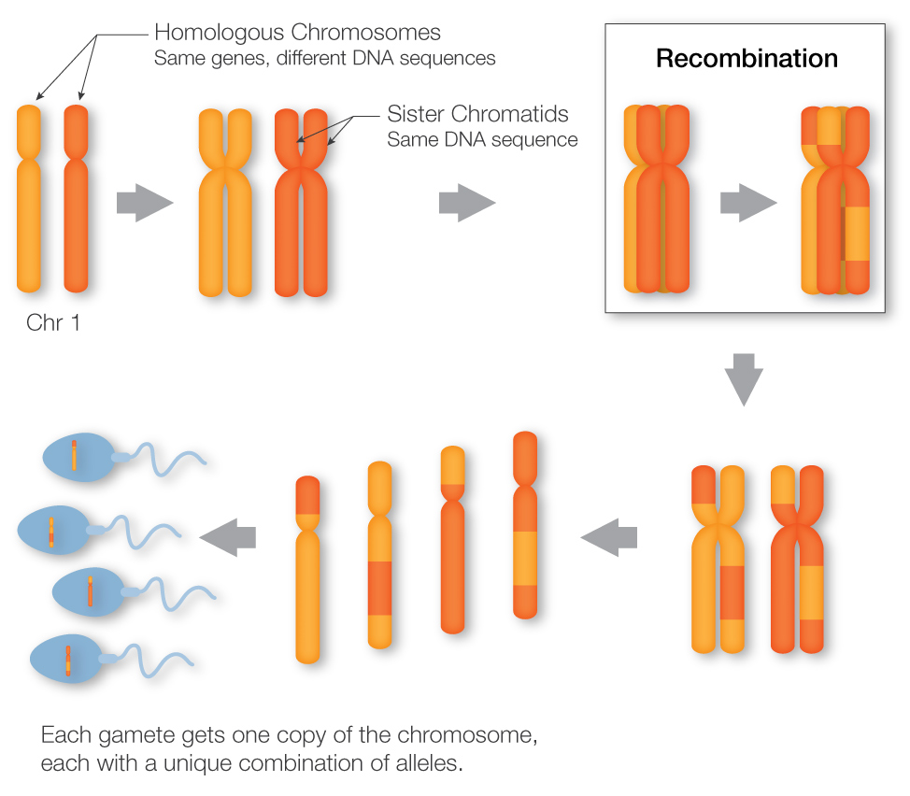
Recombination or Crossover

Slide 10
Genetics
Gene - a unit of heredity; a section of DNA sequence encoding a single protein A gene is the basic physical and functional unit of heredity. Genes, which are made up of DNA, act as instructions to make molecules called proteins. In humans, genes vary in size from a few hundred DNA bases to more than 2 million bases. The Human Genome Project has estimated that humans have between 20,000 and 25,000 genes. Every person has two copies of each gene, one inherited from each parent.
Genome - A genome is an organism’s complete set of DNA, including all of its genes. Each genome contains all of the information needed to build and maintain that organism. In humans, a copy of the entire genome more than 3 billion DNA base pairs is contained in all cells that have a nucleus.
Each genome contains all of the information needed to build and maintain that organism.
Genetics is the study of genes or heredity, the process in which a parent passes certain genes onto their children.

Slide 11
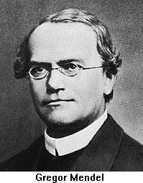
Gregor Johann Mendel
Is considered “The Father of Genetics“
Born in what is now Czech Republic in 1822
Son of peasant farmer, studied Theology and was ordained priest Order St. Augustine.
Went to the university of Vienna, where he studied botany and learned the Scientific Method
Worked with pure lines of peas for eight years
Work was largely ignored for 34 years, until 1900, when 3 independent botanists rediscovered Mendel’s work.
Mendel was the first biologist to use Mathematics – to explain his results quantitatively.
Mendel predicted The concept of genes That genes occur in pairs That one gene of each pair is present in the gametes

Slide 12
Genetic Terms
Homologous Chromosome - The two chromosomes from a particular pair, normally one inherited from the mother and one from the father, containing the same genetic loci in the same order
Allele - two genes that occupy the same position on homologous chromosomes and that cover the same trait (like ‘flavors’ of a trait).
Homozygous – having identical genes (one from each parent) for a particular characteristic.
Heterozygous – having two different genes for a particular characteristic.
Dominant – the allele of a gene that masks or suppresses the expression of an alternate allele; the trait appears in the heterozygous condition.
Recessive – an allele that is masked by a dominant allele; does not appear in the heterozygous condition, only in homozygous.

Slide 13
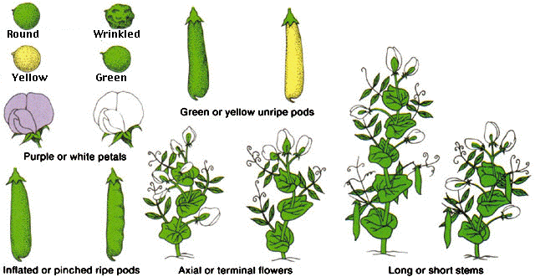
Mendel’s peas
Mendel looked at seven traits or characteristics of pea plants:

Slide 14
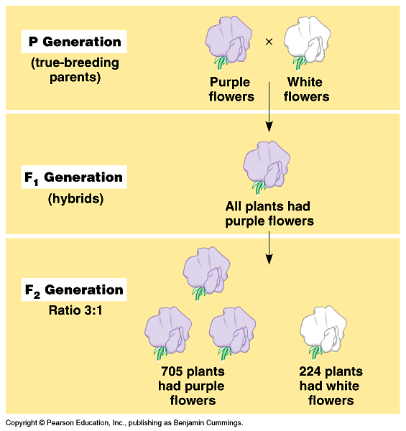
Mendel’s Laws
The first law, The Law of Segregation, states that during fertilization each parent passes on one allele for each trait. Which allele the offspring would get from the parents is random.
The second law, The Law of Independent Assortment, states that transmission of one trait does not affect the transmission of other traits.
The third law, The Law of Dominance, states that one type of allele (the dominant) could mask the other (the recessive).

Slide 15
More Genetic Terms
Genotype – the genetic makeup of an organisms
Phenotype – the physical appearance of an organism (Genotype + environment)
Monohybrid cross: a genetic cross involving a single pair of genes (one trait); parents differ by a single trait.
Dihybrid cross: a genetic cross involving two pair of genes (two trait); parents differ by a two trait.
P = Parental generation
F₁ = First filial generation; offspring from a genetic cross.
F₂ = Second filial generation of a genetic cross

Slide 16
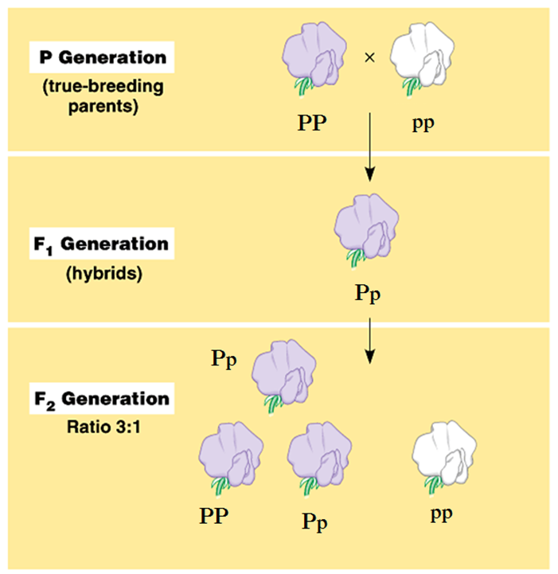
Genetic Terms
P = Allele for Purple (dominant)
p = Allele for White (recessive)
PP = Homozygous Purple Flower Pea Plant
pp = Homozygous White Flower Pea Plant
Pp = Heterozygous Purple Flower Pea Plant

Slide 17
Punnett Square
A useful tool to do genetic crosses
For a monohybrid cross, you need a square divided by four….
Looks like a window pane…
We use the Punnett square to predict the genotypes and phenotypes of the offspring.

Slide 18
Punnett Square for Parent Generation (P)
 |  | Homozygous Purple (PP)
 |  | P | P
Homozygous White (pp) | p | Pp Heterozygous Purple | Pp Heterozygous Purple
 | p | Pp Heterozygous Purple | Pp Heterozygous Purple
Genotypes
Pp | 100%
Phenotypes
Purple | 100%

Slide 19
Punnett Square for Filio Generation (F1)
Genotypes
PP | 1/4
Pp | 1/2
pp | 1/4
 |  | Heterozygous Purple (Pp)
 |  | P | p
Heterozygous Purple (Pp) | P | PP Homozygous Purple | Pp Heterozygous Purple
 | p | Pp Heterozygous Purple | pp Homozygous White
Phenotypes
Purple | 3/4
White | 1/4

Slide 20
Secret of the Punnett Square
Key to the Punnett Square:
Determine the gametes of each parent…
How? By “splitting” the genotypes of each parent:
If this is your cross
P P × p p
The gametes are:
P
P
p
p

Slide 21
Punnett Square for Parent Generation (P) Shortcut
 |  | Homozygous Purple (PP)
 |  | P
Homozygous White (pp) | p | Pp Heterozygous Purple
Genotypes
Pp | 100%
Phenotypes
Purple | 100%

Slide 22
Dihybrid cross: flower color and stem length
Genotypes
TTPP | 1/16
TTPp | 2/16
TtPP | 2/16
TtPp | 4/16
TTpp | 1/16
Ttpp | 2/16
ttPP | 1/16
ttPp | 2/16
ttpp | 1/16
 |  | Heterozygous Tall,Purple (TtPp)
 |  | TP | Tp | tP | tp
Heterozygous Tall,Purple (TtPp) | TP | TTPP Tall,Purple | TTPp Tall,Purple | TtPP Tall,Purple | TtPp Tall,Purple
 | Tp | TTPp Tall,Purple | TTpp Tall,White | TtPp Tall,Purple | Ttpp Tall,White
 | tP | TtPP Tall,Purple | TtPp Tall,Purple | ttPP Short,Purple | ttPp Short,Purple
 | tp | TtPp Tall,Purple | Ttpp Tall,White | ttPp Short,Purple | ttpp Short,White
Phenotypes
Tall,Purple | 9/16
Tall,White | 3/16
Short,Purple | 3/16
Short,White | 1/16

Slide 23
Sample Problems
Classify the following as heterozygous or homozygous: RR, Rr, yy, YyRR
What is the phenotype of the following: Yy, Rr, yy, YyRr
What is the probability of Rr x Rr producing wrinkled seeds?
What is the probability of Yy x yy producing green seeds?
What is the probability that RrYy x RRYy would produce RrYy
Round (R) is dominant to wrinkled (r). Yellow (Y) is dominant to green (y)

