Slide 1


Spatial patterns of air pollution as a probe for understanding environmental processing using public data.
Ziyi Wang
Supervised by Andrew Rate
2023-12-05/12

Slide 2
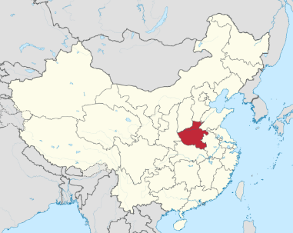
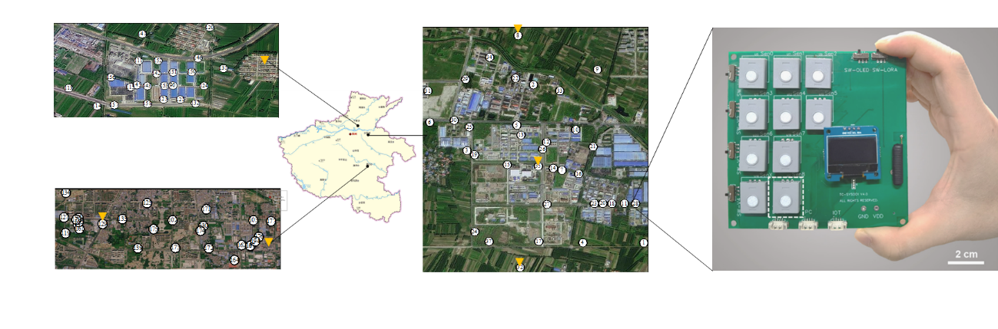
Study area in Henan
Plastic weaving park in XinXiang
0.6 km*0.5 km with 32 spots
Urban in ZhouKou
Chemical industrial park in KaiFeng
6.0 km*1.0 km with 27 spots
2.0 km*2.5 km with 36 spots

Slide 3
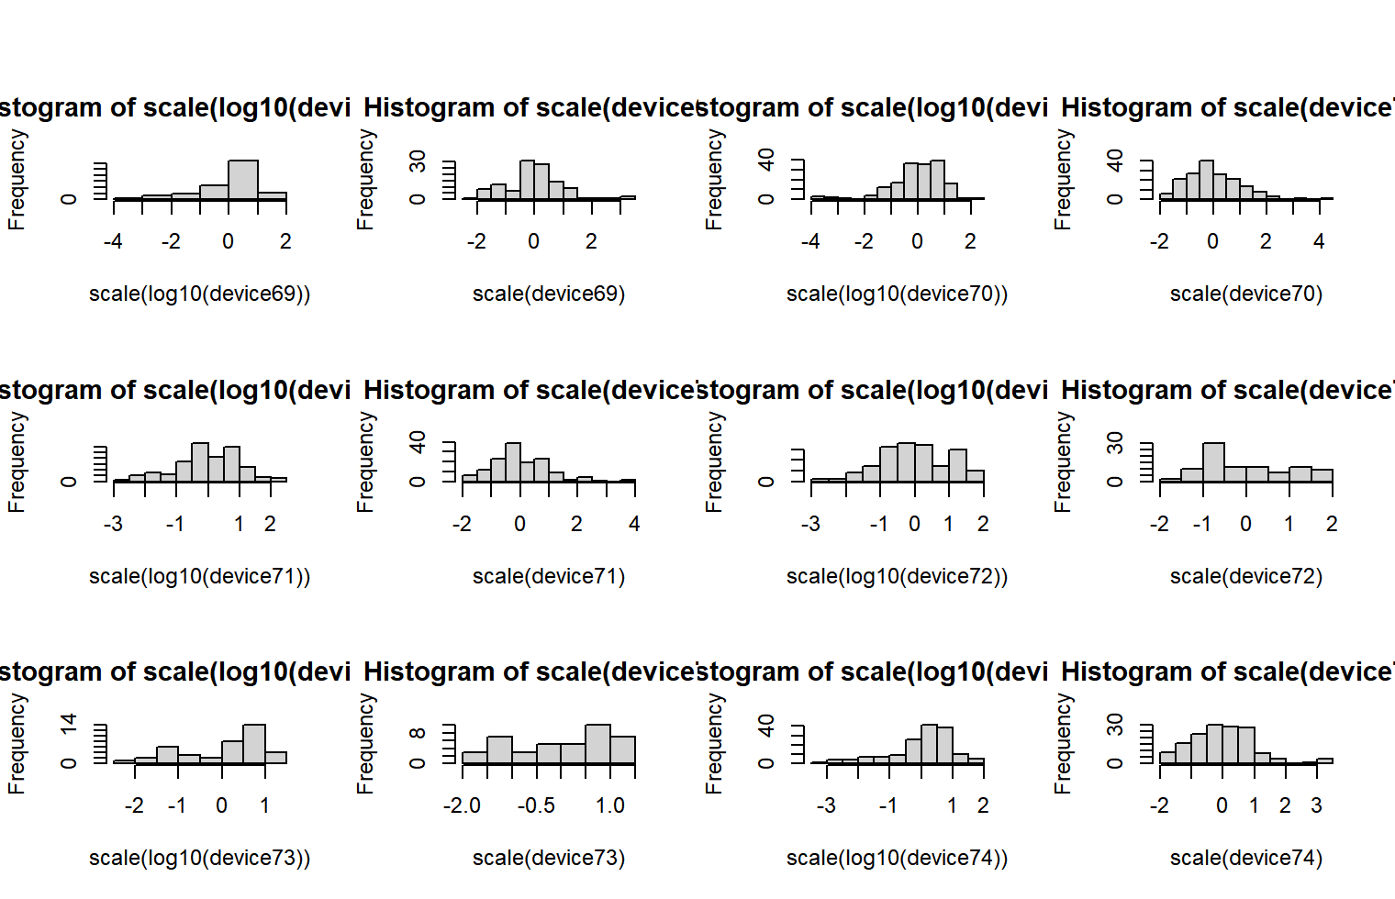
Data transformation
No transformation yet

Slide 4
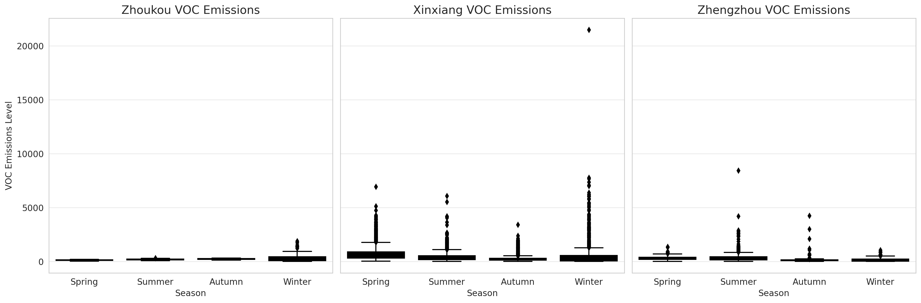
Graph to put (Logic of the Article)
seasonly pattern (from daily average)
ZK | spring | summer | atumn | winter
max | 1374 | 2894 | 4255 | 1067
qur | 409 | 450 | 155 | 228
med | 298 | 262 | 125 | 84
qur | 196 | 158 | 91 | 45
min | 19 | 17 | 11 | 11
XX | spring | summer | autum | winter
max | 6945 | 4055 | 3416 | 21496
qur | 950 | 585 | 295 | 561
me | 583 | 273 | 192 | 225
qur | 358 | 189 | 189 | 73
min | 40 | 62 | 13 | 11
KF | spring | summer | autum | winter
max | 567 | 1499 | 2397 | 3150
qur | 158 | 250 | 250 | 143
me | 114 | 185 | 178 | 80
qur | 78 | 144 | 122 | 36
min | 12 | 45 | 12 | 11
Notes:
要有对象，VOC；VOC传感器；短语要构成核心思想；提出问题和挑战。从散到有组织状态（直奔主题，能解决无组织问题）——为什么能解决——为什么现在的不行——如何做出能行的。

Slide 5
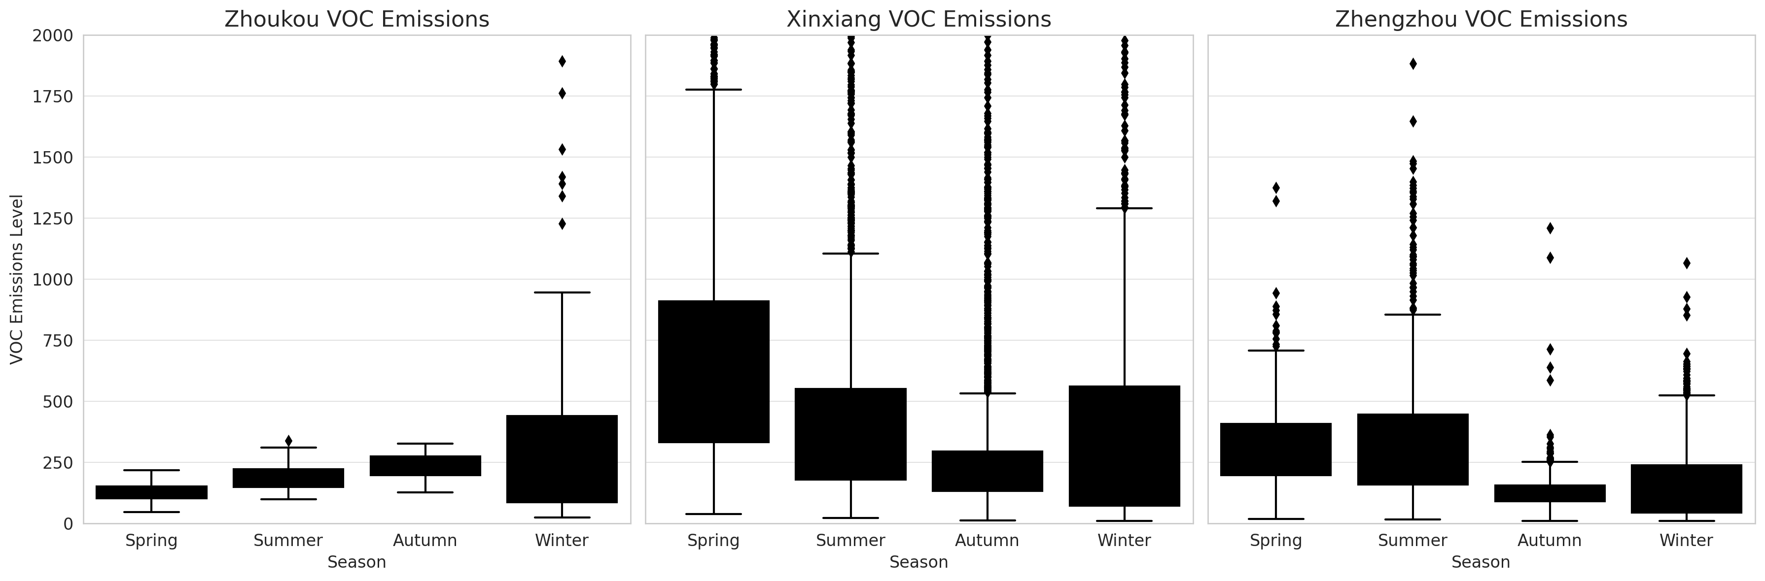
Graph to put (Logic of the Article)
seasonly pattern
ZK | spring | summer | atumn | winter
max | 1374 | 2894 | 4255 | 1067
qur | 409 | 450 | 155 | 228
med | 298 | 262 | 125 | 84
qur | 196 | 158 | 91 | 45
min | 19 | 17 | 11 | 11
XX | spring | summer | autum | winter
max | 6945 | 4055 | 3416 | 21496
qur | 950 | 585 | 295 | 561
me | 583 | 273 | 192 | 225
qur | 358 | 189 | 189 | 73
min | 40 | 62 | 13 | 11
KF | spring | summer | autum | winter
max | 567 | 1499 | 2397 | 3150
qur | 158 | 250 | 250 | 143
me | 114 | 185 | 178 | 80
qur | 78 | 144 | 122 | 36
min | 12 | 45 | 12 | 11
Notes:
要有对象，VOC；VOC传感器；短语要构成核心思想；提出问题和挑战。从散到有组织状态（直奔主题，能解决无组织问题）——为什么能解决——为什么现在的不行——如何做出能行的。

Slide 6
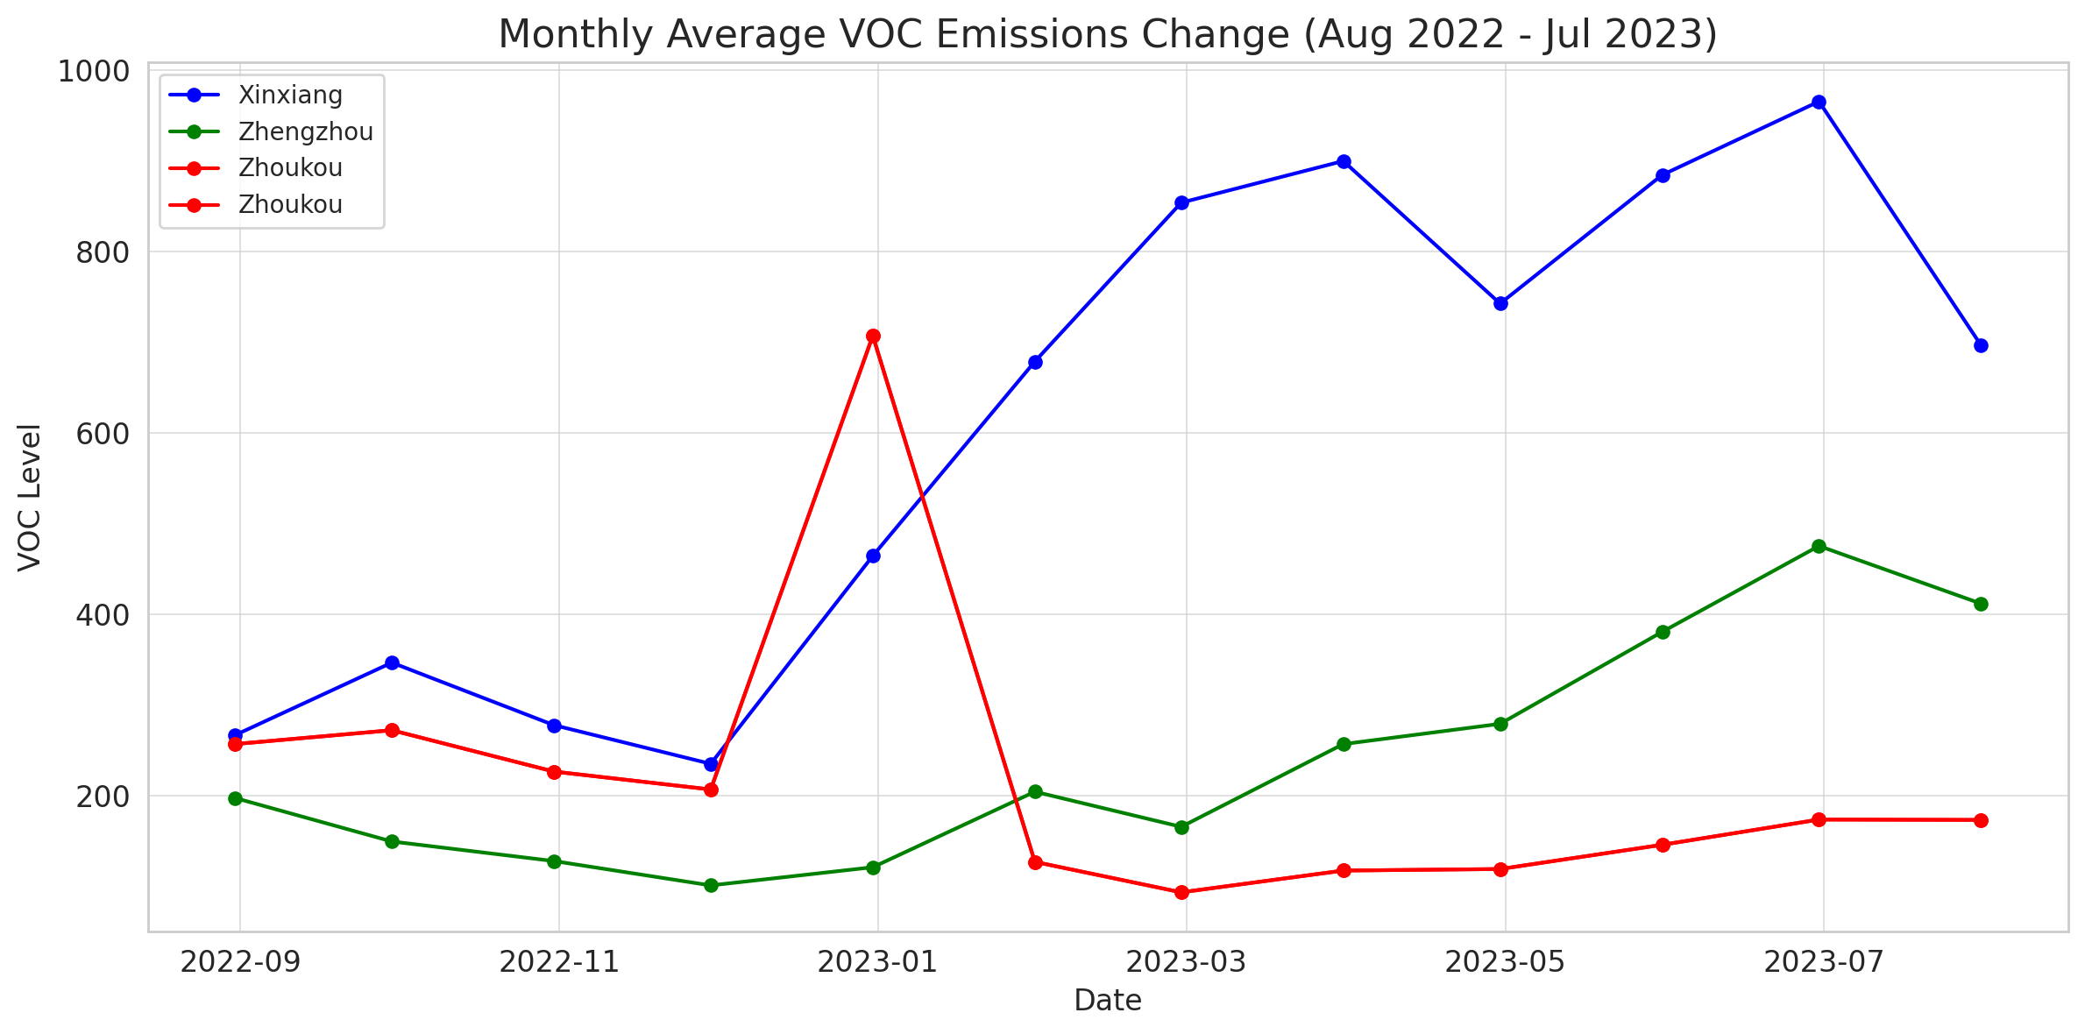
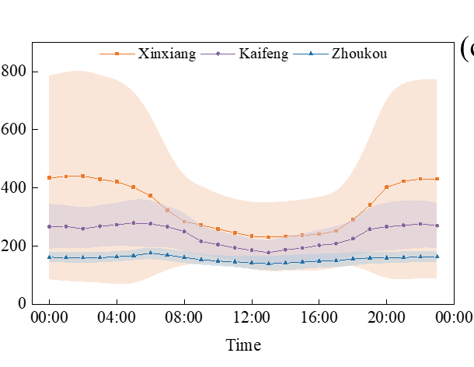
Graph to put (Logic of the Article)
Daily time series analysis for each place

Slide 7
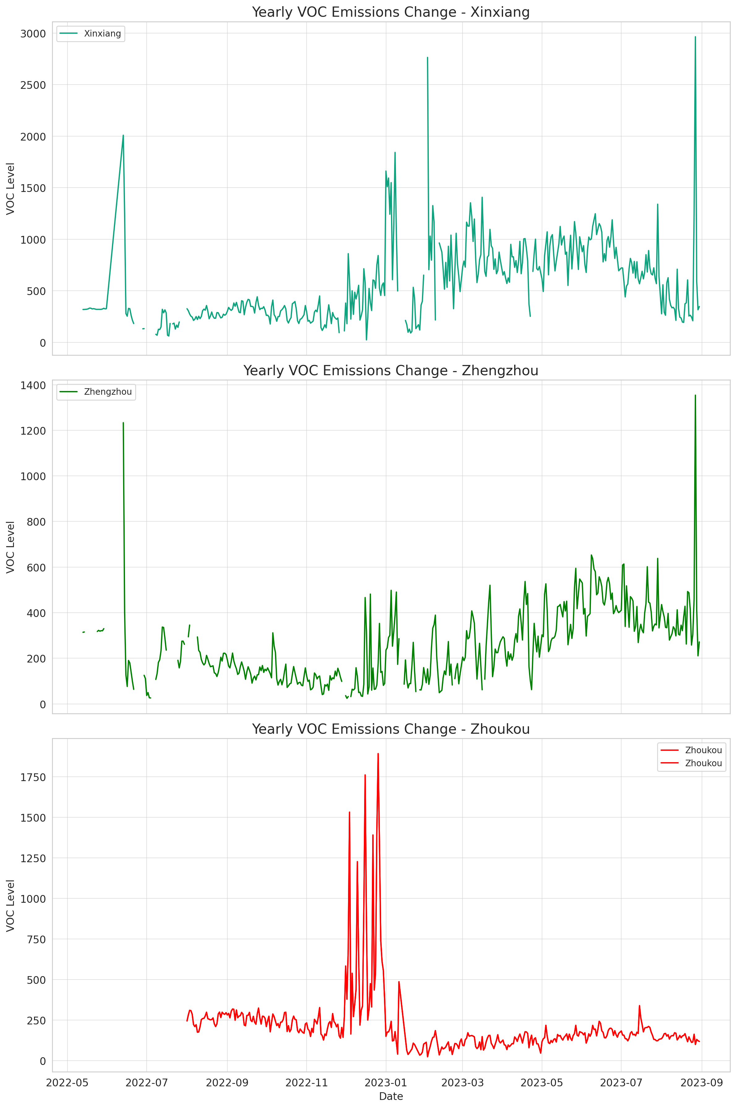
Graph to put (Logic of the Article)
time series analysis for each place

Slide 8
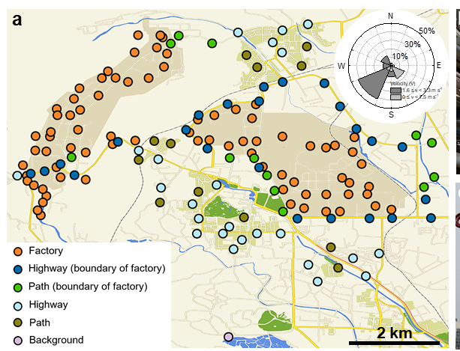
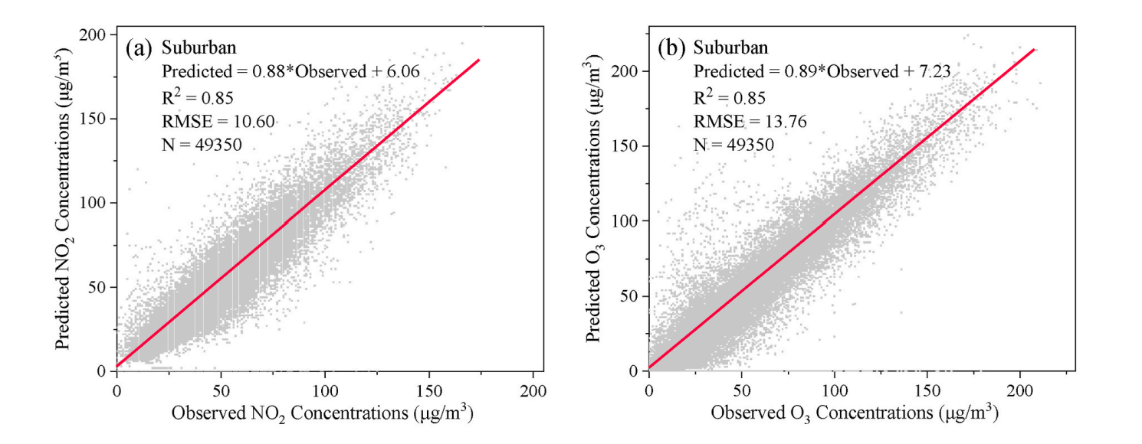
Graph to put (Logic of the Article)
AERMODE simulation (using seperate point,)
Initial emission in a representative point/day ( Combined with land type and background information)
AERMODE simulated emission after 1 hour/day
R² comparasion

Slide 9
Plan
plan before Andrew’s back
draft for intro/method/data presentation/discussion
emession distribution plot/staistical test/regression
distribution pattern-source/geological/local
plot to visualise
At the same time, chose a representative day in each season, run the model/plot- google earth

Slide 10

Acknowledgements
Collaborator:
TC Air Technology Co., Ltd
Prof. Zehui Li (Shanghai Jiao Tong University)
Notes:
要有对象，VOC；VOC传感器；短语要构成核心思想；提出问题和挑战。从散到有组织状态（直奔主题，能解决无组织问题）——为什么能解决——为什么现在的不行——如何做出能行的。

Slide 11
Thank you for your listening！
Email: andrew.rate@uwa.edu.au
21820087@student.uwa.edu.au
Notes:
要有对象，VOC；VOC传感器；短语要构成核心思想；提出问题和挑战。从散到有组织状态（直奔主题，能解决无组织问题）——为什么能解决——为什么现在的不行——如何做出能行的。

