Slide 1



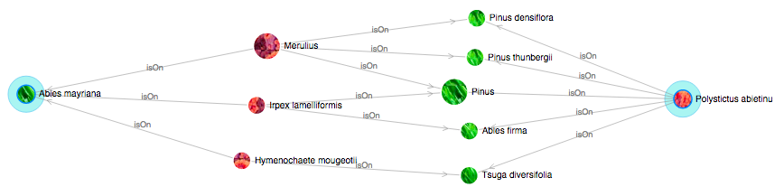
1
2
3
4
5
6
7

Slide 2
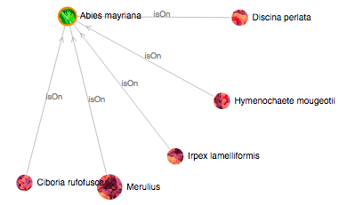
Double-Click

