Slide 1
GENERATIVE AI RAG SYSTEM FOR PDF KNOWLEDGE RETRIEVAL USING GEMINI AND CHROMADB
RATHAN RAJ M
60 CB L04 – AGENTIC AI
COMPUTER SCIENCE AND ENGINEERING
03/06/2026

Slide 2
Abstract
Description
This project presents a Generative AI RAG System for retrieving knowledge from PDF documents using Google Gemini and ChromaDB. The system extracts text from PDFs, converts it into embeddings, and stores them in a vector database for efficient semantic search. When a user asks a question, relevant document content is retrieved and provided to Gemini as context. This Retrieval-Augmented Generation (RAG) approach improves answer accuracy and reduces hallucinations. The system enables intelligent, fast, and context-aware information retrieval from large PDF collections.
Keywords: Generative AI, Retrieval-Augmented Generation (RAG), Google Gemini, ChromaDB, PDF Knowledge Retrieval, Vector Database, Natural Language Processing (NLP), Large Language Models (LLMs), Semantic Search.

Slide 3
Introduction
The rapid growth of digital documents has increased the need for intelligent systems that can efficiently retrieve and understand information. Traditional keyword-based search methods often fail to capture the actual meaning and context of user queries. Generative AI and Large Language Models (LLMs) have emerged as powerful tools for understanding natural language. However, they may generate inaccurate information when not provided with relevant knowledge sources. This challenge can be addressed through Retrieval-Augmented Generation (RAG).
This project develops a Generative AI RAG System for PDF Knowledge Retrieval using Google Gemini and ChromaDB. The system extracts text from PDF documents, converts it into vector embeddings, and stores them in a ChromaDB vector database. When a user submits a query, the most relevant content is retrieved and supplied to the Gemini model as context. This approach improves response accuracy, reduces hallucinations, and enables efficient question-answering from PDF documents. The system is useful for education, research, and enterprise knowledge management applications.

Slide 4
Need for the Project
The increasing volume of digital documents makes it difficult for users to quickly find relevant information using traditional search methods. Keyword-based searches often fail to understand the context and meaning of user queries, resulting in inaccurate or incomplete results. There is a growing need for intelligent systems that can provide precise and context-aware answers from large PDF document collections.
The proposed Generative AI RAG System addresses this challenge by combining semantic search with advanced language models. By using ChromaDB for efficient document retrieval and Gemini for answer generation, the system delivers accurate and relevant responses based on the content of uploaded PDFs. This reduces the time required for manual document analysis, improves information accessibility, and supports applications in education, research, legal, healthcare, and business domains.

Slide 5
Objectives of the Project
To develop a Generative AI-based Retrieval-Augmented Generation (RAG) system for efficient PDF knowledge retrieval.
To extract and preprocess text content from PDF documents for effective information retrieval.
To generate vector embeddings and store them in ChromaDB for semantic search and similarity matching.
To integrate Google Gemini for generating accurate, context-aware responses based on retrieved document content.
To reduce hallucinations in AI-generated answers by providing relevant document context during response generation.
To enable users to interact with PDF documents through natural language queries and obtain quick, reliable information.
To improve knowledge accessibility, productivity, and decision-making across educational, research, and enterprise applications.

Slide 6
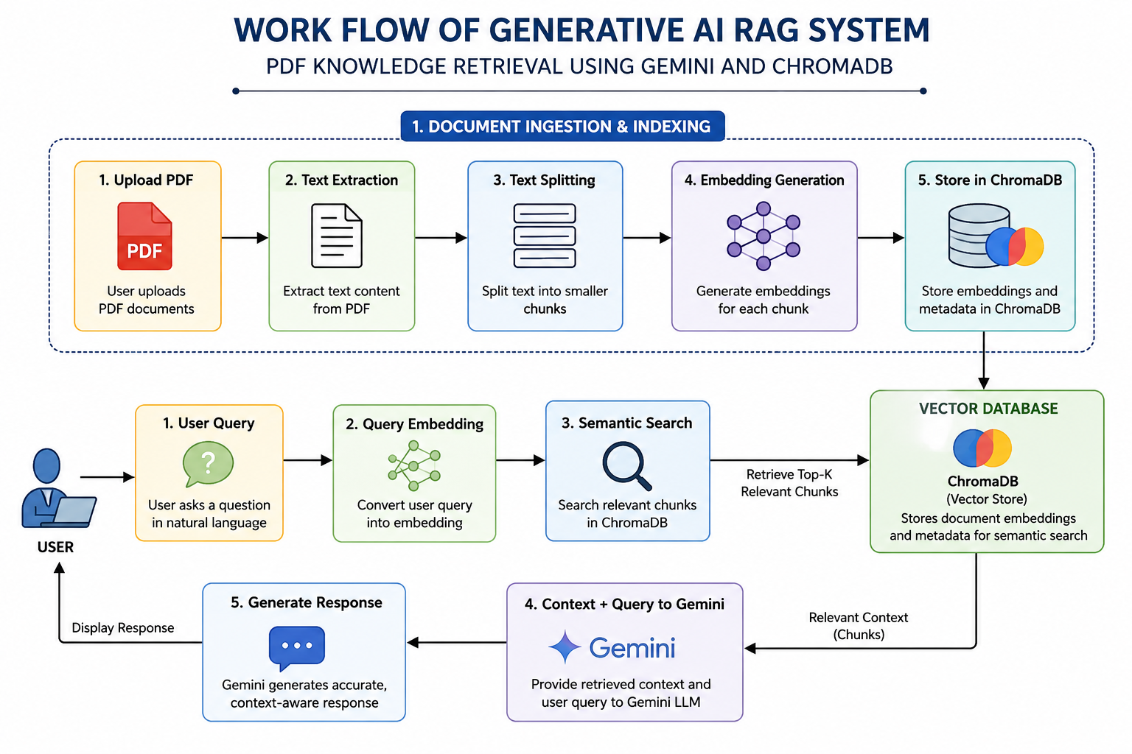
Work flow

Slide 7
Technologies Used
Component | Technology
Programming Language | Python
LLM | Google Gemini
Vector Database | ChromaDB
Framework | LangChain
PDF Processing | PyPDFLoader / PyPDF2
Embeddings | Google Generative AI Embeddings

Slide 8
AI Assistant Module
Key Features of Gemini AI Assistant
Natural Language Understanding (NLU)
Context-Aware Response Generation
Multi-turn Question Answering
Reduced Hallucination through RAG
Fast and Accurate Information Retrieval
User-Friendly Conversational Interface
AI Assistant Model Used: Google Gemini Role: Answer Generation based on Retrieved PDF Context.

Slide 9
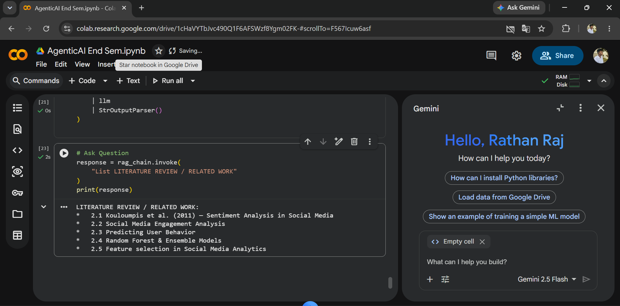
APPENDIX – SNAPSHOTS

Slide 10
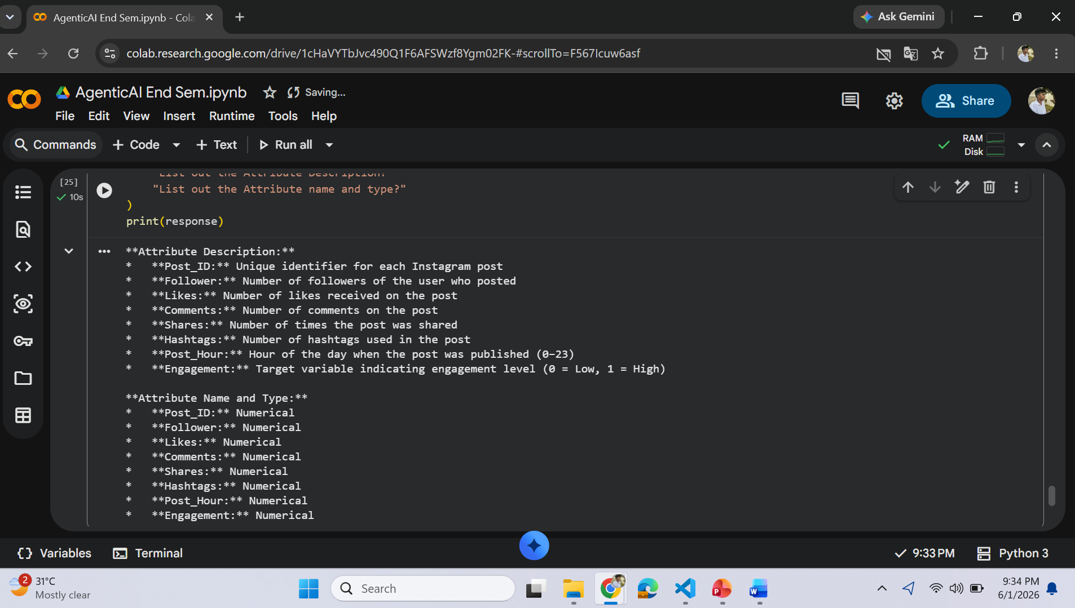
APPENDIX – SNAPSHOTS

Slide 11
Future Enhancements
Future Enhancements
Support multiple document formats such as DOCX, PPT, TXT, and Excel files.
Implement multilingual support for document processing and question answering.
Add voice-based interaction using speech-to-text and text-to-speech technologies.
Enable cloud deployment for better scalability and multi-user access.
Introduce document summarization and advanced analytics for enhanced knowledge extraction.

Slide 12
Conclusion
The Generative AI RAG System for PDF Knowledge Retrieval using Gemini and ChromaDB provides an effective solution for extracting and retrieving information from PDF documents.
By combining semantic search with AI-powered response generation, the system delivers accurate, context-aware, and reliable answers to user queries.
ChromaDB enables efficient storage and retrieval of document embeddings, while Gemini generates meaningful responses based on the retrieved content.
This approach reduces hallucinations and improves the quality of information access.
The system is highly useful for education, research, and enterprise knowledge management applications.

Slide 13
Thank You !

