Slide 1
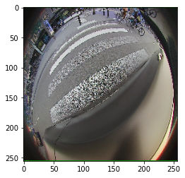
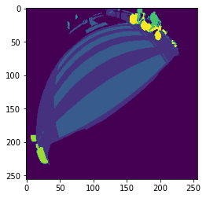

Input Image
G.T. Mask
Pred. Mask

Slide 2
