Slide 1
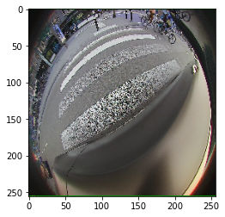
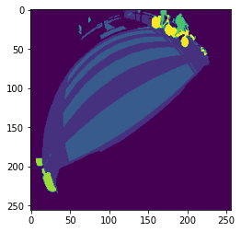

Input Image
G.T. Mask
Pred. Mask

Slide 2
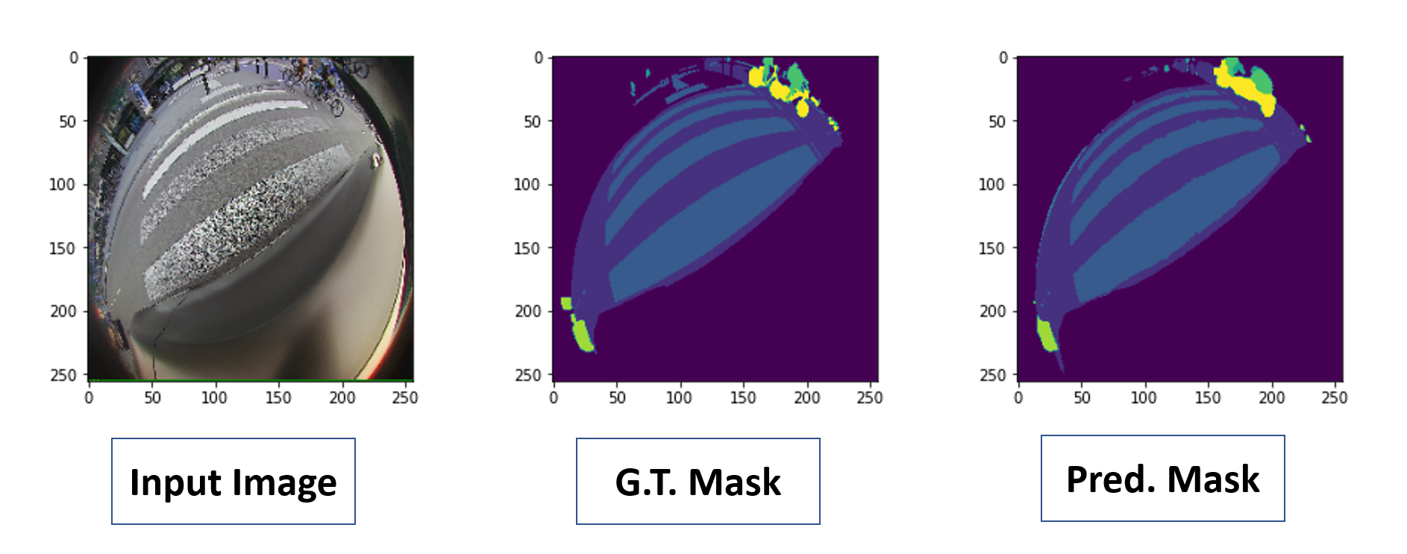

Slide 3
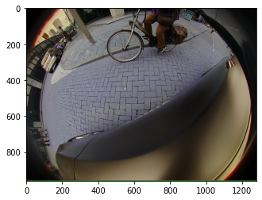
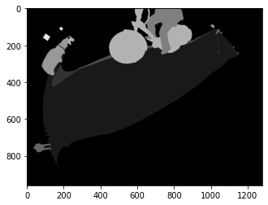
Input Image
G.T. Mask

Slide 4
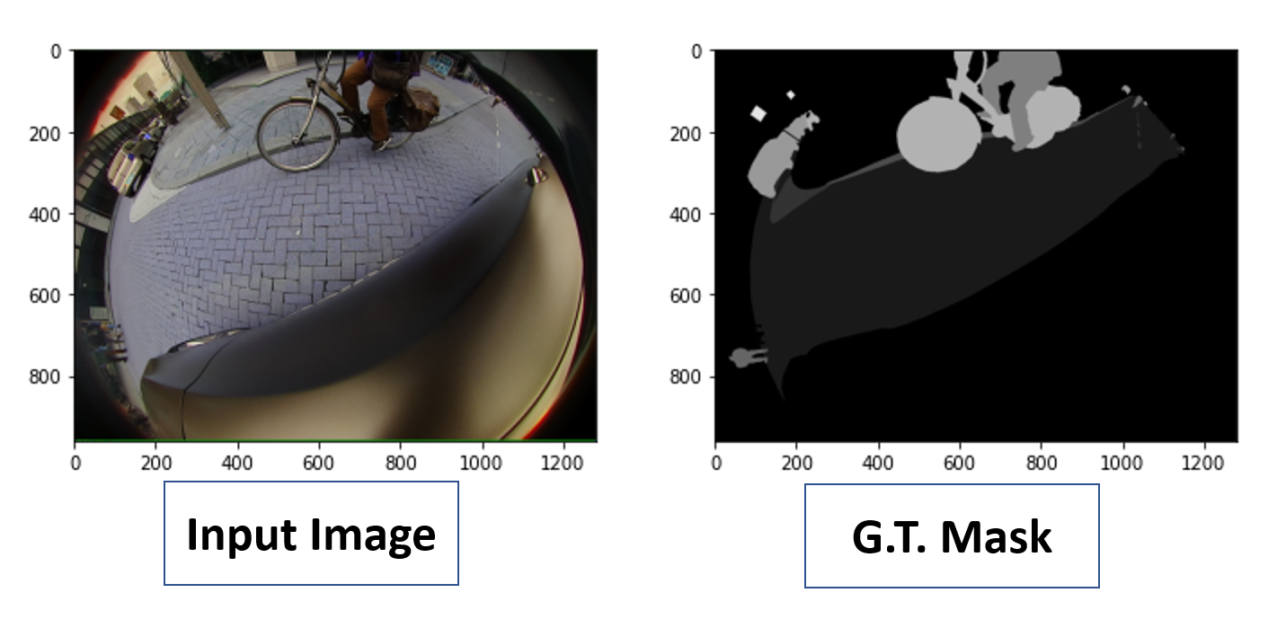

Slide 5
*Pred. Mask
966 x 1280
Input Image
966 x 1280
G.T. Mask
966 x 1280
Resize
Resize
UNET/Training
*Input Image
512 x 512
*G.T. Mask
512 x 512
Pred. Mask
512 x 512

Slide 6
