Slide 1

Term Project Virtual Assistant using RASA
CMPE 252- Fall 2021 Section 02
By
Pradeepa Rathi Thiagarasu (Student ID : 015015104)
Code repository : https://github.com/Rathi-Thiagu/Tyrion_2.0

Slide 2

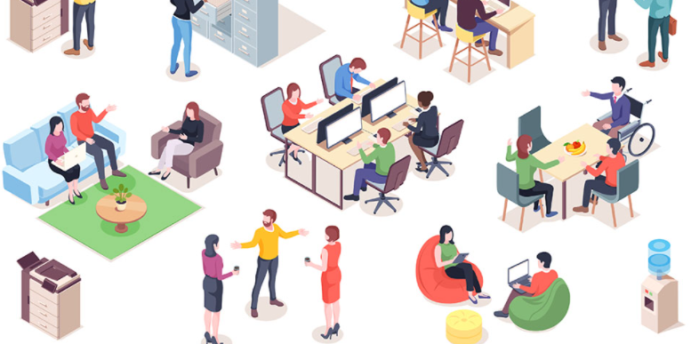
Tyrion Workplace Resource assistant
Tyrion’s primary goal is to make a company's resources and amenities more accessible to employees with fewer searches/conversations.
E.g. Company products, news, policies, facilities, workflows , food courts , gyms , banks

Slide 3
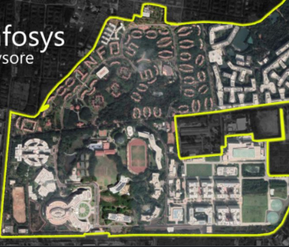
Motivation
Work experience with Infosys
Huge campus-377 acres. Many times, need to ask someone to access amenities
lots of food courts with different timings and menu
checking printer availability in a floor
arts/social clubs and events
location of amenities
Notes:
I got motivated with this use case based on my work experience at Infosys. It was a 377-acre complex with almost 14,000 IT workers, all working together. Even though there are lots of resources available, sometimes you may not have the chance to explore them, especially if you are working at client's place. Until my last day at Infosys, I had no clue there was an arts/sports club.
So, in essence, Tyrion may be viewed as an employee who has been with Infosys for more than 20 years and is well-versed in the company's workflow, facilities, and products.
Tyrion will be able to assist you with any company-related questions.

Slide 4
Conversation flows
Company products
Company policies
Company news
Workflows
Applying leave
Company transport availability and booking
Reimburse
Amenities exploration
Food Courts and Menus based on the food
Printer availability
Washrooms / Restrooms
Dorman try
Hospitals
Banks
Gym
Feedback / Complaints assistance
Complaints (e.g., Harassment complaints , emergency)
Analyzing employee mood and suggesting activities
Ergonomics and assistance

Slide 5
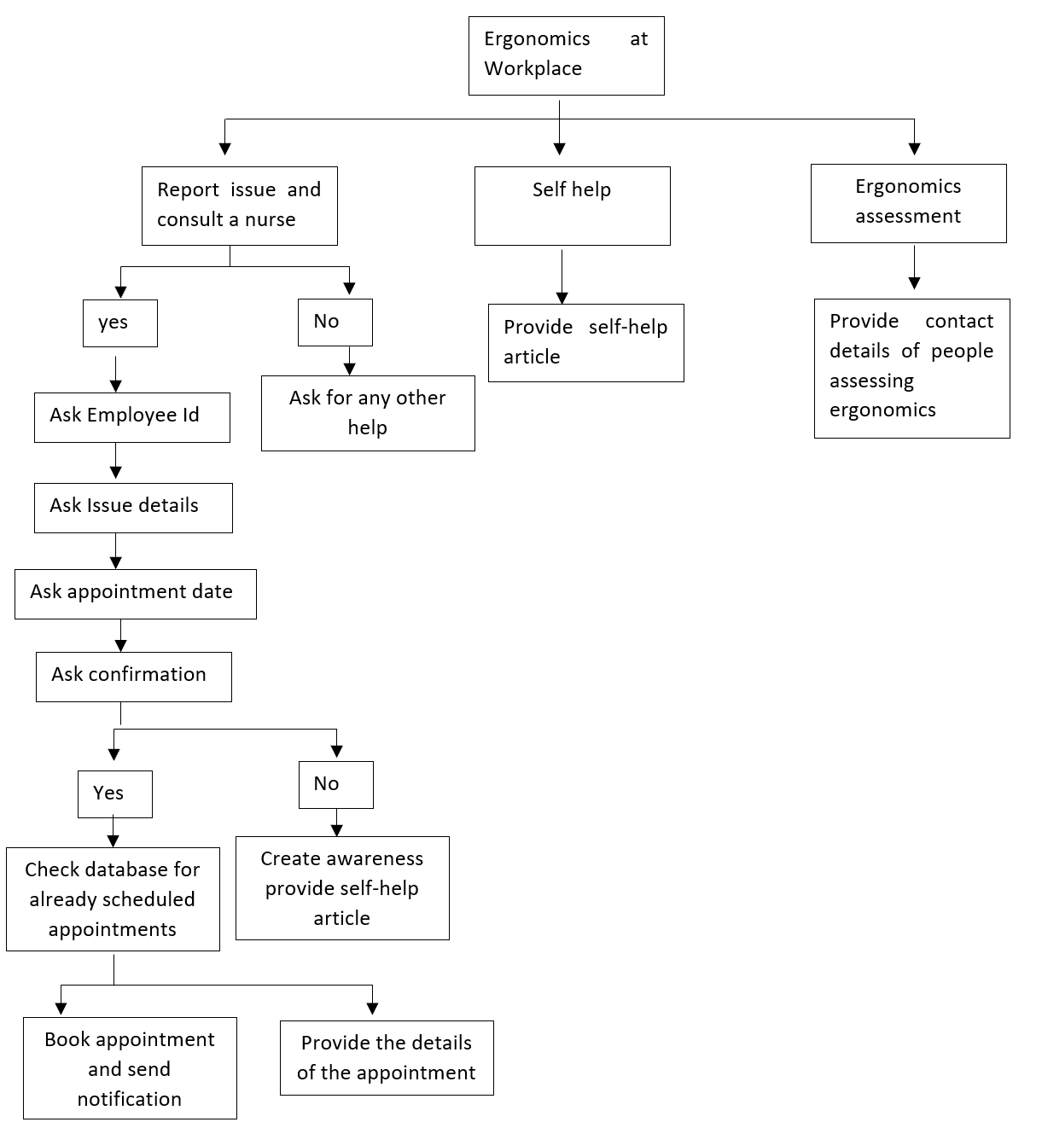

Slide 6
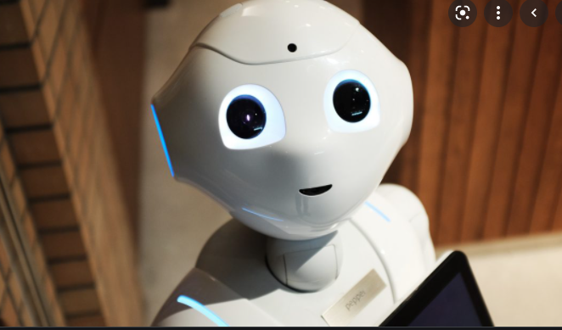

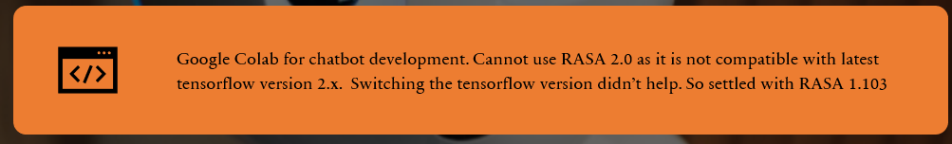
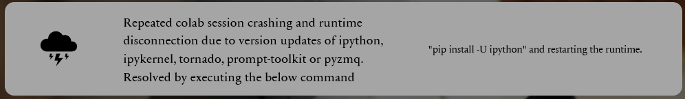
Challenges encountered

Slide 7

Insights and Learning
Learning a Cloud Agnostics Tools like RASA is better than cloud native tools, as it can be installed in any cloud platform .
Colabcode - Python package that allows you to start a code server right from your Colab notebooks without setting up anything locally on your system.
Notes:
RASA 2.0 is more comfortable to work with as the intensions and actions can be clearly defined in the stories.md. In addition, all of the training files in RASA 2.0 are.yml files, which may be modified just by opening the file, unlike RASA1.10, which requires command execution.
RASA 2.0 project can only be downloaded after the initial project training in Rasa playground.

Slide 8
GitHub Link for code:
https://github.com/Rathi-Thiagu/Tyrion_2.0

