Slide 1
NAME : RATHIKA C REG NO : 212921106062 DEPARTMENT : ECE DEPARTMENT
Name: c RathikaReg: 212921106062Department: ECEYear : lll

Slide 2
Title: Exploration and Prediction of Company Registration Trends with Register of Companies (ROC)

Slide 3
Introduction
Briefly introduce the topic and its significance.
Mention the data source (Register of Companies) and its importance in tracking business trends.

Slide 4
Objectives
Clearly state the objectives of your presentation, such as analyzing historical data, identifying patterns, and making predictions.

Slide 5
Data collection
Explain how you collected data from the Register of Companies Mention any challenges or limitations you encountered during data collection.

Slide 6
Data preprocessing
Describe the steps taken to clean and prepare the data for analysis. Highlight any data cleaning techniques used.

Slide 7
Exploration data analysis (eda)
Present visualizations and insights from your exploratory data analysis.- Discuss any trends or patterns you observed in the data.
Present visualizations and insights from your exploratory data analysis.- Discuss any trends or patterns you observed in the data.

Slide 8
Predictive modeling
Explain the machine learning or statistical techniques you used for prediction.- Mention any features or variables you considered for modeling.

Slide 9
Model evaluation
Discuss the metrics used to evaluate the predictive model's performance.Present the results, including accuracy, precision, recall, etc.

Slide 10
Future trends and prediction
Share your predictions for future company registration trends based on your model. Discuss the implications and potential business insights.

Slide 11
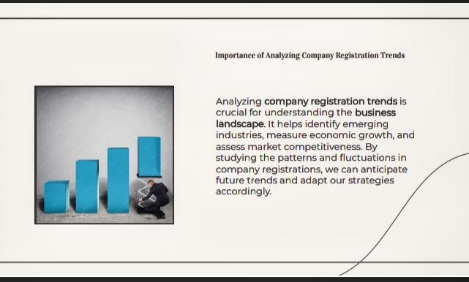

Slide 12
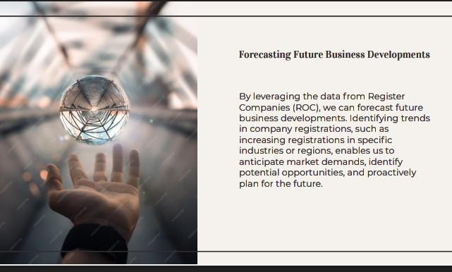

Slide 13
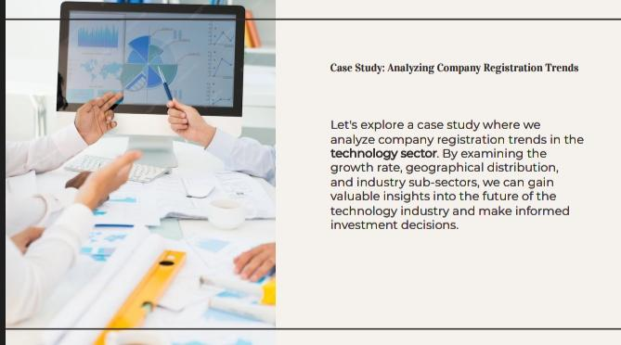

Slide 14
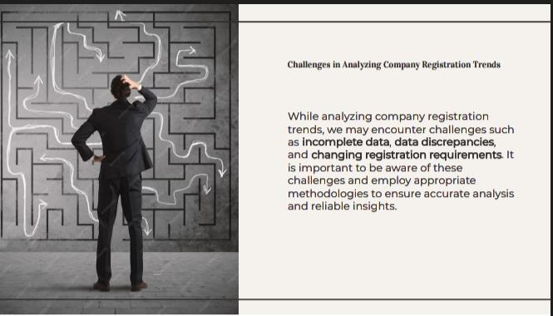

Slide 15
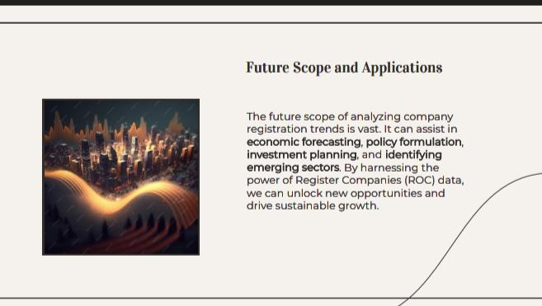

Slide 16


Slide 17
Recommendation
Provide recommendations for businesses or policymakers based on your findings.- Suggest actions that can be taken to adapt to or leverage the predicted trends.

Slide 18
Conclusion
Summarize the key takeaways from your exploration and prediction of company registration trends. Reiterate the significance of your findings.

