Slide 1
Employee Data Analysis using Excel
STUDENT NAME: Rathik.D
REGISTER NO:312211193 asunm1423312211193
DEPARTMENT: B.Com Bank Management
COLLEGE: Dr.MGR Janaki College Of Arts And Science For Women

Slide 2
PROJECT TITLE
Employee Performance Analysis using Excel

Slide 3


AGENDA
Problem Statement
Project Overview
End Users
Our Solution and Proposition
Dataset Description
Modelling Approach
Results and Discussion
Conclusion
3/21/2024 Annual Review

Slide 4

PROBLEM STATEMENT
The employee data analysis is done in order track the employee's performance for the betterment of the company

Slide 5

PROJECT OVERVIEW
Objective: Evaluate employee performance to align individual contributions with organizational goals.
Key Focus Areas: Productivity, efficiency, skill gaps, and alignment with KPIs.
Methodology: Use performance metrics, feedback systems, and data analytics to assess and track progress.
Outcome: Identify strengths and areas for improvement while enhancing employee engagement and productivity.
Implementation: Develop targeted training, recognition programs, and performance improvement plans.

Slide 6


WHO ARE THE END USERS?
Manager
Human Resources Department
Team Leader
IT and System Administrator
Payroll and Finance Teams
Legal and Compline Teams
Internal Communication Teams
External Vendors or Parners
Empolyess themselves
Auditors or Regulators

Slide 7

OUR SOLUTION AND ITS VALUE PROPOSITION
Conditional formatting – missing
Filter - remove
Formula - performance
Pivot – summary
Graph - data visualization

Slide 8
Dataset Description
Employee-kaggle
26-features
9- features
Emp id-num
Name-text
Emp type
Performance level
Gender- male female
Employee rating-num

Slide 9

THE "WOW" IN OUR SOLUTION
Performance level =IFS(Z8>=5,"VERY HIGH",Z8>=4,"HIGH",Z8>=3,"MED", TRUE, "LOW")
3/21/2024 Annual Review
9

Slide 10
MODELLING
Data collection
From kaggle
2) From edunetdashboard
Feature collection
Data cleaning
Identified missing values
Filtered out the missing values
Performance level calculation
Through attendance
2) Ratings
Pivot table
Graph
1) Visualization
10

Slide 11
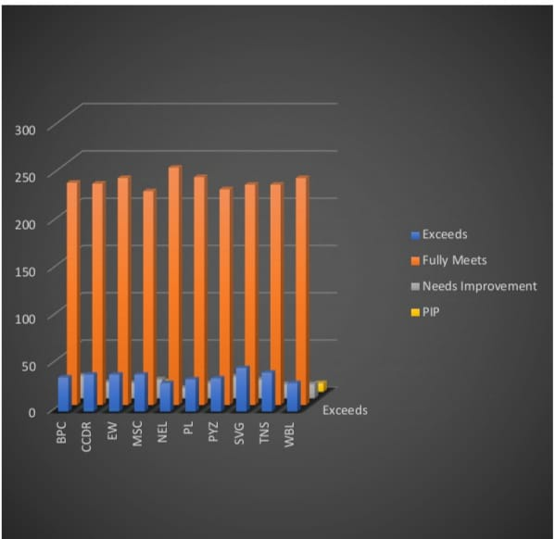
RESULTS
11

Slide 12
Conclusion
By comparing the performance of the employee's Number of employees performaning average are higher in number and so we should motivate them to do better. As the graph shows employees who perform well are very low in number here. we should motivate the employee's by giving out tasked based on there performance to get better output

