Slide 1

PARALLEL IMPLEMANTATION OF LINEAR EQUATION
BACK SUBTITUTION
CONJUCATE GRADIENT
GAUSS SIEDEL
M LOHESH
P RATHNA SABAPATHY

Slide 2
BACK SUBTITUTION
Independent Iterations: Each iteration updates a separate element of the solution vector independently, allowing for concurrent execution of loop iterations.
Data Parallelism: The algorithm's structure enables simultaneous processing of multiple elements of the solution vector, distributing the workload efficiently across threads.
Load Balancing: The parallelization framework dynamically assigns loop iterations to threads, ensuring equitable distribution of computational tasks and maximizing resource utilization.
SPEED UP
[5000, 5250, 5500, 5750, 6000, 6250, 6500, 6750, 7000, 7250, 7500, 7750, 8000, 8250, 8500, 8750, 9000, 9250, 9500, 9750, 10000]
[79.28571429, 78.28947368, 76.78571429, 71.19565217, 56.63265306, 53.7037037 , 52.19298246, 48.80952381, 48.48484848, 47.22222222, 44.55128205, 43.07228916, 43.10344828, 43.27956989, 43.36734694, 44.04761905, 41.37168142, 38.88888889, 36.99186992, 36.04651163, 37.84246575] n=4

Slide 3
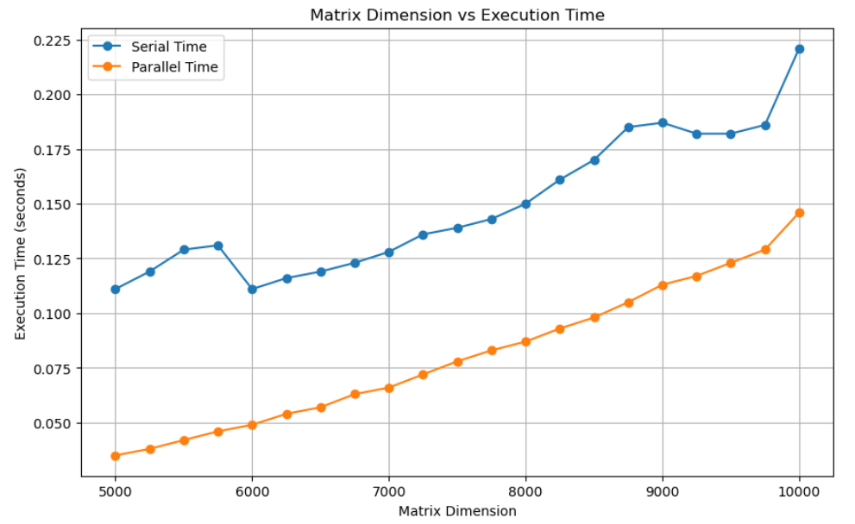
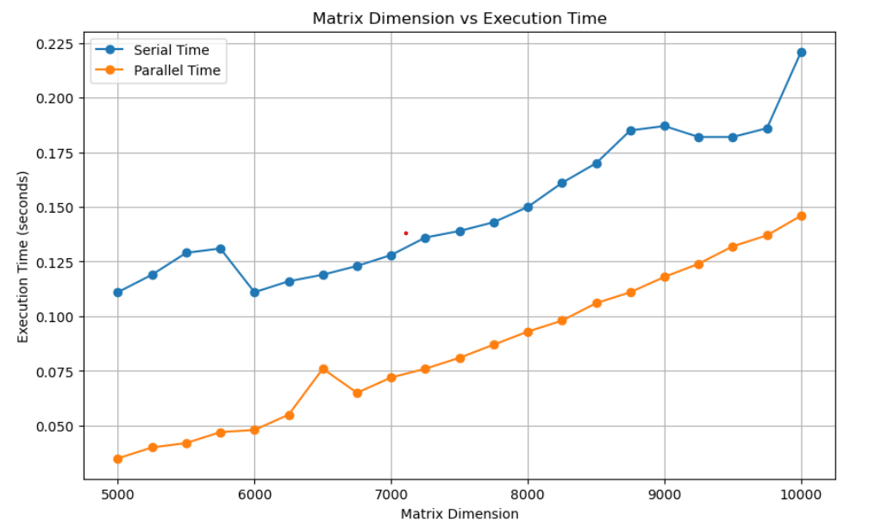
Matrix Dimension vs Execution time vs No. of cores
Number of Thread: 4
Number of Thread: 8

Slide 4
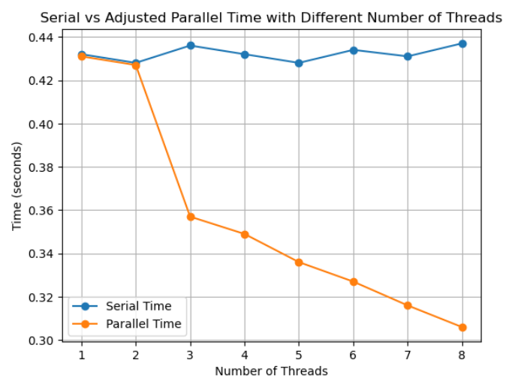
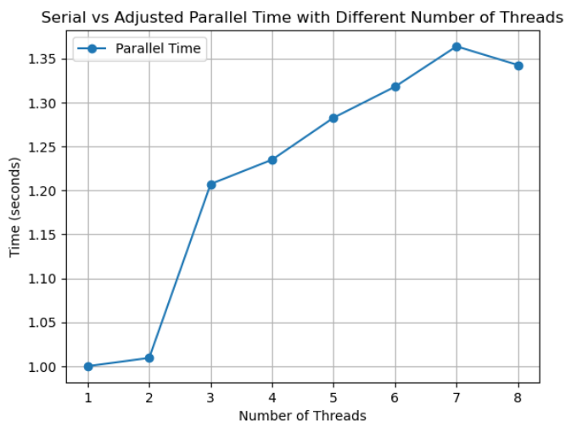
No of cores vs Execution Time
No of cores vs Speed-up

Slide 5
CONJUCATE GRADIENT
Concurrent Vector Operations: The algorithm performs vector operations such as dot products and vector updates concurrently, exploiting parallelism to accelerate convergence.
Parallel Matrix-Vector Multiplication: The multiplication of the matrix with a vector and other matrix-vector operations are parallelized, distributing computation across threads efficiently.
Iterative Task Parallelism: Each iteration of the conjugate gradient method involves a sequence of independent tasks, enabling parallel execution of these tasks to enhance overall performance.
SPEED UP
[5000, 5250, 5500, 5750, 6000, 6250, 6500, 6750, 7000, 7250, 7500, 7750, 8000, 8250, 8500, 8750, 9000, 9250, 9500, 9750, 10000]
[166.19047619, 158.87096774, 169.140625 , 164.08450704, 155.0304878 , 166.01796407, 161.42473118, 167.70833333, 166.82692308, 161.68831169, 139.31034483, 150.0862069 , 147.23974763, 142.37536657, 142.34417344, 142.53164557, 145.50492611, 148.62110312, 152.3364486 , 162.79620853, 150.98752599]n=4

Slide 6
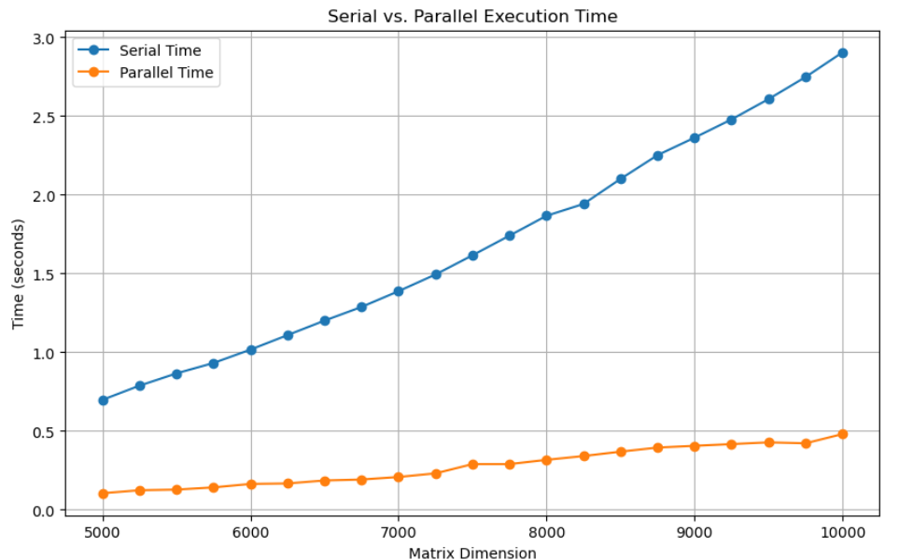
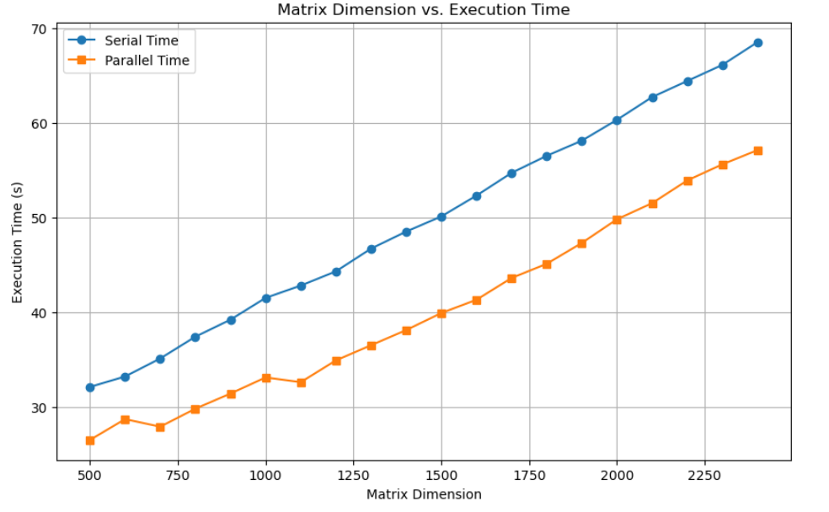
Matrix Dimension vs Speed Up vs No. of cores
Number of Thread: 4
Number of Thread: 8

Slide 7
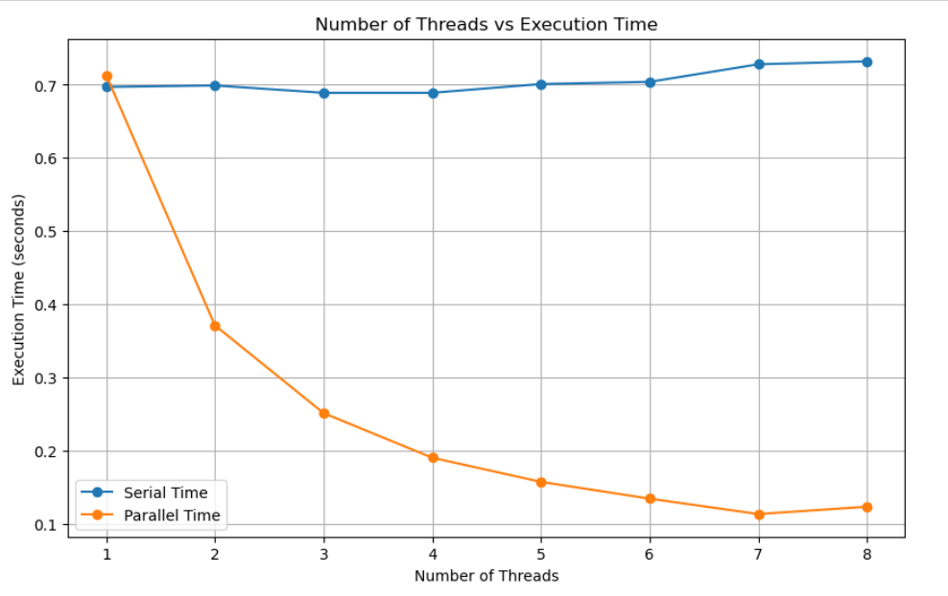
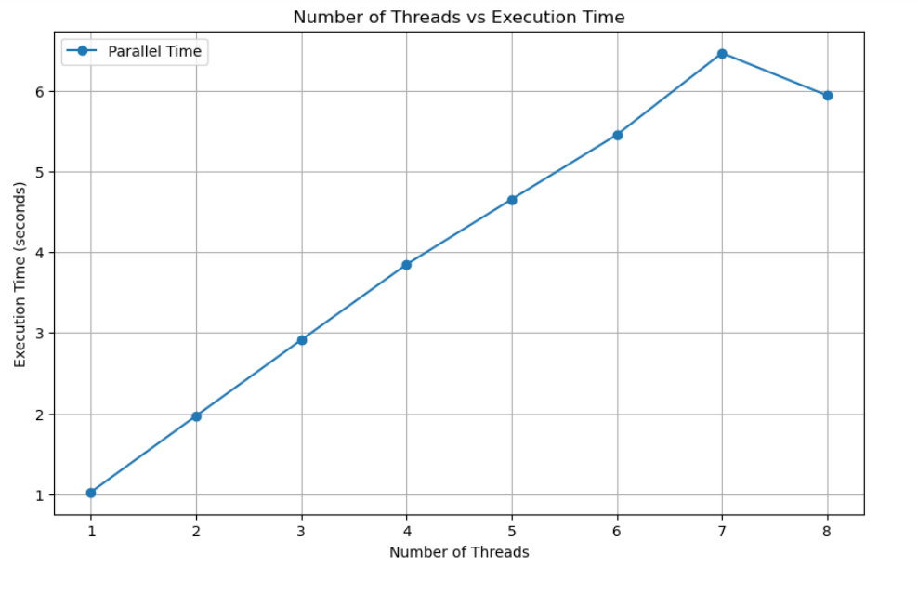
No of cores vs Execution Time
No of cores vs Speed-up

Slide 8
GAUSS SIEDEL
Local Data Dependencies: Gauss-Seidel method exploits the localized nature of data dependencies, allowing for concurrent updates of individual solution components within each iteration.
Intra-Iteration Parallelism: Within each iteration, updates to solution components are performed sequentially. However, across iterations, different solution components can be updated concurrently, enabling parallelism.
Convergence and Parallel Execution: The convergence properties of Gauss-Seidel ensure that updates to solution components propagate gradually, enabling parallel execution of subsequent iterations without compromising correctness.
SPEED UP
[5000, 5250, 5500, 5750, 6000, 6250, 6500, 6750, 7000, 7250, 7500, 7750, 8000, 8250, 8500, 8750, 9000, 9250, 9500, 9750, 10000]
[ 96.875 , 85.49107143, 141.55844156, 142.28395062, 154.01234568, 165.9375, 164.04494382, 175.54945055, 172.16494845, 170.23809524, 171.49122807, 174.78813559, 165.18518519, 163.10344828, 164.86928105, 142.28723404, 153.27868852, 168.10344828, 145.06726457, 158.14479638, 149.69512195]n=4

Slide 9
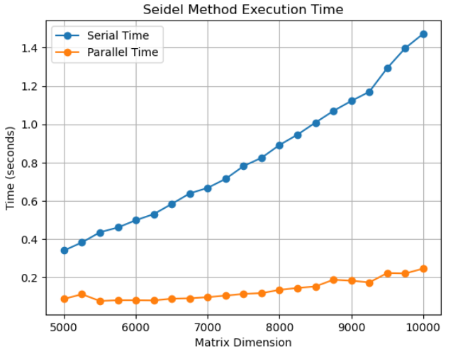
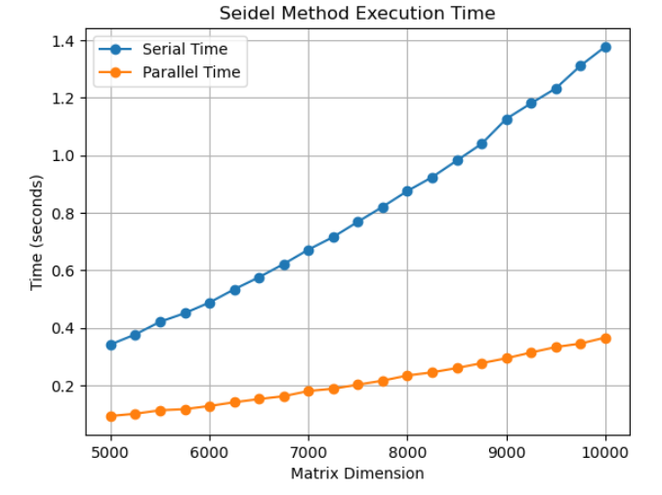
Matrix Dimension vs Speed Up vs No. of cores
Number of Thread: 4
Number of Thread: 8

Slide 10
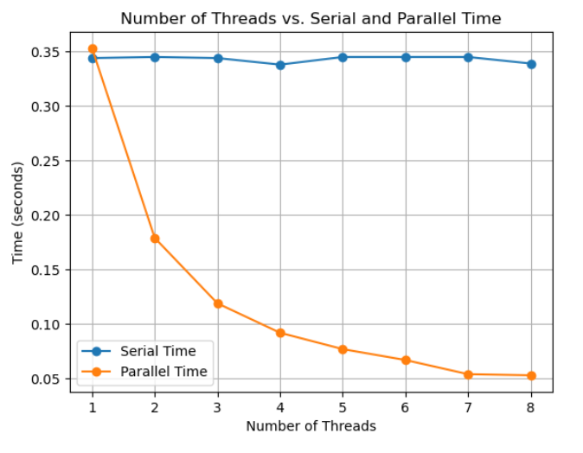
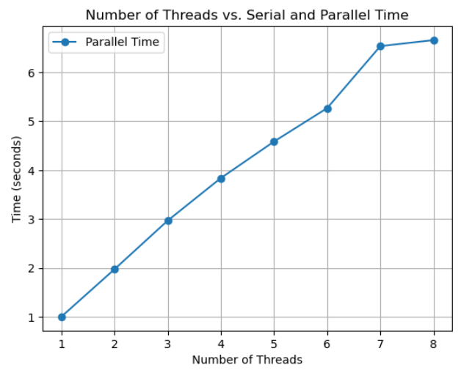
No of cores vs Execution Time
No of cores vs Speed-up

