Slide 1
Library Management System
Presented By
Rajeshwari.P
Under the guidance of
Mrs.Pavithra

Slide 2

INTRODUCTION

Slide 3
Library Management System is an application which refers to library systems which are generally small or medium in size.
It is used by librarian to manage the library using a computerized system where he/she can record various transactions like issue of books, return of books, addition of new books, addition of new students etc.
Books and student maintenance modules are also included in this system which would keep track of the students using the library and also a detailed description about the books a library contains.
With this computerized system there will be no loss of book record or member record which generally happens when a non computerized system is used.
In addition, report module is also included in Library Management System. If user’s position is admin, the user is able to generate different kinds of reports like lists of students registered, list of books, issue and return reports.
All these modules are able to help librarian to manage the library with more convenience and in a more efficient way as compared to library systems which are not computerized.

Slide 4
ANALYSIS

Slide 5
Existing system :
In the available Online Library Management System, librarian maintains the details of each book on the registers so to find out the number of books available in the library they need to go to check the entire entry which makes the process slow.
While they need to spend an extra hour to maintain the records of books. For a student who wants to know about a book in the library need to search the entire book section. The student needs to check the status of the book means the last date of book, how many books has issued.
Proposed system :
The proposed Online Library Management System project will help the students and librarian to maintain the details of the library. It will assist the librarian before the shortage of books while they can know the details of the number of currently available in the library according to the author by accessing the system. A student can view the details of the book issued by them, and the system will notify the students about the last date of submission of books.
At the time of issue of a book, the student will get assisted by the system about different authors of a similar book so that they can get the best available book from the library.

Slide 6
OBJECTIVE
The objective behind developing this Online Library Management System project is to build a system which can maintain the work of the library on the web based application.
This software will contain the features by using of which the library becomes smart and any user will get the information regarding the library instantaneously.
This will help the librarian in maintaining the detail of available books in the library while a student can check the availability of the required books.
The Online Library Management System project will be web based so the user can access the details of books without going to the library.

Slide 7
Which topics is covered in this project ?
Classes and objects
Inheritance
File handling with objects
ArrayList
Implementing Interface
Exception handling and User-defined Exception

Slide 8
SYSTEM REQUIREMENTS
Software Requirements :
Core Java
OS 1.1, 1.5, 1.6, 2.0
Eclipse
Hardware Requirements :
Processor : Pentium IV 1Ghz
Hard disk : 80GB
RAM : 1GB

Slide 9
DESIGN

Slide 10
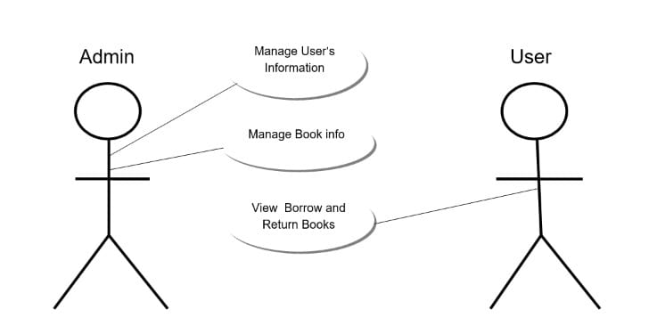
USECASE DIAGRAM

Slide 11
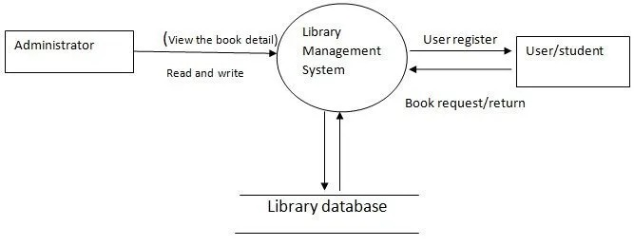
DATA FLOW DIAGRAM

Slide 12
MODULES

Slide 13
Admin Verification
Admin Manager
Book Data
Login MainTest
Password Validation
User Verification
User Manager
Username Validation

Slide 14
OVERVIEW OF TECHNOLOGIES USED

Slide 15
About JAVA
It is a simple programming language. Java makes writing, compiling, and debugging programming easy. It helps to create reusable code and modular programs.
Java is a class-based, object-oriented programming language and is designed to have as few implementation dependencies as possible.
A general-purpose programming language made for developers to write once run anywhere that is compiled Java code can run on all platforms that support Java.
Java applications are compiled to byte code that can run on any Java Virtual Machine. The syntax of Java is similar to c/c++.
The principles for creating java were simple, robust, secured, high performance, portable, multi-threaded, interpreted, dynamic, etc.
In 1995 Java was developed by James Gosling, who is known as the Father of Java. Currently, Java is used in mobile devices, internet programming, games, e-business, etc.
On November 13, 2006, Sun released much of its Java virtual machine as free, open-source software. On May 8, 2007, Sun finished the process, making all of its JVM’s core code available under open-source distribution terms.

Slide 16
About ECLIPSE
Eclipse is an integrated development environment (IDE) that takes care of compiling and running Java programs in addition to providing other useful features such as version control and debugging.
Thus, it is a popular tool for programmers to write and test their code.
Eclipse IDE (integrated development environment) for Java has been the leading development environment with a market share of 65% as of today.
It can be extended with an additional software component. Eclipse calls these software components as plugins, which can grouped into features.
Many companies have extended Eclipse IDE on top of the Eclipse framework. It is also available as IDE for other languages.
Resources are items in the workspace, i.e. projects, folders, files and other dependent resources. These are all objects that will be or have been created with Eclipse. They are stored as normal files within the Eclipse workspace. A project holds several folders with files.

Slide 17
IMPLEMENTATION

Slide 18
INTEGRATION AND TESTING
Integration
Integration is all about combining the individual parts of the system and making the system into a single unit.
Testing
1. Compilation Test: Stress testing is done early on, because it gives us time to fix some of the unexpected stability problems that only occur when components are exposed to very high transaction volumes.
2. Execution Test: The program is successfully loaded and executed with no execution errors. The complete performance of the project “Library Management System” is good.

Slide 19
OUTPUT SCREENS

Slide 20
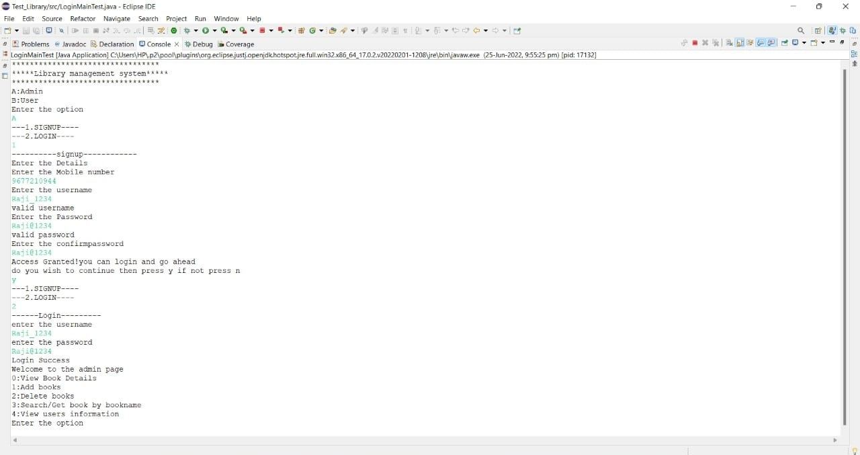
Your great subtitle in this line

Slide 22
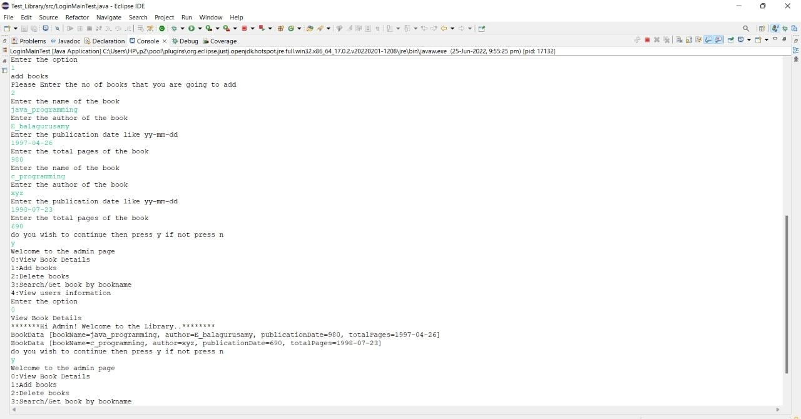

Slide 23
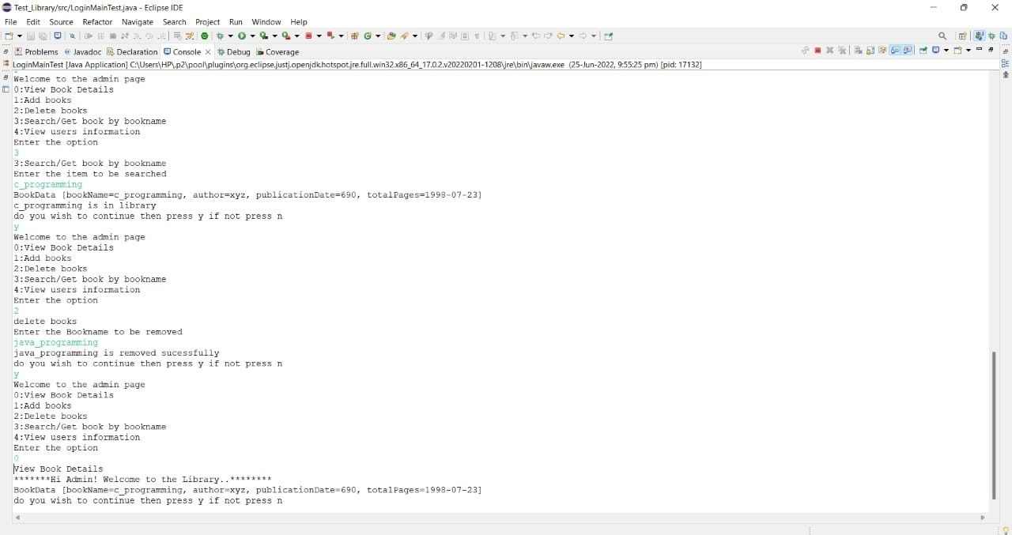

Slide 24
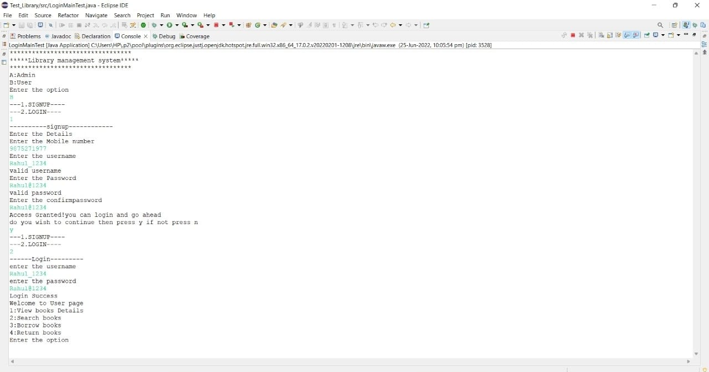

Slide 25
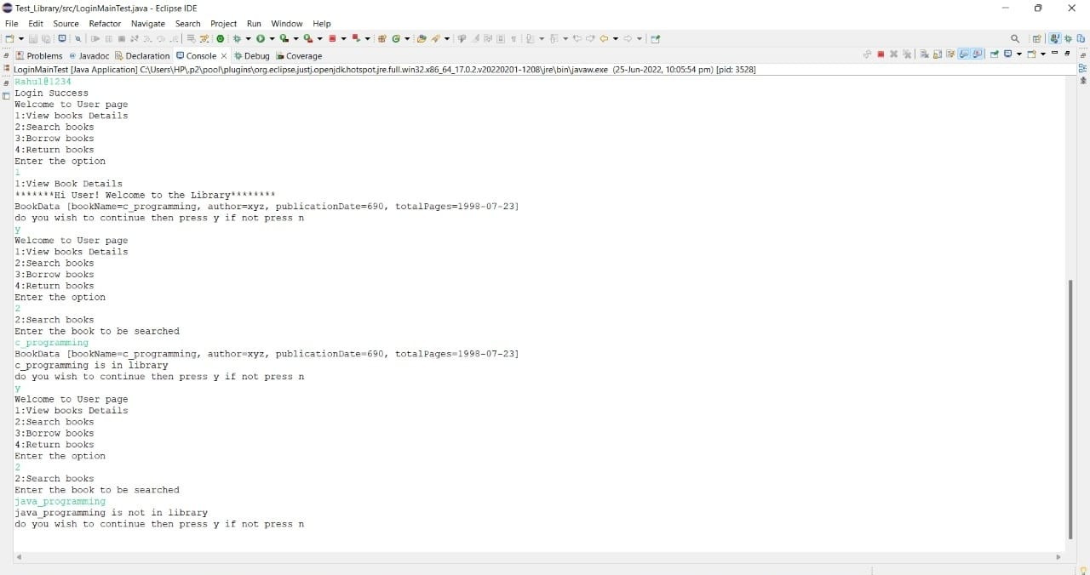

Slide 26
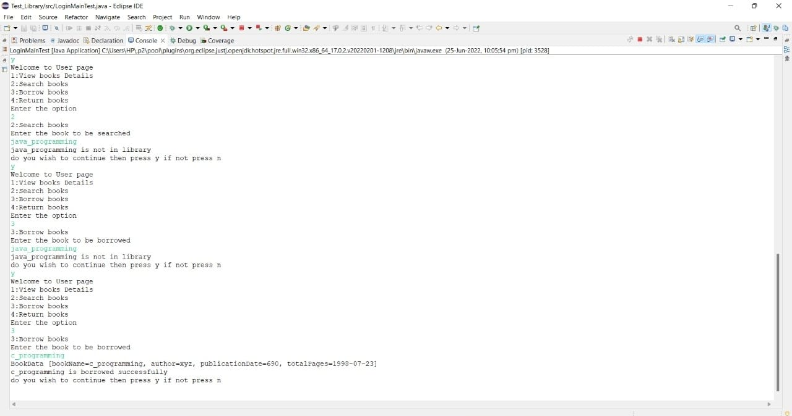

Slide 27
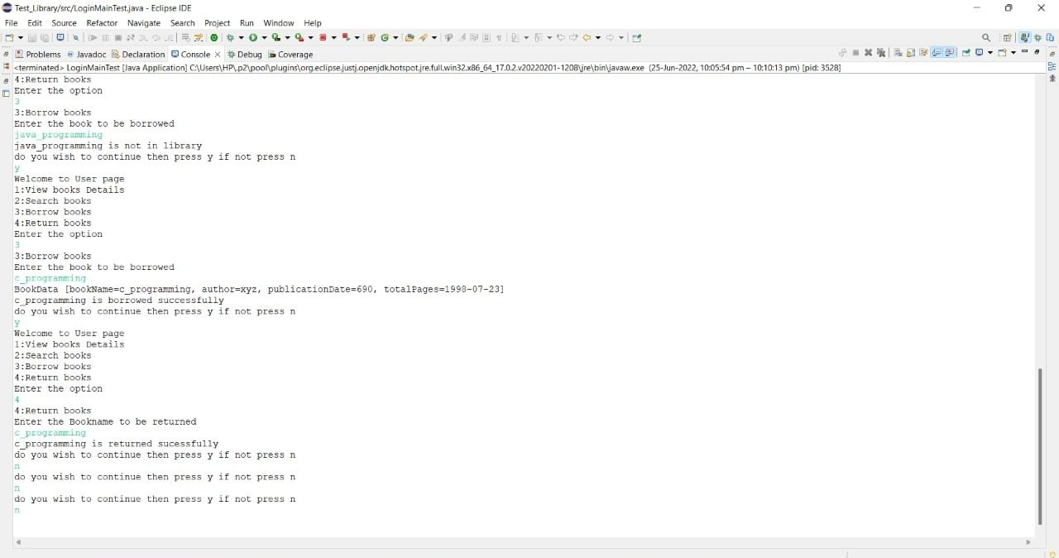

Slide 28
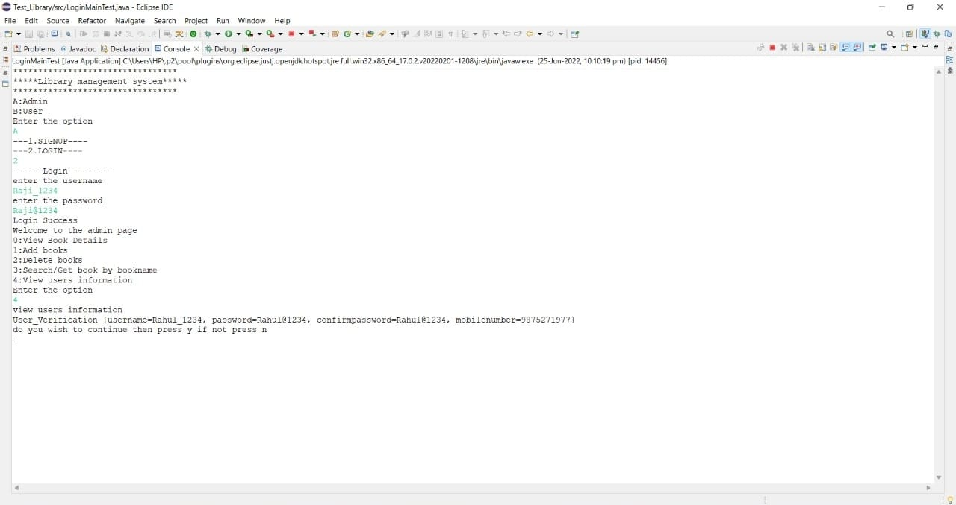

Slide 29
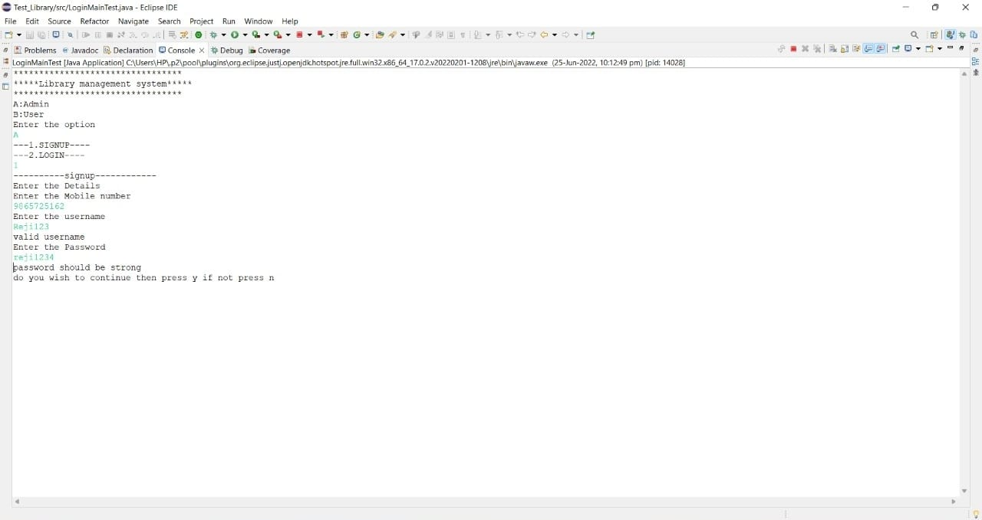

Slide 30
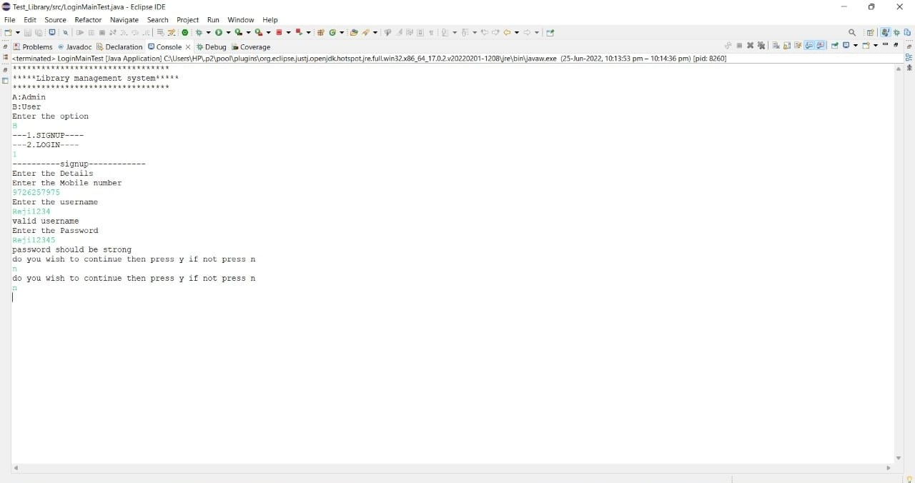

Slide 31
CONCLUSION

Slide 32
It will take care of the current book detail at any point of time.
The book issue, book return will update the current book details automatically show that user will get the update current book details.
The main purpose of this project is to reduce the manual work.
• This software is capable of managing book issues, returns, and calculating/managing fines.
Generating various reports for record keeping according to end user requirements.

Slide 33
REFERENCES

Slide 34
https://www.javapoint.com/how-to-use-eclipse-for-javav
https://www.javapoint.com/file-operations-in-java
https://www.w3schools.com/java/java inheritance.asp

Slide 35
THANK YOU

