Slide 1

Creative Forms
Presented By:
J.R.AMRESH CHANDH 18UN12
M.DHARANI DHARAN 18UN14
J.N.RATHNAVEL 18UN23
DR .A. AZHAGAMMAL M.Sc., M.Phil., Ph.D.

Slide 2
ABOUT THE SOFTWARE
FRONTEND: REACT JS (a Java Script library)
BACKEND : Django (a python web Framework )

Slide 3
ABSTRACT
Creative form is a WebApp .
It allows user to create interactive form on their own.
User can create form with simple drags and drop.
React provides a smooth UI for application.

Slide 4
Modules
1.Sign Up Module
01
2.Sign In Module
02
3.Forgot Password Module
03
4.Reset Password Module
04
5.Form Creation Module
05
6.From Response Module
06

Slide 5
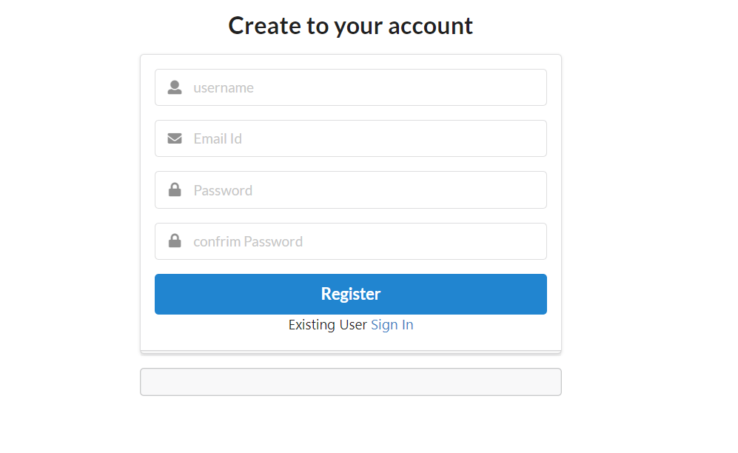
Sign Up Module
Sign Up allows to create account in Creative Forms
Allow also allows to redirect to Sign In page

Slide 6
Sign In Module
Sign In allows to enter into Creative Forms using their account credentials.
Also allows to help with user's with their forgotten password

Slide 7
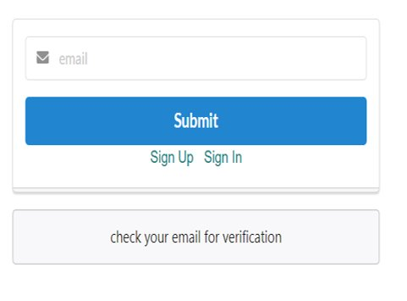
Forgot Password Module
Provides Redirection to Reset password Module.
Redirection provided with verification E-mail

Slide 8
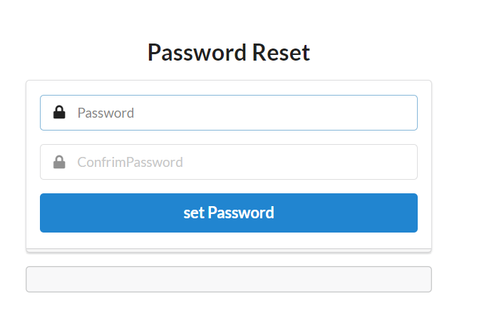
Reset Password Module
Allow to Enter New Password

Slide 9
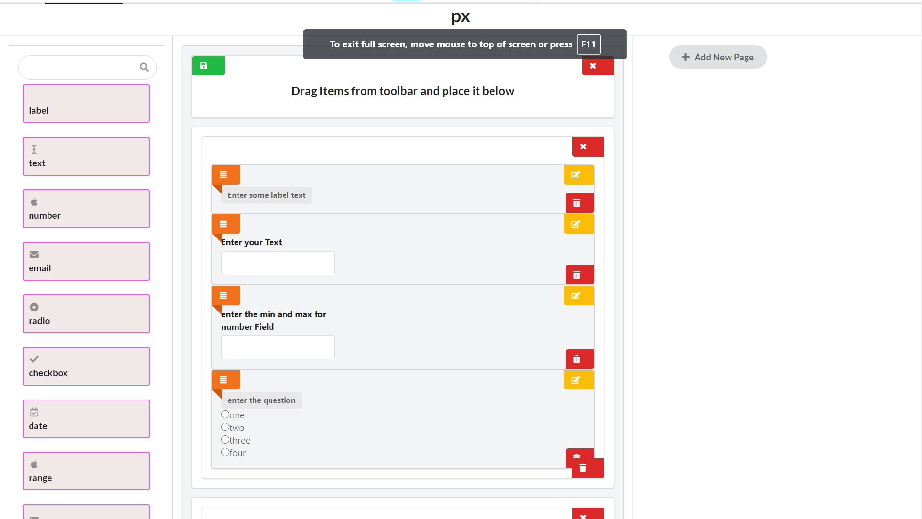
Create Form Module
Allow to Design Your Forms

Slide 10
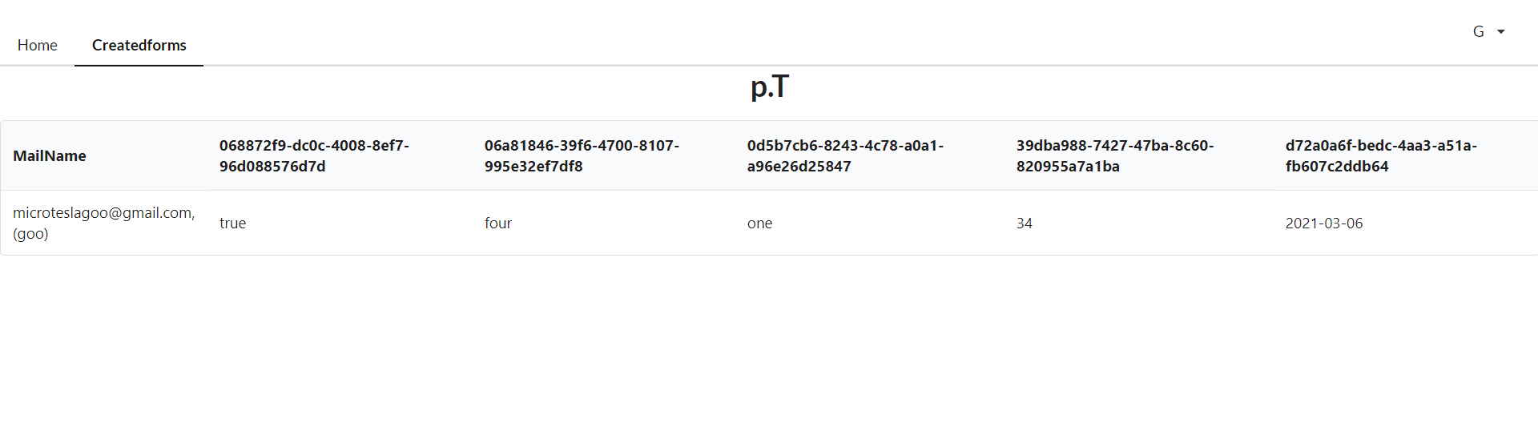
Form Response Module
Allows to view the Responses of Your Forms

Slide 11
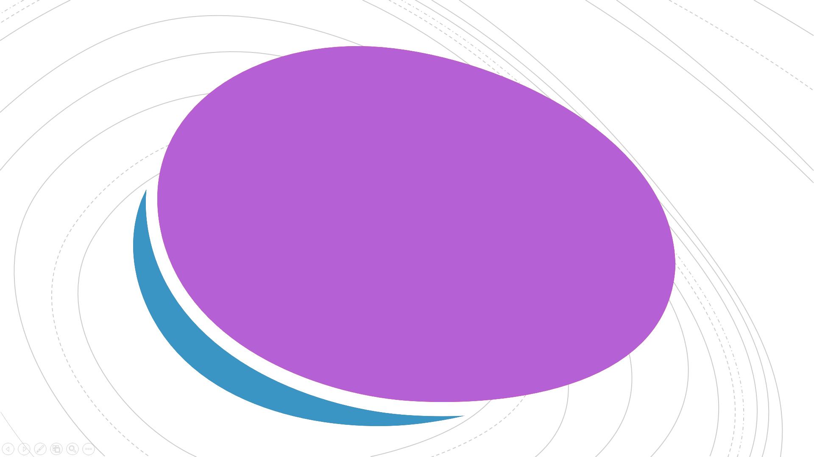
THANK YOU

