Slide 1
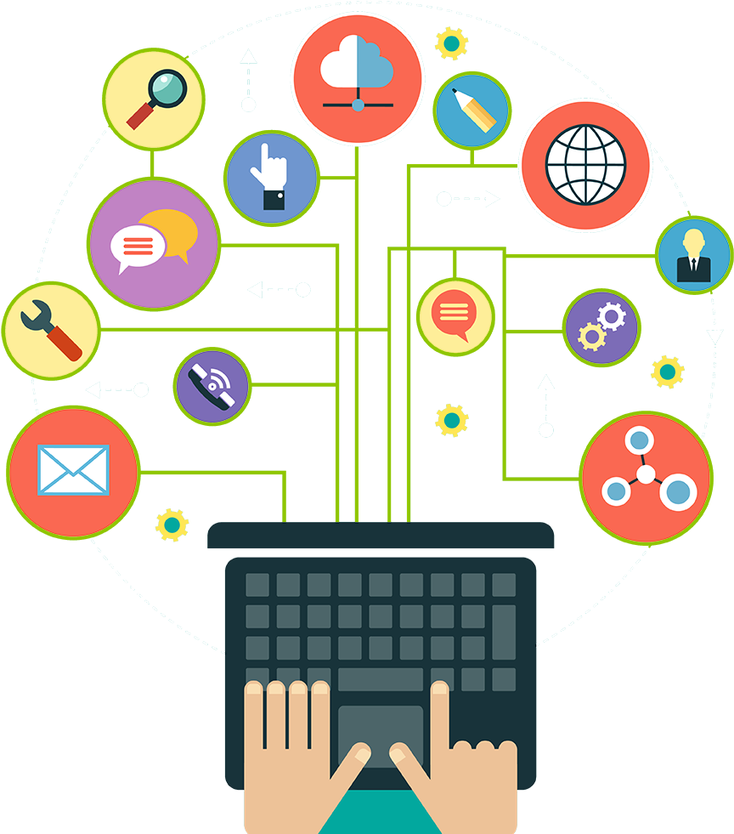
360 Learning
PRESENTED BY TEAM BRATS :
DEEPSHIKHA (RVS)
ABHISHEK CHANDRASEKARAN (RVS)

Slide 2
Table of contents:
INTRODUCTION
NEED OF PROJECT
IDEA
DESCRIPTION OF THE APPLICATION
FEATURES
FUTURE ENHANCEMENT

Slide 3
INTRODUCTION :
Now a days, Students tend to be more social online than in the real world. Today’s generation is using numerous apps for learning activities without any school involvement. eBooks, apps and other digital relearning materials are easily accessible and easy to carry, unlike the traditional learning materials.
By 2022, the global online learning market is expected to reach $275.10 billion in monetary worth, Reuters says.
From 2001 to 2017, the corporate online education industry has grown by 900%, and at least 42% of organizations that employed learning apps have greatly boosted their profitability, according to the statistics by e-Learning industry.
eLearning is more sustainable than face-to-face learning in terms of the environment. A study by The Open University found that “distance learning courses involve 87% less energy and 85% lower CO2 emissions than the full-time campus-based courses” .

Slide 4
Need of project:
Every child of this era loves the screen, and online courses revolve around the screen. Studies have shown that humans learn better when they see and hear. Online courses media features such as video, graphics, illustrations, attracts youngsters.
It frees students to work at their own pace and give them time for other things. They can utilize their time more effectively.
It empowers one’s interacting powers, even the introverts feel free to interact. eLearning methods allow them to study at home.
Online courses cater to an unlimited number of students unlike the traditional way of learning where the number per class is limited are allowed to enroll in this virtual world.
It is less expensive and time-saving as compared to the traditional way of learning. It saves travel costs and time and also it is very affordable, unlike traditional learning.
The COVID-19 has resulted in schools shut all across the world. Globally, over 1.2 billion children are out of the classroom.
As a result, education has changed dramatically, with the distinctive rise of e-learning, whereby teaching is undertaken remotely and on digital platforms.

Slide 5
IDEA:
Our customized e-Learning app is targeted not only at a certain group of people, but it is available to all irrespective of the age groups, it will feature a variety of courses in multiple subjects of various difficulty level and duration from different tutors around the world we can access it accordingly.
The courses will be available in three forms first is pre-recorded lectures, secondly webinars and third will be notes in the form of PDFs/Documents, anyone can access the courses as per there convenience.
We are introducing A gamified education service which will encourage a young audience to study while playing so that they won’t get bored easily like it will be having badges, different modules or levels to cross and even leader board, due to this there wont be any distractions made or the flow of study won’t get affected.

Slide 6
We will also be having a dashboard or profile of an individual where we will be showing the performance chart their progress etc. and also will have a to-do-list, calendrer so that a particular individual can manage his/her timetable for study accordingly.
Our app will feature a chat room or an online conferencing tool, which will let users to interact in real time, a discussion will be there, The first option helps students learn to communicate more effectively and to think faster, whereas the second one gives them an opportunity to take time to formulate their thoughts.

Slide 7
DISCRIPTION OF the APPLICATION:
We will be creating an Android Application which will be having :
Splash Screen .
Login and sign up page .
Courses to enroll for and level of the course .
A personal dashboard consisting of course progress , to-do list and a section which will be showing badges earned, leader board and levels completed .
A chat room and discussion form .

Slide 8
FEATURES:
Collaboration Of Various Learning Tools/Methods i.e. pre recorded lectures ,webinars , Notes in the form of PDFs/Documents .
Strong Reporting With Customization .
Self Registration .
A gamified education service .
A team of well educated professionals/tutors .
A chat room and a discussion forum.

Slide 9
FUTURE ENHANCEMENT :
We can Think about how to adopt the latest technologies, such as machine learning and AI, voice chatbots, AR/VR, or PWA.

Slide 10

THANK YOU !!

