Slide 1
Personalized Application for Dementia Patients in Cognitive Rehabilitation with Continuous Monitoring
D-care

Slide 2
Research Group Details
Group ID : 2020-017
Supervisor : Dr.Dharshana Kasthurirathna
Co-Supervisor : Mrs. Thilini Jayalath
External Supervisor :
Dr.Chathurie Suraweera
Consultant Psychiatrist,
National Hospital, Colombo
Name | IT Number
Rathnayaka M.H.K.R. | IT16067370
Watawala W.K.C.R. | IT17096126
Manamendra M.G. | IT17119504
Silva S.R.R.M. | IT17100076

Slide 3

Introduction
Developing an application which consists of games and activities for Dementia patients.
This application will help to improve the cognitive functionalities of the patients.
Games and activities will mainly focus the Frontal lobe and Temporal lobe from the cerebral cortex.

Slide 4
Research Problem
Current prevalence of dementia is 47.5 million worldwide[1].
The number will nearly double in every 20 years globally.
Dementia is basically a syndrome which can’t be cured by medicines
There are not any applications suitable for the Sri Lankan culture
Language and Images
There are not any software based solution which can learn from the user behavior and get customized to the user

Slide 5
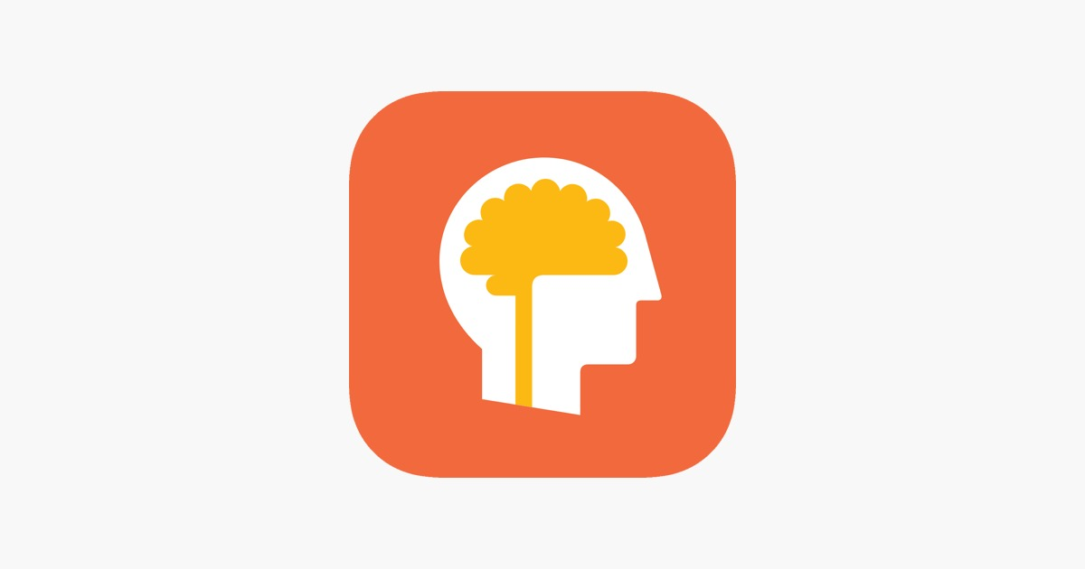
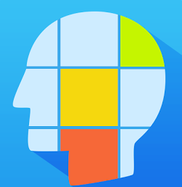
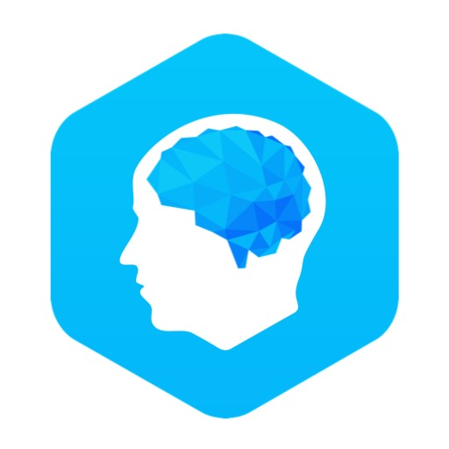
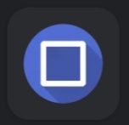


Comparison with existing Applications
Features | Lumosity | Brain Games | Elevate | Eidetic | Proposed System
Learning from the user and personalize it
View the daily report
Doctor can view the progress of the patients
Games in Sinhala language
View the history
Suitable for elderly people
Take voice inputs
Based on many functionalities

Slide 6
Main Objective
Help the Dementia patients by giving rehabilitation in a cognitive way using different kinds of games or activities by learning from the user aspects which will be implemented in this application with continuous monitoring.
Decrease the mild and moderate stages of Dementia patients
Both patients and caregivers to make their life easier because there is not a special or exact medication for Dementia
Reduce the cost for external caregivers

Slide 7
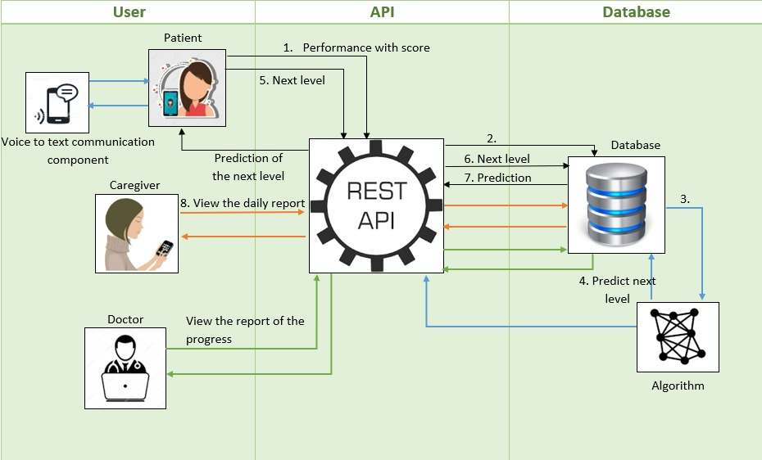
High Level Diagram of the System

Slide 8
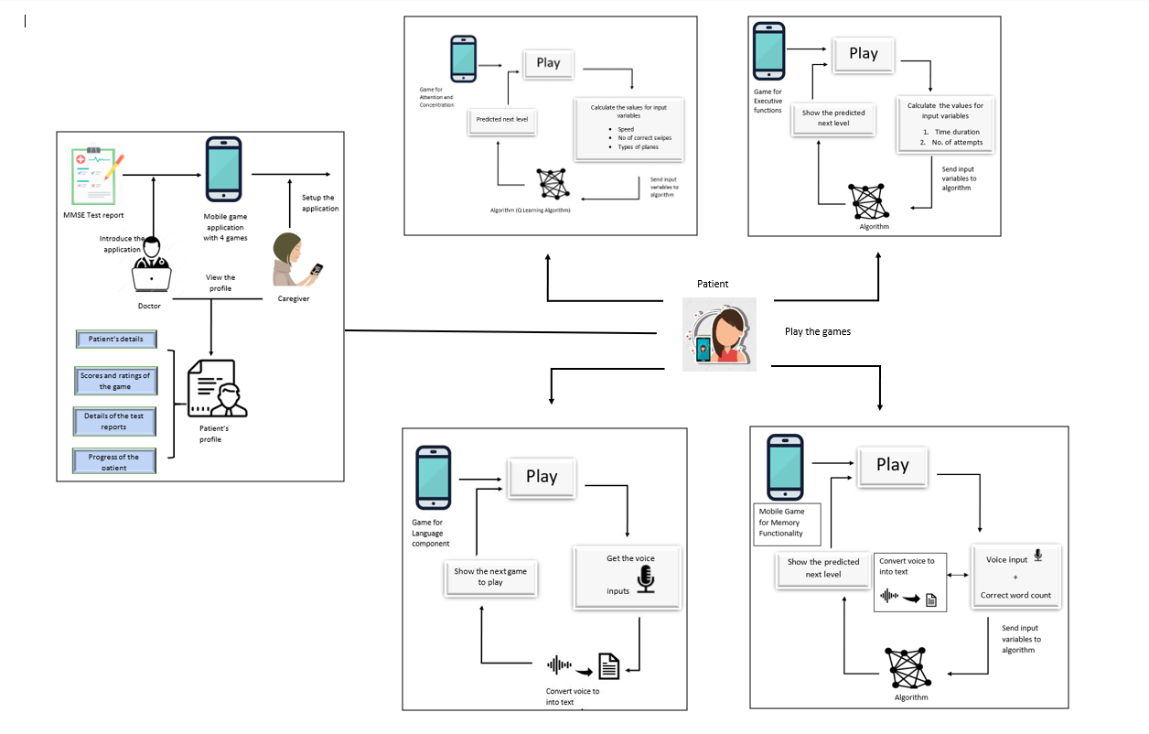
Overview of the System

Slide 9
Methodology
Design the Games and relevant other interfaces.
Create the database.
Implement the mentioned Games and Interfaces.
Maintain Attention and Concentration of Dementia Patients
Improve the effectiveness and speed process of Executive Functions
Improve the impairments of Language Skills
Maintain the registration, recall, recognition of memory
Using reinforcement learning algorithms and getting the positive or negative rewards based on the way how the user plays the game and predict the most suitable next step for the user.
Connect the client and server.
Generate the relevant reports.

Slide 10
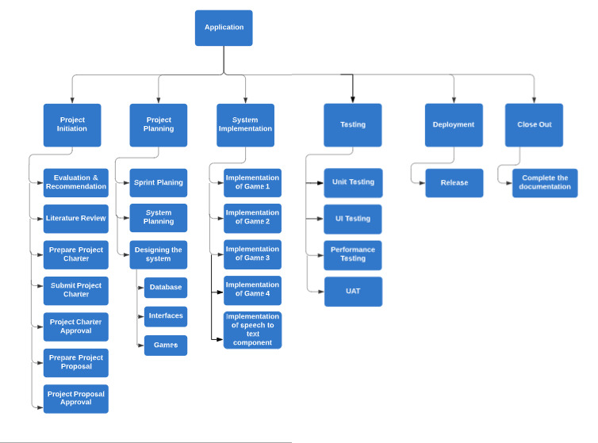
Work Breakdown Structure

Slide 11
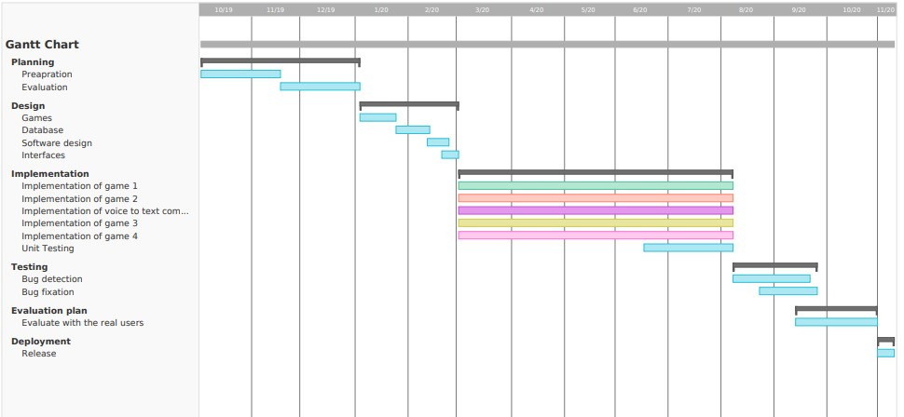
Research Gantt Chart

Slide 12
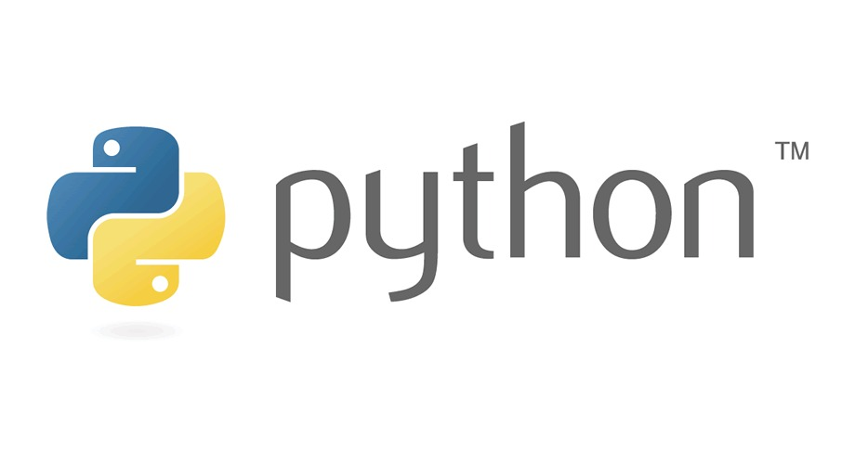

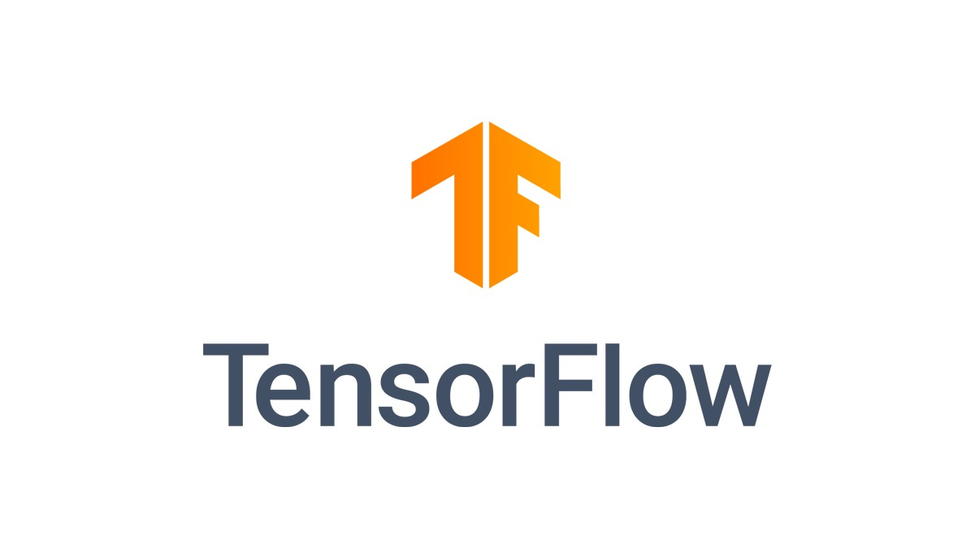


Technologies and Algorithms
Python
TensorFlow
MySQL
Flask REST API
AWS Cloud
Unity
Q learning

Slide 13
Requirements
Real world requirement from the Consultant Psychiatric, National Hospital of Colombo.
Functional Requirements
Login, User profile
Four main games
View the progress report
Non functional Requirements
Performance
Scalability
Usability

Slide 14
Expected Outcome
A user-friendly application for the Dementia patients including appropriate algorithms and techniques to learn from the user and provide a customized set of games or activities

Slide 15
Rathnayaka M.H.K.R. IT16067370
Mobile Game to improve Attention and Concentration

Slide 16

Attention
Focus on one thing at a time.
Concentration
Controlling the focus of attention

Slide 17

Research Question
How to help Dementia patients to improve the attention and concentration by developing a mobile game with reinforcement learning?

Slide 18
Objective
Develop a mobile game for Dementia patients to improve Attention and Concentration and make their life little easier.

Slide 19
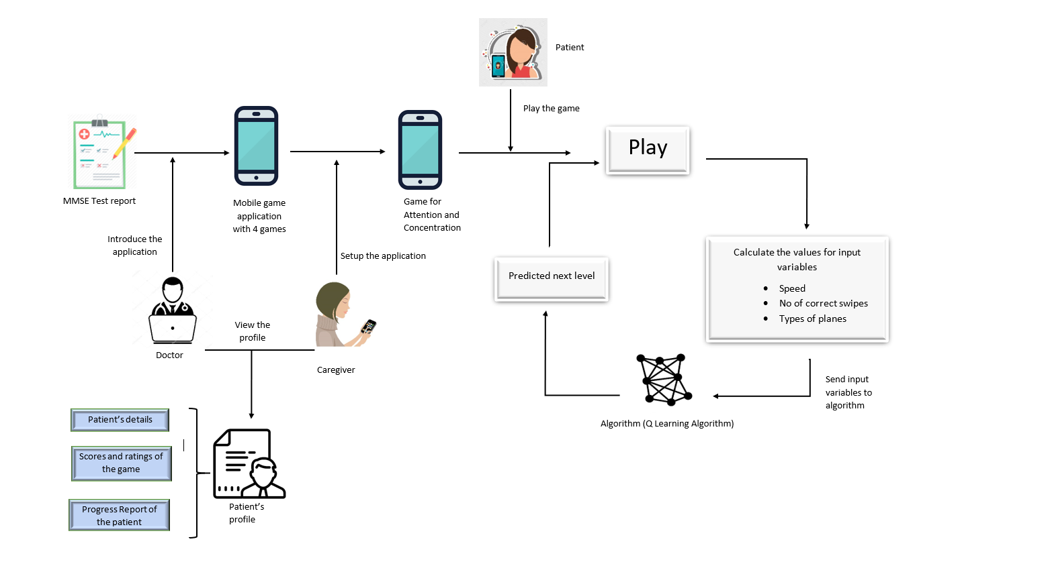
Overview of the component

Slide 20

Technologies and Algorithms
Unity
MySQL
Python
Q learning algorithm

Slide 21
Requirements
Functional Requirements
One main game which includes to improve both Attention and Concentration.
Game should have small tutorial
Attention and concentration levels should be include separately in the reports.
Non functional requirements
Performance
Usability
Accuaracy

Slide 22
Expected Outcome
Mobile game which can use for Dementia patients to improve their Attention and Concentration in a very user friendly way.

Slide 23
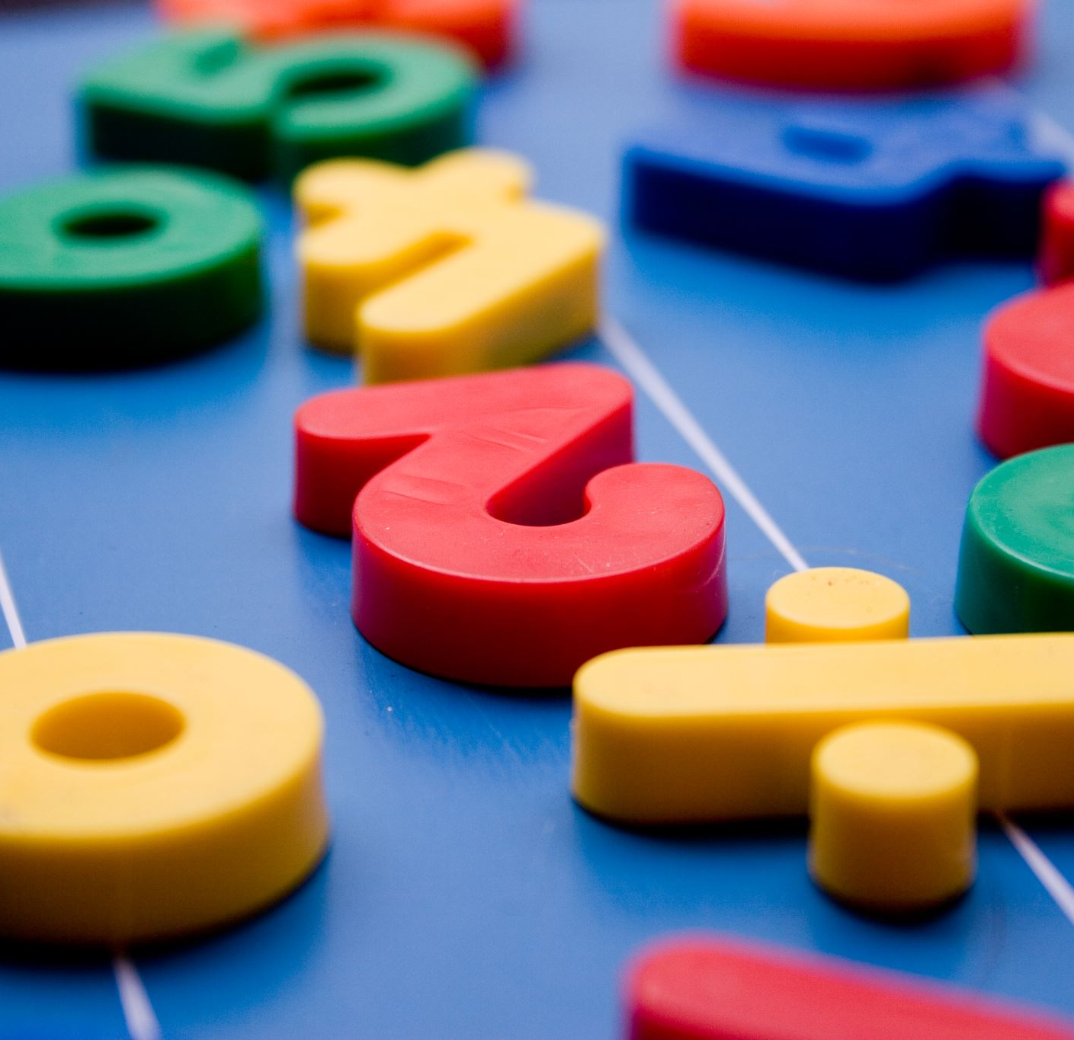
Mobile Game to improve the Executive Functions Executive functions include the ability to organize, use of proper judgement, plan and do a set of tasks in an effective way. Watawala W.K.C.R IT17096126

Slide 24
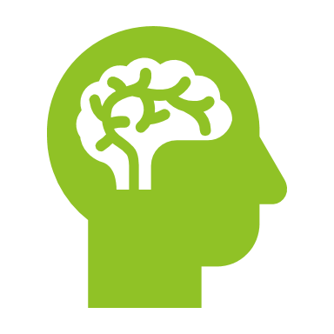
Research Question
How to cover all the aspects of executive functions using reinforcement learning algorithm and help dementia patients to escape their impairments ?

Slide 25
Objective
Improve all the sub functions (problem solving, decision making, planning, etc.. ) in executive functions of dementia patients.

Slide 26
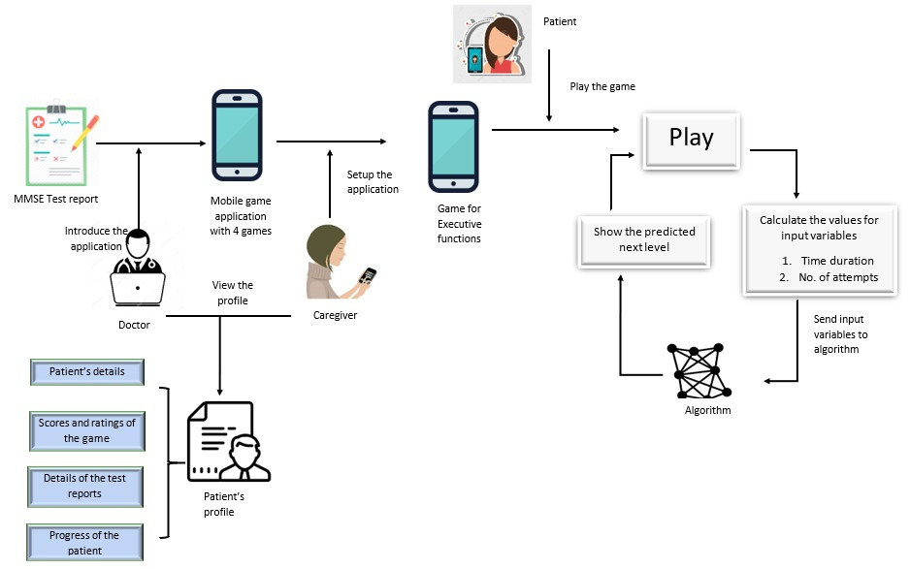
Overview of the component

Slide 27
Technologies and Algorithms
Unity
MySQL
Python
Deep Q learning algorithm

Slide 28

Requirements
Functional requirements
Progress of every level in the game
Clear instructions before start the game.
Non-functional requirements
User friendly
Performance

Slide 29
Expected Outcome of Component
Develop a user friendly game or activity to improve executive functions impairments of dementia patients.

Slide 30
Mobile Game to improve the Language skills Manamendra M.G. IT17119504

Slide 31

Research Question
How to give a solution for the impairment of the language skills of Dementia patients using speech to text communication activities to make their day-to-day life easier?

Slide 32

Objectives
Improve the skills of Dementia patients
Reading
Writing
Comprehension
Communication
Reduce the Language impairment problem

Slide 33
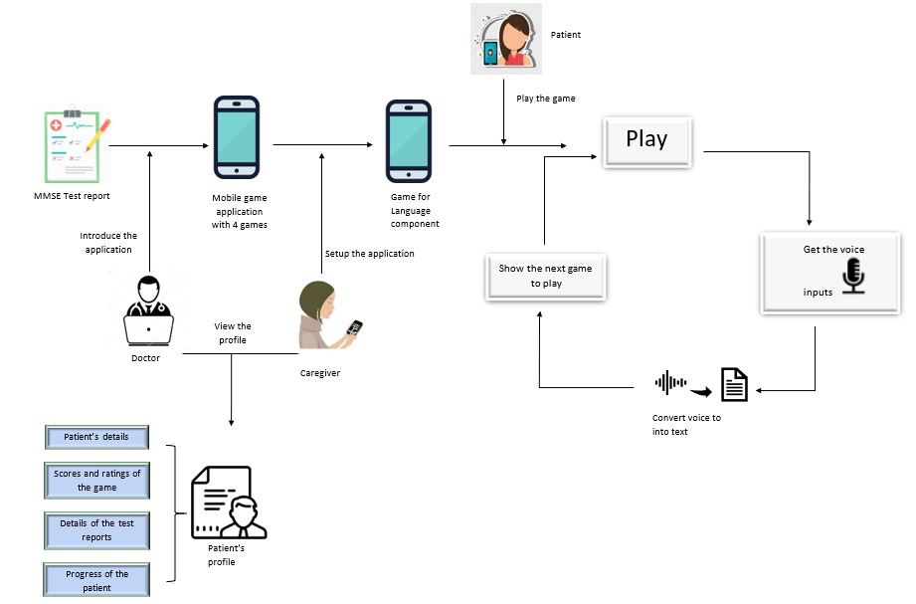
Overview of the component

Slide 34



Algorithm and Technologies
Algorithm
Deep Neural Network
Convolutional Neural Network
Technologies
Unity
Python
TensorFlow

Slide 35

Requirements
Functional Requirements
Get the voice inputs of the user to continue the game/activity
Non Functional Requirements
Performance
Usability
User-friendly

Slide 36
Expected Outcome
Introduce an application which includes the ability to reduce the impairment of the Language skills of Dementia patients and recover those patients

Slide 37
Mobile Game to Improve Memory Skills
IT17100076
SILVA. S. R. R. M

Slide 38

Research Question of the Component
How does the Reinforcement Learning use to involve in develop Memory Recover/ Improve mobile game application.

Slide 39

Objective of the Component
Help Dementia Patients to,
Recover their memory
Improve their memory

Slide 40
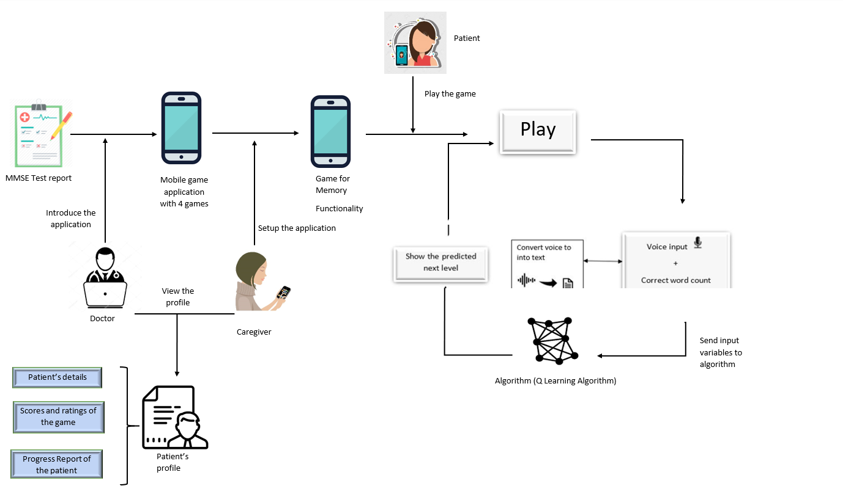
Overview of the component

Slide 41
Algorithms and Technology
Unity
MySQL
Python
Q learning algorithm

Slide 42

Requirements
Functional
Memory related mobile game should contains three stages of the each level
Should have certain number of levels in the game
Non Functional
User-friendly
Performance

Slide 43
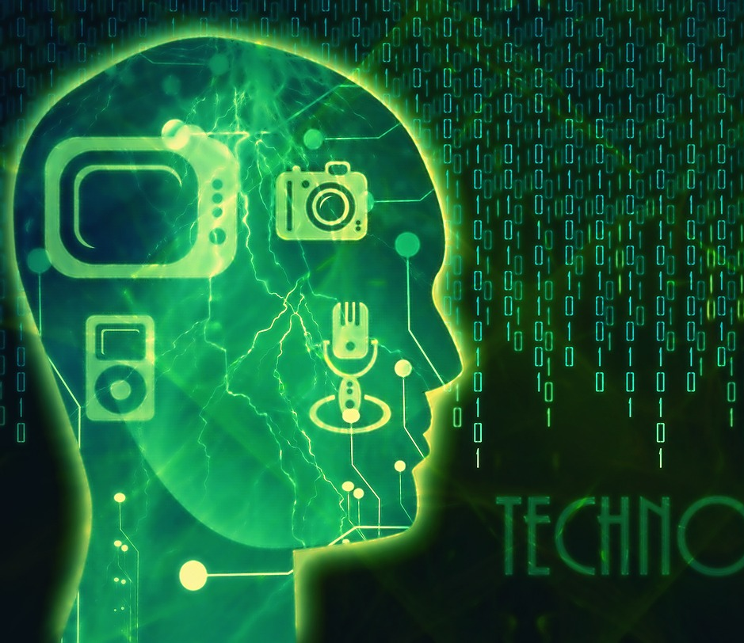
Expected Outcomes of the Component
Eventually public statement a gaming app which is user friendly and help to recover/ improve Dementia patients’ memory

Slide 44

Evaluation Plan
What will be evaluated ?
How ?
Why?
When?

Slide 45
Challenges
Gaining the knowledge about Dementia
Designing the Games
Selecting the most important functionalities for the games
Select sample users(patients)
Limitations
Patients in mild and moderate stages only can use the application.
Need smart phone to install the application.
Doesn’t have the games for the all the functionalities.

Slide 46

Helping hands to Dementia…
Introducing the application(D-care) to the doctors.
Explain the benefits of application to the caregiver.
Patients installing and using the D-care application with the doctor recommendation.
Patients getting one month trial period.
Continue the D-care application with small payment.
Commercialization

Slide 47
References
https://trello.com/c/qWoaLYSS/32-charter
https://www.uksmobility.co.uk/blog/2016/07/25-useful-apps-for-dementia-patients-and-carers/#top
https://www.alz.org/alzheimers-dementia/what-is-dementia/types-of-dementia/vascular-dementia
https://www.allianz.lk/articles/facts-dementia-alzheimers-disease/
https://www.alz.org/alzheimers-dementia/diagnosis/medical_tests

Slide 48

Thank you…

