Slide 1
Object Detection using Gabor filter and Artificial Neural Network (ANN)
JAYESH RATHOD
Advisor: Hassan S. Salehi, Ph.D.

Slide 2
Contents
Project Introduction
Object Detection
Gabor Filter
Artificial Neural Network
Conclusion

Slide 3
Introduction
An automatic method for the selection of images out of a set of Two Object’s large images collected from the Different source.
This selection depends on the extraction of dominant features using Gabor filtering.
Features are selected carefully from a preliminary image set and fed into a neural network as a training data
The method collects a large set of raw images containing two distinct Object images.
The classification performance highly depends on the number of candidate features of the particular image.

Slide 4
Object Detection
Object detection is a computer technology related to computer vision and image processing that deals with detecting instances of semantic objects of a certain class
Object detection is the process of finding instances of real-world objects such as faces, bicycles, and buildings in images or videos.
Object is define by his Shape ,Size and Color.
For Example , Face detection and pedestrian detection .

Slide 5
Gabor Filter
A Gabor filter can be viewed as a sinusoidal plane of particular frequency and orientation, modulated by a Gaussian envelope
Gabor filters are special classes of bandpass filters, i.e., they allow a certain ‘band’ of frequencies and reject the others.
A Gabor filter responds to edges and texture changes.

Slide 6
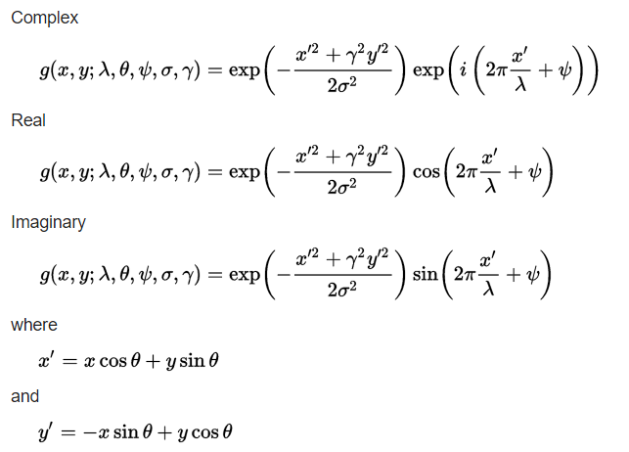
Gabor Filter
Equation
https://en.wikipedia.org/wiki/Gabor_filter

Slide 7
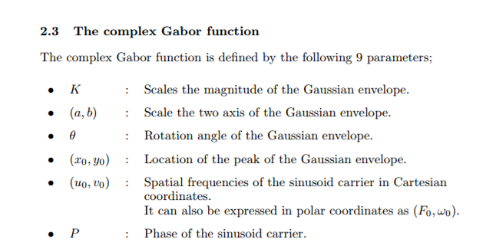
https://cvtuts.wordpress.com/2014/04/27/gabor-filters-a-practical-overview/

Slide 8
(ANN ) Artificial Neural Network
The first artificial neuron was produced in 1943 by the neurophysiologist Warren McCulloch and the logician Walter Pits. But the technology available at that time did not allow them to do too much.
An artificial neural network (ANN) is a computer simulation of a "brainlike" system of interconnected processing units.
Reference taken from Human Brain
I'll explain a type of artificial neuron called a perceptron

Slide 9
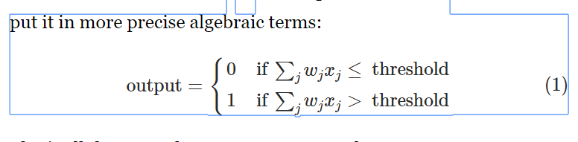
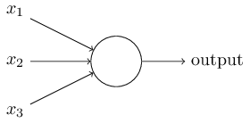
Example Question is Whether you want to go to attend Festival ? Answer is depend on ‘Weight’ and ‘Threshold’ value 1) Is the weather good? 2)Does your friend want to accompany you? 3)Is the festival near public transit? (You don't own a car).
http://neuralnetworksanddeeplearning.com/chap1.html

Slide 10
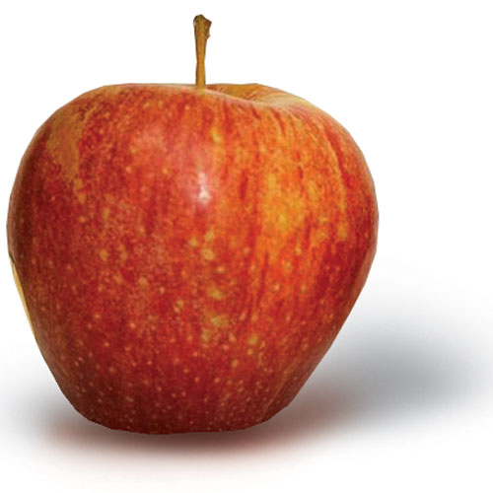
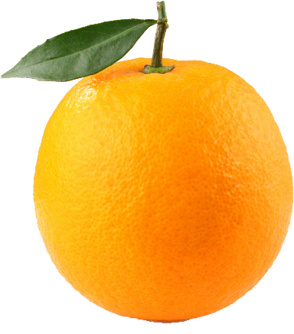
Taking Two Image

Slide 11
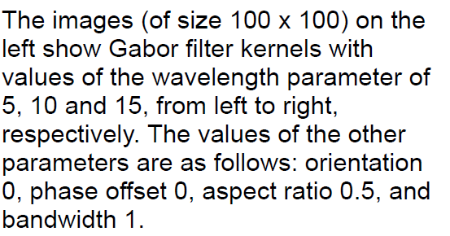
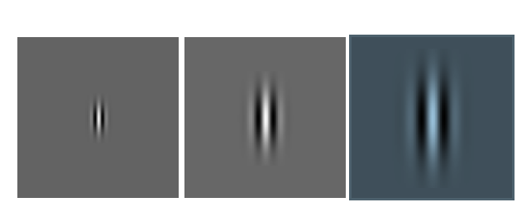
Wavelength
http://matlabserver.cs.rug.nl/edgedetectionweb/web/edgedetection_params.html

Slide 12
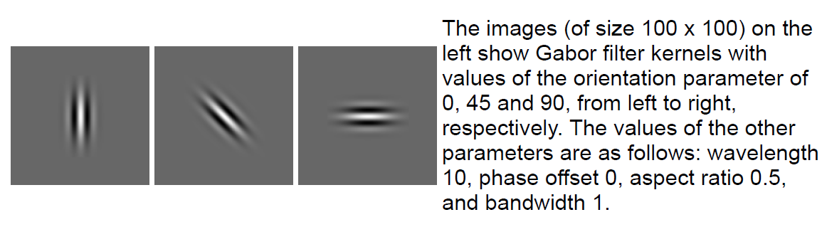
Orientation(s) (θ)
http://matlabserver.cs.rug.nl/edgedetectionweb/web/edgedetection_params.html

Slide 13
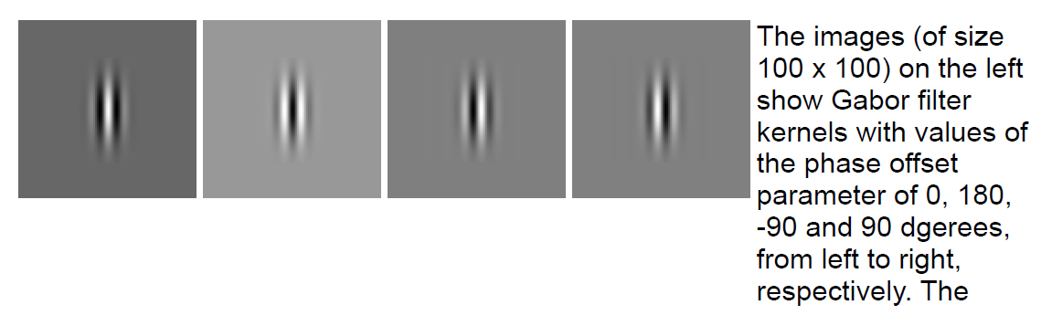
Phase offset(s) (φ)
http://matlabserver.cs.rug.nl/edgedetectionweb/web/edgedetection_params.html

Slide 14
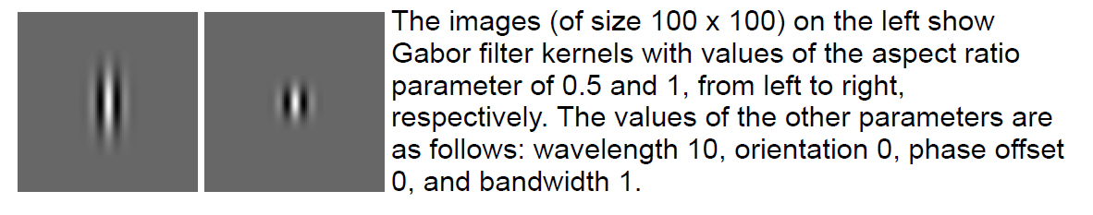
Aspect ratio (γ)
http://matlabserver.cs.rug.nl/edgedetectionweb/web/edgedetection_params.html

Slide 15
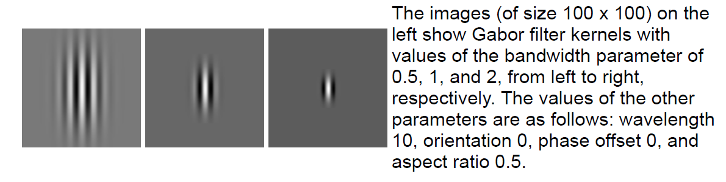
Bandwidth (b)
http://matlabserver.cs.rug.nl/edgedetectionweb/web/edgedetection_params.html

Slide 16
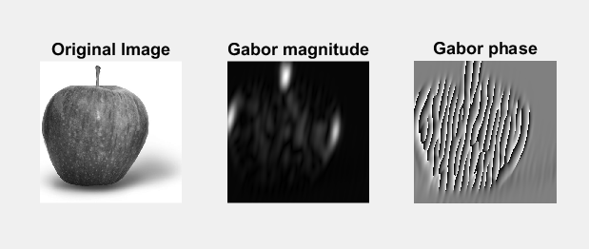
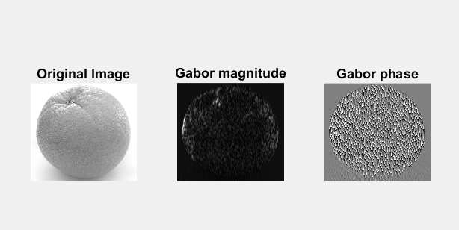
Gabor Filters
Feature Extraction
Gabor filter on Apple
Gabor filter on Orange

Slide 17
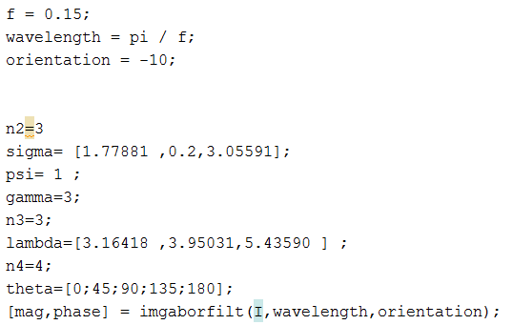
Code

Slide 18
Flow Chart
Features extraction
Gabor Filter
Normalization
ANN
Image
Acquisition
Training
Weight adjustment
Testing

Slide 19
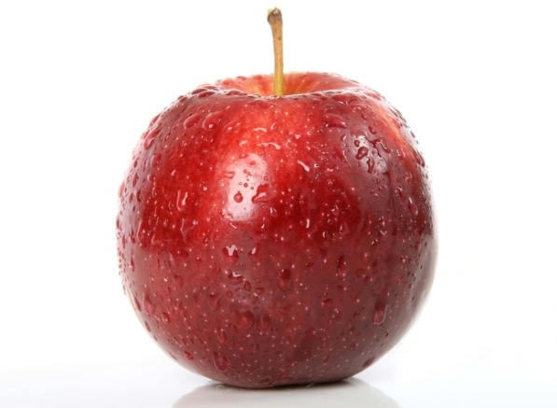
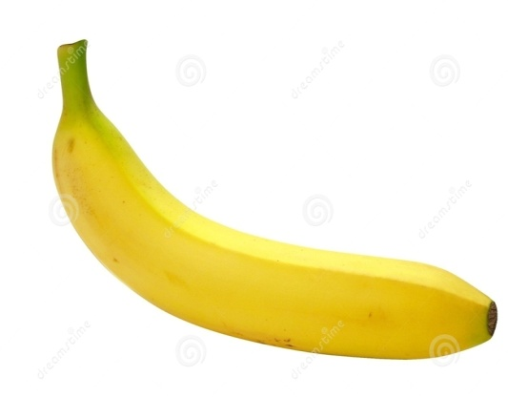
Image Acquisition
Two Fruits
Size - 650*650
Image format.jpg
White background
Banana
Apple

Slide 20
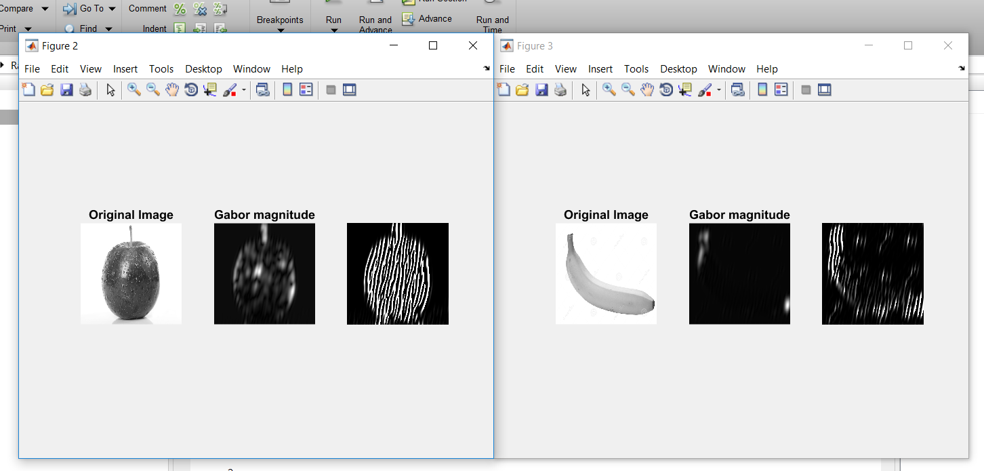
Gabor Filter
Features Extraction

Slide 21
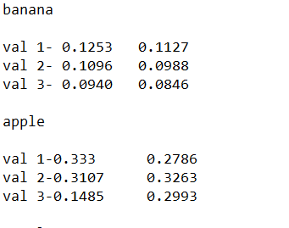
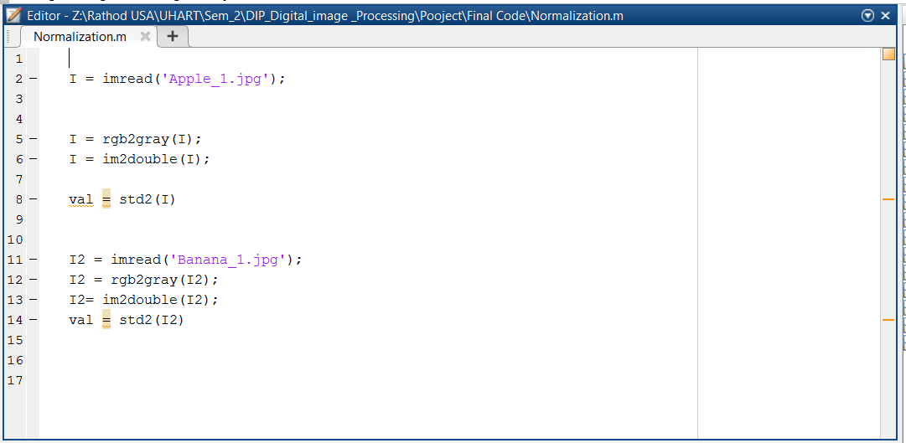
Normalization
Normalized value
Code for normalization

Slide 22
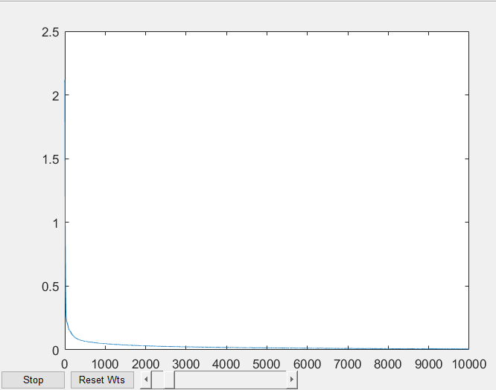
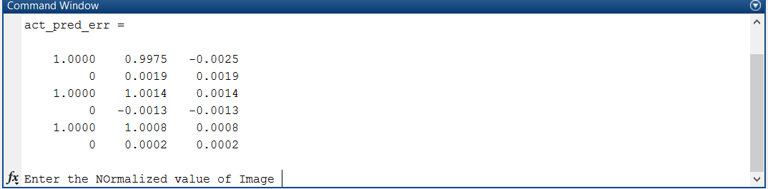
Training
Error rate
Graph Error VS Epochs

Slide 23
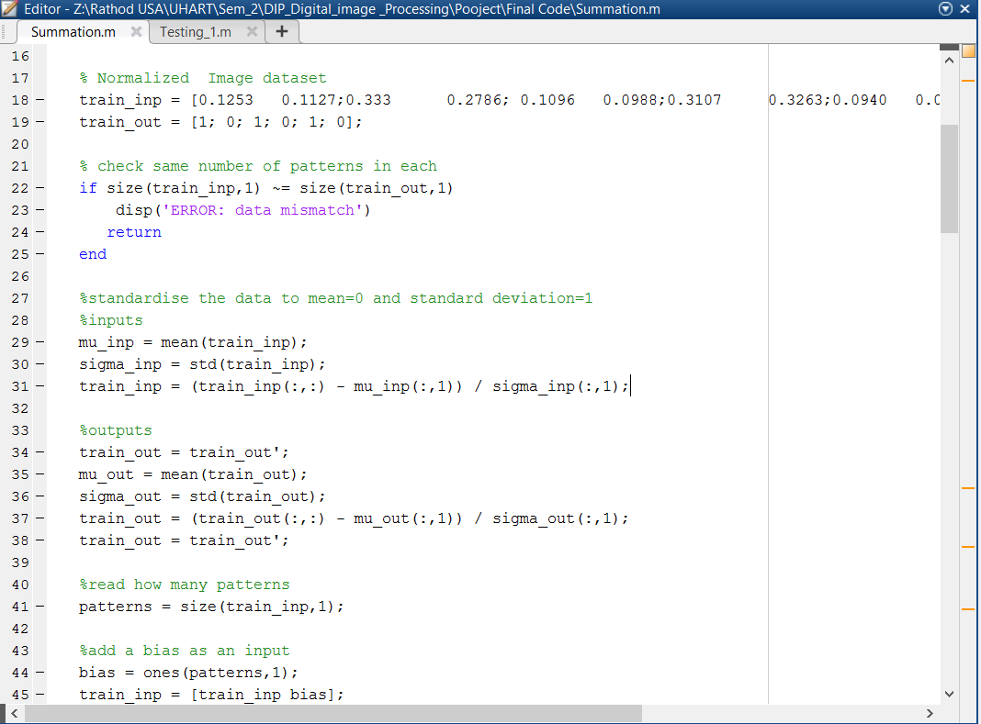
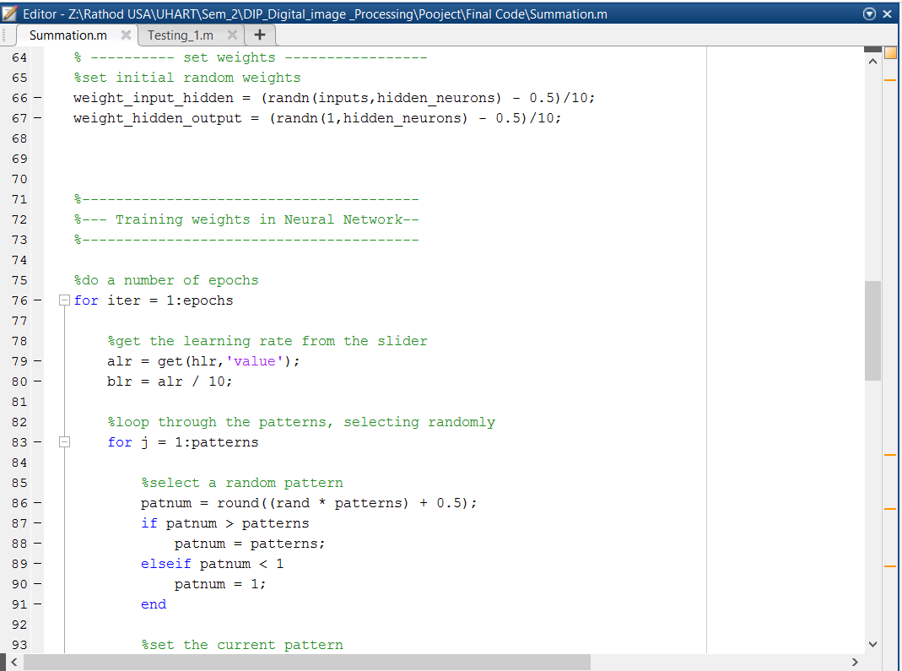
Code

Slide 24
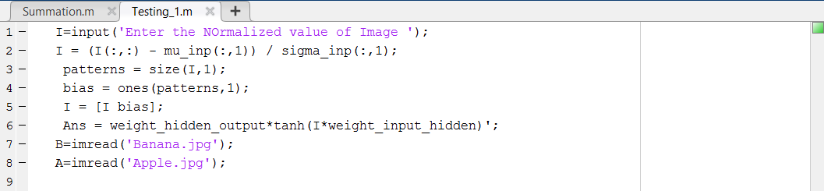
Testing
Results
Testing Function

Slide 25
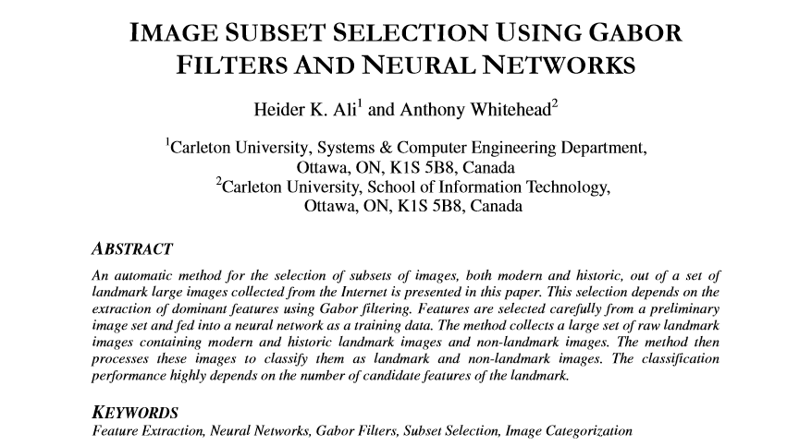
Literature Review

Slide 26
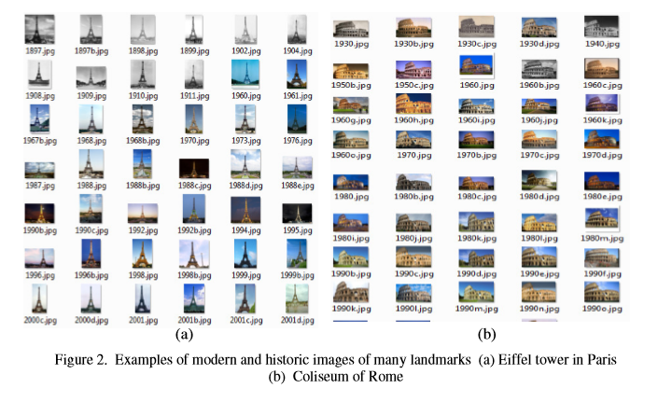
Results

Slide 27
Reference
https://www.mathworks.com/discovery/object-detection.html
http://neuralnetworksanddeeplearning.com/chap1.html
https://cvtuts.wordpress.com/2014/04/27/gabor-filters-a-practical-overview/

Slide 28
Question?

