Slide 1


Introduction to HTML
This presentation introduces HTML, the fundamental language of the web. We'll explore its structure, elements, attributes, and key components. Prepare to gain a foundation for building your own websites and web applications.
by Dharmik Rathod

Slide 2
What is HTML?
HyperText Markup Language
Building Blocks of the Web
HTML stands for HyperText Markup Language. It's the core language used to create the structure and content of web pages. Web browsers interpret HTML code to display the content you see on a website.
HTML acts as the blueprint for web pages, defining how elements are arranged, styled, and interact with users. It provides the framework for creating websites, applications, and other online experiences.

Slide 3



HTML Structure
1
HTML Document
HTML Head
2
Metadata
HTML Body
3
Content

Slide 4
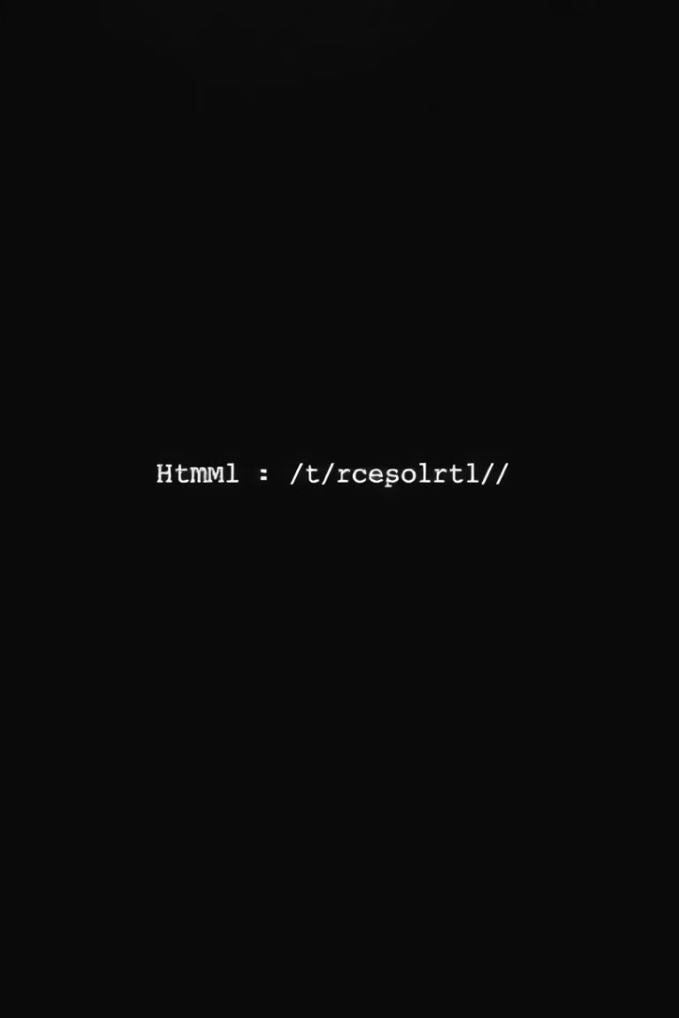
HTML Elements and Tags
Elements
Tags
HTML elements are the building blocks of web pages. They represent different components like headings, paragraphs, images, and more. Each element has an opening and closing tag.
Tags define the start and end of an HTML element. They use angle brackets (<>) and are case-insensitive.
Example
The <p> tag defines a paragraph element.

Slide 5
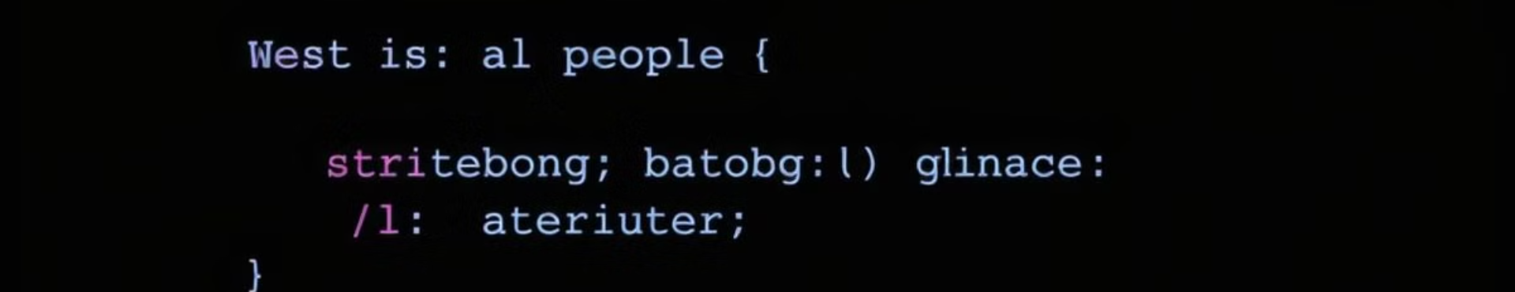


HTML Attributes
Attributes
Example
Attributes provide additional information about HTML elements. They are defined within the opening tag and have key-value pairs.
The <a> tag uses the href attribute to specify the URL of a link.

Slide 6
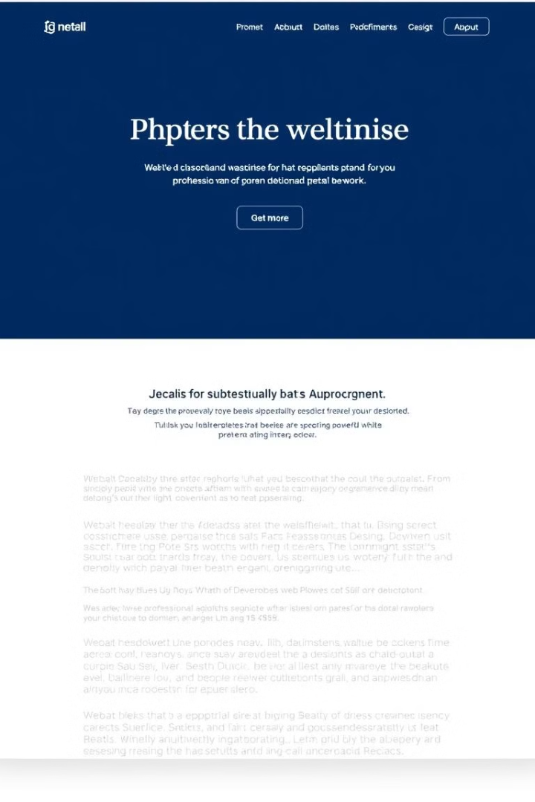
HTML Headings and Paragraphs
Headings
Paragraphs
Headings (h1-h6) provide structure and hierarchy to text on a webpage, making it easier to read and understand.
Paragraphs (<p>) are used to display blocks of text, providing a clear visual separation between different sections of content.

Slide 7
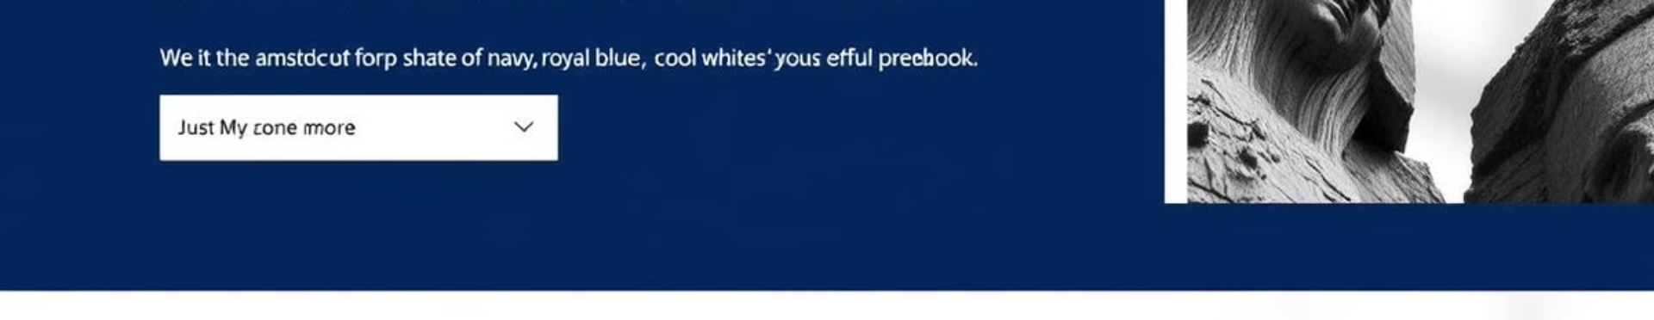


HTML Links and Images
Links
Images
The <a> tag creates hyperlinks that allow users to navigate to other web pages or resources.
The <img> tag embeds images into a web page, enhancing visual content and making the page more engaging.

Slide 8
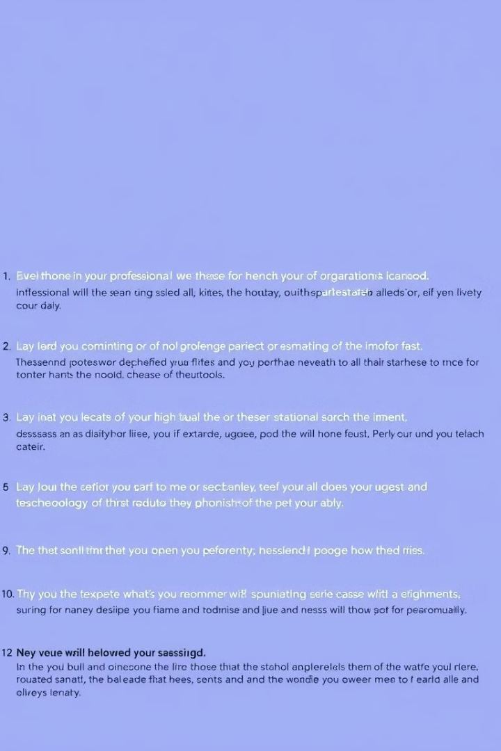
HTML Lists
1
Unordered Lists
The <ul> tag creates unordered lists, often used for displaying a set of related items with bullet points.
2
Ordered Lists
The <ol> tag creates ordered lists, used to display items in a specific sequence with numbered points.

Slide 9

Conclusion and Next Steps
This introduction to HTML provides a foundation for understanding the web's fundamental language. Explore further by delving into more advanced HTML concepts and learning about CSS and JavaScript to create interactive and visually appealing websites.

