Slide 1

Home
About Us
Service
Contact
A Secure Chat Application for Instant Communication
chatApp
MALLAREDDY DEMEED TO BE UNIVERSITY

Slide 2
CHATAPP
Home
About Us
Service
Contact
Introduction
Developed a real-time chat platform for instant, secure communication.
Built using MERN stack (MongoDB, Express.js, React.js, Node.js) and Socket.io.
Lightweight, responsive, and scalable communication solution.
CHATAPP

Slide 3
CHATAPP
Home
About Us
Service
Contact
PROBLEM
STATMENT
1
2
Existing applications are complex and resource-heavy
Security concerns with user data and message privacy
3
Need for a simple, fast, and secure real-time chat platform
CHATAPP

Slide 4
CHATAPP
Home
About Us
Service
Contact
SYSTEM
ARCHITECTURE
Frontend: React.js - handles UI and socket client connections.
Backend: Node.js with Express - manages APIs and WebSocket server.
Database: MongoDB stores users and message histories.
Socket.io handles bi-directional real-time communication

Slide 5
CHATAPP
Home
About Us
Service
Contact
FRONTEND
DEVELOPMENT
Created responsive UI with React.js (login, chat screen)
Integrated Socket.io-client for real-time messaging
Implemented user authentication frontend using JWT tokens.
Handled chat message rendering and auto-scroll functionality

Slide 6
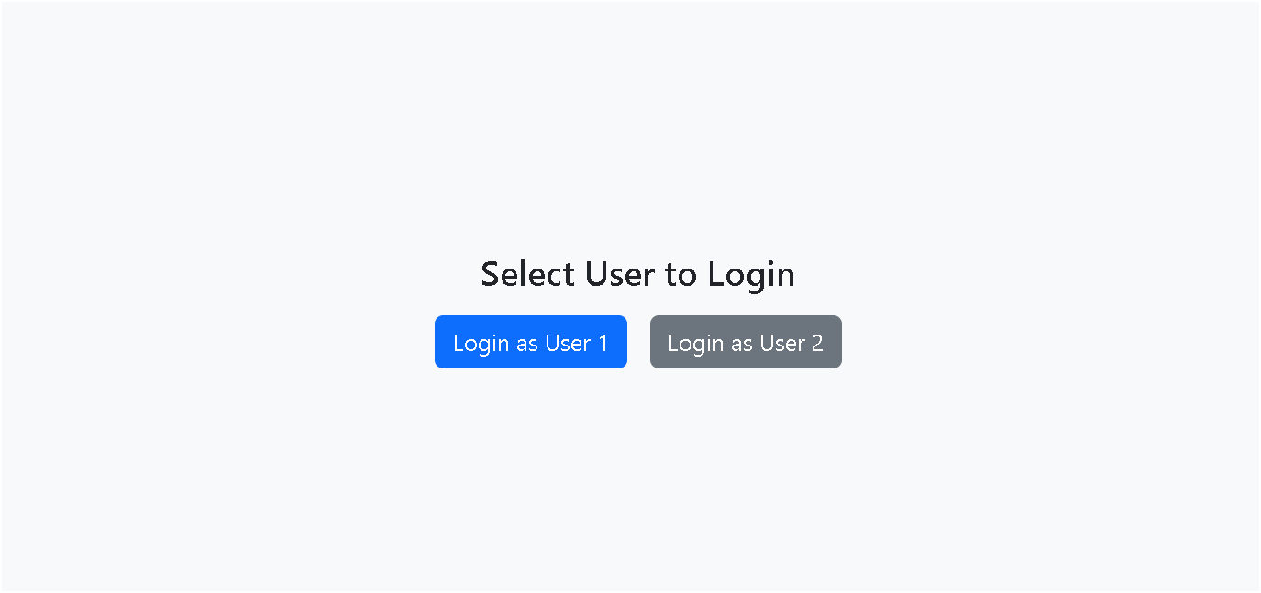
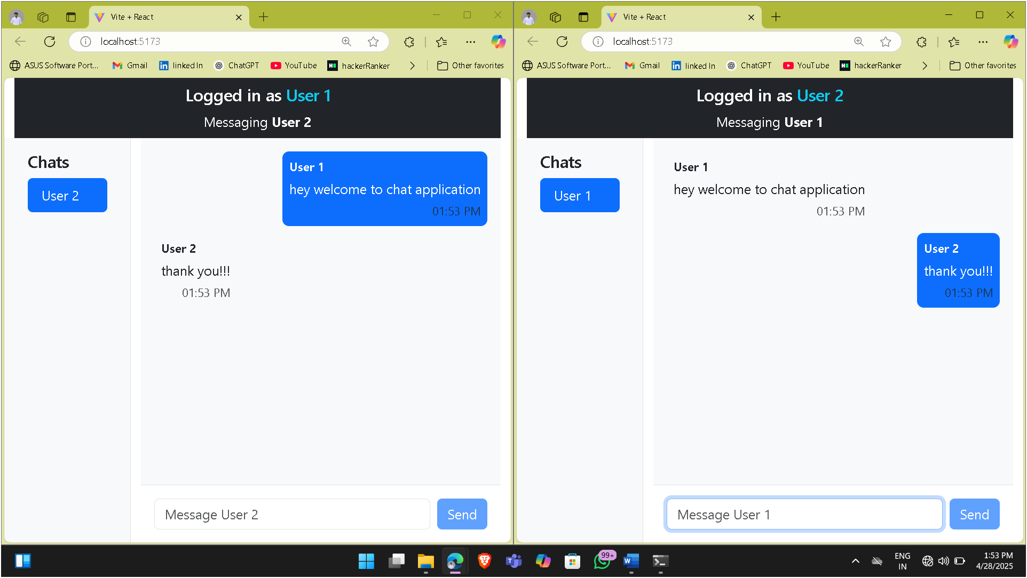
CHATAPP
Home
About Us
Service
Contact
FRONTEND
SCREENSHOTS

Slide 7
CHATAPP
Home
About Us
Service
Contact
BACKEND
DEVELOPMENT
Built REST APIs for user registration, login, and fetching chat history.
Established WebSocket server using Socket.io.
Managed events like 'send_message' and 'receive_message
Ensured API validation and error handling.

Slide 8
Wardiere Inc.
Home
About Us
Service
Contact
Payment App
Backend Code
Snippet
socket.on('send_message', (data) => {
// Save message to DB and emit to receiver});
socket.on('join_room', (room) => {
¡ socket.join(room);});

Slide 9

CHATAPP
Home
About Us
Service
Contact
DATABASE
AUTHENTICATION
Designed MongoDB collections for Users and Messages.
Used JWT tokens for user authentication and session management.
Secured sensitive user data storage
Implemented password hashing using bcrypt for security.

Slide 10
CHATAPP
Home
About Us
Service
Contact
DATABASE SCHEMA
OVERVIEW
Users Collection:
Fields: username, email, hashed_password.
Messages Collection:
Fields: sender_id, receiver_id, message_content,timestamp.

Slide 11
CHATAPP
Home
About Us
Service
Contact
EXECUTION
OVERVIEW
1. Start backend server (Node.js + Socket.io initialized).
2. Launch frontend (React.js) in browser (localhost).
3. User login and authentication verified.
4. Real-time messaging starts via Socket.io events.
5. Messages instantly reflected for both users.

Slide 12
CHATAPP
Home
About Us
Service
Contact
OUTPUT

Slide 13
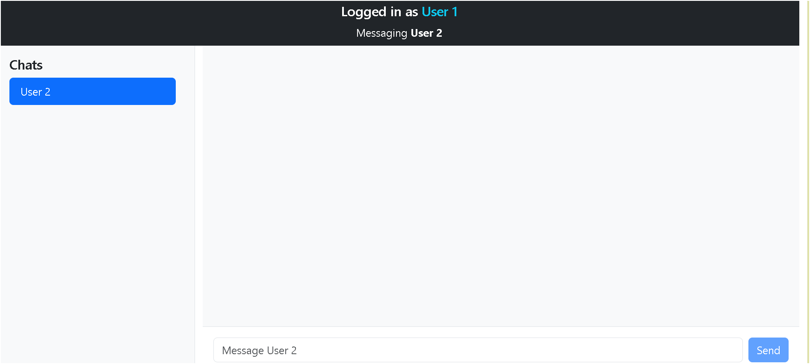
CHATAPP
Home
About Us
Service
Contact

Slide 14
CHATAPP
Home
About Us
Service
Contact

Slide 15
CHATAPP
Home
About Us
Service
Contact
CHALEGES FACED
Handling real-time message synchronization with multiple users.
Ensuring database consistency under concurrent message loads.
Maintaining security (authentication, data protection).
Mobile responsiveness across devices.

Slide 16
CHATAPP
Home
About Us
Service
Contact
FUTURE SCOPE
Group chat functionality (multiple users per room).
Media sharing (images, documents, voice notes).
Mobile app development (React Native).
Message read receipts and typing indicators.

Slide 17
CHATAPP
Home
About Us
Service
Contact
CONCLUSION
Built a fully functional real-time chat application.
Achieved secure user management and instant communication.
Learned real-world full-stack development and deployment practices.

Slide 18
CHATAPP
Home
About Us
Service
Contact
THANK YOU(Q/A)
Thank you for your attention!
We are ready to answer your questions.

