Slide 1

Ambica Store
A Premium Musical Instruments E-Commerce Platform
DEVELOPED BY:
Karina Rathod - 3247
Raj Patel - 3291
Yug Dabgar - 3296

Slide 2
Academic Details
Program: B.Sc. / M.Sc. (CA & IT)
Semester: 6
Institution: K. S. School of Business Management & IT
University: Gujarat University
Internship Organization: Ambica Tabla Store
Guide / Mentor Name: Dipak V Dabgar
Group ID: 05

Slide 3
1. Introduction to Internship
Internship Overview:
Explored comprehensive full-stack web development.
Hands-on experience building a modern e-commerce application.
Domain:
Software Development (Full Stack Web Architecture)
Training Duration:
120 Hours of development.

Slide 4
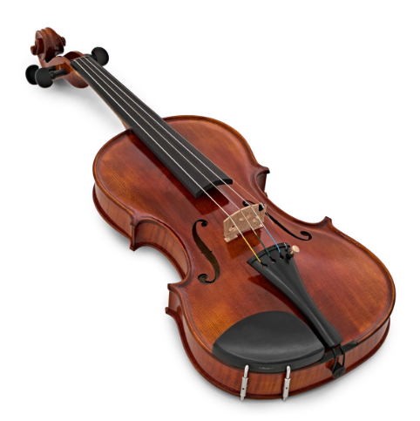
2. Project Overview (Ambica Store)
Project Philosophy:
Premium storefront for handcrafted musical instruments.
Core Objectives:
Centralize inventory securely.
Algorithmic pricing for 'Low' to 'Premium' tiers.
Interactive Amazon-like shopping UI.

Slide 5
3. Target Audience & Business Value
Target Users (Customers):
Professional Musicians
Music Enthusiasts and Collecters
Music Schools and Students
Store Staff & Administrators:
Easy-to-use digital dashboard allowing complete command over product availability.

Slide 6
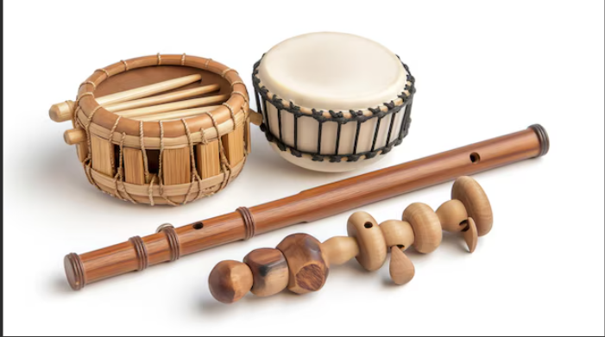
4. Key Features Delivered
Secure Client Authentication System.
Advanced Product Catalog functionality.
Dynamic Image Swapping for color variations.
Auto-calculating Secure Cart details.
Complete Admin Dashboard for controls.

Slide 7



5. Special Innovation: Dynamic Variants
The Problem:
Customers couldn't visualize instrument colors accurately.
The Solution:
Removed CSS & integrated JS Source Swapping.
Multiple colors and Range are available.
Increases UI trust deeply.

Slide 8
6. Scope & Limitations
Current Project Scope:
Complete localized product purchasing cycle.
Digital warranty and returns tracking setup.
Limitations:
Payment mechanisms are restricted to manual local QR processing.
Third-party Logistics APIs (Delivery Tracking) are not integrated.

Slide 9
7. Development Methodology
Model: Iterative Agile Methodology
Phase 1: Conceptual Architecture & UI Prototyping.
Phase 2: Database blueprinting & SQLite initial bridging.
Phase 3: Sprints covering modular Python routing, Frontend DOM updates.
Phase 4: Transition to Databases (MySQL/PostgreSQL).

Slide 10
8. Frontend Technology Stack
Core Standards:
HTML5 ,Customized Vanilla CSS3 & jinja2 Templating.
Design Paradigm:
Dark-mode 'Glassmorphism' (Frosted glass visual effects).
Dynamic hover animations enhancing the premium feel.
JavaScript Functionality:
Real-time DOM manipulation for instantaneous Cart & Display updates.

Slide 11
9. Backend Development Stack
Core Language & Framework:
Python running on Flask Web Framework.
Architecture Logic:
Modular Flask 'Blueprints' mapped into patterns.
Robust security checkpoints.
Security Mechanisms:
Werkzeug Secure Password Hashing.

Slide 12
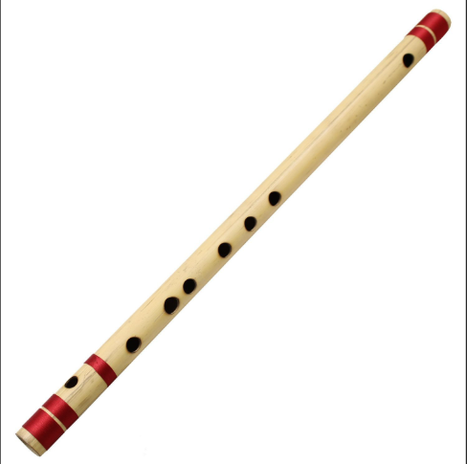
10. Database Architecture
Engine Setup:
Local Development over MySQL.
Entity Framework (SQLAlchemy):
Product Tables (distinct tiers & visual variants)
User Tables (Customer vs Admin logic).
Logging functionality via Cart/Order levels.

Slide 13
11. Conclusion
The Ambica Store platform successfully digitizes organic instrument trading via secure, scalable code.
Through Agile structuring, the application grew into a modular, feature-rich E-Commerce suite.

Slide 14
Thank You.
Ambica Store Team
Karina | Raj | Yug.

