Slide 1
Hamlet: An Epitome of the Dilemma of Modern Man
ENG 316
Seminar Paper and viva voce
Presented by
Bappi Rani Das
Registration No: 2020236006
Session : 2020-2021

Slide 2
Objective
Introduction
Complexity of Hamlet’s Action
Hamlet’s Different angles toward Approaching the Play
Motif of Misogyny
Power Position
Conclusion

Slide 3
Introduction
Almost University considered Hamlet is one of the most remarkable characters in all Literature.
He is filled with passion and contradiction
His personality even his sub-conscious have intrigued readers and t heater-goers for centuries.

Slide 4
Complexity of Hamlet’s Action :
Uncertainty
Acting Recklessly
Lack of spontaneity

Slide 5

Frustration
Alienation
Deception
procrastination
Hamlet’s Different Angles Towards Approaching The Play
Retribution

Slide 6

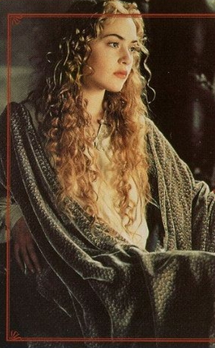
Motif of Misogyny

Slide 7
Power position
Claudius
Both have power
Ophelia
Hamlet
Victim of politics

Slide 8
Conclusion
Shakespeare’s versatile genius has produced characters that belong to no particular age rather than surpass time confinement . This great playwright acute psychological insight into human nature helped him intensely in his creation of characters that are simply timeless. In Hamlet’s complex psychology or mental framework modern psychologists, philosophers, and scholars have found immense possibilities for interpreting modern psychological theories. He has created Hamlet as a Character who possesses the traits to be labeled as our contemporary man or a modern man.

