Slide 1
PRESENTED BY
Rati Srivastava
DATA VISULAISATION EXXPLORATORY COURSE
R290222056
Quantitative Analysis of Employee Attrition Using Tableau
1,470 EMPLOYEES
~16% ATTRITION RATE
237 ATTRITIONS

Slide 2

Problem Definition & Analytical Objective
Employee attrition is a measurable indicator of organizational health, affecting productivity, operational continuity, and cost efficiency. At moderate levels, it reflects underlying systemic inefficiencies rather than isolated employee exits.
Employees | 1,470
Attritions | 237
Attrition Rate | ~16%
Problem:
Objective:
Traditional analysis treats attrition as independent factors and relies on aggregated metrics, which fail to capture interactions between variables.
Attrition is a multi-variable system where workload, compensation, job role, and tenure interact in non-linear ways.
Identify and quantify key drivers of attrition
Analyze interaction between multiple variables
Detect high-risk employee segments
Enable data-driven, predictive insights

Slide 3
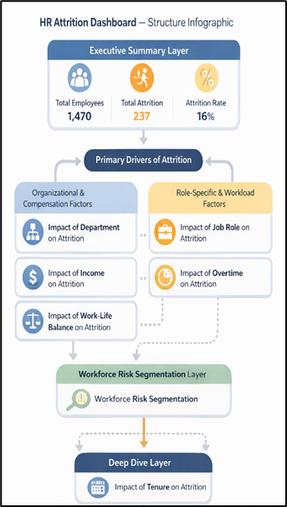
Methodology & Analytical Framework
Tools Used:
Tableau (Data Visualization & Interactive Dashboard)
Microsoft Excel (Data Preparation & Preprocessing)
Data Structure:
Categorical Variables: Department, Job Role, Attrition, Overtime
Numerical Variables: Monthly Income, Years at Company, Age
Analytical Methods:
Attrition Rate Calculation (calculated field)
Risk Segmentation (Low, Medium, High)
Tenure Binning (0–5, 5–10, 10+ years)
Comparative Analysis (category vs attrition)
Distribution Analysis (income and tenure patterns)

Slide 4
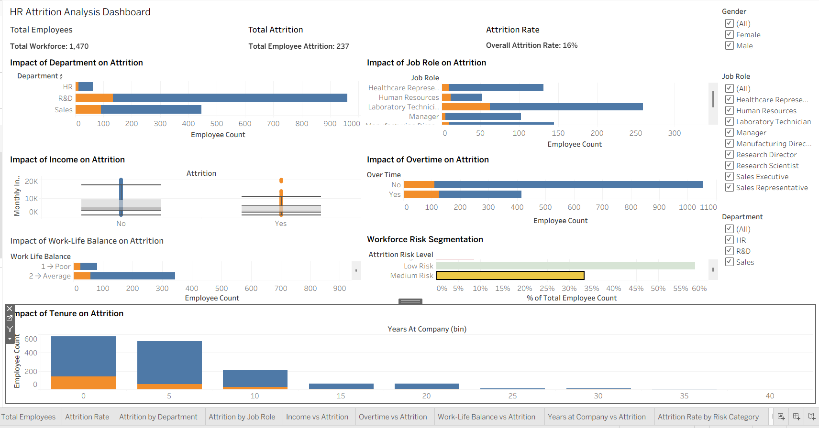
Full Dashboard Overview

Slide 5
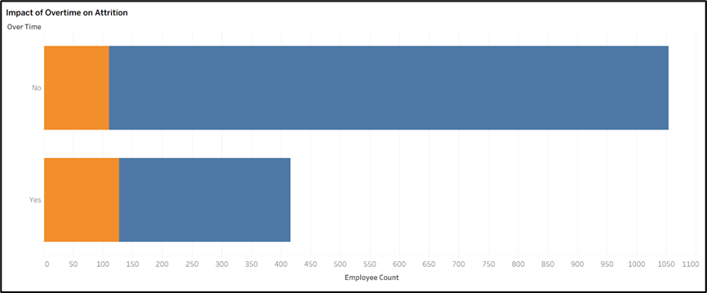
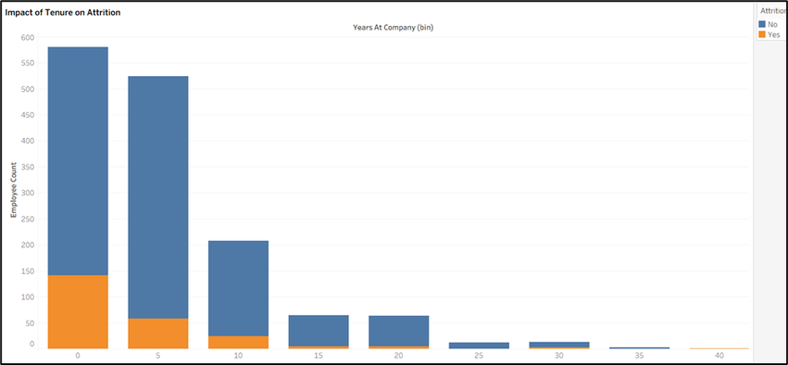
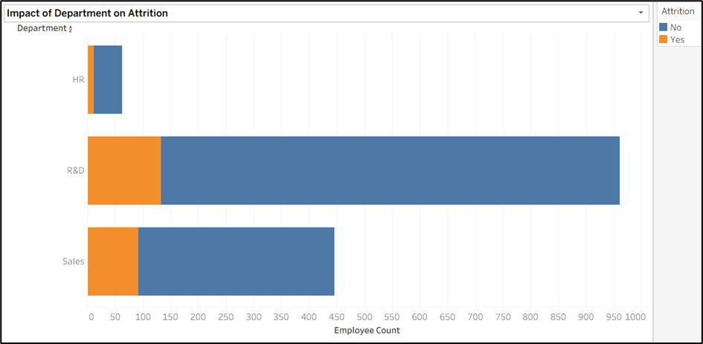
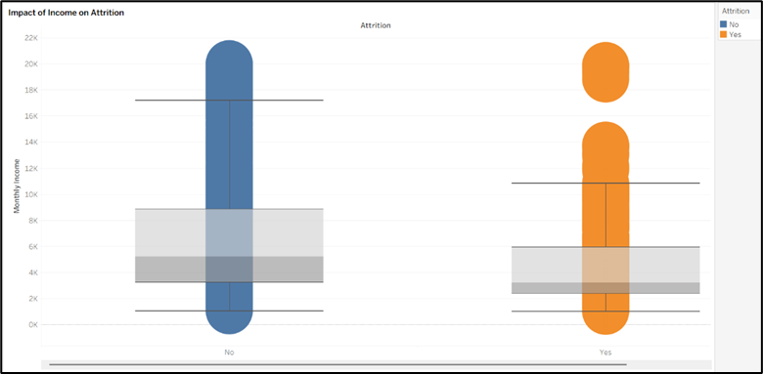

What Actually Drives Attrition?
Attrition is not evenly distributed — it is concentrated in specific workforce conditions
Workload
Effect
Early Tenure
Risk
Overtime → ~30.5% attrition
No overtime → ~10.4%
→ Nearly 3× higher risk
0–5 years → highest attrition (~18%)
10 years → minimal attrition
→ Instability at entry stage
Income Pressure
Role & Department Impact
Attrition cluster: ₹3K–₹4K
Retention cluster: ₹5K–₹6K
→ Lower income reduces retention
Sales → ~20.6% attrition
Lab Technician → ~23.9% (highest)
→ High-pressure roles drive exits
Highest Risk Condition: Early tenure + Overtime + Low income + High-pressure roles
→ Attrition emerges from combined stress factors, not single variables

Slide 6
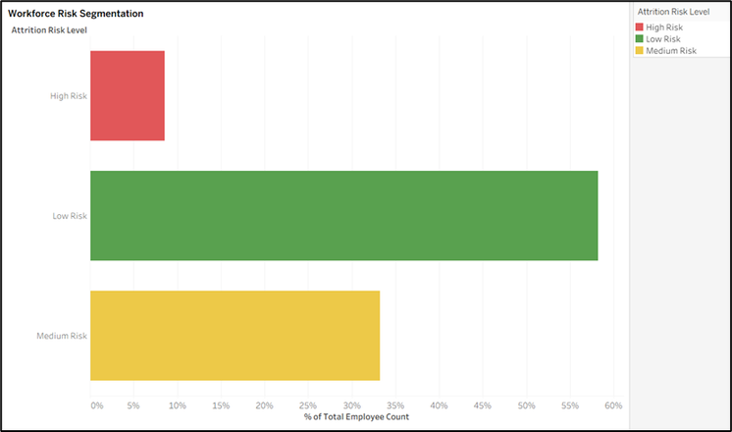
What Actually Drives Employee Attrition?
Dashboard Capability:
Quantified Conclusions:
Interactive filtering across department, role, and gender enables multi-dimensional analysis without restructuring data
Real-time identification of high-risk employee segments
Total Attrition: 237 / 1,470 (~16%)
Early Tenure (0–5 years): ~200 exits (~18%)
Overtime Attrition: ~30.5% vs ~10.4% (≈3× increase)
High-risk group: <10% workforce driving a major share of exits
Risk Segmentation Output:
Actionable Impact:
Attrition is not random behavior; it is a predictable system driven by interacting variables and can be reduced through focused, data-driven decisions
Reducing overtime exposure → attrition drops from ~16% to ~12–13%
Improving income and work conditions → reduces attrition by ~10–15% within risk groups
Targeting ~130 high-risk employees yields maximum impact with minimal intervention scope
Low Risk: ~58% (~850 employees)
Medium Risk: ~33% (~480 employees)
High Risk: ~9% (~130–140 employees)
High-risk group contributes disproportionately to total attrition

Slide 7
By Rati Srivastava
Thank You for Your Time
Related Data, Reports, Tableau: Dashboard Tutorial and explanation
Git Hub
Google Drive

